Slide 1

Do stricter gun laws reduce firearm gun deaths?
Khyati Naik
Data 608
Fall 2023
Story 3

Slide 2
Introduction
Firearm-related deaths, with far-reaching consequences, are a pressing concern in countries like the United States, prompting a deeper exploration of potential solutions.
It is important to analyze this topic as it lies at the crossroads of public safety, individual rights, and government regulations, making it a matter of significant societal importance.
Our objective in this presentation is to analyze data and trends, aiming to uncover evidence-based insights into the relationship between gun laws and firearm-related death rates. We seek to provide a nuanced perspective that informs the ongoing debate and supports informed decision-making.

Slide 3
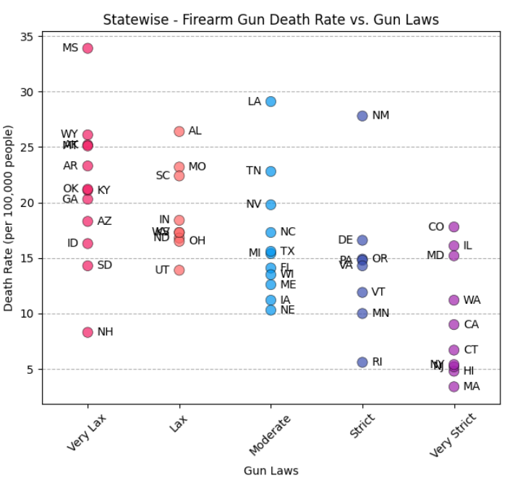
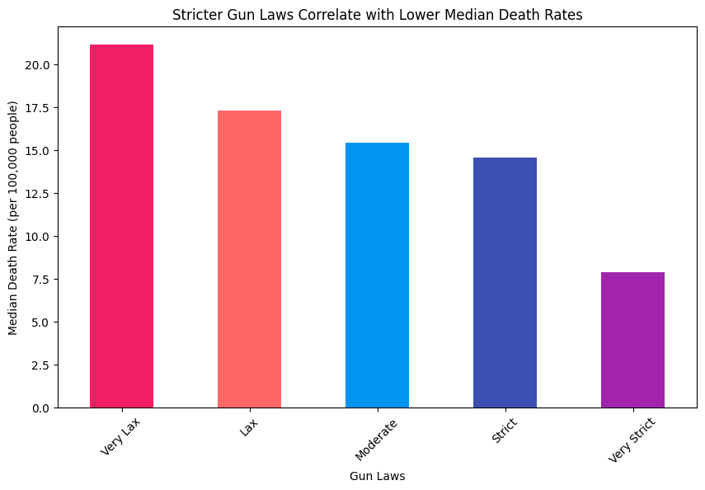

Gun Laws Impact on Death Rates
Our analysis reveals a consistent trend where stricter gun laws are associated with reduced median death rates, suggesting a potential avenue for enhancing public safety.
Mississippi stands out with the highest death rate; Massachusetts boasts the lowest death rate.
Among states with strict gun laws, New Mexico presents an intriguing outlier. Despite having strict regulations, it reports relatively high death rates compared to similar states.
This anomaly highlights the complex interplay of factors influencing firearm-related deaths.

Slide 4
Conclusion
Our analysis reveals a clear trend: as gun laws become stricter, median death rates consistently decline. This correlation suggests that stringent gun regulations may contribute to reducing firearm-related deaths.
Mississippi stands out with the highest death rate, and notably, its gun laws are categorized as "very lax." This observation underscores the potential impact of policy stringency on public safety outcomes.
On the other end of the spectrum, Massachusetts boasts the lowest death rate, coinciding with its categorization as having "very strict" gun laws. This alignment highlights the effectiveness of stringent regulations in promoting public safety.
Within states with strict gun laws, New Mexico presents an intriguing outlier. Despite its strict regulations, New Mexico reports relatively high death rates compared to other states with similar gun laws. This anomaly emphasizes the multifaceted nature of factors influencing firearm-related deaths.

Slide 5
References
Gun Laws: https://sightmark.com/blogs/news/states-ranked-by-how-strict-their-gun-laws-are
Firearm gun deaths: https://www.cdc.gov/nchs/pressroom/sosmap/firearm_mortality/firearm.htm

