Slide 1

Infrastructure Investment & Jobs Act (IIJA) Funding Allocation funding allocation analysis
Khyati Naik
Data 608
Fall 2023
Story 1

Slide 2
Introduction
The Infrastructure Investment and Jobs Act is a piece of legislation signed into law in the United States. It is designed to provide significant funding for various infrastructure projects across the country.
Understanding how funding is distributed can shed light on potential equity or bias
In this analysis, we will be answering below questions:
Is the allocation equitable based on the population of each of the States and Territories, or is bias apparent?
Does the allocation favor the political interests of the Biden administration?
We utilized three primary data sources for this analysis.
These sources include data on funding allocation, State and Territory populations from census, and election results data from USA government website.

Slide 3
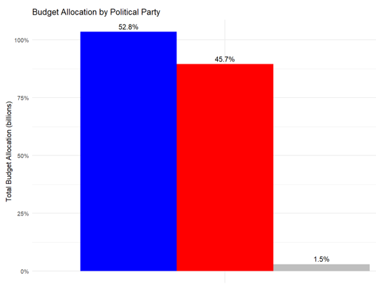

What is the share of budget allocation by political party?
The share of budget allocation by each party provides insights into how budgets are distributed among different political affiliations
We have categorized political parties into three groups: Democratic, Republic, and Missing.
Missing is for Tribal Communities
For US Territories like American Samao, we have used the delegates election results instead of presidential election results
Democratic party states has close to 53% of Infrastructure Investment & Jobs Act (IIJA) Funding Allocation

Slide 4
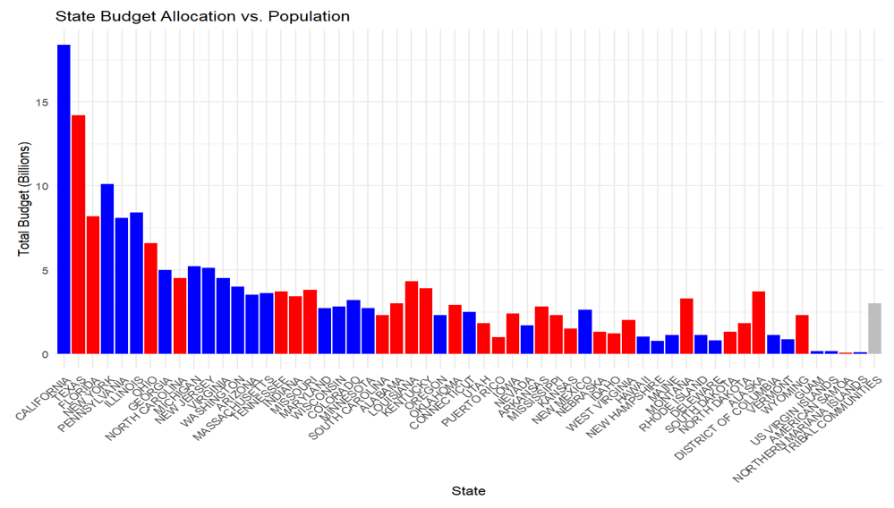
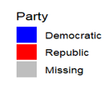
Budget Allocation vs Population
Here, we shall analyze the relationship between state budget allocation and population size.
In this chart, states are ranked by population size, and bars represent the total budget allocation for each state. Political parties are color-coded.
This comparison helps us understand if budget allocation correlates with population density and political party dominance.
Based on this chart, it seems like California is being given the highest investments.
We can also note that republican states like Louisiana and Kentucky are being provided higher budget allocation compared to many states (to their left) with lower population.

Slide 5
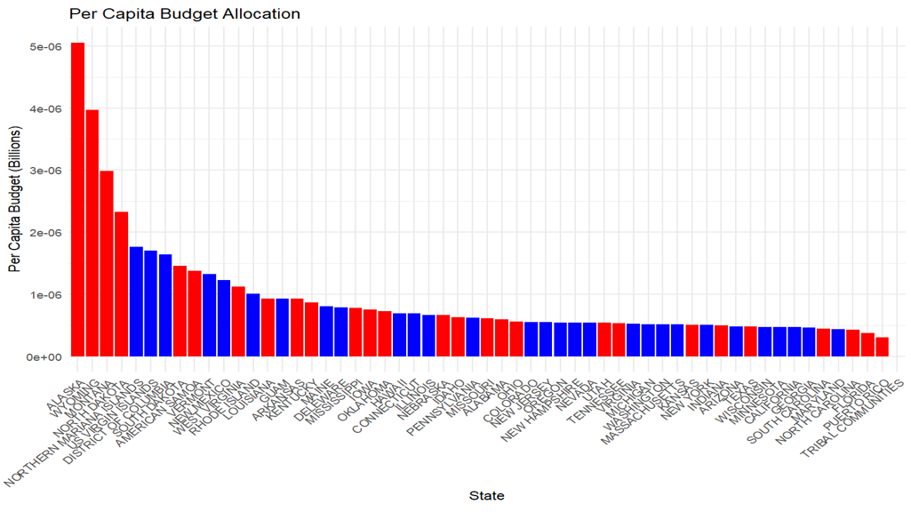

Per Capita Budget Allocation
This slide examines per capita budget allocation, which takes into account both budget size and population.
States are ranked by per capita budget allocation, and the bars show how much each state allocates per person. Again, political parties are color-coded.
This analysis allows us to assess how efficiently IIJA budgets are allocated, considering both size and population.
This chart suggests that Alaska, Wyoming, Montana and North Dakota has been given disproportionately higher per capita budget allocation compared to other states.

Slide 6
Conclusion
Using budget allocation vs population chart and per capita chart, we can conclude that equity based on population is not fully realized.
For instance, Florida, one of the most populous states, ranks 6th in terms of the allocated budget, indicating a discrepancy.
Conversely, states like Louisiana and Kentucky receive a higher budget allocation compared to states with lower populations.
States such as Alaska, Wyoming, Montana, and North Dakota receive disproportionately higher per capita budget allocations, indicating possible inequity in distribution.
Political Interests Neutrality
Despite disparities in allocation, there is no apparent favoritism toward the political interests of the Biden administration.
Notably, the states with skewed per capita budget allocations predominantly align with the Republican party.
Similarly, states like Louisiana and Kentucky, which receive higher budgets despite lower populations, are also Republican states.
This suggests that the allocation disparities are not politically motivated to favor the Biden administration's political interests.

Slide 7
References
Population Data: https://data.census.gov/table?q=Population+Total&g=010XX00US$0400000&tid=ACSDT1Y2021.B01003
Election results data sourced from: statistics2020.pdf (house.gov)
IIJA data saved on github at: https://raw.githubusercontent.com/Naik-Khyati/608/main/story1/input/story1_input_data.csv

