Slide 1

Can the FED Control Inflation and Maintain Full Employment
Khyati Naik
Data 608
Fall 2023
Story 2

Slide 2
Introduction
The Federal Reserve, often referred to as the FED, operates under a dual mandate established by Congress.
This mandate involves two primary objectives: controlling inflation to ensure price stability and simultaneously maintaining employment at desirable levels.
While these goals may seem complementary, they can present inherent challenges and conflicts.
For instance, strategies to combat inflation, such as raising interest rates, might inadvertently impact job growth. Achieving the right balance between these objectives is a complex task for the FED.
In story 1, we used R. Hence, in this story we would be using Python.

Slide 3
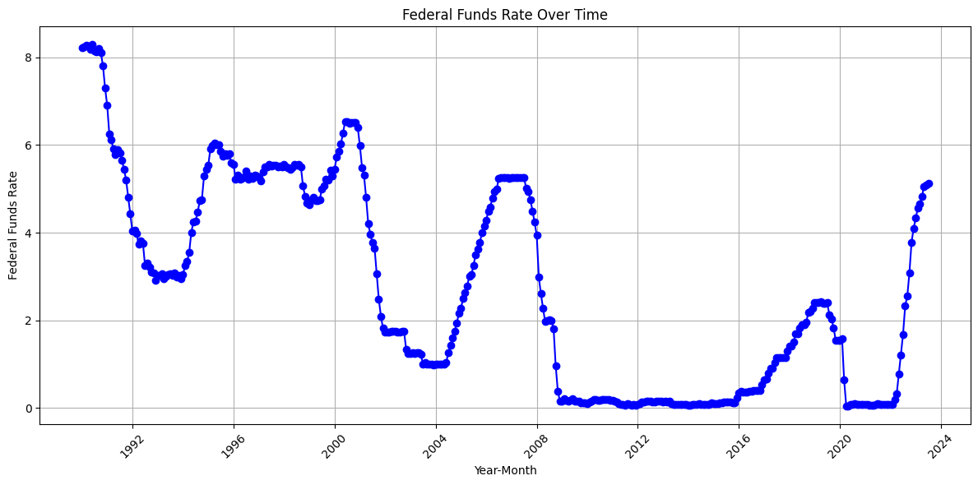
FEDFUNDS Trend Analysis
We have pulled monthly data series from 1990 onwards
We pulled FEDFUNDS rate data using API
FEDFUNDS rate has gone through multiple cycles of increases and decreases, which is typical of the Fed's response to economic conditions. For example, during the early 1990s, there were rate hikes followed by cuts. Similarly, during the 2008 financial crisis, there was a significant rate reduction. The Fed seems to have adjusted rates in response to economic conditions.

Slide 4
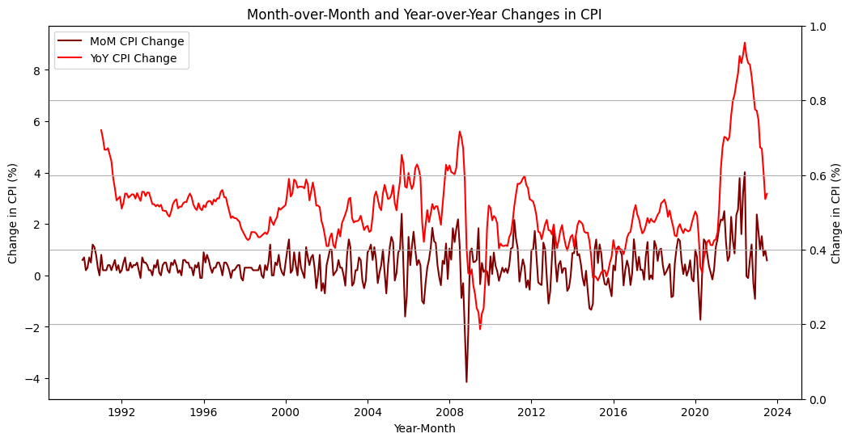
CPI Trend Analysis
We have also pulled data for CPI from BLS.
Below chart illustrates changes in the Consumer Price Index (CPI) over time, focusing on both month-over-month (MoM) and year-over-year (YoY) variations.
The red line represents the Month-over-Month (MoM) CPI change to reflect short-term fluctuations in consumer prices.
The maroon line represents the Year-over-Year (YoY) CPI change and provides a more stable view of inflation trends over time.

Slide 5
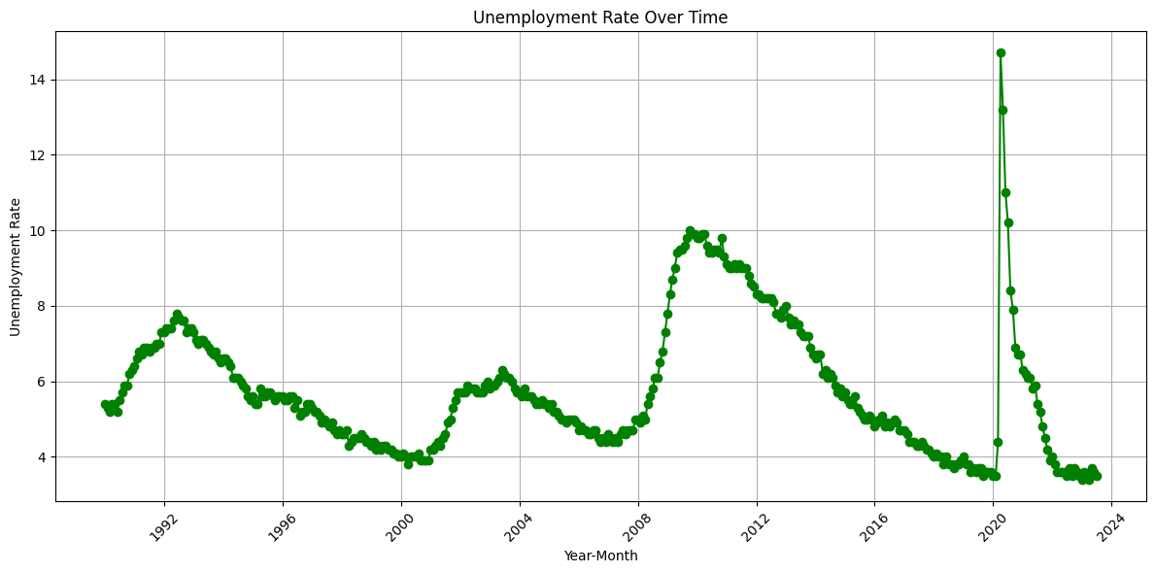
Unemployment Rate Trend Analysis
We have also pulled data for unemployment rate from BLS.
Unemployment rate is generally seen to decrease over time, which aligns with the Fed's mandate to target maximum employment. However, there are periods of increase, such as during recessions, where the Fed may have employed rate cuts to stimulate employment.

Slide 6
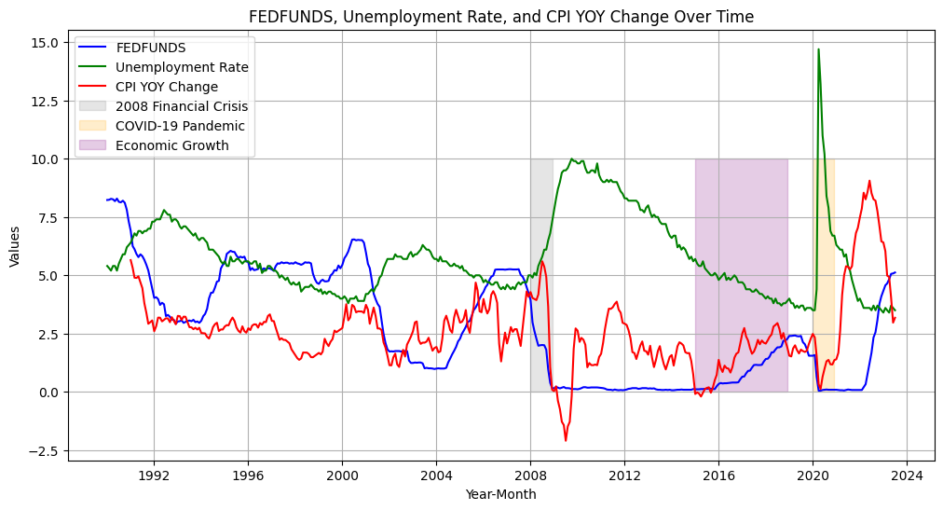
Trends in economic indicators for various economic cycles
We have identified several significant economic milestones that have had a profound impact on monetary policy and the broader economy over the past 25 years.
One of these milestones was the series of Interest Rate Cuts during the 2008 Financial Crisis. These rate reductions were a critical response to stabilize financial markets and stimulate economic recovery.
The Federal Reserve's Response to the COVID-19 Pandemic is another noteworthy event. The central bank implemented various measures to address the unprecedented challenges posed by the pandemic, including rate adjustments and asset purchases.
Lastly, we observed a period of Gradual Rate Increases during Economic Growth from 2015 to 2018. These rate hikes were aimed at preventing overheating of the economy and controlling inflation.

Slide 7
Conclusion
We have observed how changes in the FED Funds Rate correlate with significant economic events over the past 25 years.
These rate adjustments play a pivotal role in the Federal Reserve's efforts to manage inflation and employment levels.
The fluctuations in the Consumer Price Index (CPI) have been a critical factor in our analysis. Understanding the implications of CPI changes helps us gauge the broader economic landscape and potential future trends.
Unemployment Rate trends also emerged as a key component of our discussion. These trends have a direct impact on the FED's decision-making process and, consequently, on the overall economic well-being of the nation.
It's important to acknowledge that finding the right balance between controlling inflation and maintaining employment is a complex task. The Federal Reserve faces ongoing challenges and potential conflicts as it strives to fulfill its dual mandate effectively.

Slide 8
References
FEDFUNDS data sourced via API from: https://fred.stlouisfed.org/series/FEDFUNDS
CPI data sourced from: https://data.bls.gov/timeseries/CUUR0000SA0?years_option=all_years
Unemployment rate data sourced from: https://data.bls.gov/timeseries/LNS14000000

