Slide 1

Analyzing Customer Wait Times in Coffee Shops: A Simulation Study
Khyati Naik
Data 604
Summer 2023
Final Project

Slide 2

Presentation Flow
Introduction
Flow Chart Model
Simulation
Validity and Verification
Data Analysis and Visualization
Insights from the Model
Conclusion

Slide 3

Introduction
The project aims to analyze customer wait times in coffee shops, as this aspect plays a crucial role in customer satisfaction and operational efficiency.
By simulating the coffee shop environment, we can gain insights into the factors influencing wait times and explore potential improvements.
Problem: The project aims to simulate the coffee shop process and analyze customer wait times.
Significance: Analyzing customer wait times helps in understanding the efficiency of the coffee shop operations and their impact on customer experience. It enables coffee shop owners to optimize processes and enhance satisfaction.

Slide 4
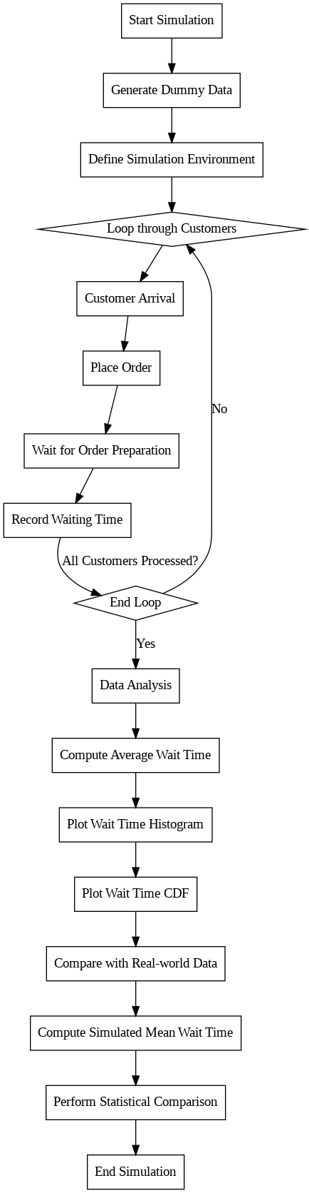
Flow Chart Model

Slide 5

Simulation
To simulate the coffee shop process, we generated dummy data for customer arrival times and service times. This allowed us to create a realistic environment for the simulation.
The simulation was implemented using simulation libraries, which facilitated the modeling of customer arrivals, order placements, and order preparation.
The simulation is run for 500 customers to represent a realistic scenario.
This number ensures statistical significance and provides meaningful insights into the coffee shop process and customer wait times.

Slide 6

Validity and Verification
The validity of the model is ensured by comparing simulated results with real-world data to evaluate its accuracy and reliability.
Statistical tests, such as t-test, are performed to determine if there are significant differences between simulated and real-world mean wait times.

Slide 7
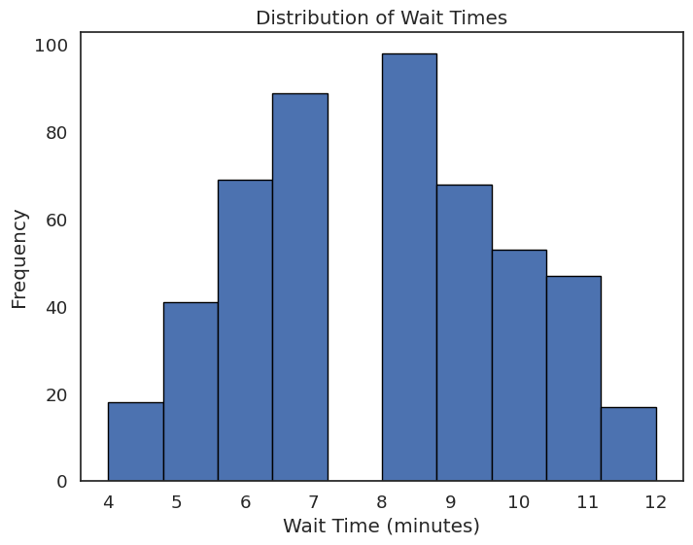
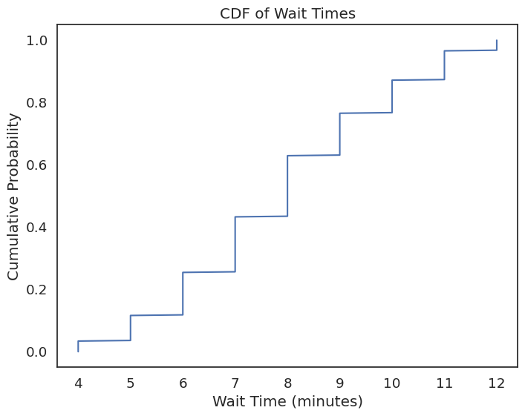
Data Analysis and Visualization
To better understand the distribution of customer wait times, we created a histogram that displayed the frequency of wait times within different time intervals. This visualization provides insights into the typical wait times experienced by customers.
The cumulative distribution function (CDF) plot showcased the cumulative probability of wait times. This plot allowed us to observe the spread and variability of wait times in a cumulative manner.

Slide 8

Insights from the Model
The simulation results provide valuable insights into the efficiency of the coffee shop's operations and the factors contributing to wait times.
Average wait time in the coffee shop: 7.922 minutes
Distribution of wait times reveals patterns for operational improvement
Simulated mean wait time: 7.922 minutes
Real-world mean wait time: 3.71 minutes
Significant difference between simulated and real-world mean wait times
T-test results: t-statistic = 6.653, p-value = 7.463e-07
Based on the findings, recommendations can be made to reduce wait times and enhance customer satisfaction. This may involve optimizing staffing levels, streamlining order processing, or implementing technological solutions like mobile ordering or self-service kiosks.

Slide 9

Conclusion
In conclusion, simulating and analyzing customer wait times in coffee shops offer valuable insights for improving operational efficiency and customer experience.
Understanding the factors influencing wait times allows coffee shop owners and managers to make informed decisions and implement strategies to reduce wait times, ultimately enhancing customer satisfaction and loyalty.

