Slide 1
Lending Club
Khyati Naik

Slide 2
Agenda
Introduction
Business Problem
Exploratory Data Analysis
Data Cleaning
Models
Model Performance
Fine Tuning
Conclusion

Slide 3
Business Problem
Lending Club is a marketplace for personal loans that matches borrowers who are seeking a loan with investors looking to lend money and make a return
Each borrower fills out a comprehensive application, providing their past financial history, the reason for the loan, and more
Lending Club evaluates each borrower’s credit score using past historical data and assigns an interest rate to the borrower. Lenders based on this information decides to fund the loan
If a loan is fully paid off on time, the investors make a return which corresponds to the interest rate the borrower had to pay in addition to the requested amount. Many loans aren’t completely paid off on time, however, and some borrowers default on the loan

Slide 4
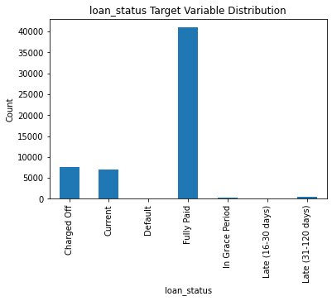
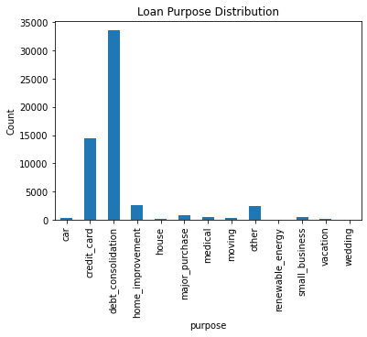
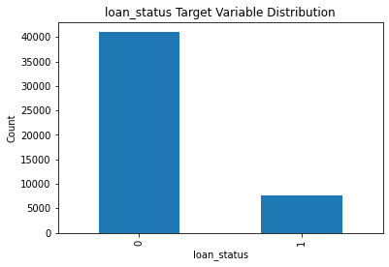
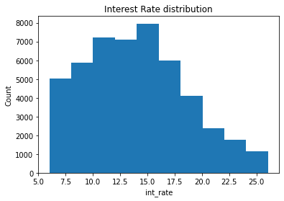
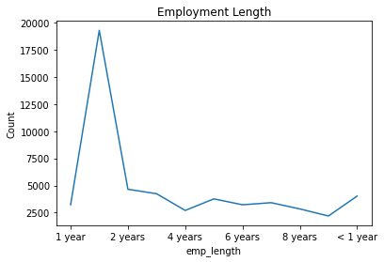
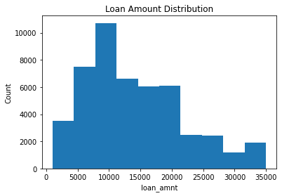
Exploratory Data Analysis

Slide 5
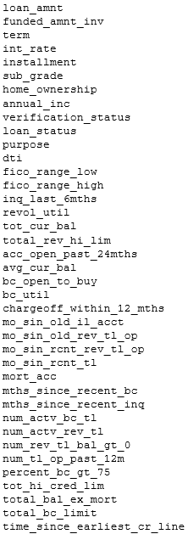
Data Cleaning
Identifying the target leakage
Removing the text variables
Removing the non-significant variables
Missing Value Imputation

Slide 6
Models
Naïve Bayes
Support Vector Machines
Converges quickly, doesn’t have the curse of dimensionality
Kernels are provided for better parameterization, avoids overfitting, efficient memory use

Slide 7
Fine Tuning
class_weight
max_iter
As the target is unbalanced, so used class_weight = ‘balanced’ to improve the model AUC
Tried with different number of iterations to fit the model

Slide 8
Model Performance
The best scores after the cross validation
Naïve bayes: 0.53
Support Vector Machine: 0.71
AUC on test data is 0.66

Slide 9
Conclusion
SVM is better at prediction then Naïve Bayes, per AUC metric

Slide 10


Thank You
Questions

