Slide 1
Topic : Chatbot
By :
Bharti Asrani
Juhi Naik

Slide 2
Holiday Bot
A chatbot that provides automated customer service through a messaging platform such as Facebook Messenger.
Holiday Bot provides following services :
Flight Booking
Hotel Booking

Slide 3
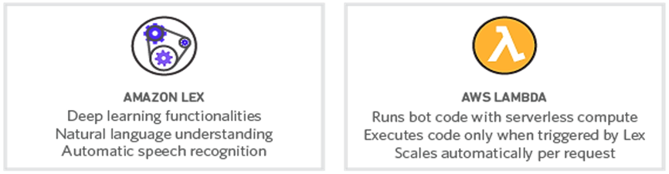

Technologies Used
Amazon Lex
Amazon Lambda
Amazon DynamoDB

Slide 4
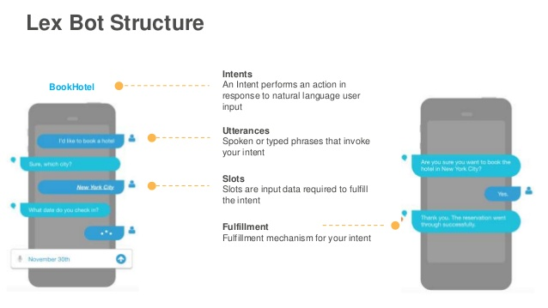

Slide 5
How it works???

Slide 6
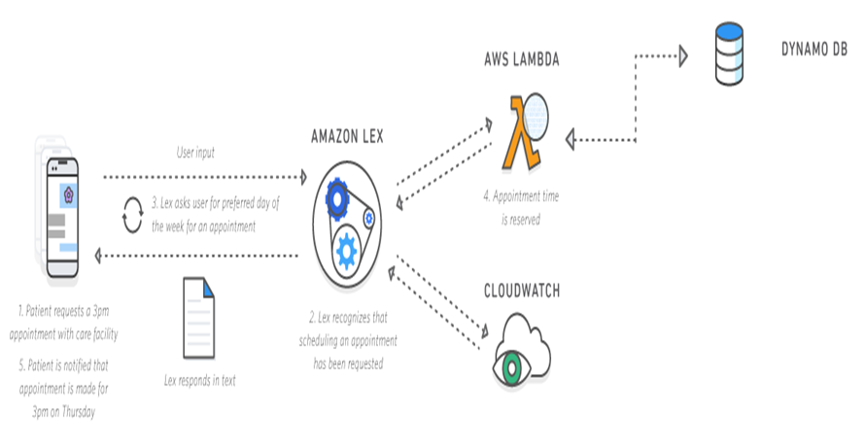

Slide 7
It's time for a live demo….

Slide 8
Chatbots as powerful tools/Why Chatbots?

Slide 9
Chatbot : Convenience and Simplicity.
Applications :
Customer Support
Sales
Personal Finance Assistant
Schedule a meeting
News
Send Money

Slide 10
Replicability of Chatbots in Credence & some Innovations

Slide 11
Forex live rates for different currencies
Deal booking
Email/SMS Notifications

Slide 12
Objective Met

Slide 13
Basics of AWS Lex and Lambda learnt.
Learnt to create an application on serverless platform.

Slide 14
Thank you….

