Slide 1


Department of Computer Science and Engineering
Major Project – Phase 1 - Review 1
REAL TIME AI/ML QUISHING AND SMISHING DETECTION AND PREVENTION SYSTEM
NITHIN NAIK.R(1BY23CS152)
S MD UMAR(1BY23CS190)
SAGAR S.H(1BY24CS415)
PRASHANTH(1BY23CS161)
UNDER THE GUIDANCE OF:
Prof. BRUNDA S
Assistant Professor
DEPT. OF CSE
BMSIT&M
2025-26

Slide 2
Problem Statement
In today’s digital world, mobile users depend heavily on QR codes and SMS messages for banking and payments, making them vulnerable to phishing attacks. QR phishing and SMS phishing exploit user trust by delivering malicious links that often bypass traditional security systems.
Most existing solutions rely on blacklists and external APIs, which fail to detect newly generated (zero-day) phishing attacks and raise concerns related to privacy and delayed response. As attackers continuously create new domains and deceptive message patterns, users remain exposed to financial loss and data theft. Therefore, there is a need for a self-contained, intelligent detection system that can proactively identify suspicious patterns and protect users against emerging QR and SMS-based phishing threats without relying on external services.
The targeted users of this system include mobile banking users(UPI), elderly users, students, and organizations that rely on digital payments and mobile communication.

Slide 3
Motivation
The rapid growth of QR-code–based scan and SMS communication has significantly increased the risk of phishing attacks targeting mobile users. Many existing security solutions depend heavily on blacklists and external APIs to identify malicious links, but these approaches are ineffective against zero-day attacks, where newly created phishing domains are not yet listed in security databases. Cyber attackers continuously generate new phishing websites and deceptive SMS messages that can easily bypass traditional rule-based or signature-based detection systems. Therefore, there is a strong need for a real-time AI/ML-based detection system capable of intelligently analyzing messages and QR codes to identify suspicious patterns. Such a system can help protect users from financial loss, identity theft, and other cyber fraud, while improving overall security in digital payment and communication platforms.

Slide 4
Literature Survey (Tabular column)
Author, Paper title , Year | Key findings | Gaps
Luis Rivas, Varun Kumar Singh, Vinayak Khabdelwal, Lanier Watkins, “Securing QR Codes Infrastructure Using AI to Detect Malicious Activity”, 2025 | Based on threats in QR codes in areas such as payments,Restaurants & information sharing. Proposed AP3X Secure QR code infrastructure(Web Based Platform). Distinguishes between URL and Non-URL content. | Depend on 3rd party APIs. Lack in evaluation on MLs Attacks. Potential dataset aging
Zhursinbek Mukhammedali, Khan Vyacheslav, Abdul Razaque, M. Ajmal Khan, Zhuldyz Kalpeyeva,“AI-Enhanced Security Framework for QR Codes”, 2025 | Threats Related to QR code Scans(Phishing). QR code lack encryption & verification. AI enhanced Multilayer QR code Security. ML-models-XGBoost,Random forest analyse. | High Cryptographic Verification Time. Limited Real-World Testing.
Akshat Gaurav, Brij B. Gupta, Kwok Tai Chui, “AI-Driven Smishing Detection in Android Devices Using TinyBERT and Aquila Optimization”,2025 | High Detection Accuracy. Aquila Optimization Improves Model Performance. Effective Smishing Detection Using TinyBERT. | Dataset Dependency. Limited Evaluation on Real Devices.

Slide 5
Literature Survey (Tabular column)
Author, Paper title , Year | Key findings | Gaps
Saleem Raja Abdul Samad, Pradeepa Ganesan, Thangam S,Sundaravadivazhagan, Saranya Rajiakodi, Amna Salim Rashid Al Kaabi ,“SMS-Shield: A Lightweight Approach for Smishing Detection using Machine Learning”, 2024 | Lightweight Smishing Detection Framework. Use of Machine Learning for SMS Classification. Feature Engineering Improves Detection | Limited Dataset Diversity. Limited Real-World Deployment. No Integration with Advanced AI Models.
Gangisetty Raj Charan, Dr. K Deepa Thilak, “Detection of Phishing Link and QR Code of UPI Transaction using Machine Learning”, 2023 | Machine Learning Improves Fraud Detection. Real-Time Monitoring. Classification Algorithms Help Identify Fraud. | Limited Use of Advanced AI Models. Moderate Detection Accuracy
Delano Oscar Do Rosario Lourenco, MVH Sai Sriraj, Krotha Kayne Thambi, Vibho Ranjan,“Malicious URLs and QR Code Classification using Machine Learning and Deep Learning Techniques”, 2023 | Hybrid Approach Using ML and Deep Learning. Multiple Machine Learning Algorithms Evaluated. Deep Learning Models for QR Code Classification. | High Computational Requirements. Dependency on Large Datasets. Vulnerability to Adversarial Attacks.

Slide 6
Literature Survey(Summary)
Existing research mainly focuses on individual phishing detection methods, targeting either SMS phishing or QR code phishing, rather than addressing both threats together.
The SMS-Shield framework (2024) uses lightweight machine learning for smishing detection but has limitations such as limited dataset diversity and lack of real-world deployment.
The UPI phishing detection study (2023) detects phishing links and QR fraud using machine learning but relies mainly on basic classification algorithms with moderate accuracy.
Another study on malicious URL and QR code classification (2023) uses multiple ML and DL models but faces issues like high computational requirements and dependency on large datasets.
Many existing approaches are vulnerable to new phishing techniques and adversarial attacks, making them less effective for zero-day threats.
In contrast, the proposed system provides a unified detection framework that analyzes both SMS messages and QR codes in real time.
The system integrates TinyBERT for smishing detection and XGBoost for QR phishing detection, along with cross-verification, risk scoring, automated link blocking, and user alerts to improve detection accuracy and security.

Slide 7
Research Gap Identified
Most existing systems focus on only one attack type (either smishing or QR phishing) and do not provide a unified detection system for both threats.
Many current solutions rely on blacklists or external APIs, which are ineffective for detecting zero-day phishing attacks and newly generated malicious domains.
Existing research mainly uses traditional machine learning models, with limited use of advanced AI models for deeper contextual analysis.
Most studies lack contextual correlation between SMS content and QR code URLs, making it difficult to detect contextual phishing attacks.
Several systems require large datasets and high computational resources, which makes deployment on mobile devices difficult.
Scope for Improvement
Develop a real-time unified system that detects both smishing and quishing attacks.
Use advanced AI/ML models for better contextual understanding and detection accuracy.
Implement cross-verification between SMS content and QR URLs to detect contextual phishing.
Provide real-time risk scoring, automated blocking, and user alerts for effective prevention.

Slide 8
Proposed System
The proposed system is a Real-Time AI/ML-Based Quishing and Smishing Detection System designed to protect mobile users from phishing attacks delivered through SMS messages and QR codes. The system continuously monitors incoming SMS messages and scanned QR codes and analyzes them using NLP and machine learning models to detect malicious patterns and suspicious URLs.
The system architecture includes data acquisition, feature extraction, AI/ML detection modules, cross-verification, and prevention layers. The TinyBERT model analyzes SMS content to detect smishing attacks, while XGBoost evaluates the safety of URLs extracted from QR codes. A cross-verification engine correlates SMS context with QR landing pages to identify contextual phishing attacks.
Based on the analysis, the system assigns a risk score (Low, Medium, High) and automatically performs actions such as blocking malicious links and alerting users, thereby providing real-time protection against phishing threats.

Slide 9
Objectives
To continuously monitor incoming SMS messages and scanned or embedded QR codes in real time.
To preprocess SMS text and QR code images using NLP techniques and computer vision methods for reliable feature extraction.
To analyze SMS content using AI/ML models for detecting smishing attacks based on context, urgency, and sender patterns.
To detect malicious QR codes using visual analysis and URL safety classification models.
To correlate SMS content with QR-decoded URLs to identify contextual phishing attacks and brand impersonation attempts.
To develop a real-time AI/ML-based Quishing and Smishing detection and prevention system for malicious links and QR codes used in digital scans and Threat SMS.

Slide 10
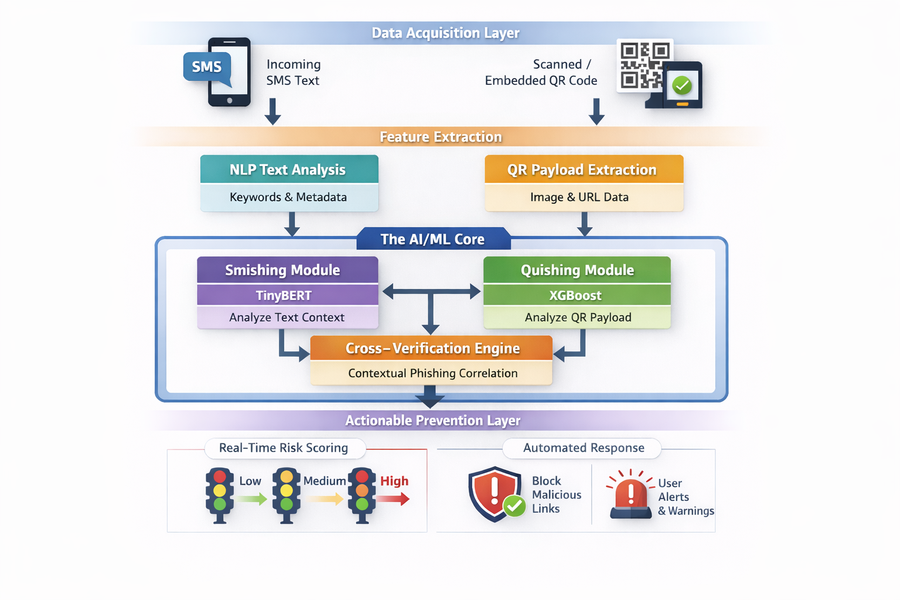
System Arictecture

Slide 11
Methodology
Data Acquisition Layer:
Dual-Input Streams: Simultaneous monitoring of incoming SMS text and embedded/scanned QR code images.
Feature Extraction: Utilizing NLP for text metadata and Computer Vision for QR payload extraction.
The AI/ML Core (Hybrid Pipeline):
Smishing Module: Employs TinyBERT to analyze text context, urgency, and sender reputation.
Quishing Module: Uses XGBoost to evaluate the decoded URL safety.
Cross-Verification Engine:
Correlates SMS context with QR landing pages to detect "Contextual Phishing“ (e.g., an SMS about banking leading to a non-banking URL).
Actionable Prevention Layer:
Real-Time Risk Scoring: Categorizes threats as Low, Medium, or High.
Automated Response: Instant blocking of malicious links and user alerts with visual safety indicators.

Slide 12
Tools & Technologies
Tools and Technologies
Layer | Tools & Technologies | Purpose
Mobile App Development | Android Studio, Kotlin / Java | Development of the Android mobile application
Data Acquisition | Android SMS API, ZXing | Capturing incoming SMS messages and scanning/decoding QR codes
AI/ML Models | TinyBERT, XGBoost, Scikit-learn | Detecting smishing attacks from SMS and evaluating phishing URLs from QR codes
Backend Integration | Python, FastAPI | Connecting AI models with the mobile application for processing and communication
Mobile Dashboard & Alerts | Android UI (XML / Jetpack Components) | Displaying risk scores, phishing alerts, and security notifications within the mobile app

Slide 13
Feasibility Study
The proposed Real-Time AI/ML Based Quishing and Smishing Detection and Prevention System is feasible in terms of technical, economic, operational, and schedule aspects.
From a technical perspective, the system can be implemented using technologies such as ZXing for QR code scanning, TinyBERT for SMS phishing detection, and XGBoost for URL safety analysis.
Natural Language Processing using SpaCy is used for SMS text preprocessing and feature extraction.
FastAPI frameworks can be used to integrate AI/ML models with the mobile application.
From an economic perspective, the project is cost-effective because it uses open-source tools and existing hardware resources.
From an operational perspective, the system works in real time by monitoring SMS messages and scanned QR codes, providing alerts to users when phishing threats are detected.
From a schedule perspective, the project can be completed within the academic timeline by dividing tasks such as data collection, model development, application integration, and testing among team members.

Slide 14
SDG (Sustainable Development Goals) mapped (as per the metrics provided by Dept.)
GOAL 4 – Quality Education
Protects students and educational platforms from phishing attacks
GOAL 8 – Decent Work and Economic Growth
Prevents financial losses due to phishing scams
GOAL 9 – Industry, Innovation and Infrastructure
Support safe adoption of cloud services, online platforms, and digital systems
GOAL 11 – Sustainable Cities and Communities
Protects citizens using online public services and QR-based systems
GOAL 16 – Peace, Justice and Strong Institutions
Helps combat cybercrime and digital fraud

Slide 15
Work Plan (Timeline)
The project will be completed over a 16-week development period, divided into multiple phases. The initial phase focuses on dataset collection and preprocessing.
The next stages involve feature extraction and AI/ML model development using TinyBERT and XGBoost.
After developing the models, the team will build the Android mobile application, integrate the detection modules, and implement the cross-verification and prevention mechanisms.
The final stages include system testing, evaluation, documentation, and project presentation.

Slide 16

Work Plan (Timeline)
• Performance expectations
Innovation contribution
Outcome Component | Tick which one is your project outcome
Publication
Patent
Product
Note: Mandatory Outcome Any one of the above must be achieved as the outcome of the project.

Slide 17
References
[1] Luis Rivas, Varun Kumar Singh, Vinayak Khabdelwal, Lanier Watkins, “Securing QR Codes Infrastructure Using AI to Detect Malicious Activity”, 2025 IEEE 15th Annual Computing and Communication Workshop and Conference (CCWC).
[2] Zhursinbek Mukhammedali, Khan Vyacheslav, Abdul Razaque, M. Ajmal Khan, Zhuldyz Kalpeyeva,“AI-Enhanced Security Framework for QR Codes”, 2025 1st International Conference on Secure IoT, Assured and Trusted Computing(SATC).
[3] Akshat Gaurav, Brij B. Gupta, Kwok Tai Chui, “AI-Driven Smishing Detection in Android Devices Using TinyBERT and Aquila Optimization”, The 27th International Conference on Advanced Communications Technology(ICACT 2025).
[4] Saleem Raja Abdul Samad, Pradeepa Ganesan, Thangam S,Sundaravadivazhagan, Saranya Rajiakodi, Amna Salim Rashid Al Kaabi ,“SMS-Shield: A Lightweight Approach for Smishing Detection using Machine Learning”, 2024 1st International Conference on Innovative Engineering Sciences and Technological Research (ICIESTR).
[5] Gangisetty Raj Charan, Dr. K Deepa Thilak, “Detection of Phishing Link and QR Code of UPI Transaction using Machine Learning”, 2023 3rd International Conference on Innovative Mechanisms for Industry Applications (ICIMIA).
[6] Delano Oscar Do Rosario Lourenco, MVH Sai Sriraj, Krotha Kayne Thambi, Vibho Ranjan,“Malicious URLs and QR Code Classification using Machine Learning and Deep Learning Techniques”, 2023 3rd Asian Conference on Innovation in Technology (ASIANCON).
[7] Swarangi Uplenchwar, Varsha Sawant, Prajakta Surve, Shilpa Deshpande, Supriya Kelkar, “Phishing Attack Detection on Text Messages Using Machine Learning Techniques”, 2022 IEEE Pune Section International Conference (PuneCon).
[8] Samadhan M. Nagare, Pratibha P. Dapke, Syed Ahteshamuddin Quadri, Sagar B. Bandal, Manasi R. Baheti, “Short Message Service (SMS) Mobile Spam Detection using Naïve Bayes”, 2024 5th International Conference on Mobile Computing and Sustainable Informatics (ICMCSI).
[9] N Nasurudeen Ahamed, Tangavel Murugan, Bhabendu Kumar Mohanta,“QR Code Phishing (Quishing): Food Supply Chain Management Traceability Risks Combined With Blockchain Technology”, 2025 3rd International Conference on Business Analytics for Technology and Security (ICBATS).
[10] Aleksandr Nahapetyan, Sathvik Prasad, Kevin Childs, Adam Oest, Yeganeh Ladwig, Alexanderos Kapravelous, Bradley Reaves,“On SMS Phishing Tactics and Infrastructure”, 2024 IEEE Symposium on Security and Privacy (SP).
[11] Zeynep Aslanpencesi, Muhammet Baykara, Talha Burak Alakus, “SMS Phishing Detection with Hybrid CNN-GRU”, 2024 7th World Symposium on Communication Engineering (WSCE).

