Slide 1

(Accredited By National Assessment & Accreditation Council (NAAC))
(Approved by AICTE, New Delhi & Affiliated to Visvesvaraya Technological University, Belagavi)
Doddaballapura Main Road, Avalahalli, Yelahanka, Bengaluru-560119.
REAL TIME AI/ML PHISHING DETECTION AND PREVENTION SYSTEM
NITHIN NAIK.R(1BY23CS152) UMAR(1BY23CS190) SAGAR S.H(1BY24CS415) PRASHANTH(1NY23CS161)
B.E.
COMPUTER SCIENCE AND ENGINEERING
UNDER THE GUIDANCE OF:
Prof. BRUNDA S
Assistant Professor
DEPT. OF CSE
BMSIT&M
2026-27

Slide 2
CONTENT
Abstract
Introduction
Problem statement
Objectives of the work
Proposed Methodology
SDG mapped (as per the metrics provided by Dept.)
Project management and Finance
Expected outcomes
References(IEEE format)

Slide 3
ABSTRACT
The inability to provide real-time, adaptive, and explainable threat detection significantly
increases the probability of credential harvesting, session hijacking, ransomware deployment,
and large-scale data breaches..
Context: Write the background or setting of your mini-project here. Explain why the topic is important and what motivated the work.
Problem Identified: Clearly mention the specific problem, gap, or challenge that your project aims to solve. Objective: State the goals of the project—what you set out to build, analyze, or achieve.
Methods: Briefly describe the methodology you used. This may include algorithms, models, datasets, frameworks, or tools.
Results: Summarize the key outcomes, model performance, detection accuracy, system behavior, or improvements achieved.
Keywords: Add all important keywords used in the project (e.g., Deep Learning, Image Processing, CNN, Object Detection, YOLO, Dataset Name, etc.).
Note:The entire abstract should be between 200 to 250 words

Slide 4
INTRODUCTION
Phishing attacks have evolved into highly sophisticated cyber threats exploiting human psychology, weak security configurations, and gaps in legacy detection mechanisms.
Threat actors now leverage Machine learning (ML), Deep learning (DL), and natural language generation (NLG) to create context-aware phishing campaigns that bypass signature- and rule-based security systems.
Attack vectors are no longer limited to email; they now span SMS, instant messaging platforms, and websites using domain spoofing, homoglyph attacks, and redirection chains.
The dynamic and polymorphic nature of these attacks has rendered traditional anti-phishing mechanisms—such as static URL blacklists, regex-based filters, and signature matching—ineffective against zero-day exploits.
Explain background and motivation.
Define the problem statement clearly.
Scope and importance of the project.
Literature review or related work overview.

Slide 5
PROBLEM STATEMENT
Current anti-phishing ecosystems lack the technical adaptability and intelligence required to detect and mitigate emerging threats in real time.
The main technical limitations include:
Static Detection Models: Legacy tools rely on rule-based engines and signature libraries that fail against dynamically generated URLs, short-lived domains, and polymorphic attack payloads.
Insufficient NLP/ML Analysis: Many systems lack advanced contextual and semantic analysis, resulting in undetected threats embedded in AI-generated or obfuscated messages.
Complex Link Obfuscation: Phishing URLs often employ techniques like multiple HTTP 3xx redirection hops, Base64/hex encoding, and URL parameter cloaking, evading traditional scanners.
Latency in Detection: Many security platforms perform post-delivery scans or asynchronous sandboxing, providing alerts after the end-user has engaged with the malicious link or attachment.
Poor Model Generalization: ML classifiers trained on historical datasets often exhibit model drift and fail to generalize to zero-day phishing campaigns without active retraining pipelines.
Limited Endpoint and Browser Integration: Available solutions are primarily cloud- or gateway-based, lacking lightweight real-time integrations with browsers, mail clients, and endpoint security agents.

Slide 6
OBJECTIVES OF THE WORK
To develop a real-time AI/ML-based phishing detection and prevention system for malicious links and QR codes used in digital and UPI transactions and Threat SMS.
To enhance user safety and trust by preventing credential theft, financial fraud, and unauthorized access.
To overcome the limitations of traditional rule-based phishing detection systems by using intelligent, data-driven models.
To provide a scalable and adaptable security solution capable of handling evolving phishing techniques.

Slide 7
METHODOLOGY
Data Acquisition Layer:
*Dual-Input Streams: Simultaneous monitoring of incoming SMS text and embedded/scanned QR code images.
*Feature Extraction: Utilizing NLP for text metadata and Computer Vision for QR payload extraction.
The AI/ML Core (Hybrid Pipeline):
*Smishing Module: Employs TinyBERT or Hybrid CNN-GRU to analyze text context, urgency, and sender reputation.
*Quishing Module: Uses CNN-based classification (ResNet/VGG) to detect "visual" tampering and XGBoost to evaluate the decoded URL safety.
Cross-Verification Engine:
Correlates SMS context with QR landing pages to detect "Contextual Phishing" (e.g., an SMS about banking leading to a non-banking URL).
Actionable Prevention Layer:
*Real-Time Risk Scoring: Categorizes threats as Low, Medium, or High.
*Automated Response: Instant blocking of malicious links and user alerts with visual safety indicators.

Slide 8
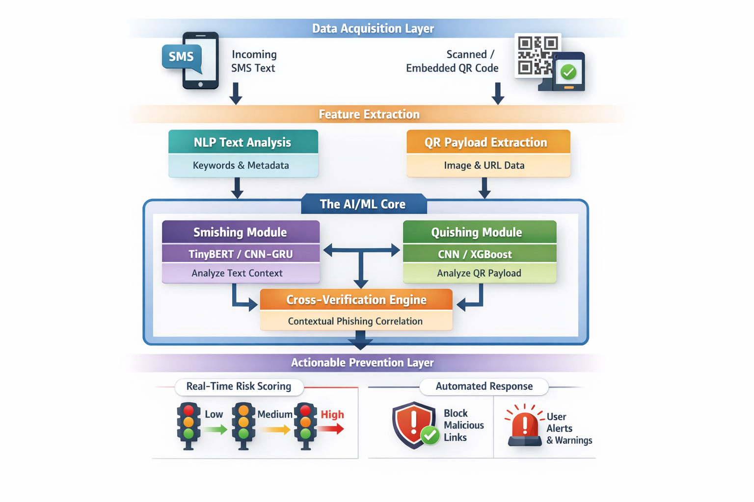
FLOW DIAGRAM

Slide 9
SDG (Sustainable Development Goals)
mapped (as per the metrics provided by Dept.)
SDG 4 – Quality Education
Protects students and educational platforms from phishing attacks
SDG 8 – Decent Work and Economic Growth
Prevents financial losses due to phishing scams
SDG 9 – Industry, Innovation and Infrastructure
Support safe adoption of cloud services, online platforms, and digital
systems
SDG 11 – Sustainable Cities and Communities
Protects citizens using online public services and QR-based systems
SDG 16 – Peace, Justice and Strong Institutions
Helps combat cybercrime and digital fraud

Slide 10
PROJECT MANAGEMENT AND FINANCE
Include a brief section on timeline, team roles.
Tools used for project scheduling (e.g., Gantt charts).
Budget or finance details if applicable.

Slide 11
References(IEEE format)
[1] Dr.K Deepa Thilak and Gangisetty Raj Charan, ”Detection of Phishing Link and QR Code of UPI Transaction using Machine Learning”. 2023 3rd International Conference on Innovative Mechanisms for Industry Applications (ICIMIA) | 979-8-3503-4363-2/23/$31.00 ©2023 IEEE | DOI: 10.1109/ICIMIA60377.2023.10426613.
[2] Vinayak Khandelwal, Varun Kumar Singh and Luis Rivas, “Securing QR Code Infrastructure Using AI to Detect Malicious Activity”. 2025 IEEE 15th Annual Computing and Communication Workshop and Conference (CCWC) | 979-8-3315-0769-5/25/$31.00 ©2025 IEEE | DOI: 10.1109/CCWC62904.2025.10903910.
[3] Swarangi Uplenchwar, Varsha Sawant and Prajakta Surve, “Phishing Attack Detection on Text Messages Using Machine Learning Techniques”. 2022 IEEE Pune Section International Conference (PuneCon) | 978-1-6654-9897-5/22/$31.00 ©2022 IEEE | DOI: 10.1109/PUNECON55413.2022.10014876.
[4] Akshat Gaurav, Brij B. Gupta, “AI-Driven Smishing Beection in Android Devices Using TinyBERT and Aquila Optimization”.The 27th International Conference on Advanced Communications Technology (ICACT2025)

