Slide 1

symbiosis skills and professional university [sspu]
SEMINAR PRESENTATION
ON
“Trainer Syllabus Tracker ”
BY
1.Miss. Naikwade Kajal Namdeo. 2.Miss.Priyanka Khandode
Guide by:-
Trainer. Supriya Ma'am

Slide 2
CONTENT
1. Introduction
2. Problem Statment
3. Objectives
4. Key Features
5. Technologies Used
6. Workflow
7. Class Digram
8. Future Enhancements
9. Architecture
10. Project Images
11. Conclusion

Slide 3
INTRODUCTION
The Trainer Syllabus Tracking System is a tool created to assist schools or training facilities in organizing their instructors, courses, and classes efficiently. It simplifies the process of managing trainers, course materials, and session schedules.

Slide 4
Problem Statement
Highlight the challenges faced without a proper tracking system:
Disorganization: Educational institutions may face challenges in keeping track of their trainers, courses, and session schedules, leading to disarray and confusion.
Inefficiency: Without a streamlined system, managing trainers, courses, and sessions becomes inefficient, resulting in wasted time and resources.
Irregularities: Scheduling conflicts and inconsistencies can arise, causing disruptions in the learning process and affecting the quality of education delivered.

Slide 5

Key Features
Trainer Management: Allows administrators to add, update, and delete trainer profiles, including details such as name, contact information, and specialization.
Course Management: Enables administrators to create and manage course profiles, including title, description, duration, and associated trainers.
Session Management: Facilitates the scheduling and organization of training sessions, including date, time, location, and enrolled participants.
Reporting and Analytics: Provides insights into trainer performance, course completion rates, session attendance, and other relevant metrics.
I Understand the Concept… But I can’t able summarized it…!!!

Slide 6
Technology
Backend: Spring Boot (Java)
Frontend: HTML, CSS, Angular
Database: MySQL or any other relational database management system (RDBMS)
Other Tools: ModelMapper for object mapping, Thymeleaf for server-side templating, Git for version control, etc.

Slide 7
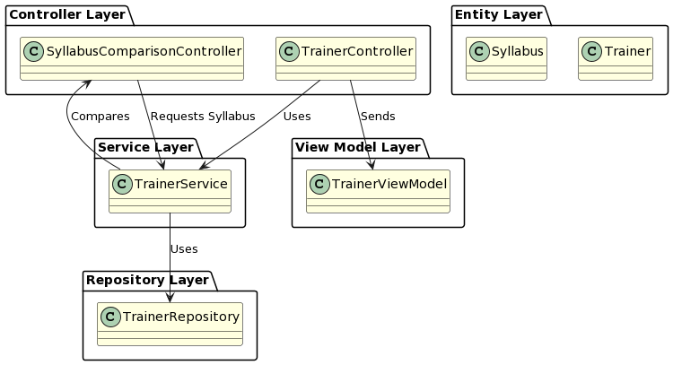
Class Digram

Slide 8

OBJECTIVES
Discuss the goals of the project:
Providing a centralized platform to manage trainers, courses, and sessions.
Streamlining the process of adding, updating, and deleting trainers, courses, and sessions.
Tracking the progress of trainers and courses to ensure alignment with syllabus objectives.
Generating reports and analytics to assess performance and make data-driven decisions.

Slide 9

Future Scope
Discuss potential future enhancements or features:
Integration with Learning Management Systems (LMS)
Automated notifications for session reminders
Enhanced analytics and predictive modeling for performance forecasting

Slide 10
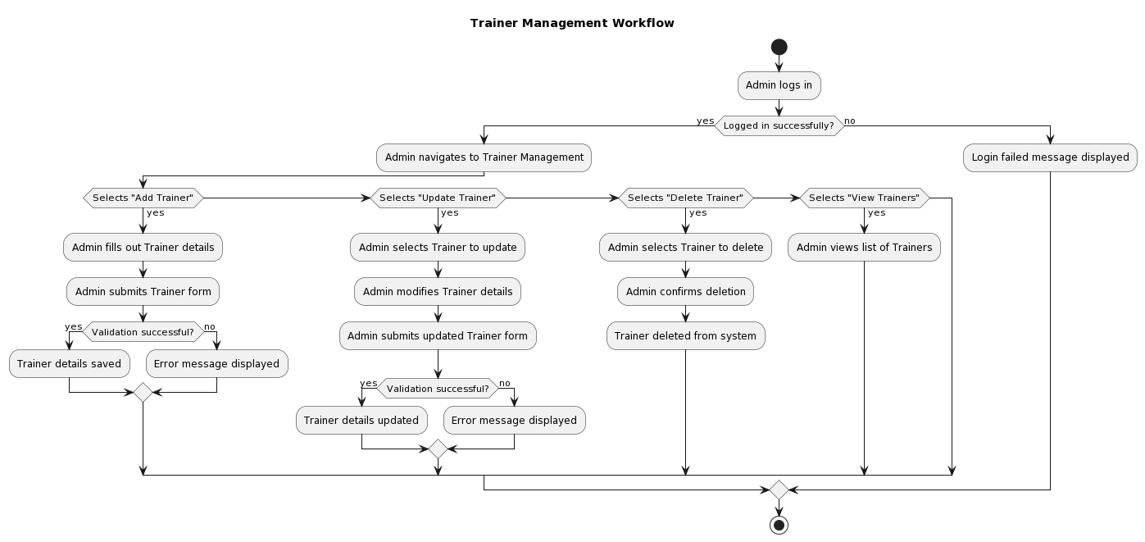
Fig : Diagrammatic view

Slide 11
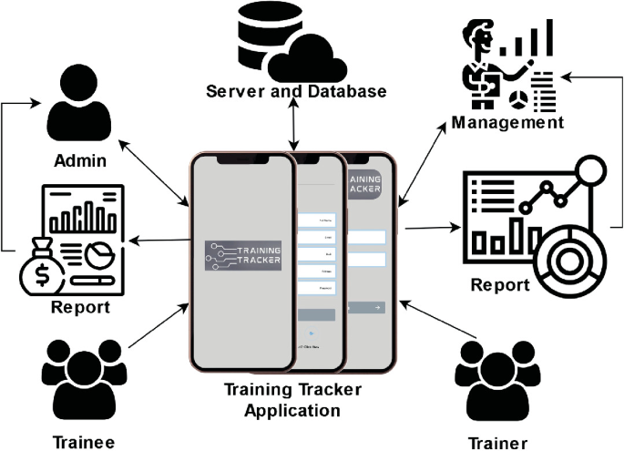

Slide 12

Conclusion
The Trainer Syllabus Tracking System aims to streamline the management of trainers, courses, and sessions in educational institutions,
improving efficiency, organization, and decision-making.

Slide 13


