Slide 1


HELLO EVERYONE !!

Slide 2


in

Slide 3

in

Slide 4


THE PROBLEMATIC

Slide 5
THE PROBLEMATIC
In the realm of electronic document management, the human element often proves to be the weakest link. To fortify this, we need to address the root of the problem, which lies in the transaction of data and documents, especially between administrators who handle important data. Even minor issues can escalate into significant problems. Therefore, it’s crucial to minimize the average number of issues to enhance the overall security of our systems.

Slide 6
THE SOLUTION

Slide 7

THE SOLUTION

Slide 8
THE SOLUTION
a plug-in That reads, analyzes, and processes documents, classifies them based on the information within each document. After classification, it encrypts these documents to protect sensitive and important information. Additionally, it alerts you if you attempt to send important documents to someone unauthorized to view them.

Slide 9
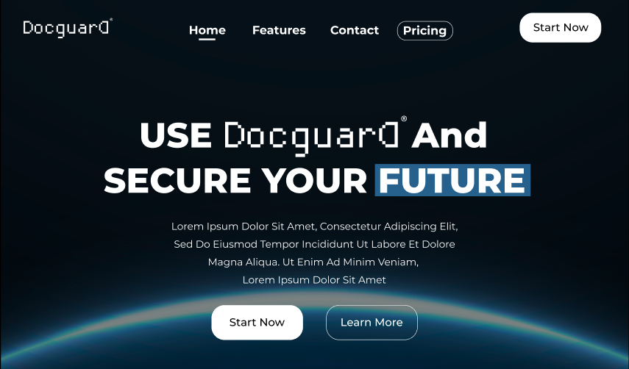

Slide 10
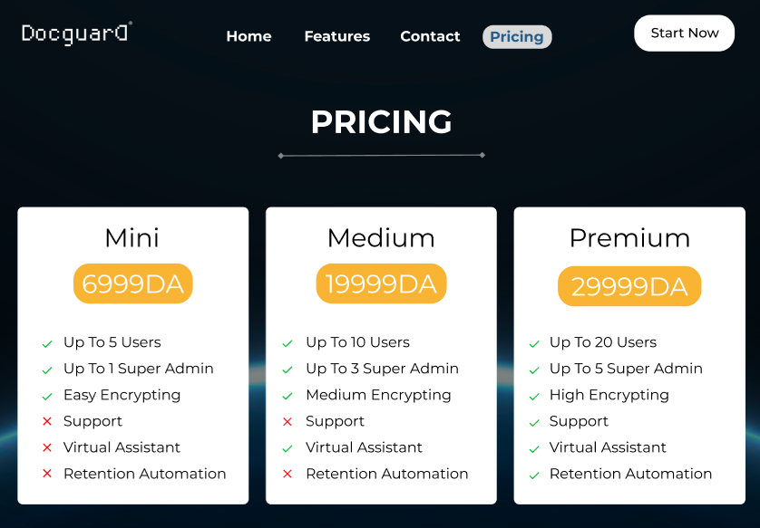

Slide 11
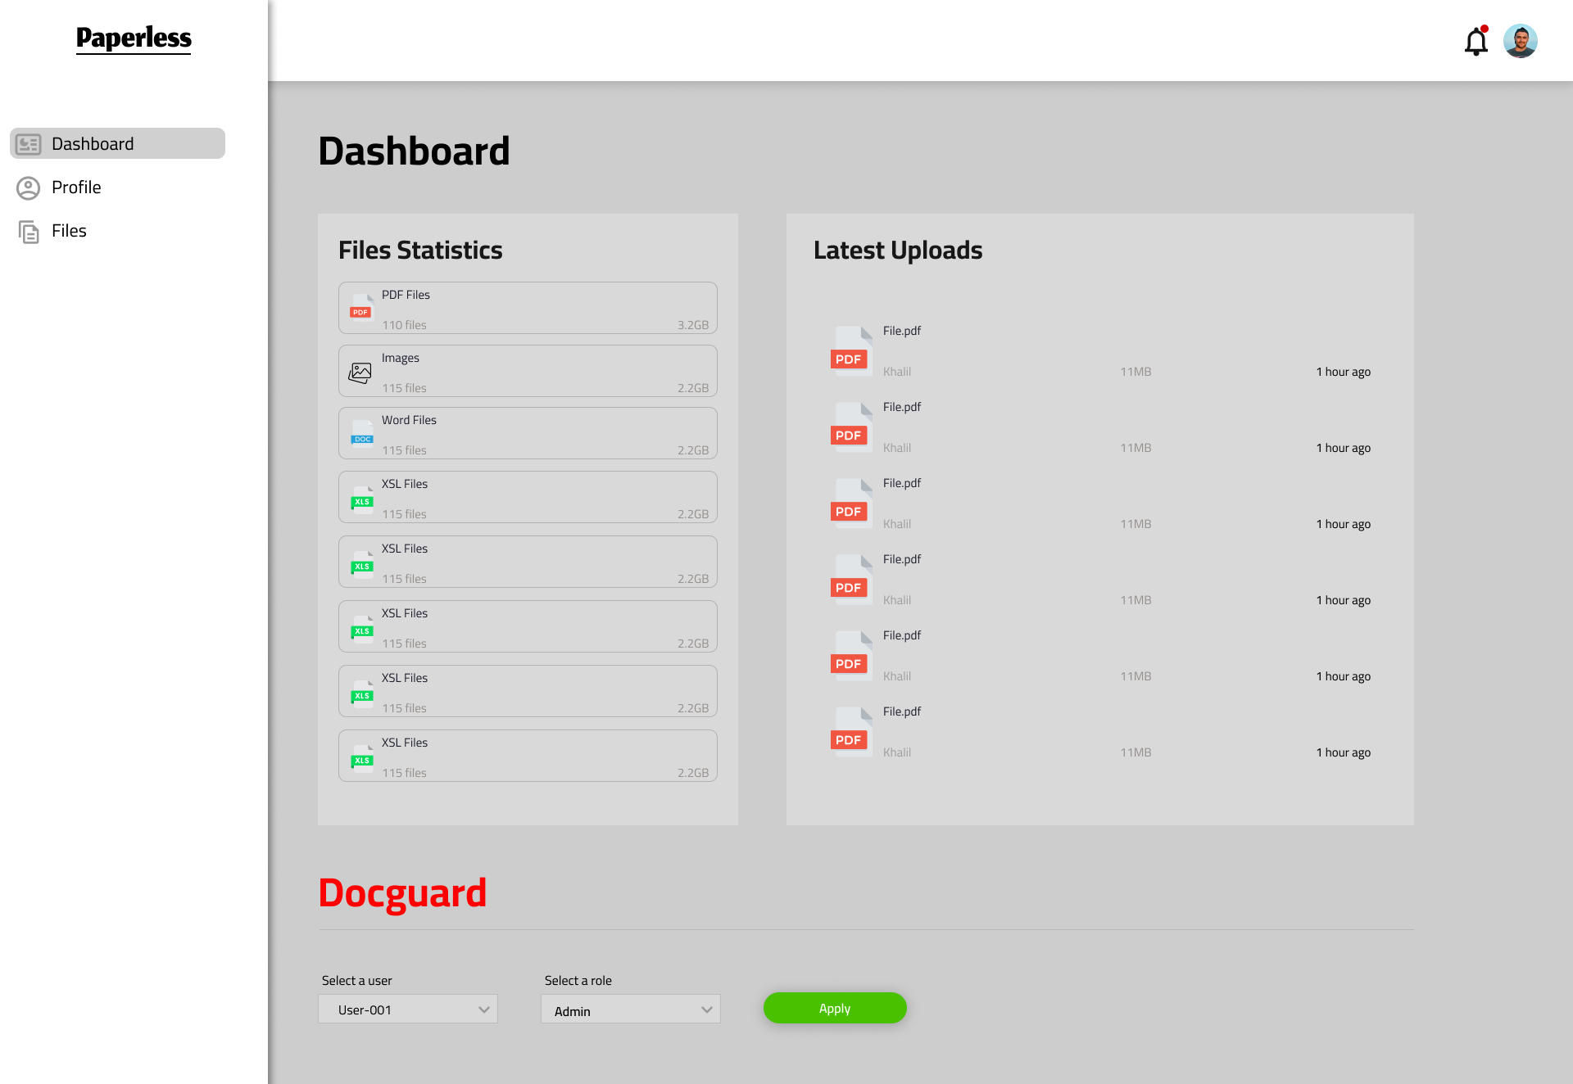

Slide 12
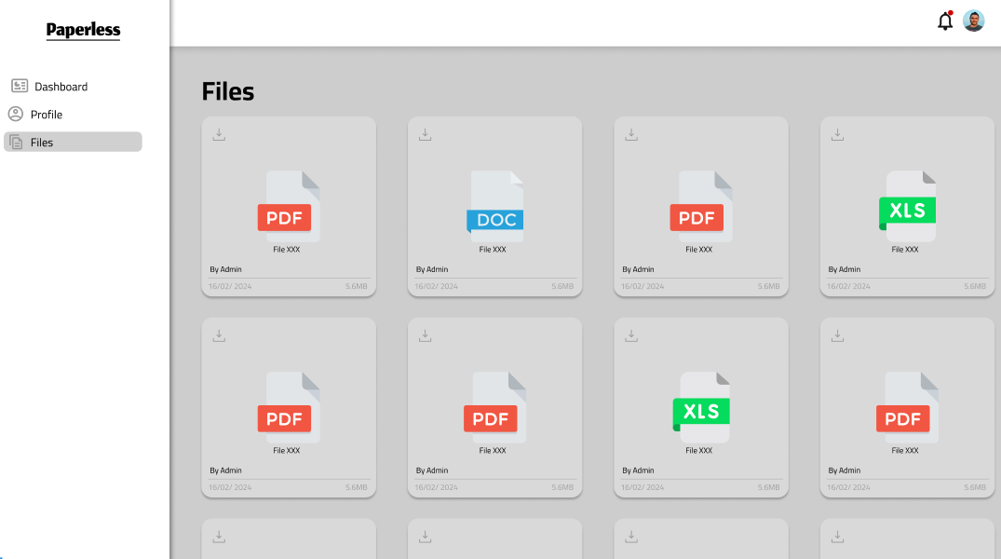

Slide 13
BMC

Slide 14
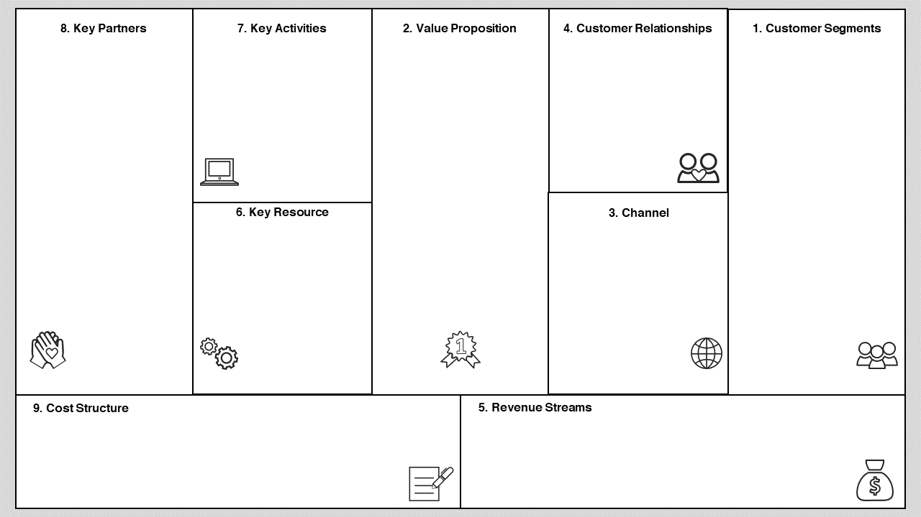
Technology Partners: Collaborations with technology providers can enhance the encrypted DMS's functionality and integrate with existing systems.
Security Experts: Partnerships with security firms can ensure the encrypted DMS adheres to best practices and remains up-to-date with evolving threats.
Channel Partners
Product Development
Marketing and Sales
Customer Onboarding and Support
Security Maintenance
Enhanced Data Security
Improved Regulatory Compliance
Reduced Risk of Data Breaches
Streamlined Access Control
Simplified Document Auditing
Freemium Mode
Dedicated Customer Support
Training and Onboarding
Organizations: Businesses of all sizes across various industries that require secure document management.
Government Agencies: Public sector entities that need to comply with regulations mandating data security for citizen information, public records, and classified documents.
BMC
Secure Document Encryption Technology
User-Friendly DMS Platform
Scalable Infrastructure
Direct Sales
Website
Partnerships
Online Marketplaces
Research and Development - Marketing and Sales
Customer Support - Infrastructure
Software Licensing - Deployment Services
Data Migration Services - Training and Support Services

Slide 15
THANK YOU !!

