Slide 1
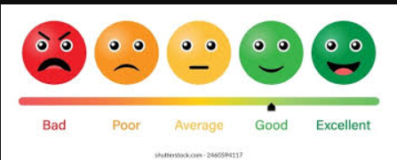
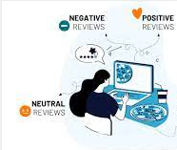
Temporal Sentiment Analysis and Predictive Modeling of Yelp Business Reviews

Slide 2

Agenda:
Introduction
Literature Review & Gaps
Research Questions
Dataset Description
Methodology Overview
Data Preprocessing

Slide 3
Agenda:
EDA & Visualization
Model Building
Results & Discussion
Conclusion
Future Work
References

Slide 4

Introduction:
Yelp reviews influence customer decisions.
Early tools (VADER, TextBlob) → simple polarity.
ML models (SVM, Naive Bayes) → better accuracy, no time factor.
Advanced models (XGBoost, BERT) → context-aware, still static.
Gap: temporal sentiment trends are overlooked.

Slide 5

Literature Review & Gaps
LDA used for topics → ignored temporal shifts.
Collaborative filtering → assumed static preferences.
NLP & ML pipelines → often separate, less robust.

Slide 6
Literature Review & Gaps
Reviews treated as time-independent.
Fragmented pipelines weakened prediction.
No early-warning systems for business decline.

Slide 7

Research Questions:
How do sentiment, ratings, and themes change over time?
Can NLP features predict business decline before ratings drop?
What behavioral patterns appear in long-term user activity?
How do review topics shift with external events (e.g., COVID-19)?

Slide 8
Dataset Description
Source:
Yelp Academic Dataset (reviews, users, businesses)
Sample:
50,000 reviews (2005–2023)
Coverage:
1,200+ businesses, 8,700+ users, 31 U.S. states

Slide 9
Dataset Description
Focus:
California, Arizona, Pennsylvania
Cleaning:
Removed incomplete entries, standardized categories, kept active users
Balance:
Stratified sampling preserved temporal diversity

Slide 10
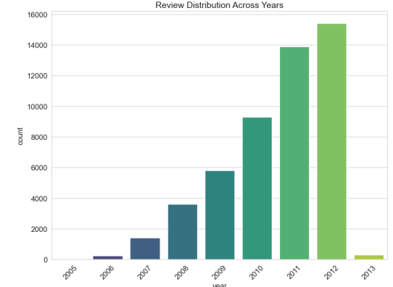
Dataset Description

Slide 11
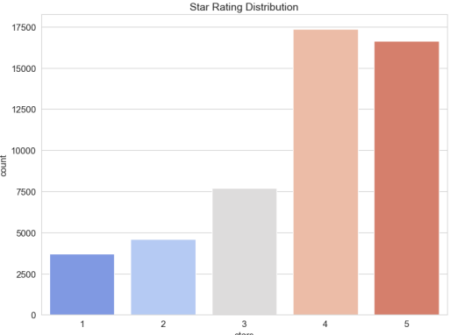
Dataset Description

Slide 12
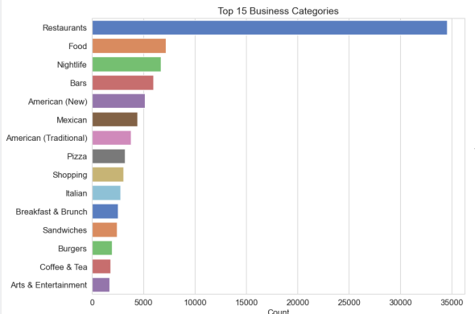
Dataset Description

Slide 13
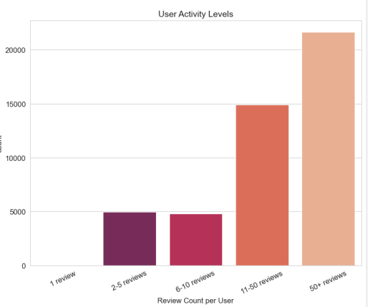
Dataset Description

Slide 14
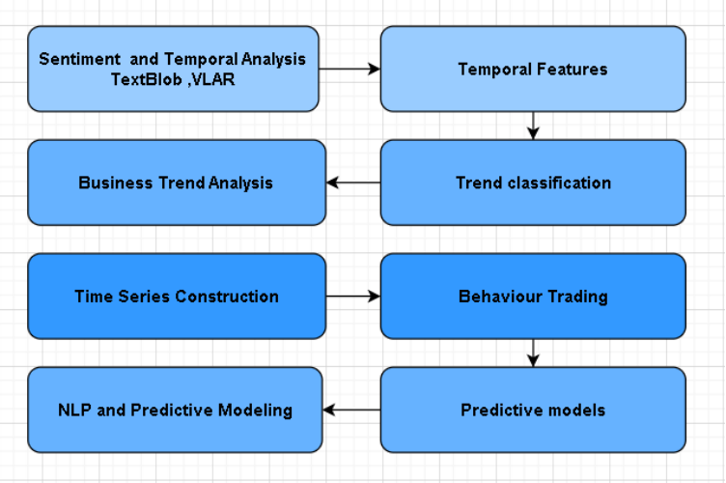
Overview of Methodology:

Slide 15
Exploratory Data Analysis & Visualization:
Sentiment Distribution
Temporal Trends
Review Length
Geographic Coverage
Business Trends

Slide 16
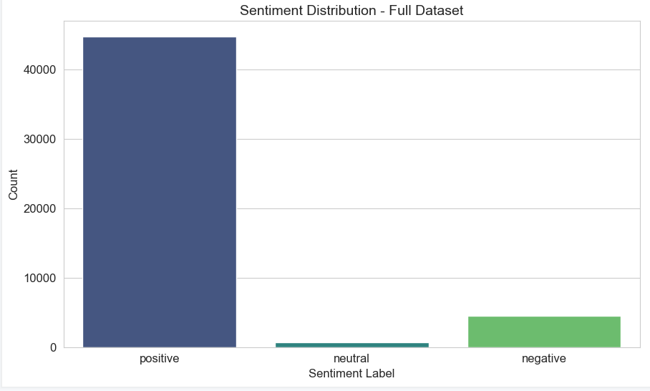
Sentiment Distribution:

Slide 17
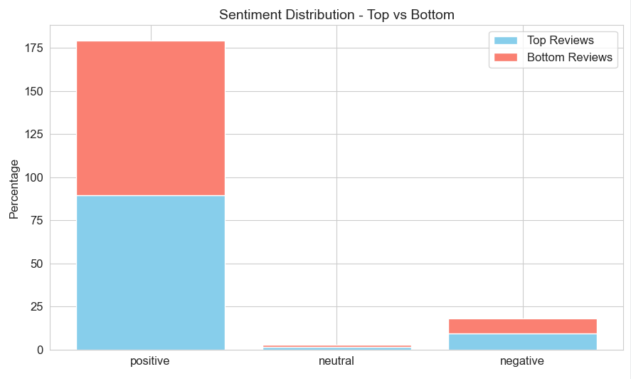
Sentiment Distribution:

Slide 18
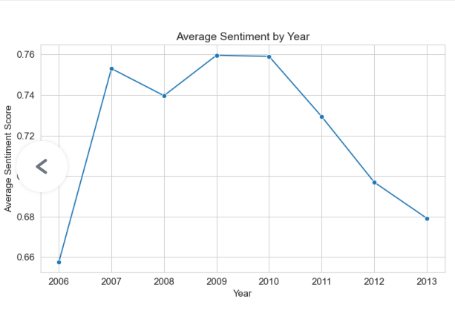
Sentiment Trends Over Time

Slide 19
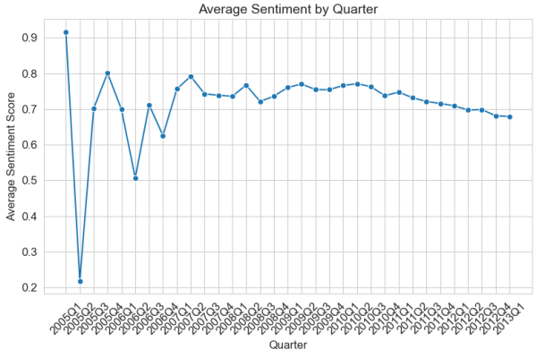
Sentiment Trends Over Time

Slide 20
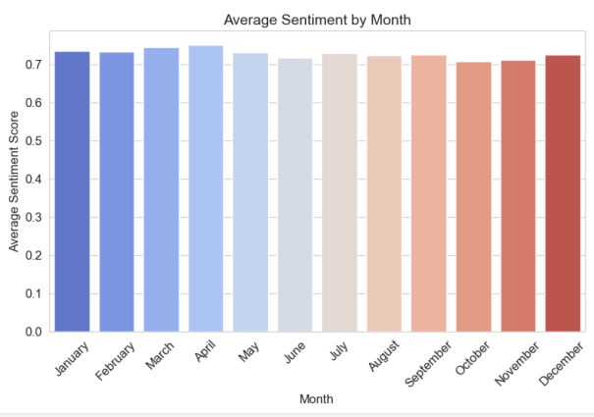
Sentiment Trends Over Time

Slide 21
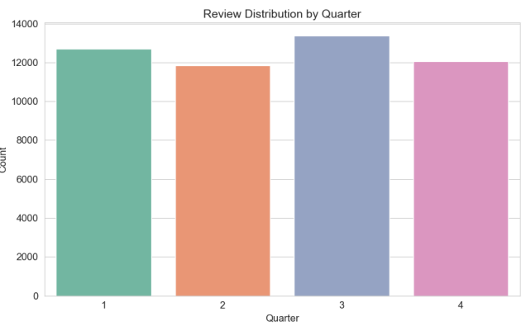
Review Length and Word Count

Slide 22
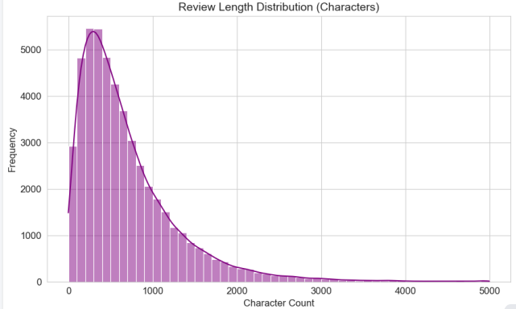
Review Length and Word Count .

Slide 23
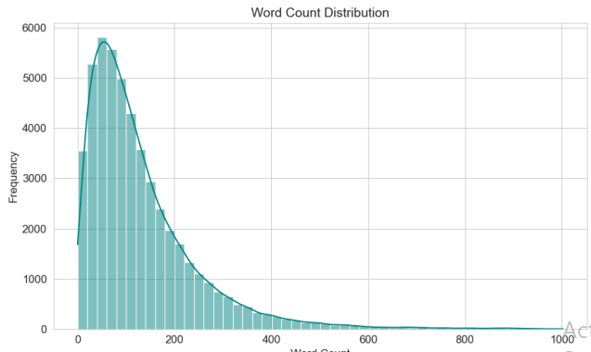
Review Length and Word Count

Slide 24
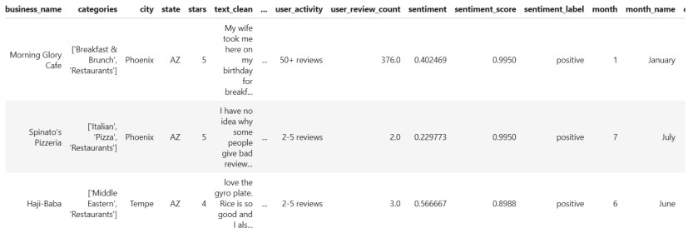
Geographic Distribution of Reviews

Slide 25
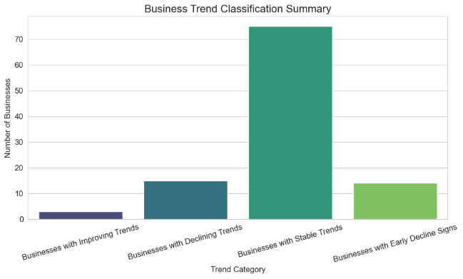
Business Trend Classification ~81% stable, ~15% decline, few improve.

Slide 26
Model Building:
Features: ratings, sentiment, trends
Dimensionality reduction (PCA)
Models: Random Forest, XGBoost
Business decline prediction
User behavior classification
Evaluation: Accuracy, F1, feature importance

Slide 27
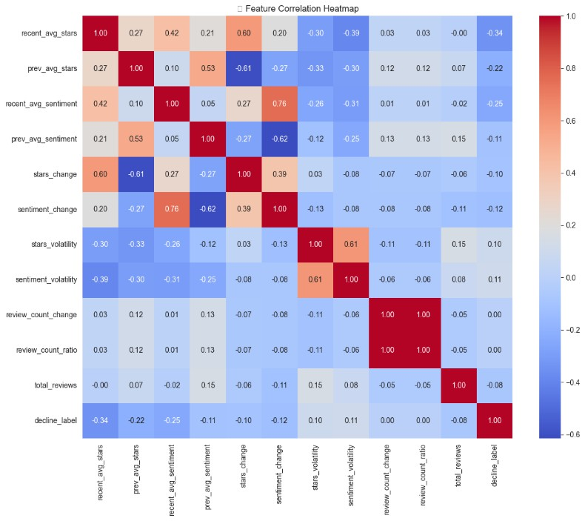
Feature Correlation Heatmap

Slide 28
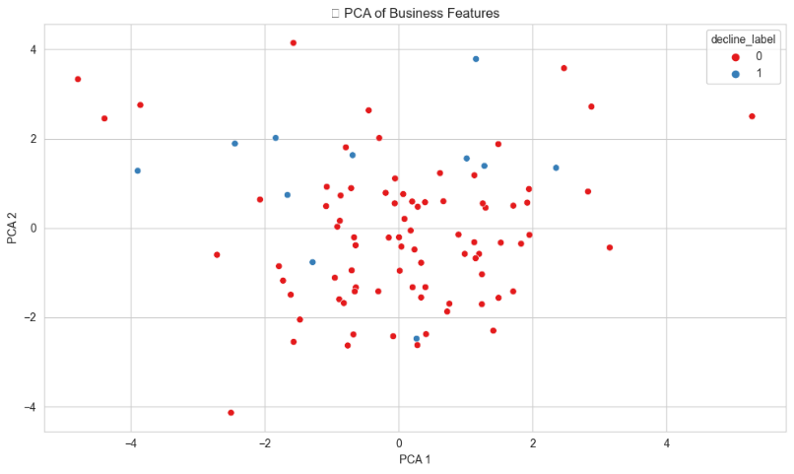
PCA of Business Features

Slide 29
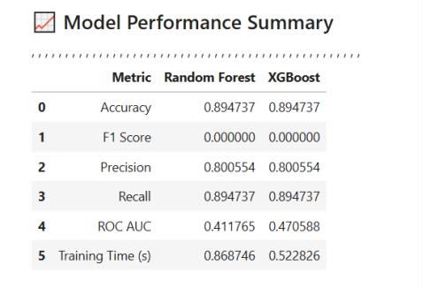
Model Performance

Slide 30
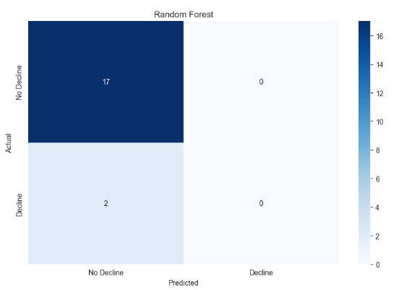
Models Comparison

Slide 31
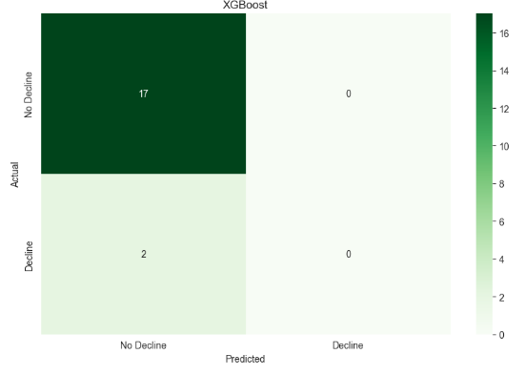
Models Comparison

Slide 32
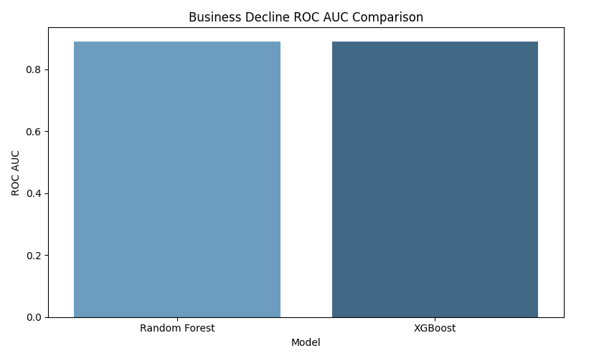
Models Comparison

Slide 33
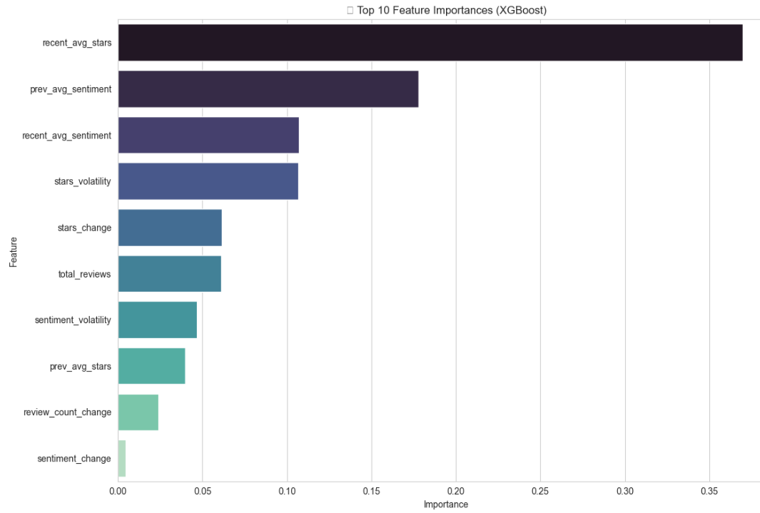
Important Features

Slide 34
Results & Discussion
14% of 5 Star reviews had hidden negatives
Sentiment dropped 6 - 9 months before ratings
Active users more critical after 2020
COVID shifted focus → safety & delivery

Slide 35
Results & Discussion Models & Bias:
Business decline prediction: ~87% accuracy
User behavior classification: ~82% accuracy
Data showed urban bias; rural underrepresented

Slide 36
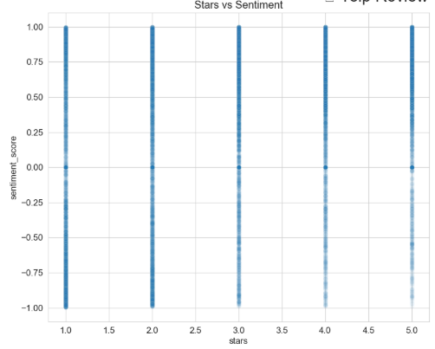
Results & Discussion
14% of 5 Star reviews had hidden negatives
Sentiment dropped 6–9 months before ratings
Active users more critical after 2020
COVID shifted focus → safety & delivery

Slide 37
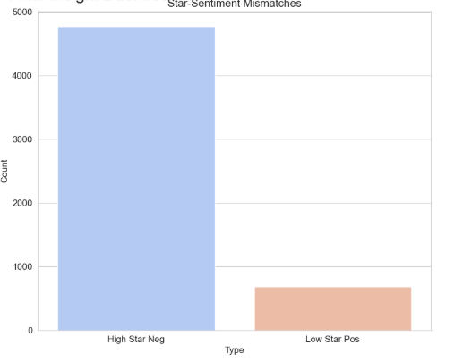
Results & Discussion
14% of 5 Star reviews had hidden negatives
Sentiment dropped 6–9 months before ratings
Active users more critical after 2020
COVID shifted focus → safety & delivery

Slide 38
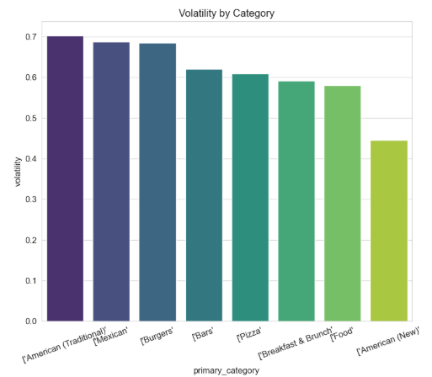
Results & Discussion
14% of 5 Star reviews had hidden negatives
Sentiment dropped 6–9 months before ratings
Active users more critical after 2020
COVID shifted focus → safety & delivery

Slide 39
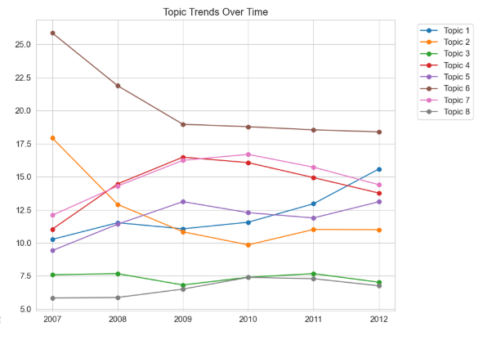
Results & Discussion
14% of 5 Star reviews had hidden negatives
Sentiment dropped 6–9 months before ratings
Active users more critical after 2020
COVID shifted focus → safety & delivery

Slide 40
Results & Discussion
14% of 5 Star reviews had hidden negatives
Sentiment dropped 6–9 months before ratings
Active users more critical after 2020
COVID shifted focus → safety & delivery

Slide 41

Conclusions
Ratings miss hidden negatives (14% in 5⭐)
Sentiment drops before ratings → early warning
23% of users more critical post-2020
Focus shifted to safety & delivery
Sentiment + trends + models = strong monitoring

Slide 42

Future Work
Integrate external data
Apply advanced models (BERT, RoBERTa)
Build real-time dashboards
Cross-platform validation
Study managerial impact

Slide 43


