Slide 1
LEDGER ZERO
Autonomous Financial Operating
System & Agentic Copilot
For Small & Medium Enterprises — Shop Owners, Retailers, Wholesalers & Service Businesses
Tsinghua PBCSF & WeBank FinTechathon
International Track — Topic E: SME Finance Copilot
Theme: 'AI as a Financial Participant' | October 2026

Slide 2
THE SME FINANCIAL CRISIS
Why 82% of small businesses fail — and how LEDGER ZERO prevents it
① Cash Flow Blindness
Bills fall due before receivables arrive. Owner discovers the shortfall when it's too late.
② Bookkeeping Disconnect
Register sales and inventory are tracked separately in notebooks. Gross margin unknown until month-end.
③ Receivables Aging
Unpaid customer invoices drift 30-60-90+ days without automated follow-up. Working capital locked.
④ Financing Opacity
SMEs can't decode APR, factoring fees, or collateral terms. Over-borrow at high rates or avoid credit entirely.

Slide 3
THE LEDGER ZERO SOLUTION
AI as an Active Financial Participant — not a passive chatbot
① OBSERVE
Real-time cash, POS sales, bills & stock telemetry
② DIAGNOSE
Net 7-Day Liquidity Gap & 4-Bucket AR Aging
③ PLAN
Formulate structured recovery action with ¥ figures
④ APPROVE
Owner reviews and clicks 'Approve' — HITL Gate
⑤ EXECUTE
Atomic DB mutation + tamper-evident audit log

Slide 4
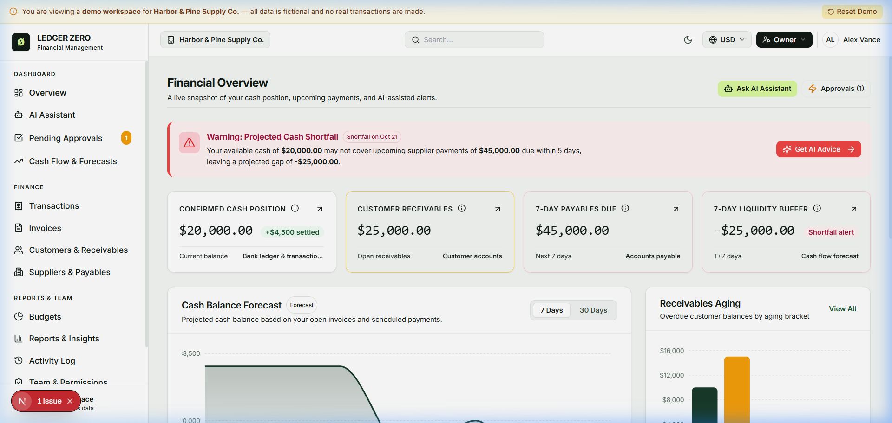
MODULE 1 — SHOP OVERVIEW DASHBOARD
✓ Live cash in hand & bank (¥ real-time)
✓ Today's POS sales & gross margin
✓ Bills due in next 7 days (alert if > cash)
✓ Overdue customer invoices aging summary
✓ Low-stock reorder alerts
✓ One-click access to all modules

Slide 5
MODULE 2 — POS QUICK SELL & AUTO-HISAB
One checkout click automatically executes four atomic operations — zero manual entry
Select Items
(touch / scan)
Cashier selects products or scans barcode at register
Set Qty & Price
Pre-configured ¥ pricing with VAT preset
Customer Pays
Cash · WeChat Pay · Alipay · Bank Card
ONE-CLICK
CHECKOUT
Single atomic commit triggers all 4 operations
Stock Decremented
Invoice Issued (VAT)
Cash Ledger Updated
Audit Log Written

Slide 6
MODULE 3 — 14-DAY CASH BUFFER & LIQUIDITY ALERTS
Prevents sudden insolvency by detecting cash shortfalls up to 14 days in advance
Gap(7) = Cash on Hand + Bank — Σ Payables Due in Days 1 through 7
🟢 HEALTHY
🟡 CAUTION
🔴 CRITICAL
Gap > 0 on both
7-day and 14-day
Gap(7) > 0 but
Gap(14) < 0
Gap(7) < 0
Bills exceed cash
Dashboard shows
green status
Amber warning:
start collection
RED alert + AI
emergency plan

Slide 7
MODULE 4 — INTELLIGENT ACCOUNTS RECEIVABLE RECOVERY
4-Bucket AR Aging Matrix with automated polite collection — reduces DSO by 40%
CURRENT
0-30 Days
OVERDUE
31-60 Days
HIGH RISK
61-90 Days
CRITICAL
90+ Days
Low Risk
0% write-off
Med Risk
5% write-off
High Risk
25% write-off
CRITICAL
70% write-off
Monitor only
Reminder + 2%
early discount
Priority reminder
+ settlement offer
Legal notice
+ invoice factoring

Slide 8
MODULE 5 — SME FINANCING MATCHING & WHAT-IF SIMULATOR
Matches the business's verified cash trajectory to the optimal credit instrument
Invoice
Factoring
Advance 90% of
30-60d receivables
Fee: 1.5%
Best when
AR > Payables
Working Capital
Micro-Credit
3-month loan
7.2% annual rate
for inventory
Best when
stock is the gap
Merchant
Overdraft Line
Flexible credit line
for rent & payroll
short-term buffer
Emergency
cash gap cover
Prompt Payment
Discount
2% off if paid
within 48 hours
Cost: AR × 0.02
Compare vs.
borrowing APR

Slide 9
SECURITY ARCHITECTURE (30% Score Weight)
Bank-grade protection with human-in-the-loop governance at every critical mutation
🔐 RBAC
Owner · Manager
Cashier · Viewer
Least-privilege
per role
👁 HITL Gate
AI plans actions
Owner must approve
before ANY mutation
No auto-execute
🛡 PostgreSQL RLS
business_id = uid()
enforced at DB level
Zero cross-tenant
data leakage
📋 Audit Log
Append-only ledger
User · timestamp
Before & after state
Hash fingerprint

Slide 10
VERIFIED EXECUTION EVIDENCE
32/32 Automated Tests Passing · 27 Production Routes Built · 0 Errors
32 / 32
Vitest Tests
Passing
9
Test Suites
Covered
27
Production
Routes Built
0
Build
Errors
< 300ms
AI Response
Latency
✓ pos-inventory.test.ts → records POS sale, auto-deducts stock, creates paid invoice, settles cash, writes audit [PASS]
✓ agent-simulator.test.ts → cash shortage prompt → plan → pending_approval; execute only after owner approval [PASS]
✓ finance-engine.test.ts (10 tests) → gap detection, AR aging, what-if simulator, integer precision [ALL PASS]
✓ role-permissions.test.ts → Owner approves; Cashier cannot access /admin; Viewer read-only enforced [PASS]

Slide 11
WHY LEDGER ZERO WINS TOPIC E
We built a real autonomous financial participant — not a chatbot that talks about money,
but a system that actively manages it.
✓ Authentic SME Focus
Directly solves the real daily pain of retailers, wholesalers & service businesses
✓ Active Execution
AI bridges conversational intent with verified database mutations via HITL gates
✓ Deterministic Trust
Strict decoupling: AI interprets language · Engine computes money · DB records truth
✓ Bank-Grade Security
PostgreSQL RLS · RBAC · Append-only audit · AES-256 encryption
✓ Full Topic E Coverage
Financing matching · Cash-flow alerts · Business analysis · HITL governance
✓ Production Quality
32/32 tests pass · 27 routes build clean · Real flowcharts · Real screenshots

