Slide 1
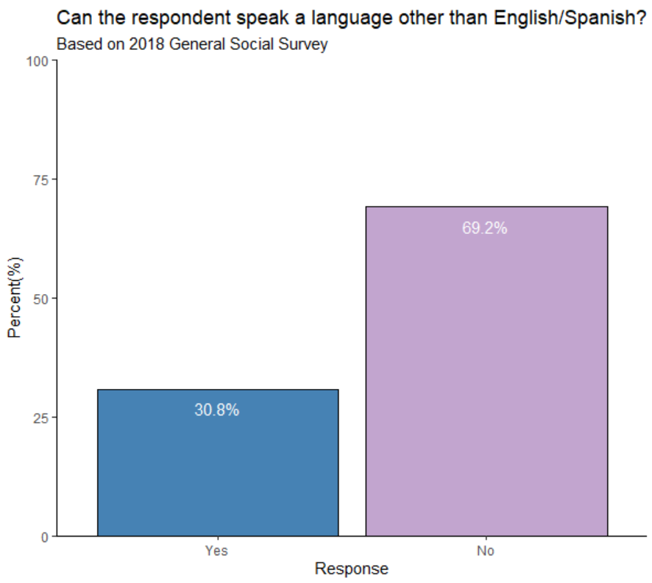

Slide 2
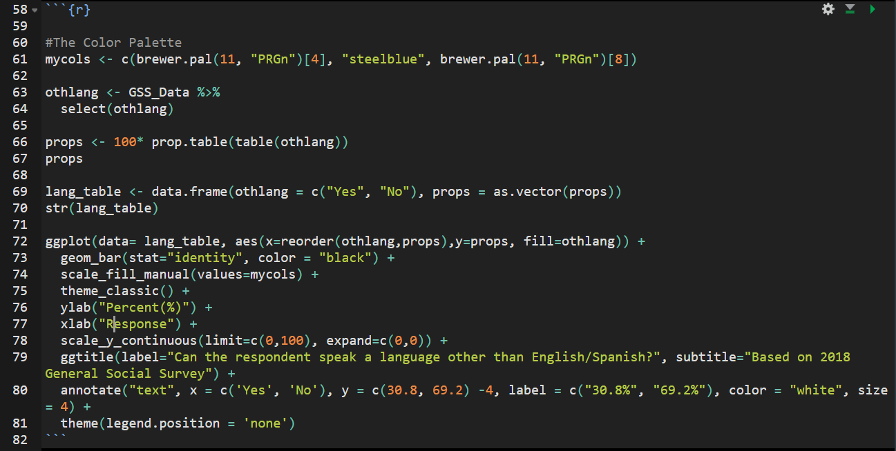
The x parameter of annotate() needs to be spelled exactly the same, and in the same order as the factors. Otherwise, it will add 2 new points to the x axis. Also, the size parameter does not scale with stretching, so if you are going to expand your image, make sure you test a few times.

Slide 3
The graphic had a redundant legend that needed to be removed. Legend.position = ‘none’ is the easiest way to remove the legend by far.

