Slide 1
Python Web Programming
Shafayat Bin Shabbir Mugdha

Slide 2
Today’s Topic
Day 2: Python Programming – Part 1
Ø Data Types
Ø Conditional Statements
Ø Loop Basics

Slide 3
Data Types

Slide 4
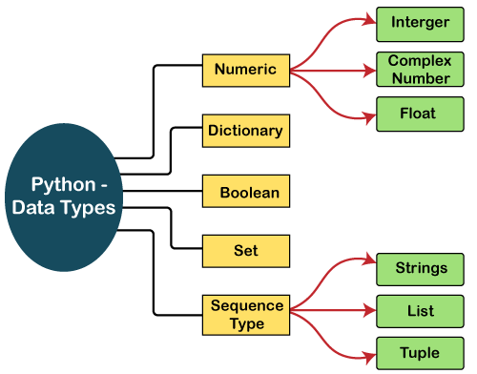

Slide 5
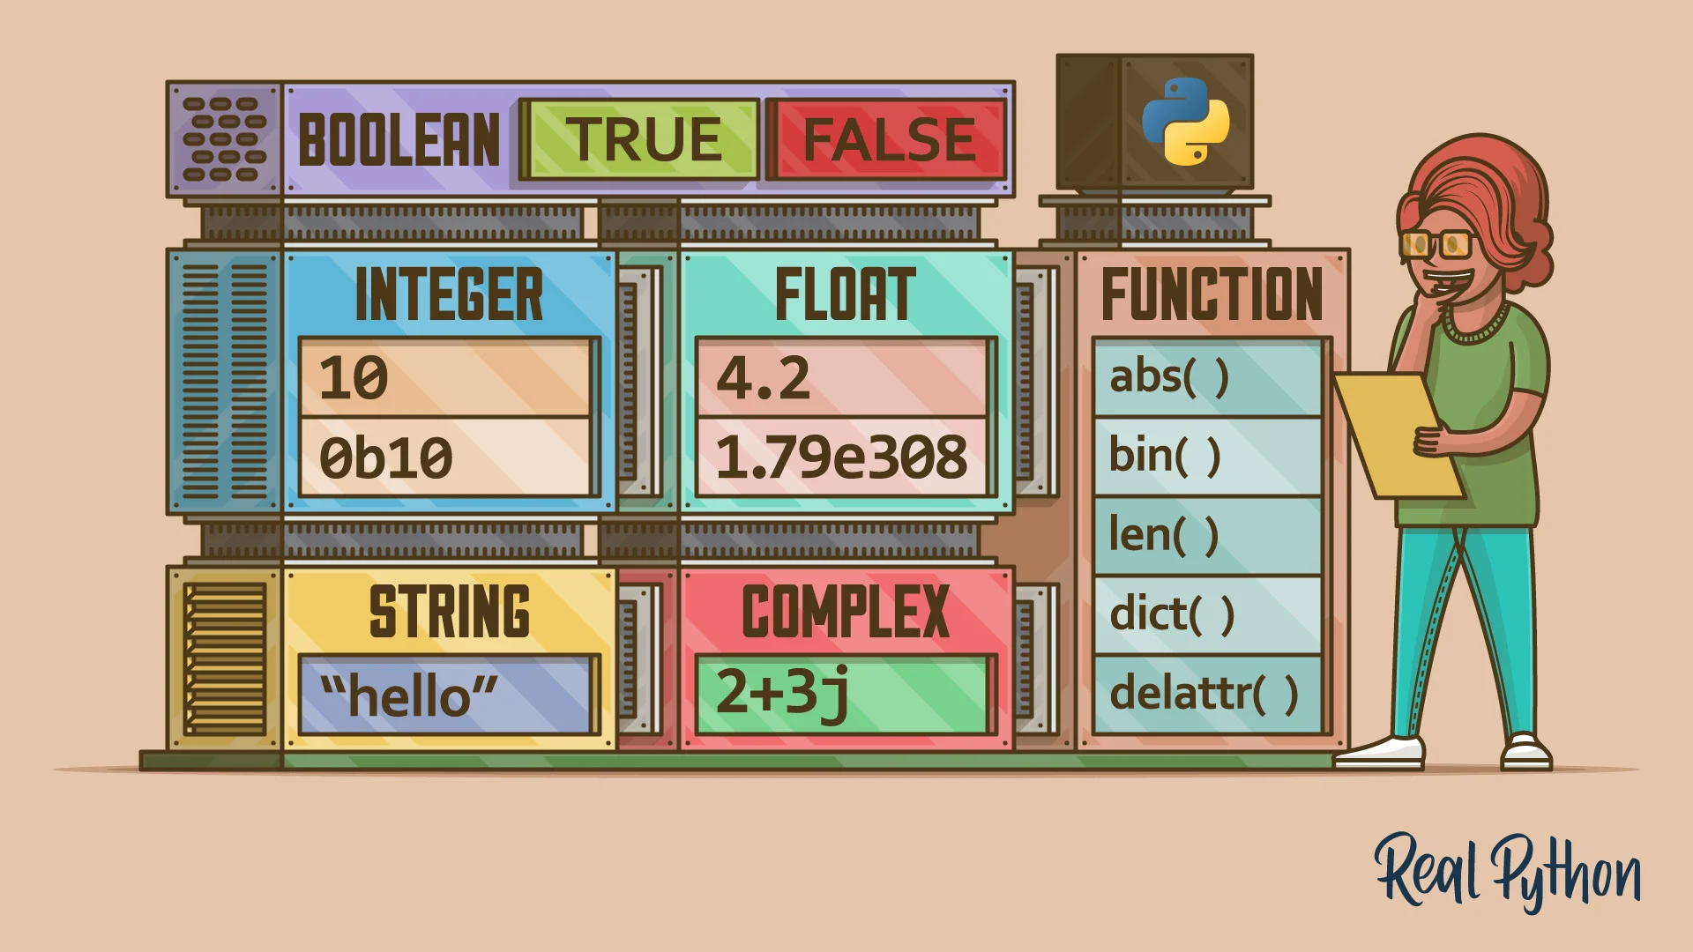

Slide 6
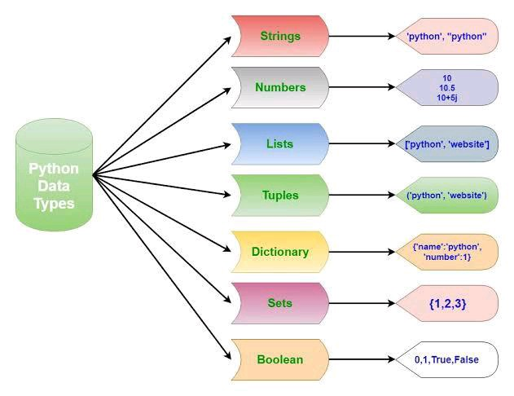

Slide 7
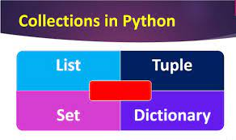
List is a collection which is ordered and changeable. Allows duplicate members.
Tuple is a collection which is ordered and unchangeable. Allows duplicate members.
Set is a collection which is unordered, unchangeable*, and unindexed. No duplicate members.
Dictionary is a collection which is ordered** and changeable. No duplicate members.
Python Collections (Arrays)

Slide 8
List
thislist = ["apple", "banana", "cherry"]
print(thislist)
print(len(thislist ))
print(type(thislist ))
Lists are used to store multiple items in a single variable.
Lists are created using square brackets.
It is also possible to use the list() constructor when creating a new list.
thislist = list(("apple", "banana", "cherry"))
print(thislist)

Slide 9
Access List Items
thislist = ["apple", "banana", "cherry"]
print(thislist[1])
Negative indexing means start from the end. -1 refers to the last item, -2 refers to the second last item etc.
thislist = ["apple", "banana", "cherry"]
print(thislist[-1])
Range of Indexes
thislist = ["apple", "banana", "cherry", "orange", "kiwi", "melon", "mango"]
print(thislist[2:5])

Slide 10
Change, Add, Remove List Items
Change
thislist = ["apple", "banana", "cherry"]
thislist[1] = "blackcurrant"
print(thislist)
Remove
thislist = ["apple", "banana", "cherry"]
thislist.remove("banana")
print(thislist)
Add
thislist = ["apple", "banana", "cherry"]
thislist.append("orange")
print(thislist)

Slide 11
Dictionary
thisdict = {
"brand": "Arong",
"style": "Shirt",
"year": 1994
}
print(thisdict)
print(thisdict["brand"])
print(len(thisdict))
print(type(thisdict))
Dictionaries are used to store data values in key:value pairs.
A dictionary is a collection which is ordered*, changeable and do not allow duplicates.

Slide 12
Conditional Statement

Slide 13
If Else
Equals: a == b
Not Equals: a != b
Less than: a < b
Less than or equal to: a <= b
Greater than: a > b
Greater than or equal to: a >= b

Slide 14
Loop
With the while loop we can execute a set of statements as long as a condition is true.
With the for loop we can execute a set of statements, once for each item in a list, tuple, set etc.
Python has two primitive loop commands
while loops
for loops

Slide 15
Lecture highlights
Data Types
Conditional Statements
Loop Basics

