Slide 1
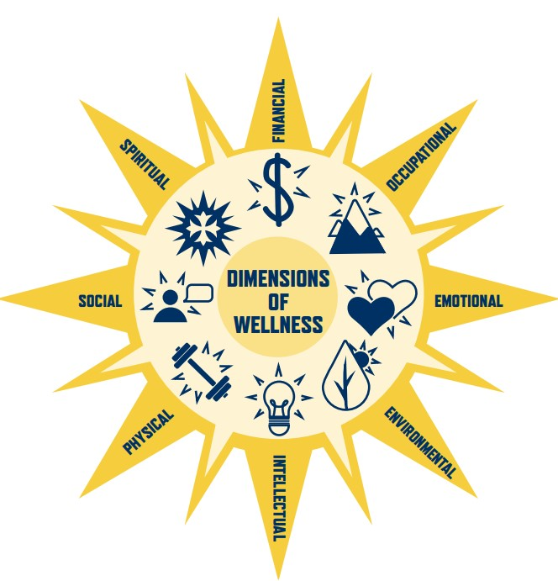
WELLNESS & HEALTHCARE
Presented By- NAIM RAHMAN IFTI AFIA ZAMAN

Slide 2
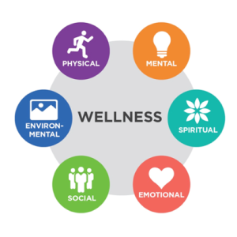
What is wellness and healthcare?
Wellness: Focuses on the whole person, addressing physical, mental, and social well-being, not just the absence of illness.
Healthcare:
Focuses on the diagnosis, treatment, and management of diseases and medical conditions.

Slide 3
INTRODUCTION
A One-Stop Destination for Wellness: Our website is a central hub for all your wellness needs. It offers a wealth of information, resources, and tools designed to empower you to take control of your health.
Informative Content Community Features
Access articles, blogs, and guides Connect with others on similar paths covering various health topics, and share experiences, fostering a sense including nutrition, fitness, mental of support and motivation.
health, and more.

Slide 4
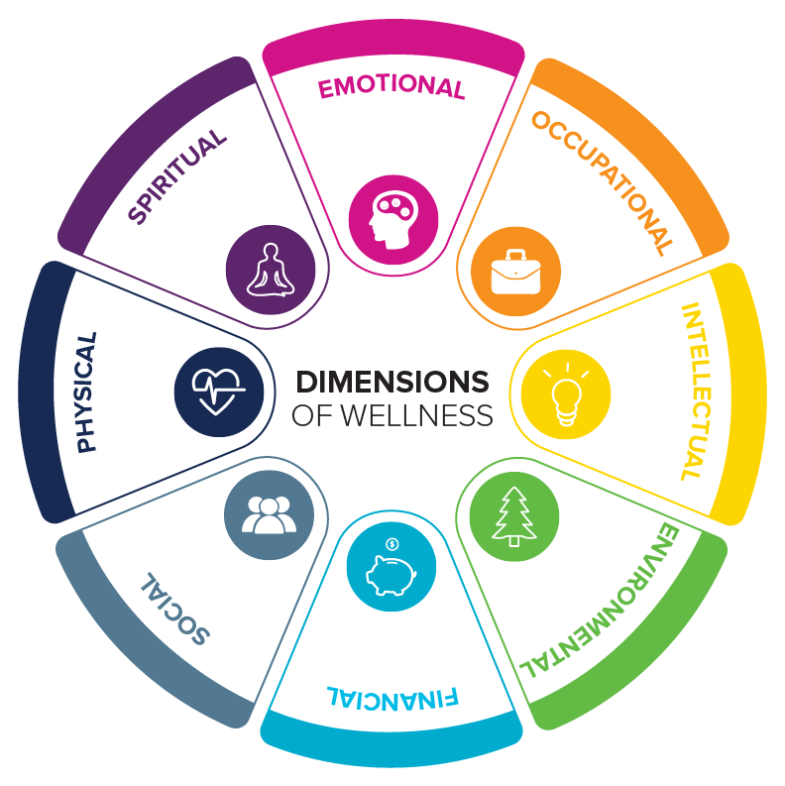
Key Features of the Website
The website will be designed with a user-centric approach, ensuring a seamless and enjoyable experience for all users.
Personalized Experience
Tailored content and recommendations based on your individual needs and preferences.
Secure Platform
Protecting your privacy and ensuring secure access to your personal health information.

Slide 5
Integrating Website and Chatbot: A Comprehensive Solution
The website and chatbot work in harmony, providing a seamless and comprehensive experience. They complement each other, offering a holistic approach to wellness and healthcare.
– Website | – Chatbot
1. Informative content | 1. Personalized guidance
2. Interactive tools | 2. Instant support

Slide 6
Engaging with the Chatbot: Personalized Guidance and Support
Initial Interaction
Introduce yourself and your health goals to the chatbot.
Personalized Responses
Receive customized advice and recommendations based on your unique needs.
Integrated Resources
Access website content and tools through the chatbot for a comprehensive experience.

Slide 7
The Future of Wellness and Healthcare: Embracing Technology
We believe that technology has the potential to revolutionize the way we approach wellness and healthcare.
Personalized Care
- Tailored health recommendations and insights based on individual needs.
Artificial Intelligence
- Advanced algorithms for data analysis, prediction, and personalized interventions.
Global Accessibility
- Expanding reach and making health information and support accessible to all.

Slide 8
Thank you

