Slide 1
HallHub
HallHub
Problem
Solution
Features
Future
Hall
Hub
Venue Booking & Management System
Mission:
“Making venue discovery and booking simpler, faster, and more organized.”
HallHub
01 / 05

Slide 2
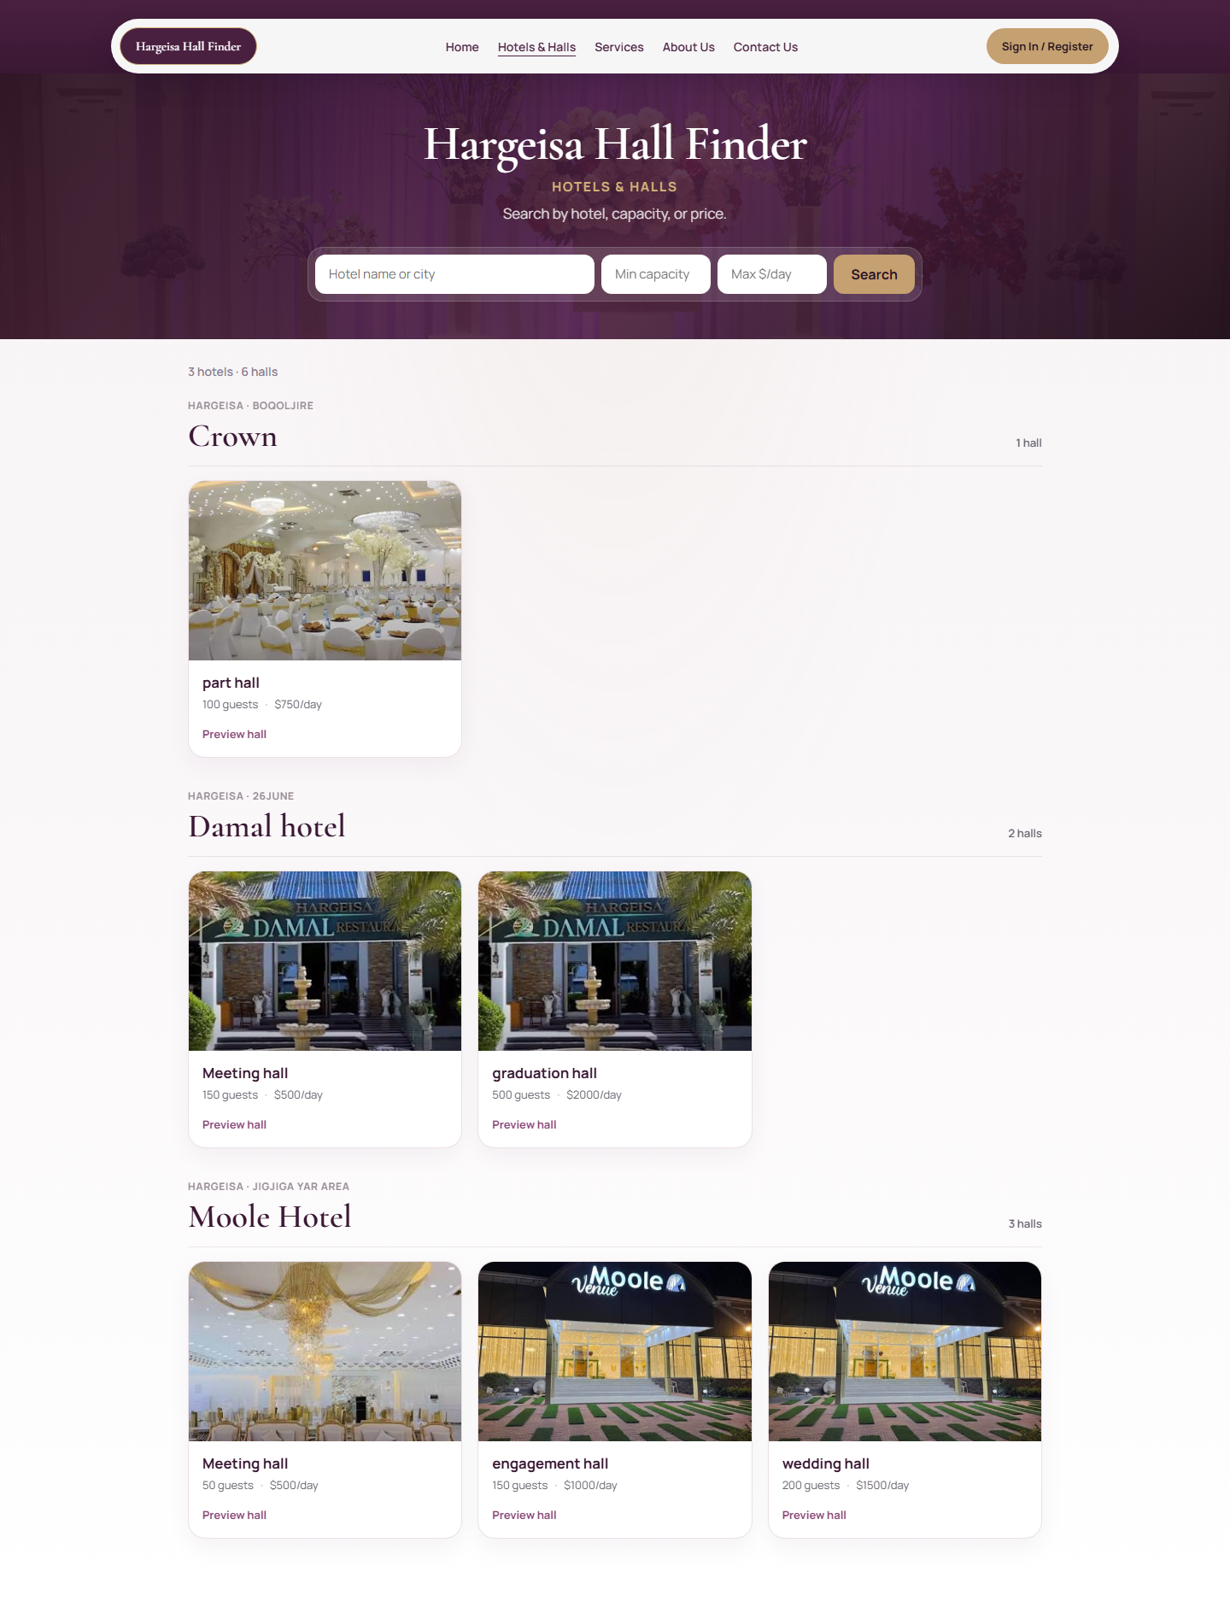
HallHub
HallHub
Problem
Solution
Features
Future
The Problem
Key Challenges Faced
Lack of Venue Information
Time-Consuming Venue Search
Difficult Booking Processes
HallHub
02 / 05

Slide 3
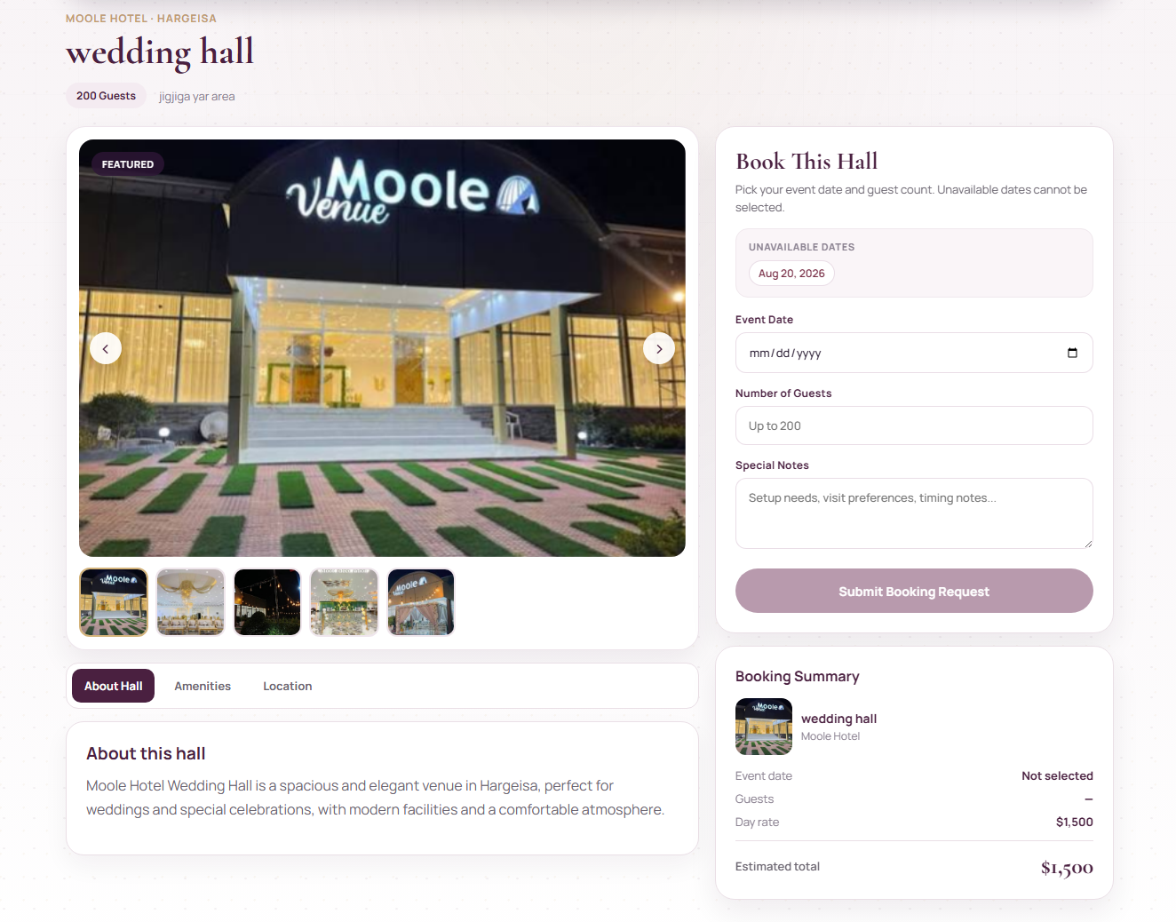
HallHub
HallHub
Problem
Solution
Features
Future
Our Solution
Key Solutions
Centralized Venue Information
Easy Availability Checking
Streamlined Booking Management
HallHub
03 / 05

Slide 4
HallHub
HallHub
Problem
Solution
Features
Future
Three main features
Customer
Search & Book Halls
Hotel Owner
Manage Halls & Bookings
Admin
Manage Users & Approve Hotels
HallHub
04 / 05

Slide 5

HallHub
HallHub
Problem
Solution
Features
Future
Future enhancement
Online Payment
Booking Commission
HallHub
05 / 05

