Slide 1

HallHub
Problem
Values
Market
Revenue
Advantage
Product
Vision
Hall
Hub
Venue Booking & Management System
“Making venue discovery and booking simpler, faster, and more organized.”
Telesom Academy — Graduation / Final Project Presentation
Presented by: Naima Muse Ahmed (Team Lead) & HallHub Team
HallHub
01 / 08

Slide 2
HallHub
HallHub
Problem
Values
Market
Revenue
Advantage
Product
02 — PROBLEM & SOLUTION
Bridging the gap between venues and event organizers
THE PROBLEM
THE SOLUTION
Manual, fragmented venue booking
Unified venue booking & management
Finding an event hall currently requires visiting multiple hotels, making endless phone calls, and dealing with manual paper coordination.
HallHub connects customers directly with approved hotels while providing hotel owners with tools to manage halls, bookings, appointments & reports.
• Finding suitable event halls is difficult and time-consuming
• Customers lack centralized details on pricing, capacity & amenities
• Checking real-time venue availability requires multiple visits
• Traditional booking processes are manual, slow, and inefficient
• Hotel owners lack modern digital tools to manage halls & schedules
• One centralized platform for venue discovery and comparison
• Real-time hall details, pricing, capacities, amenities & photos
• Streamlined booking requests with date-conflict prevention
• On-site inspection appointment scheduling before finalization
• Dedicated owner portal for managing halls, bookings & reports
HallHub
02 / 08

Slide 3
HallHub
HallHub
Problem
Values
Market
Revenue
Advantage
Product
Vision
03 — VALUE PROPOSITION
Delivering value for both customers and venue owners
FOR CUSTOMERS
FOR HOTEL OWNERS
Effortless Venue Discovery
End-to-End Venue Management
• Discover multiple verified halls in one centralized platform
• Search & filter based on capacity, budget, amenities & location
• View transparent hall details, pricing, photos & availability
• Submit and track booking requests with date-conflict protection
• Schedule in-person inspection appointments before confirmation
• Significantly reduces the time, cost, and effort to find a venue
• Manage hotel profile, multiple halls, pricing & photo galleries
• Review and manage all incoming bookings from one dashboard
• Accept, reject, confirm, and manage customer booking requests
• Schedule customer inspection visits and save meetup notes
• Automated calendar locking prevents accidental double-bookings
• Access operational analytics, revenue summaries, and reports
CORE DIFFERENTIATOR
“HallHub connects venue discovery and venue management in one platform.”
HallHub
03 / 08

Slide 4
HallHub
HallHub
Problem
Values
Market
Revenue
Advantage
Product
Vision
04 — TARGET MARKET
Serving the growing demand for digital event venue management
Event Organizers
Hotels & Venues
Market Scope
Individuals & Organizations
Venue Owners & Managers
Local Foundation → Regional
• Wedding parties and family celebrations
• Corporate meetings, seminars & workshops
• University & school graduation ceremonies
• Community forums, conferences & dinners
• Seek fast comparisons, clear pricing & dates
• Hotels with banquet, conference & party halls
• Independent event centers and wedding venues
• Seeking to transition from manual to digital tools
• Need expanded market visibility across the city
• Require tools to eliminate double-booking risks
• High frequency of year-round social & business events
• Initially focused on Hargeisa’s active hospitality sector
• Strong potential to scale to other cities and regions
• First-mover advantage in digitized venue ecosystems
• Two-sided ecosystem: Customers ↔ HallHub ↔ Venue Owners
HallHub
04 / 08

Slide 5
HallHub
HallHub
Problem
Values
Market
Revenue
Advantage
Product
Vision
05 — REVENUE STREAMS
Current business model and future monetization roadmap
CURRENT REVENUE MODEL
FUTURE REVENUE STREAMS (PLANNED)
HallHub Plus ⭐ (Subscription)
Growth & Monetization Roadmap
Hotel & hall owners subscribe to HallHub Plus to significantly increase visibility.
Future enhancements not currently implemented in the system:
• Featured Venue Badge on listing cards to establish credibility
• Higher placement in search, filter results, and venue directory
• Homepage featured placement reaching high-intent event organizers
• Additional profile photos & high-resolution gallery showcases
• Premium analytics & performance reporting tools
• Model: Hotel Owner → HallHub Plus Subscription → Increased Visibility
• Online Payments: Enable digital deposit and payment processing directly on HallHub (e.g. mobile money / card integration)
• Booking Commission: Once online payments are implemented, earn a percentage from completed transactions (e.g., 5% fee)
• Event Service Advertising: Paid placement for third-party event professionals seeking clients:
– Photographers & videographers
– Decorators, florists & sound/lighting teams
– Caterers, wedding planners, DJs & makeup artists
HallHub
05 / 08

Slide 6
HallHub
HallHub
Problem
Values
Market
Revenue
Advantage
Product
Vision
06 — COMPETITIVE ADVANTAGE
Positioning HallHub in the venue management landscape
EXISTING ALTERNATIVES
HALLHUB ADVANTAGE
Current Market Landscape
A Shared Two-Sided Ecosystem
• Individual Hotel Software: Proprietary tools that only serve a single hotel brand
• Manual Coordination: In-person visits, direct phone calls, and informal chat messaging
• Fragmented Experience: Customers must contact hotels one by one to compare terms
• Lack of Verification: Information can be outdated, with no centralized oversight
• Limited Discovery: Smaller and newer venue halls lack equal exposure to customers
• Multi-Venue Marketplace: Browse and compare multiple approved hotels in one place
• Full Venue Management: Hotel owners get comprehensive operational software
• Admin Trust Verification: Every hotel and hall is vetted before appearing publicly
• Standardized Booking: Consistent request, scheduling, and confirmation flow
• Level Playing Field: Quality halls gain visibility regardless of hotel marketing budget
MARKET POSITIONING
“Individual Hotel System → Focuses on one hotel. HallHub → Connects multiple venues with customers through one platform.”
HallHub
06 / 08

Slide 7
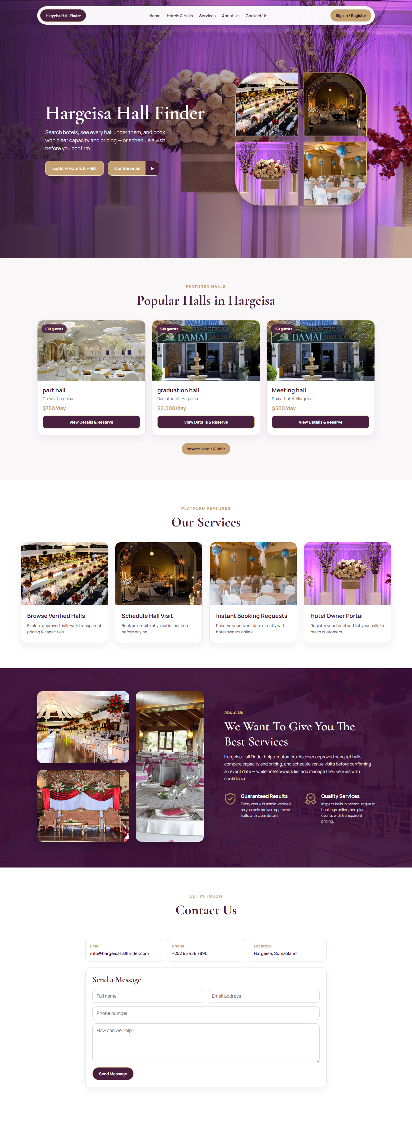
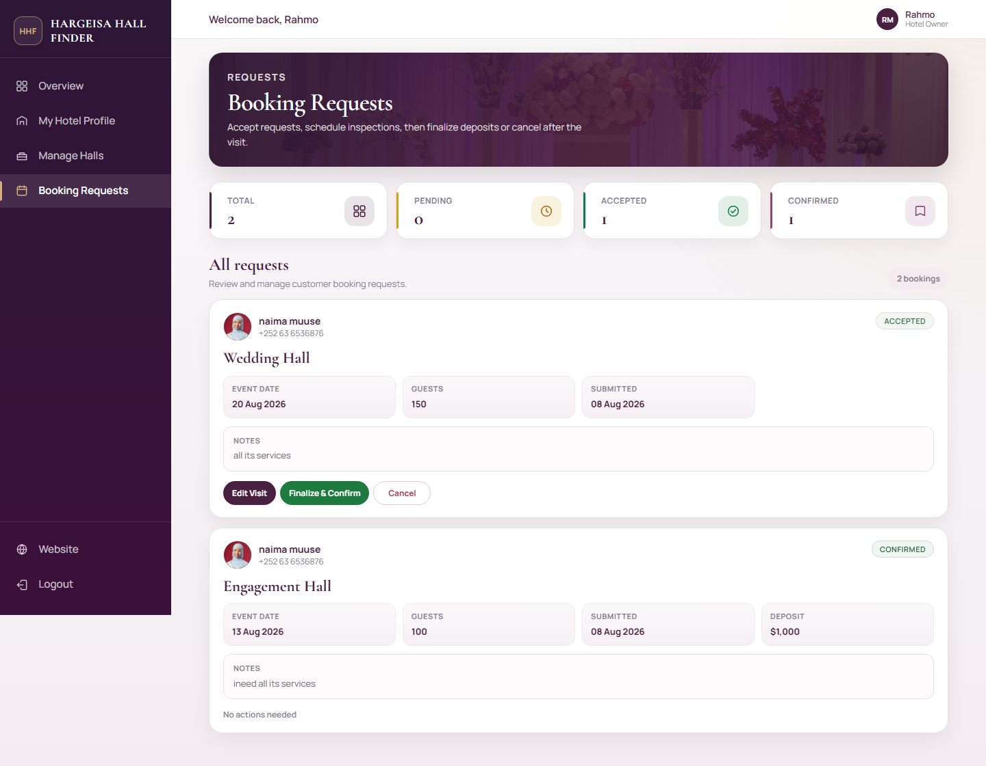
HallHub
HallHub
Problem
Values
Market
Revenue
Advantage
Product
Vision
07 — PRODUCT OVERVIEW
How HallHub works: from venue discovery to confirmation
USER JOURNEY & WORKFLOW
Step-by-Step Booking Lifecycle
1. Search & Discover Venues
Browse verified hotels, filter by guest capacity, amenities & price.
2. View Hall Details & Real-Time Availability
Inspect photos, check event calendar availability, and venue rules.
3. Submit Booking Request
Customer submits event date, guest count, and special requirements.
4. Hotel Owner Reviews Request
Accepts or rejects the booking request with instant status update.
5. Schedule Inspection Visit
Coordinate an in-person hall meetup with time & location notes.
6. Finalize & Confirm Booking
Owner records deposit collected & generates official PDF invoice.
THREE INTEGRATED PLATFORM ROLES
Customer (Browse & Book) | Hotel Owner (Manage & Confirm) | Admin (Vetting & Oversight)
HallHub
07 / 08

Slide 8
HallHub
Problem
Values
Market
Revenue
Advantage
Product
Vision
CURRENT HALLHUB (DEPLOYED)
FUTURE HALLHUB (ROADMAP)
Core Operational Platform
Full Event Planning Ecosystem
• Venue discovery with search, capacity & price filters
• End-to-end booking lifecycle & appointment scheduling
• Customer, Hotel Owner, and Administrator portal accounts
• Automated double-booking prevention & PDF invoice generation
• Operational & revenue analytics dashboards
• HallHub Plus premium visibility subscription model
• Integrated online payment processing (mobile money & cards)
• Transactional booking commission model (e.g. 5% fee)
• Third-party event service advertising directory
• Photographers, decorators, caterers, DJs & makeup artists
• Cross-city expansion across Somaliland and regional hubs
• Evolution into an all-in-one digital event marketplace
“HallHub aims to evolve from a venue booking platform into a complete digital ecosystem for planning and managing events.”
HallHub — Find Your Venue. Plan Your Event.
HallHub
08 / 08

