Slide 1
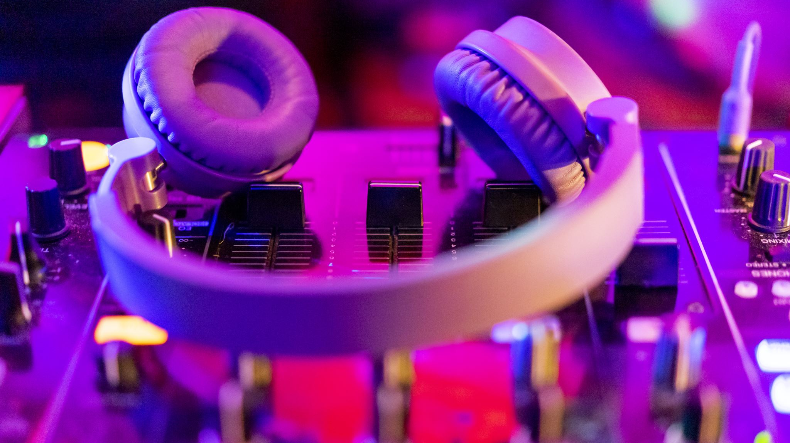
Do people mean what they say
BTS ALBUM REVIEWS
Naïma Sawadogo

Slide 2
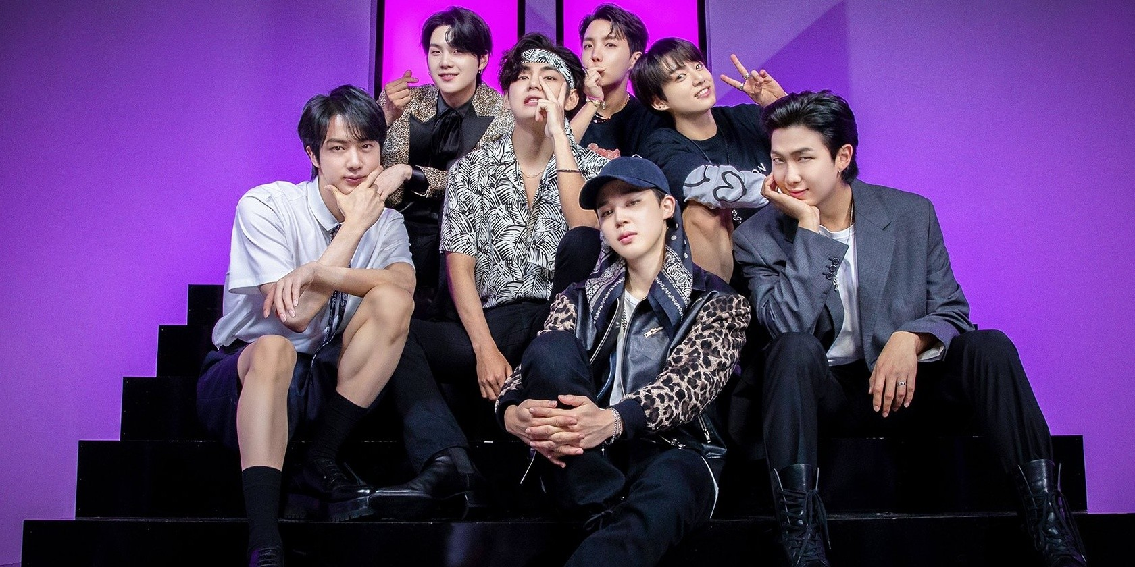
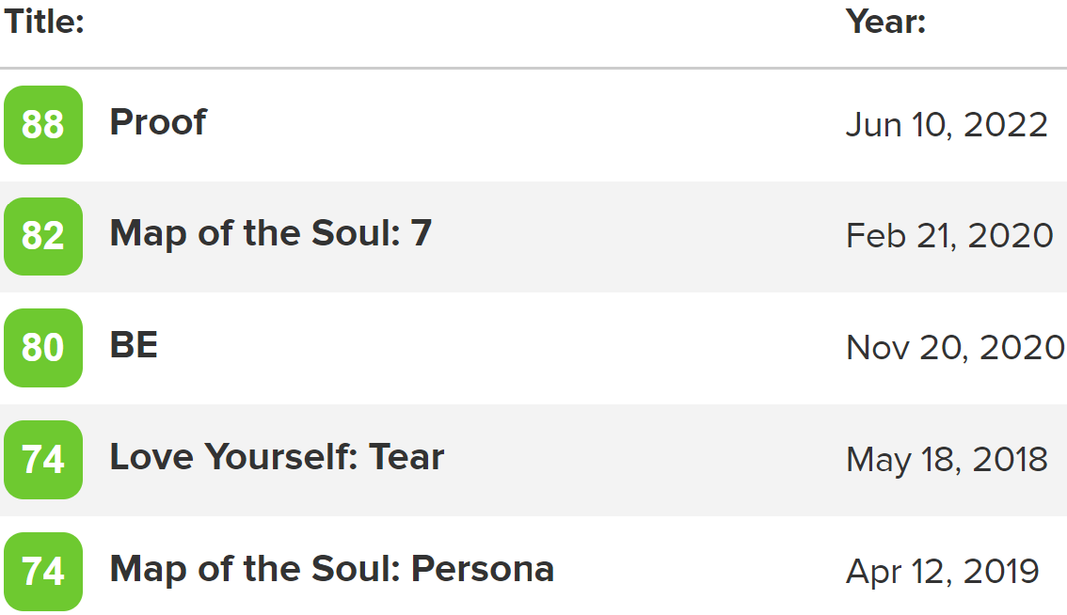
Subject Matter

Slide 3

Exploration motivations
Does the general public opinion agree with the critics' reviews
Are those opinions consistent with reviews grades

Slide 4
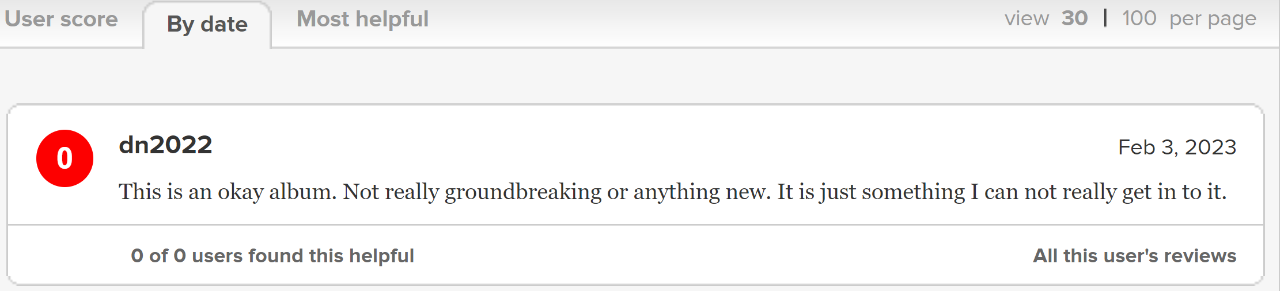
Scrapped information

Slide 5
Methodology
10055
05/24/2018 – 02/08/2023
Sentiment analysis
Grouped by day to 320 observations
Comparison plot

Slide 6
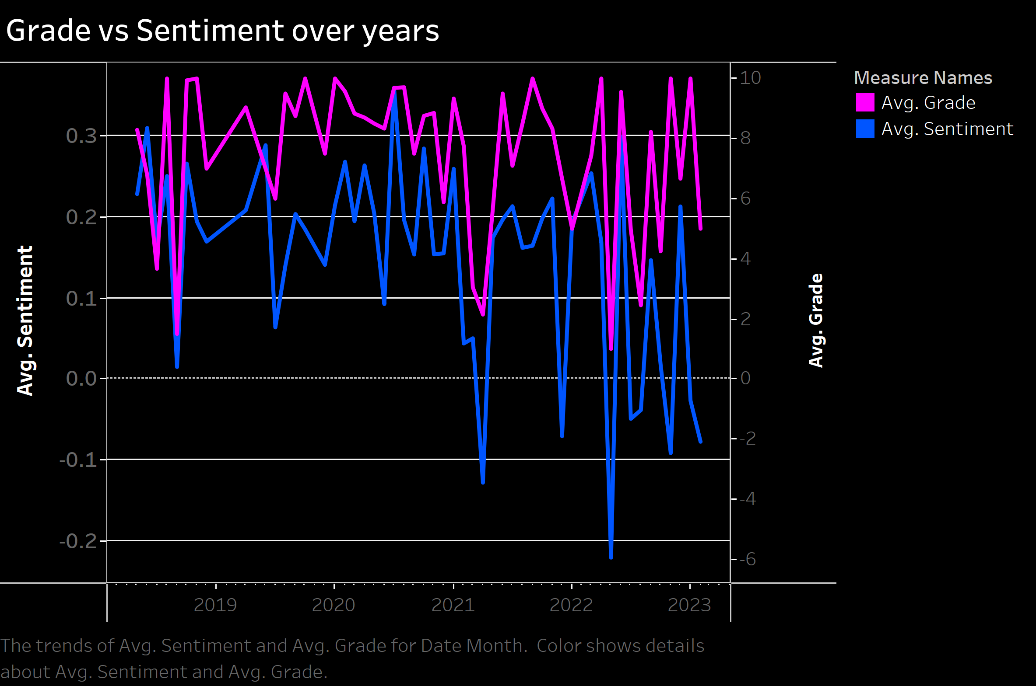

Slide 7
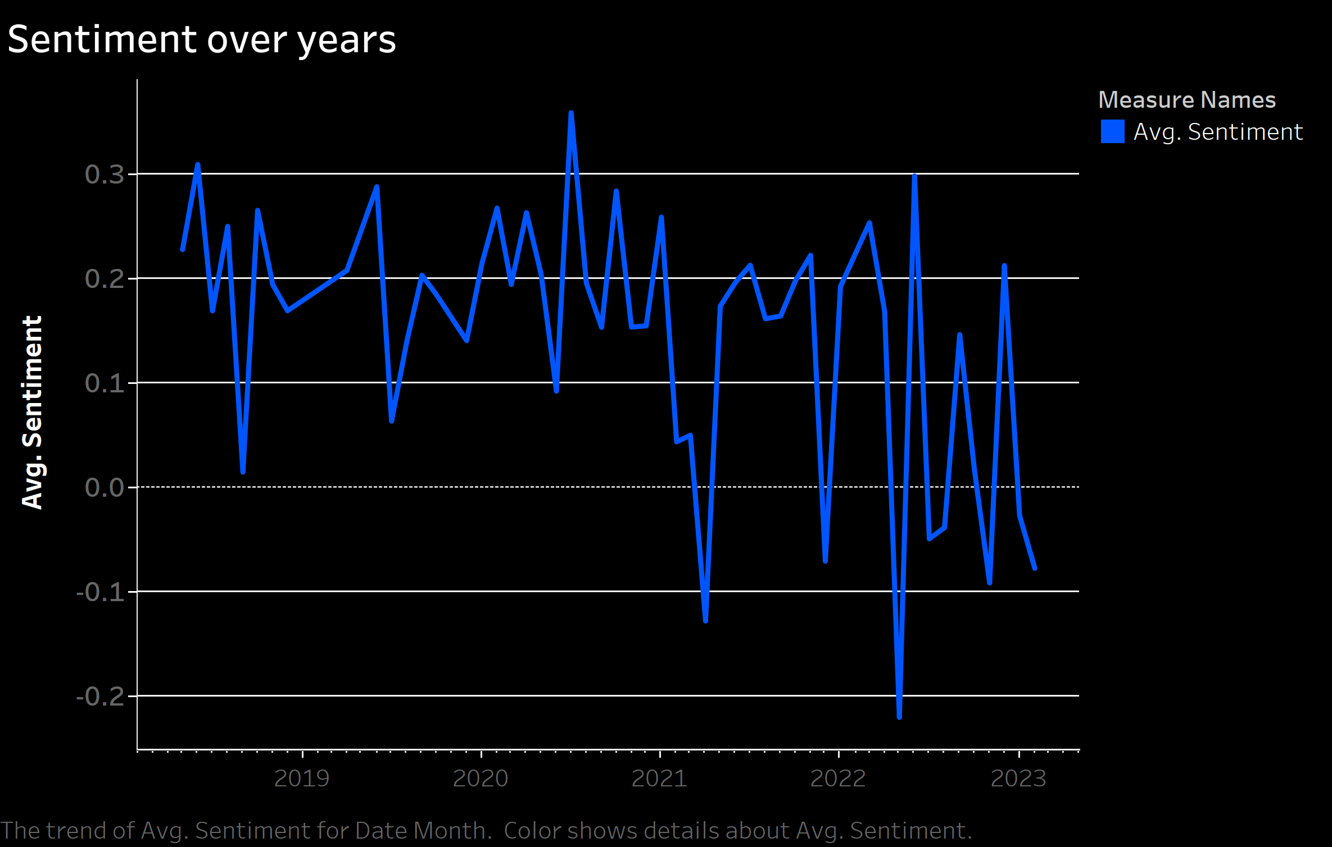

Slide 8
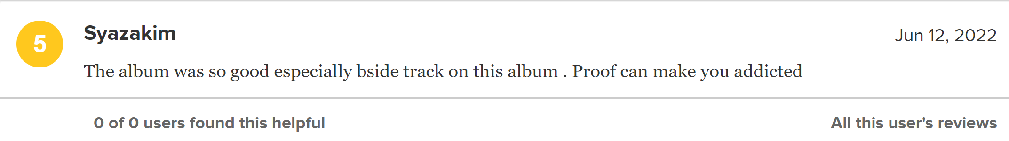
Are users harder to please?

Slide 9
Take Aways
Critics reviews do not always go hand to hand with users' sentiment
01
With every success, user expectation increases
02
It is worth investigating deeper to see if those conclusion apply to other type of reviews, like movies and products …

Slide 10
Thank you

