Slide 1
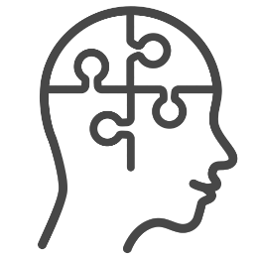

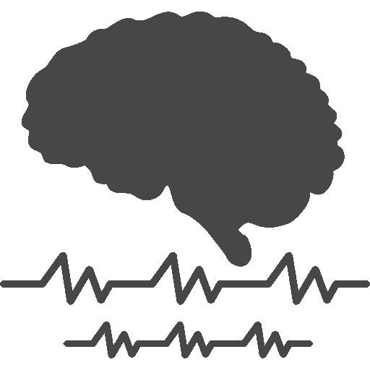
Compared to low recallers, high dream recallers show:
PREVIOUS WORKS
PRESENT THESIS
Higher interest in dreams, openness to experience, anxiety and creativity
Higher creativity
Higher rCBF in the DMN during sleep and wakefulness
Higher functional connectivity in the DMN at rest and upon awakening
Larger brain responses to stimuli during sleep and wakefulness
Longer duration of intra-sleep awakenings

