Slide 1
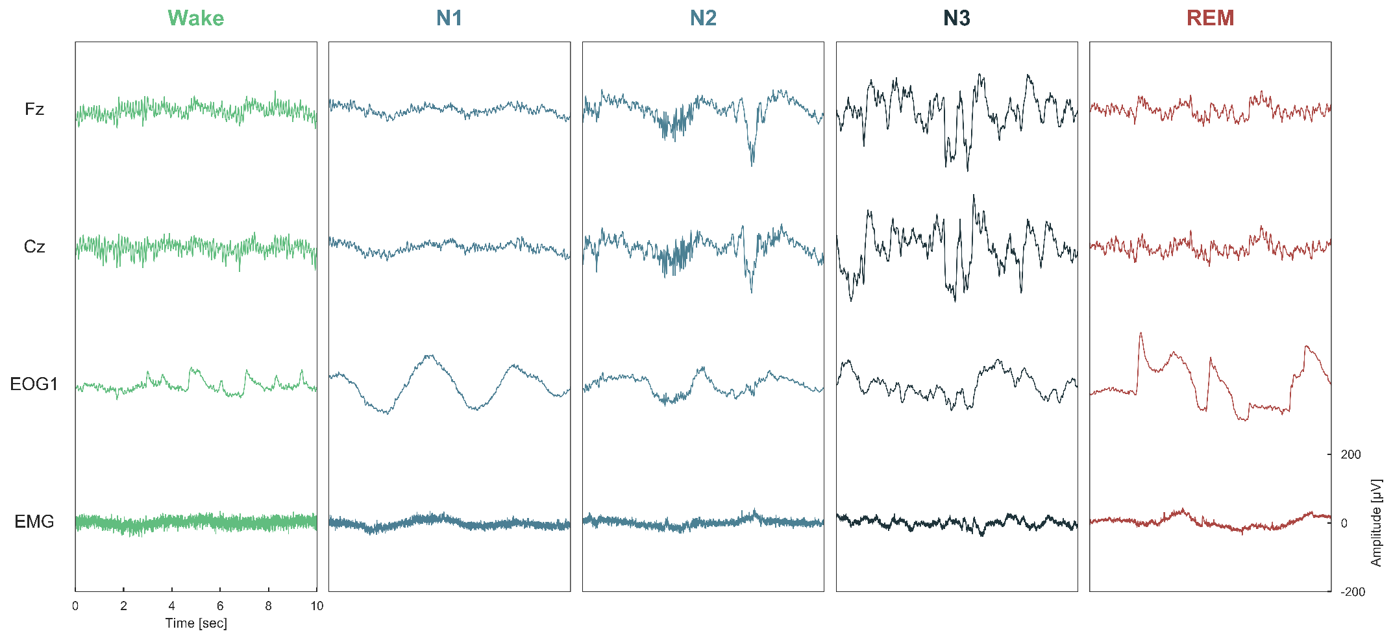
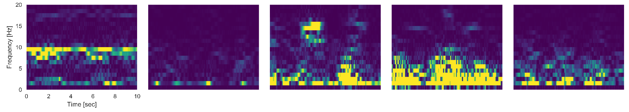
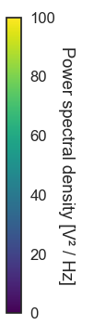
Fz
Alpha rhythm
K-complex
Cz
Rapid eye
Movements
Spindles
Delta waves
EOG
High muscular
activity
Slow eye
movements
Muscular
atonia
200
Amplitude [µV]
EMG
0
0
2
4
6
8
10
-200
0
Time [sec]
Frequency [Hz]
20
Cz
Alpha (8-12 Hz)
Delta (0.5-4 Hz)
Theta (4 –7 Hz)
15
10
5
0
0
2
4
6
8
10
0
Time [sec]

Slide 2
Alpha rhythm
K-complex
Rapid eye
Movements
Spindles
Delta waves
High muscular
activity
Slow eye
movements
Muscular
atonia
200
Amplitude [µV]
0
0
2
4
6
8
10
-200
0
Time [sec]
Amplitude [µV]
20
Cz
Alpha (8-12 Hz)
Delta (0.5-4 Hz)
Theta (4 –7 Hz)
15
10
5
0
0
2
4
6
8
10
0
Time [sec]

