Slide 1
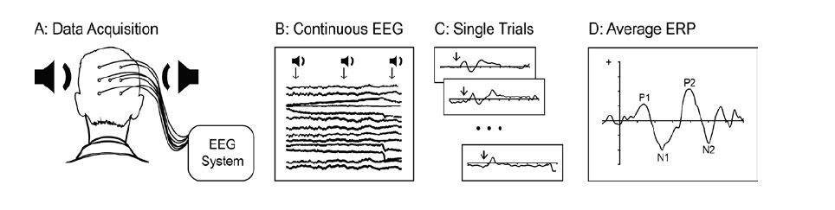
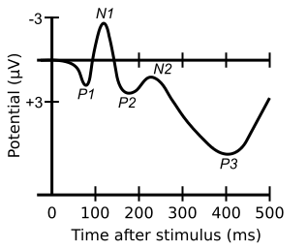
1) Data acquisition
2) Continuous EEG
3) Single trials
4) Average ERPs

