Slide 1
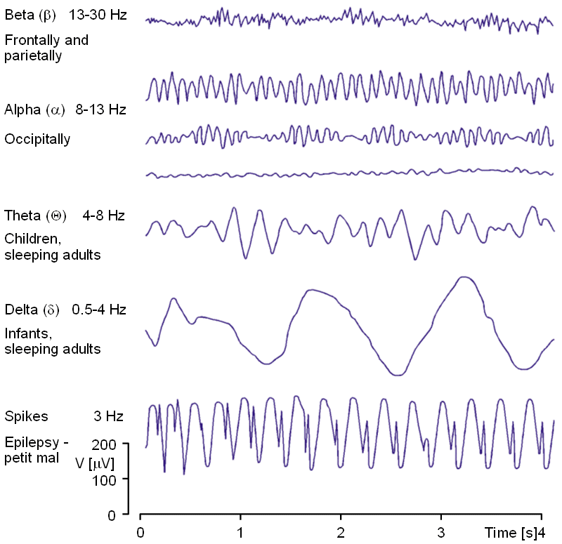
Beta
[12-30 Hz]
Alpha
[8-12 Hz]
Theta
[4-8 Hz]
Delta
[1-4 Hz]
Time
1 sec

