Slide 1

CONTENU ET FRÉQUENCE DU RAPPORT DE RÊVE.
Approches comportementales et neurophysiologiques.
Raphaël Vallat
Université Claude Bernard Lyon 1,
Centre de Recherche en Neurosciences de Lyon,
Équipe Dynamique Cérébrale et Cognition
Soutenance de thèse
8 décembre 2017

Slide 2
Introduction
Dream recall
Dream content
Software
Conclusion
Outline
General introduction on dreaming
Mechanisms of dream recall frequency (DRF)
Studies 1–4
Dream content and dream function
Study 5
Methodological development
Study 6
General conclusion
R. Vallat – Ph.D. Oral Defense – December 8th 2017
Outline

Slide 3
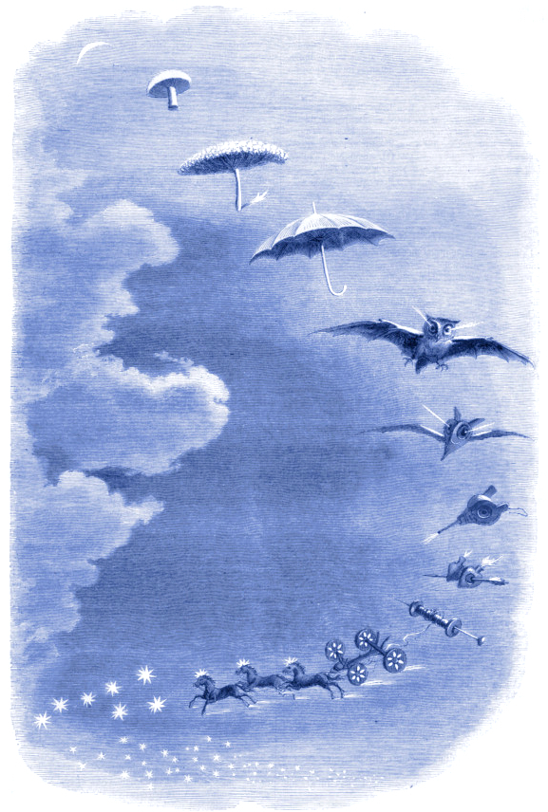
INTRODUCTION
What is dreaming?
When does it occur during sleep?
Does it have a function?
Why such variability in dream recall?
— Jean-Jacques Grandville
Second rêve: une promenade dans le ciel. 1847

Slide 4
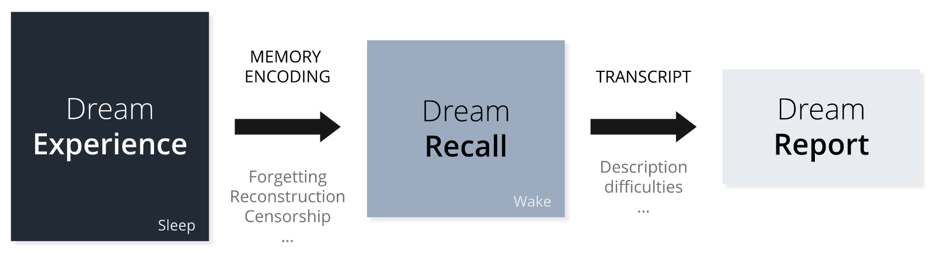
Introduction
Dream recall
Dream content
Software
Conclusion
What is dreaming?
Dreaming is a mental experience during sleep which can be recalled and reported at wake.
Guénolé 2009; Schwartz et al. 2005
R. Vallat – Ph.D. Oral Defense – December 8th 2017
Introduction

Slide 5
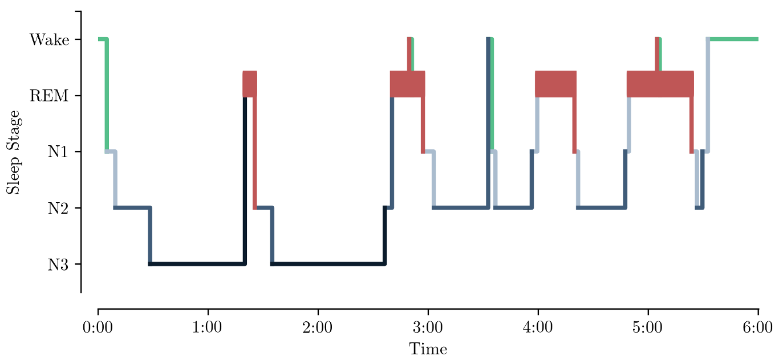
Introduction
Dream recall
Dream content
Software
Conclusion
When does it occur during the night?
Dreaming can occur in all sleep stages
R. Vallat – Ph.D. Oral Defense – December 8th 2017
Introduction

Slide 6

Introduction
Dream recall
Dream content
Software
Conclusion
When does it occur during the night?
Dreaming can occur in all sleep stages
It is impossible to know for sure whether someone asleep is dreaming or not unless awakening him or her.
Even after awakening the sleeper, we cannot be sure that failure to recall a dream means that the sleeper was not dreaming before.
Le rêve est le phénomène que nous n'observons que pendant son absence. Le verbe rêver n'a presque pas de présent. Je rêve, tu rêves, ce sont figures de rhétoriques car c'est un éveillé qui parle ou un candidat au réveil.
—Paul Valery
Analecta. 1926
R. Vallat – Ph.D. Oral Defense – December 8th 2017
Introduction

Slide 7
Introduction
Dream recall
Dream content
Software
Conclusion
Do dreams have a function?
The guardians of sleep (Freud 1900)
Psychological individualism (Jouvet 1991)
No function (Hobson et al. 1998)
Emotional regulation (Cartwright et al. 1998)
Memory consolidation (Wamsley et Stickgold 2010)
Threat simulation (Revonsuo 2000)
R. Vallat – Ph.D. Oral Defense – December 8th 2017
Introduction

Slide 8
Introduction
Dream recall
Dream content
Software
Conclusion
Outline
General introduction
Mechanisms of dream recall
Study 1: DRF and arousals
Study 2: DRF and sleep inertia
Study 3: DRF and the default mode network
Study 4: DRF in the student population
Conclusion
Dream content and dream function
Study 5: The link between waking-life and dream content
Methodological development
Study 6: An open source software for sleep scoring and analysis
General conclusion
R. Vallat – Ph.D. Oral Defense – December 8th 2017
Outline

Slide 9
Introduction
Dream recall
Dream content
Software
Conclusion
We must also inquire what the dream is, and from what cause sleepers sometimes dream, and sometimes do not; or whether the truth is that sleepers always dream but do not always remember (their dream); and if this occurs, what its explanation is.
—Aristotle
On Sleep and Sleeplessness. 350 B.C.
R. Vallat – Ph.D. Oral Defense – December 8th 2017
II. Mechanisms of dream recall frequency - Introduction

Slide 10
Introduction
Dream recall
Dream content
Software
Conclusion
Outline
General introduction
Mechanisms of dream recall frequency (DRF)
Study 1: DRF and arousals
Study 2: DRF and sleep inertia
Study 3: DRF and the default mode network
Study 4: DRF in the student population
Conclusion
Dream content and dream function
Study 5: The link between waking-life and dream content
Methodological development
Study 6: An open source software for sleep scoring and analysis
General conclusion
R. Vallat – Ph.D. Oral Defense – December 8th 2017
Outline

Slide 11
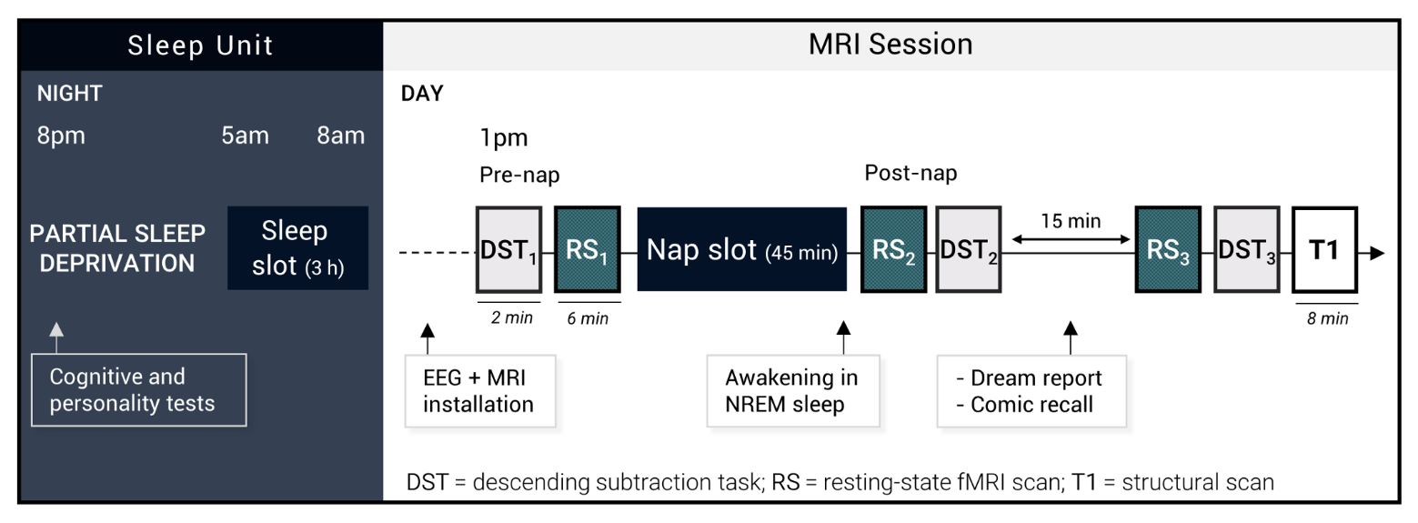
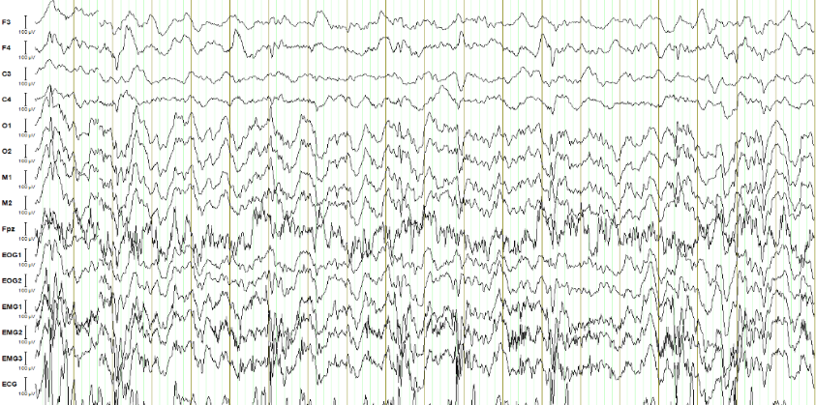
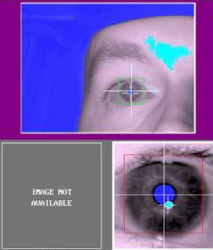
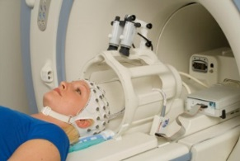
Introduction
Dream recall
Dream content
Software
Conclusion
EEG-fMRI Paradigm
MRI-compatible EEG cap
15 channels – EasyCap
Eye-Tracker
(SR Research, EyeLink)
Online correction of cardioballistic artefact
20 sec window – N3 sleep – BrainVision RecView
R. Vallat – Ph.D. Oral Defense – December 8th 2017
II. Mechanisms of dream recall frequency – Study 2

Slide 12
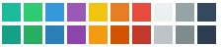
Color
Background nav bar
Text outline + nav bar
Highlight
Main text
Bottom text + vline
Font size:
Title = 18 Helv. Neue bold
Main text = 16 Helv. Neue
References = 14 Helv. Neue LT light
Outline & bottom = 11 Roboto light (medium for chapter)

