Slide 1

CONTENT AND FREQUENCY OF DREAM REPORTS.
Psychological and Neurophysiological Correlates.
Raphaël Vallat
Lyon 1 University
Ph.D. Oral Defense
December 19, 2017

Slide 2
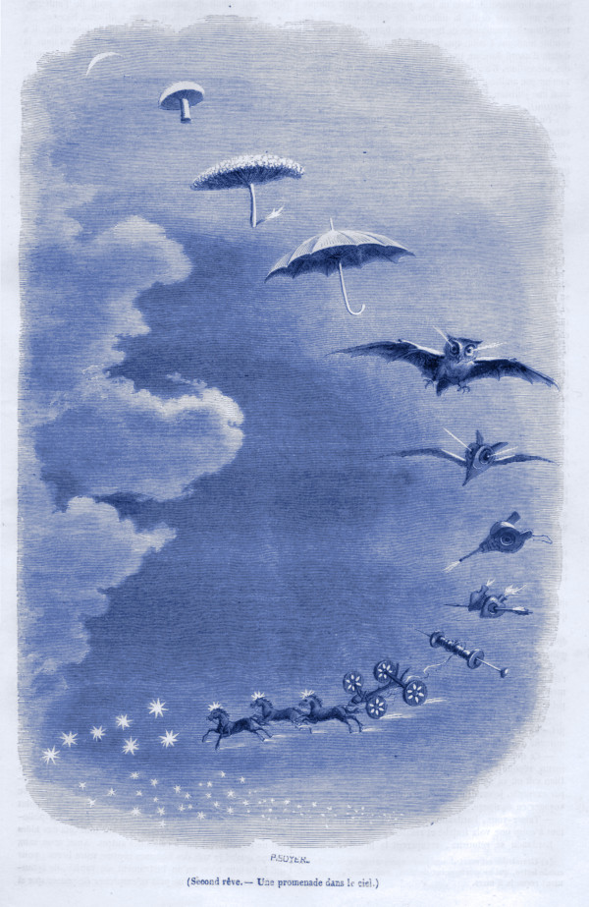
GENERAL INTRODUCTION
DREAMING
Grandville. Second rêve – Une promenade dans le ciel. 1847.

Slide 3
Dreaming
Introduction
Methods
Study I
Study II
Study III
Conclusion

Slide 4
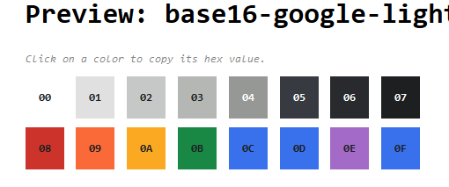
Dreaming

