Slide 1
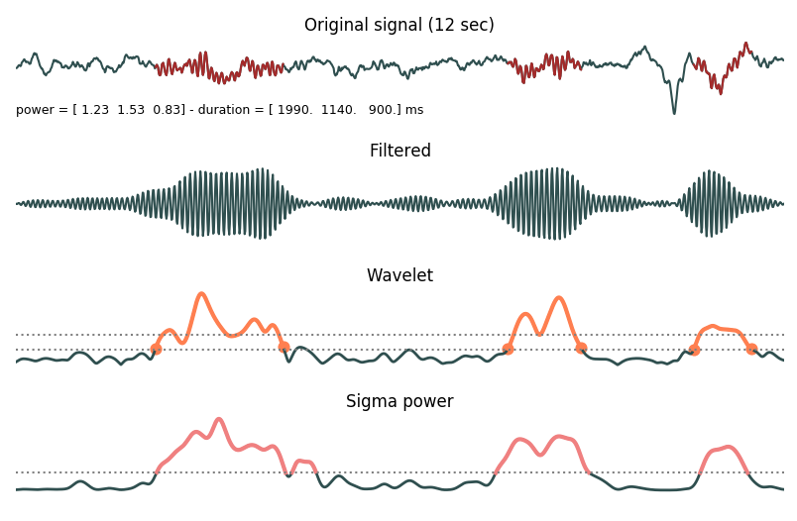
Original EEG signal (C3)
Power = [ 1.23 1.53 0.83 ] µV²/Hz – duration = [1.99 1.14 0.90 ] sec
Filtered signal (tuned frequency band: 11.5–13.5 Hz)
Amplitude of wavelet transform
Hard threshold
Soft threshold = 0.5 * hard threshold
Sigma power
0
Time (sec)
12

