Slide 1
"Exploring Next.js: Core Concepts and Styling Approaches"
Mastering routing, navigation and styling in next.js
Presented By: Student Leader Naimal Salahuddin

Slide 2

What is Next.js
❔❔❔
Next.js is a React framework that gives us power to build a full-stack web application, react components can be used to build the user interfaces (UIs).
It provides us to write backend and frontend for our application at one place…
It is the most famous framework that enables Server Side Rendering (SSR) and Static Site Generation (SSG), making react application more faster and Search Engine Optimization (SEO) friendly.

Slide 3

What is the page.tsx file, and what is the layout.tsx file?
page.tsx:
This file represent a separate and unique page in nextjs application. Page.tsx or page.jsx is a naming convention from nextjs.Nextjs is known for its file-based routing system so this file creates a route.
layout.tsx:
This file represents the shared layout across the application. This file mainly holds the common components like Header, Footer or some providers like contextProvider, MetaMask wallet Provider etc to give access of your application to the state management libraries

Slide 4
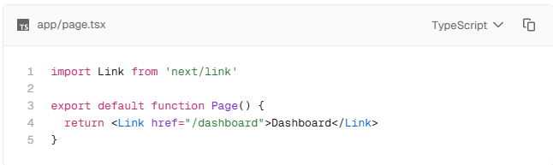
What is the Link component, why do we use this, and what is its purpose?
Link Component:
A Link component is the pre-built component in nextjs used for client-side navigation between pages.
Purpose:
Enhance SEO as it navigates us between the pages without reloading the whole page with improves user experience (UX).
Enables faster transition as compared to anchor tag in HTML which reloads the whole page when user clicks any of the nav links

Slide 5
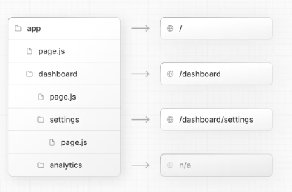
How can we create nested pages in Next.js?
Creating nested routes in nextjs is super duper easy… Let’s make a nested route with me. First take a bowl and spatula, then add nested route mixture in it and add a little amount of water, then mix mix mix and boom guyz… 💥 NESTED ROUTE IS READY TO SERVE😋😋 How was it❔❔❔ Okay apart from joke, you can create nested route by following these steps: Nested means inside something and routes means a page in nextjs so simple create a folder inside a route and then create a page.tsx inside that folder.
Nested routing helps in defining complex folder structure and intuitive path at the same time. It is used to structure the pages in a hierarchical manner.

Slide 6

What are components, and why do we use them?
As a medical student I always learn about the Amino acid are the building block of Protein, monosaccharides are the building block of carbohydrates and etc. So what are the building blocks of react and next js application❔❔❔
Yes, you are right👍 Components are the building block of react and next js application, As you can see in the picture as these building blocks combine and makes up a beautiful application. “Components are the piece of code which is reusable in different parts of your application”
Component gives us modularity and convenience to manage sections of the application smoothly without getting into much code because component

Slide 7
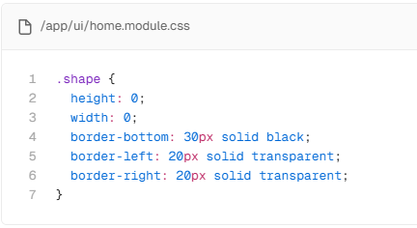
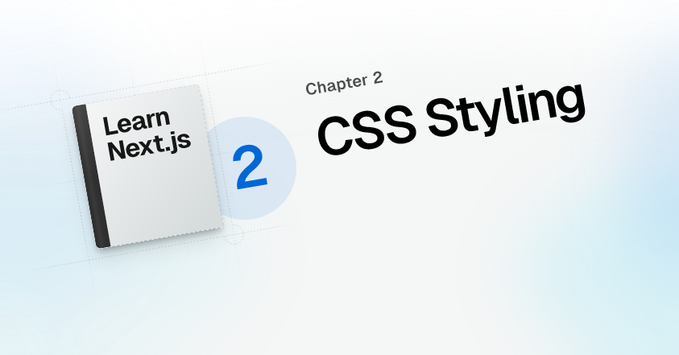
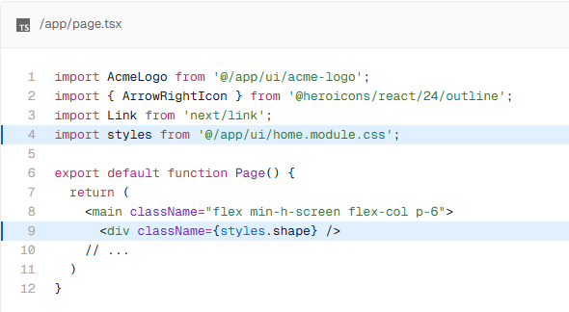
How can we apply CSS in Next.js?
There are many ways to apply styling in nextjs, Let's discuss two of them: CSS Module and Tailwind CSS
CSS Modules:
Css modules is like defining css properties in vanilla css in a filename.module.css, then import it where you want to apply style.

Slide 8

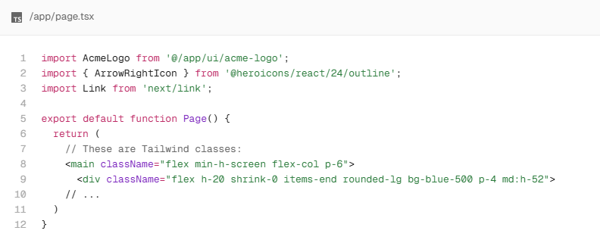
Tailwind CSS:
Tailwind is a CSS framework that speeds up the development process by allowing you to quickly write utility classes directly in your TSX markup.
In Tailwind, you style elements by adding class names. For example, adding the class "text-blue-500" will turn the <h1> text blue.
When you use create-next-app to start a new project, Next.js will ask if you want to use Tailwind. If you select yes, Next.js will automatically install the necessary packages and configure Tailwind in your application.
Tailwind CSS

Slide 9

What are the differences between Tailwind CSS and standard CSS?
Key difference between Tailwind and Standard CSS:
Utility-first vs Custom-style: Tailwind CSS uses utility classes to style elements directly in HTML, while standard CSS typically involves writing custom class rules in separate CSS files.
Faster Styling: Tailwind css allows rapid styling without switching files, while standard css required defining and managing styles.
Consistency: Tailwind promote design consistency with pre-defined spacing, color, fonts etc, while standard css required manual setup and consistency.
File Size: Tailwind purges unused styles in production, often resulting in small css file size, while standard css may contain unused style unless manually optimized.
VS

Slide 10
Thank you for Reading
😇

