Slide 1
Modern Infrastructure as CODE
by
Raja Nagendra Kumar, Code Doctor, +91-9886723872 nagendra.raja@tejasoft.com

Slide 2
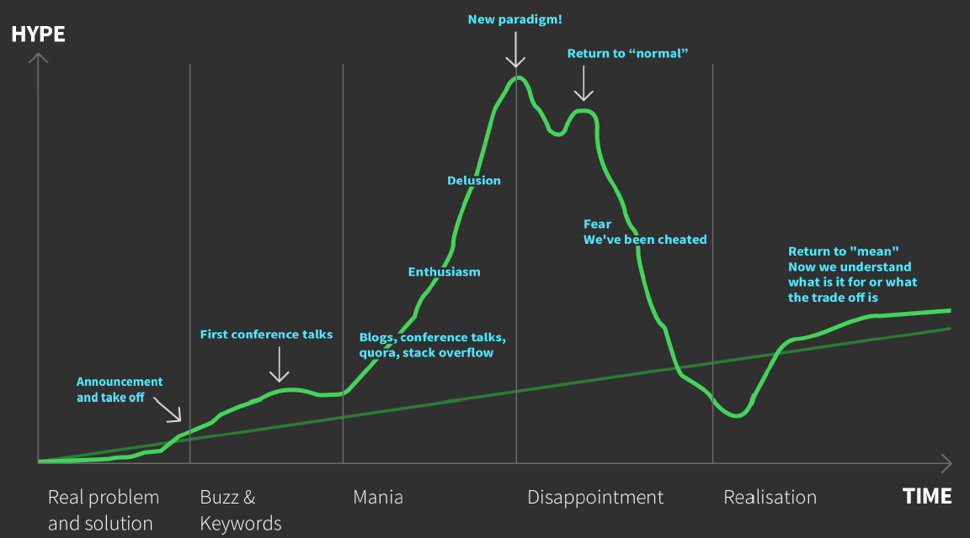
Hype driven development

Slide 3
<Lc/nc> - LOW CODE NO CODE to Everything as CODE
NO ADMINS
DevOps
YAML - sick of "programming" in yaml
DOCKER
IaC

Slide 4
IaC -Infrastructure as Code

Slide 5
the state of the machine drifts from the baseline due to manual changes and updates

Slide 6
CaC - Configuration as Code

Slide 7
provisioning

Slide 8
configuration drift

Slide 9
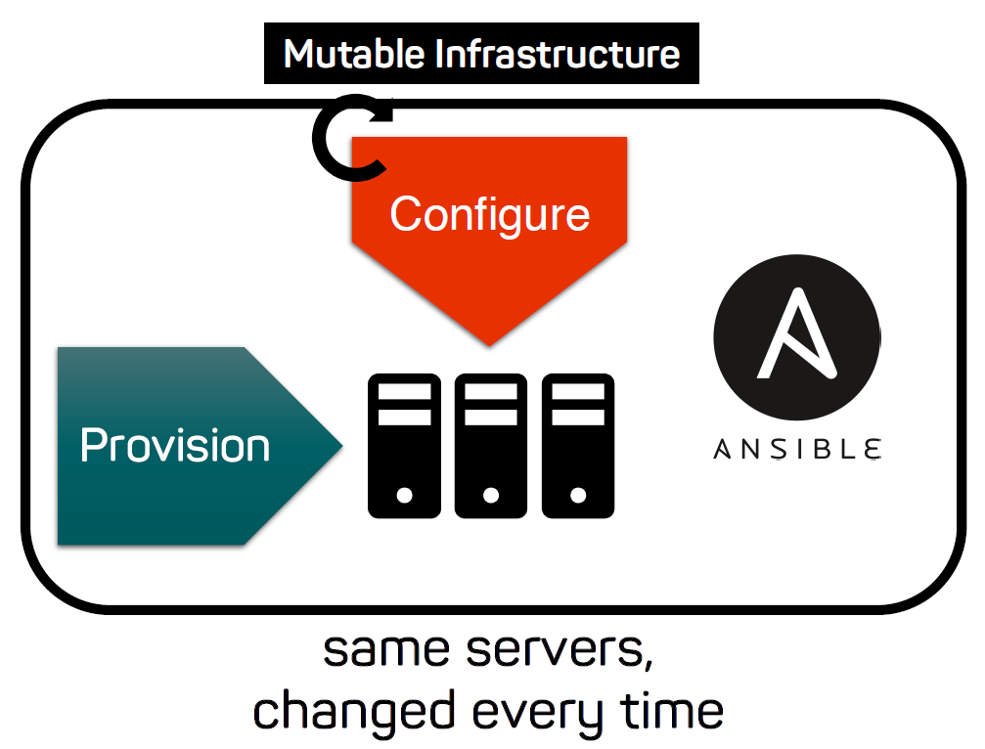

Slide 10
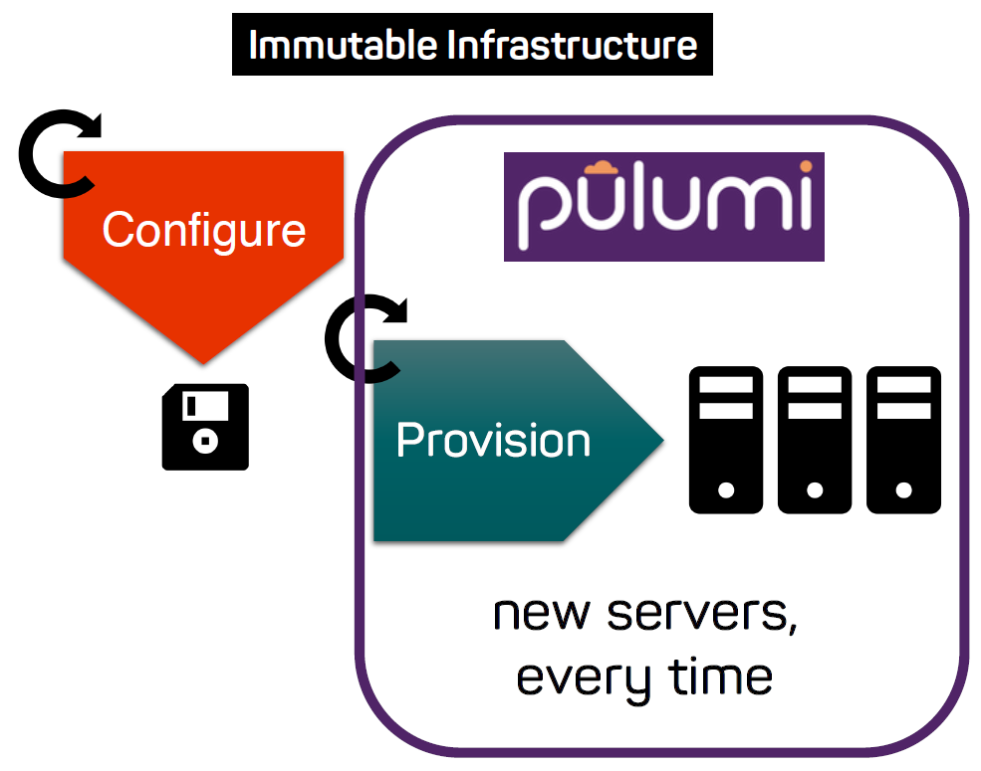

Slide 11
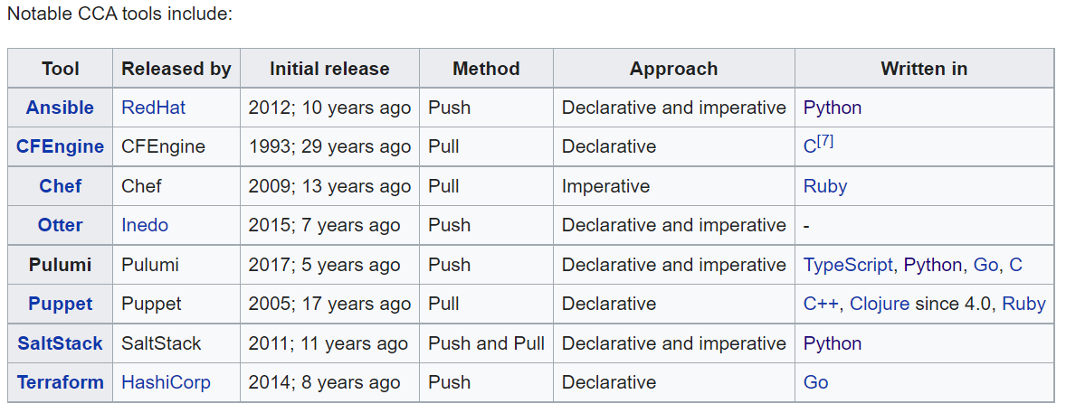
CCA - Continuous Configuration Automation

Slide 12
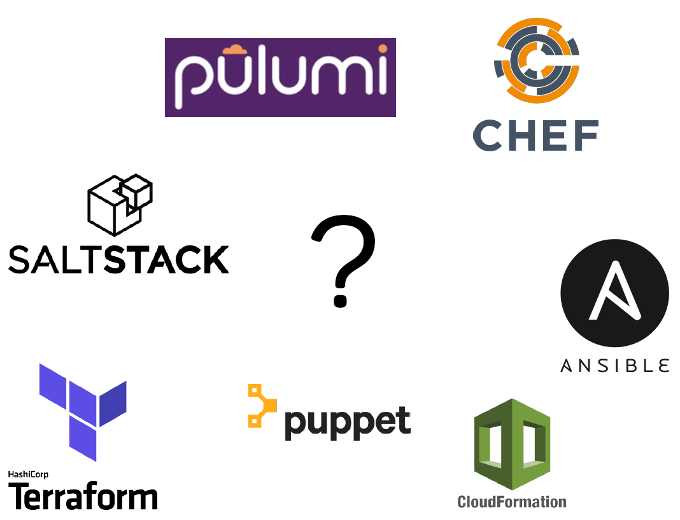

Slide 13
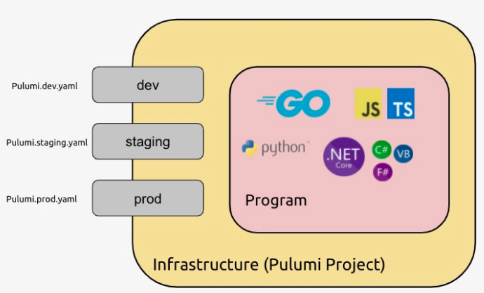
Multi language IaC

Slide 14
Getting started
CLI – Pulumi - https://www.pulumi.com/docs/get-started/install
Login – pulumi login
Create Project – pulumi stack init dev
Compile & Deploy – pulumi up –y
Destroy – pulumi destroy –y & pulumi stack rm dev

Slide 15
concepts

Slide 16
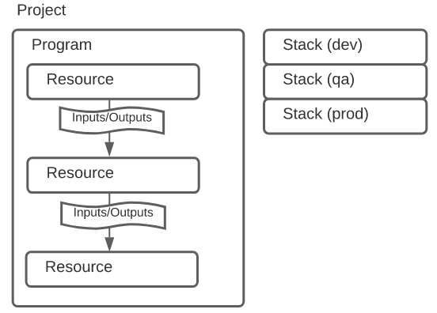
How Pulumi works
pulumi new aws-java

Slide 17
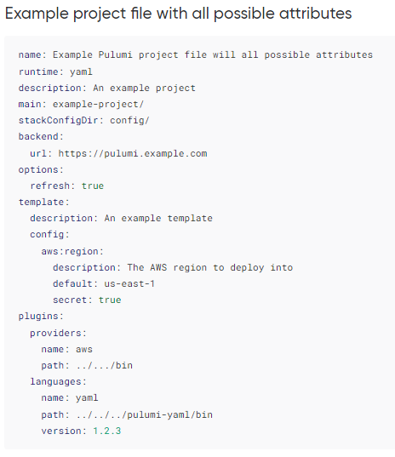
Project - Pulumi.yaml

Slide 18
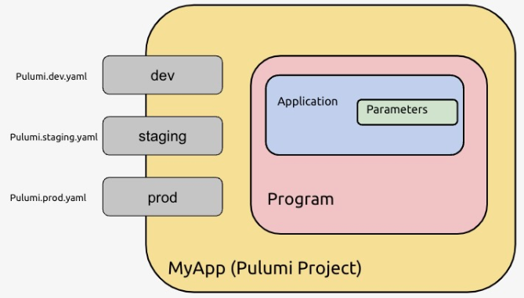

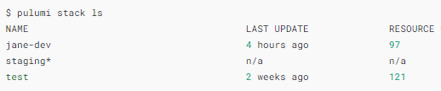
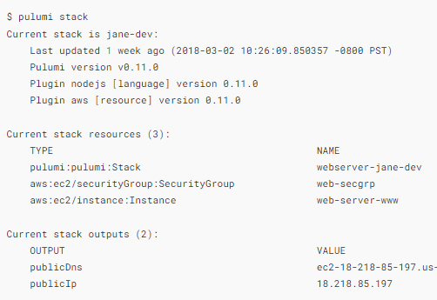
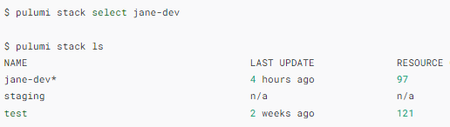

stack

Slide 19
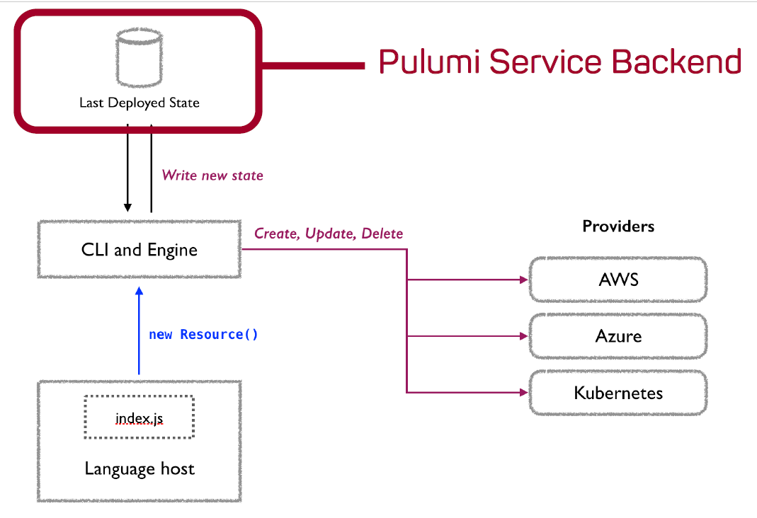
State and Backends
app.pulumi.com
Self-managed backend
on-premise app.pulumi.com (Enterprise version only)
Resource Providers
https://app.pulumi.com/nagkumar/hw/dev/updates/11

Slide 20
Resources

Slide 21
Inputs and Outputs

Slide 22

Configuration

Slide 23

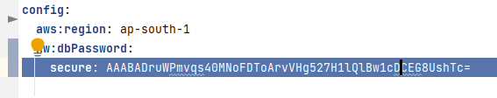
Secrets

Slide 24
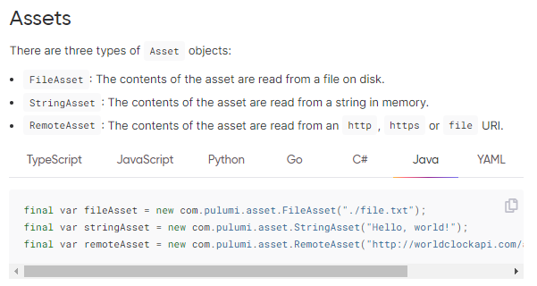
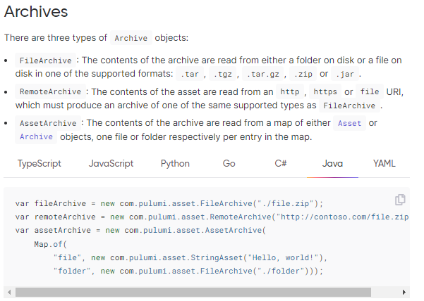
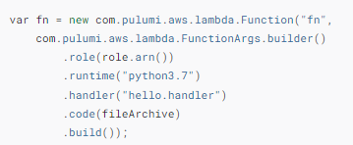
Assets and Archives

Slide 25
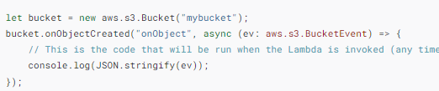
In-line code -Function Serialization

Slide 26
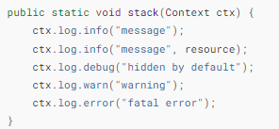
Logging

Slide 28
A Stack defines the State
micro-stacks.

Slide 29
Iac testing
Unit Testing
Property Testing
Integration Testing

Slide 30
Pulumi Registry
Packages
Providers
Native Providers
Resource Providers
Component

