Slide 1
Modern Infrastructure as CODE Cloud Engineering
by
Raja Nagendra Kumar & Naimeesh R +91-9886723872, inquiry@tejasoft.com

Slide 2
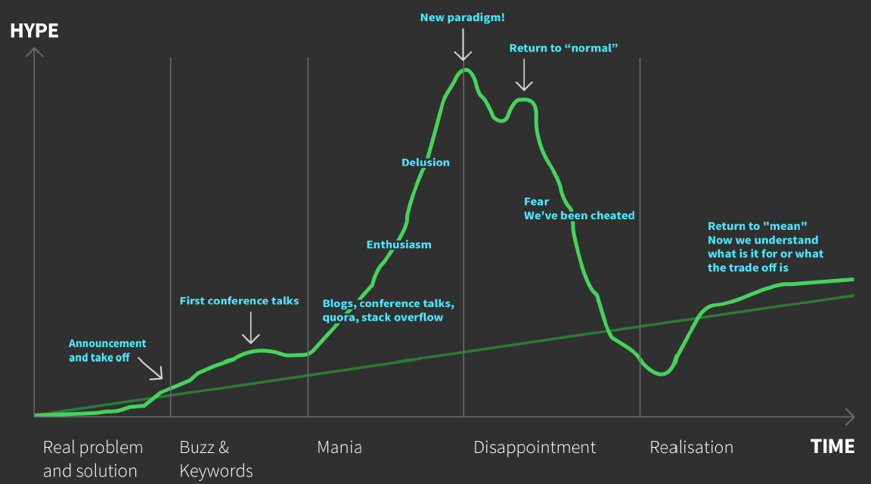
Hype driven development

Slide 3
<Lc/nc> - LOW CODE/NO CODE Devops to Everything as CODE
NO Admins/IT
DevOps
YAML - sick of "programming" in yaml
Docker
IaC
VMs
Serverless

Slide 4
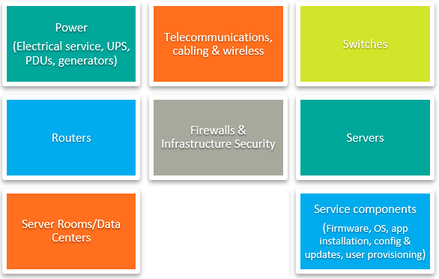
infrastructure - hARDWARE
Compute Machine

Slide 5
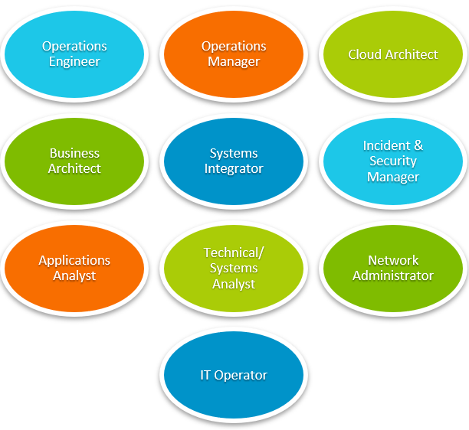
infrastructure – OPERATIONS

Slide 6
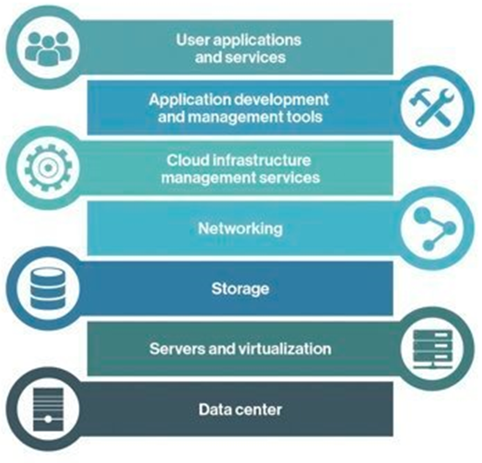

Cloud infrastructure

Slide 7

IaC -Infrastructure as Code
Software coding practices made for the cloud
Apply standard software engineering practices and tools uniformly across infrastructure, development, and compliance teams to tame the complexity of delivering and managing modern cloud deployed solutions.
✗
✗
Creating, Deploying, and Managing cloud infrastructure – all with CODE

Slide 8
Procurement/provisioning
10 – I9 Machines
128 GB ROM
4 TB HDD
2 GPU
FTTH with speed 1 gbps
Virtual Machines – VMs
Docker Containers
Serverless
Hosting Providers
Data Centres

Slide 9
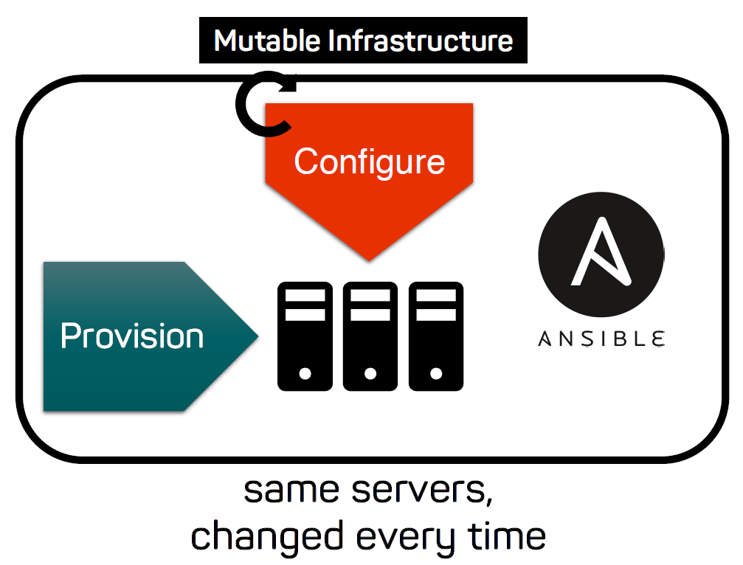

Slide 10
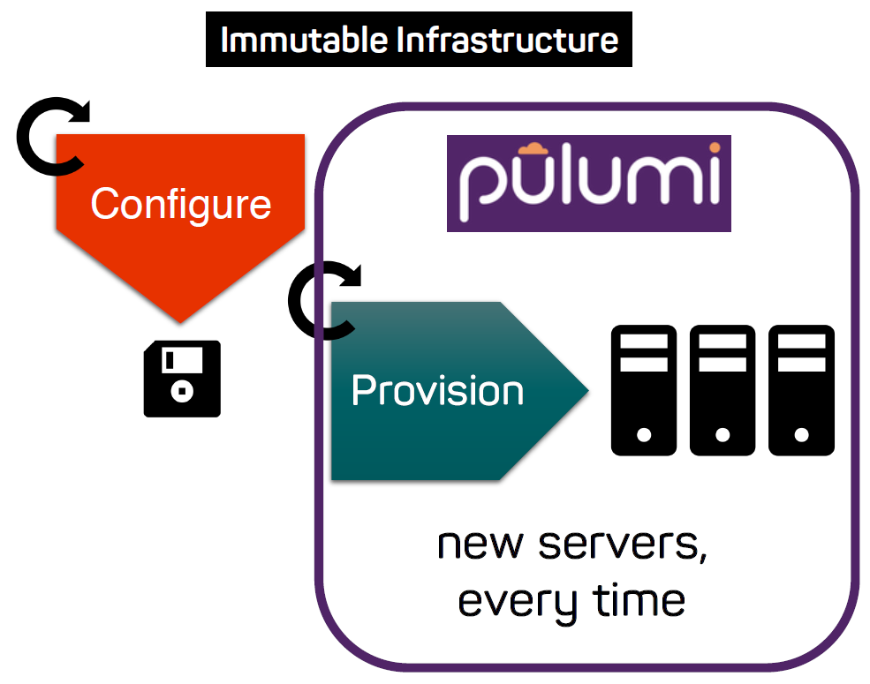

Slide 11
Configuration/software Install
Install OS
JDK, PYTHON, GO, NodeJS, NGNIX, Apache HTTPD, Database – SQL, NoSQLs
Clustering of Machines – accept more load or failure over tolerance
Can Only connect to xyz machines
CPU Temperate Notifications
File Ports to be Open
Allow only XYZ remote users

Slide 12
CaC - Configuration as Code
Archival of Disk Images
Shell Scripts, Make, ANT, Maven, Gradle, Bazel (limited verstions)
YAML

Slide 13
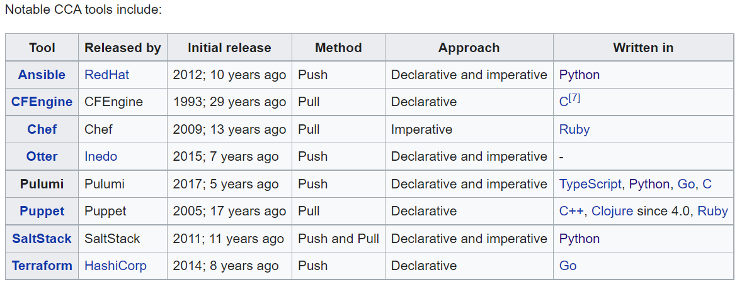
CCA - Continuous Configuration Automation

Slide 14
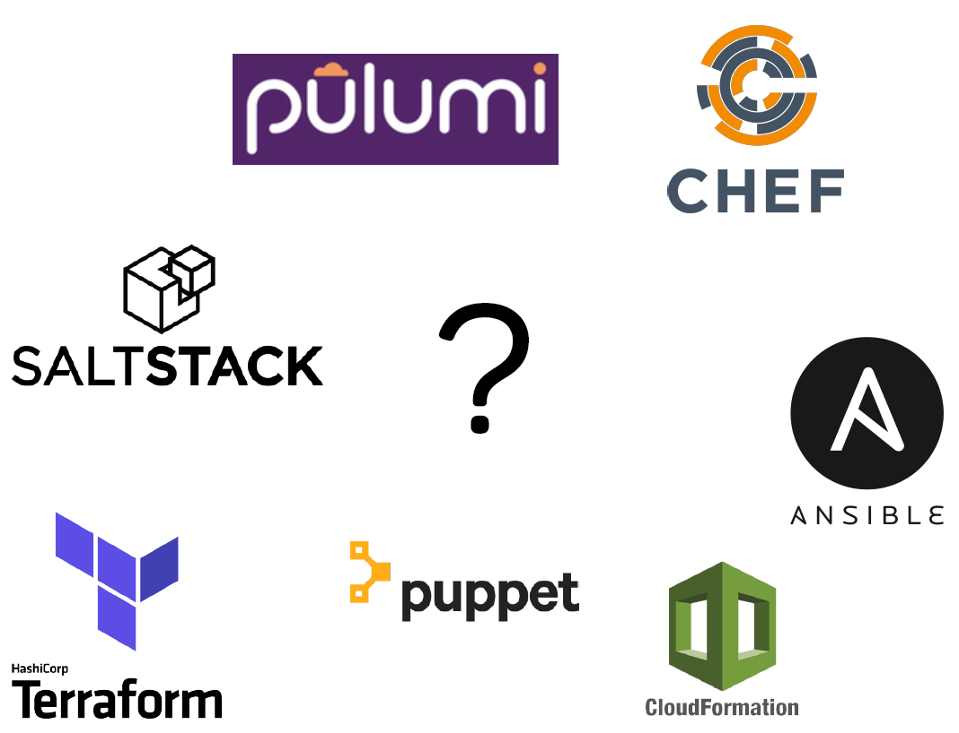

Slide 15
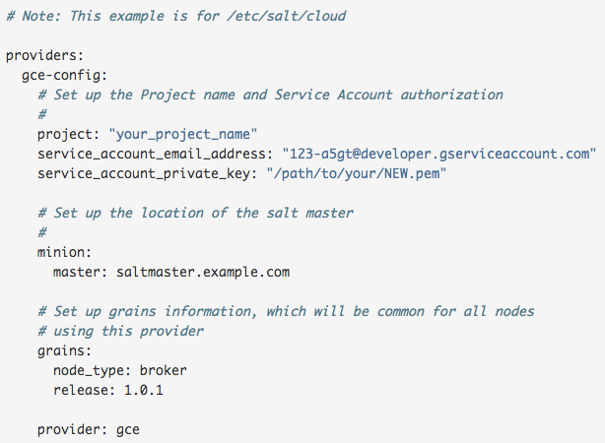
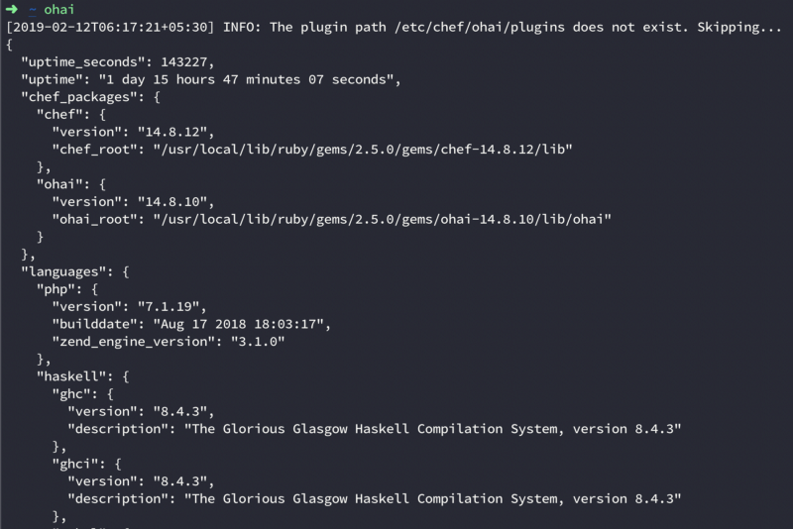
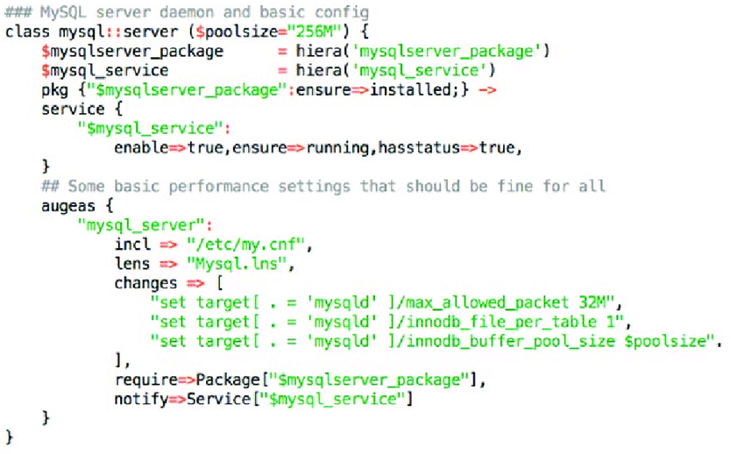
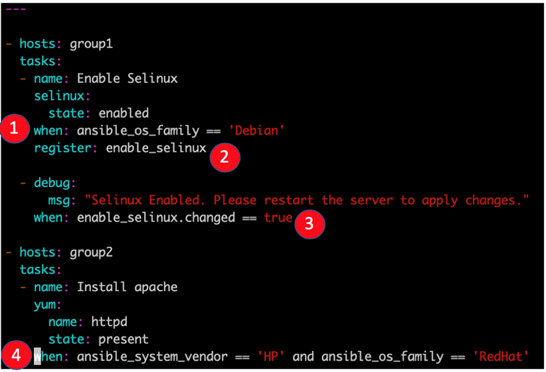
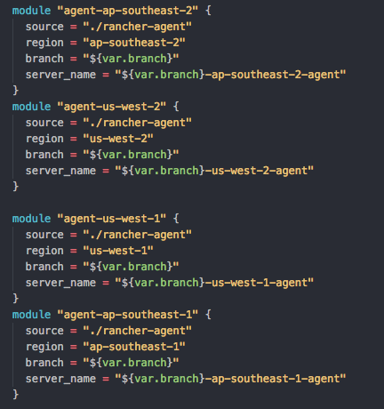
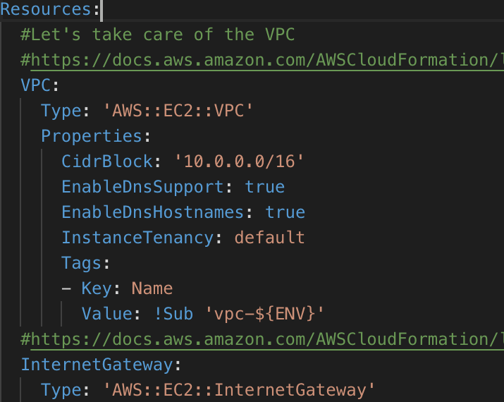

Slide 16
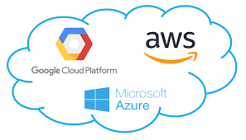
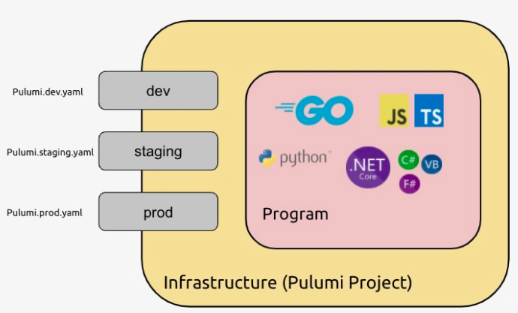
Era of MULTI CLOUD & Multi language IaC - pulumi
Aws API are
HTTP API - Used by Terraform provider, this terraform driver is used by Pulumi internally AWS Classic Provider
REST API
Cloud Formation
CDK
CCA - Cloud Control API - AWS Native Provider uses this, fast, however functionality is limited as AWS cca are not complete by aws itself – Native Drivers depend on this API
PULUMI

Slide 17
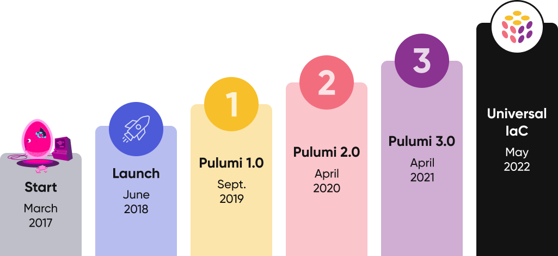
Getting started - concepts
CLI – Pulumi - https://www.pulumi.com/docs/get-started/install
Login – pulumi login
Create Project – pulumi new aws-java & pulumi stack init dev
Compile & Deploy – pulumi up –y
Destroy – pulumi destroy –y & pulumi stack rm dev

Slide 18
CODESHOP
https://github.com/nagkumar/pulumi

Slide 19
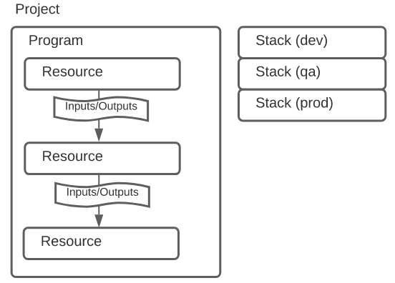
How Pulumi works
pulumi new aws-java
pulumi stack init dev

Slide 20
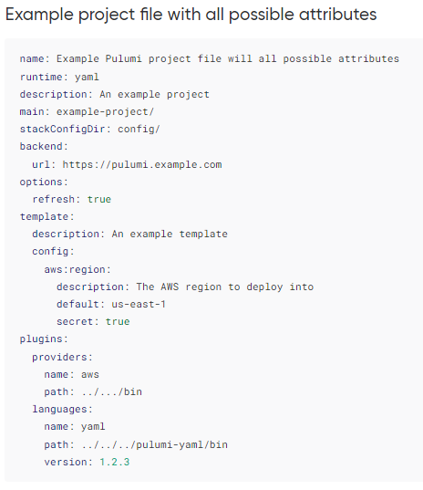
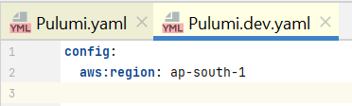
Project - Pulumi.yaml & Pulumi.dev.yaml

Slide 21

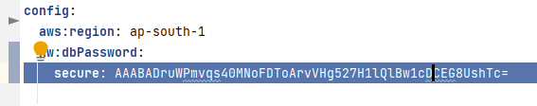
Secrets

Slide 22
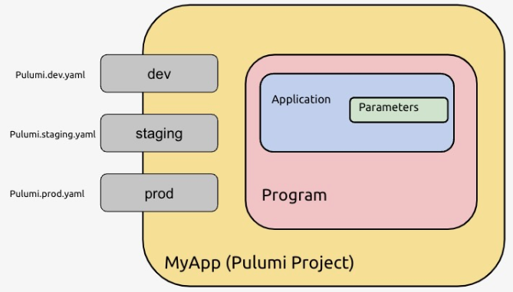

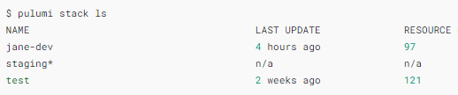
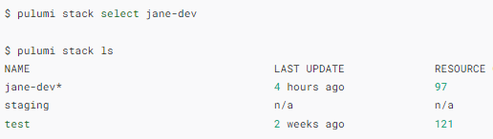
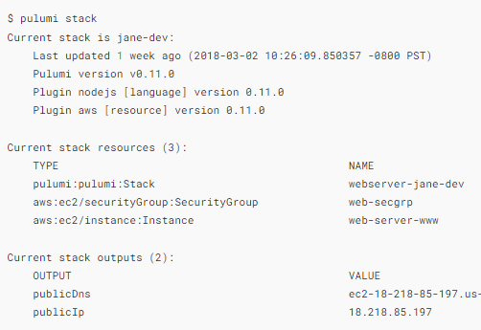

stack

Slide 23
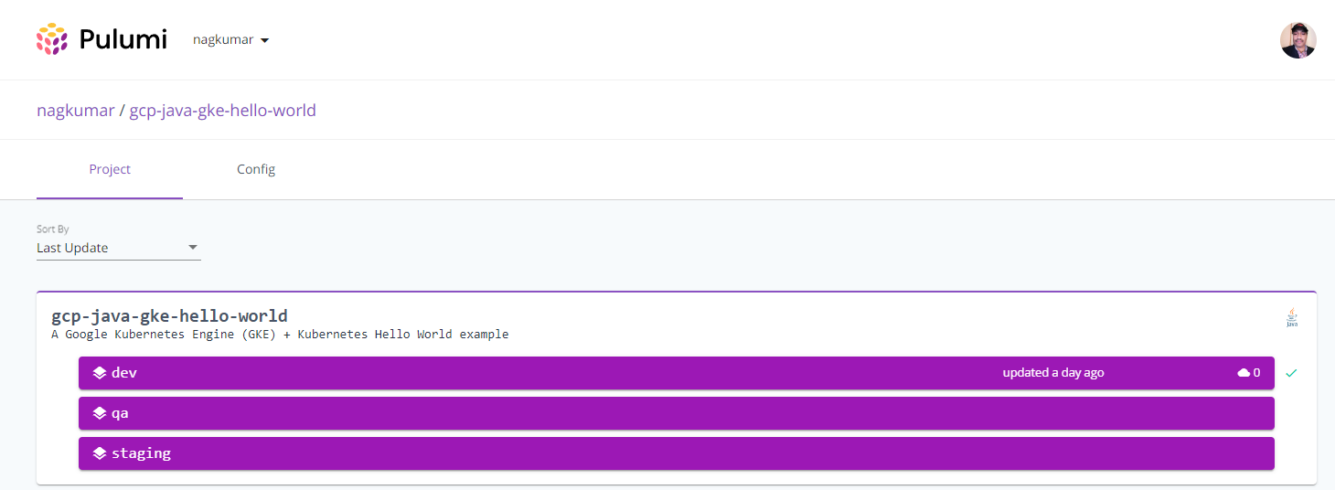
PULUMI Service

Slide 24
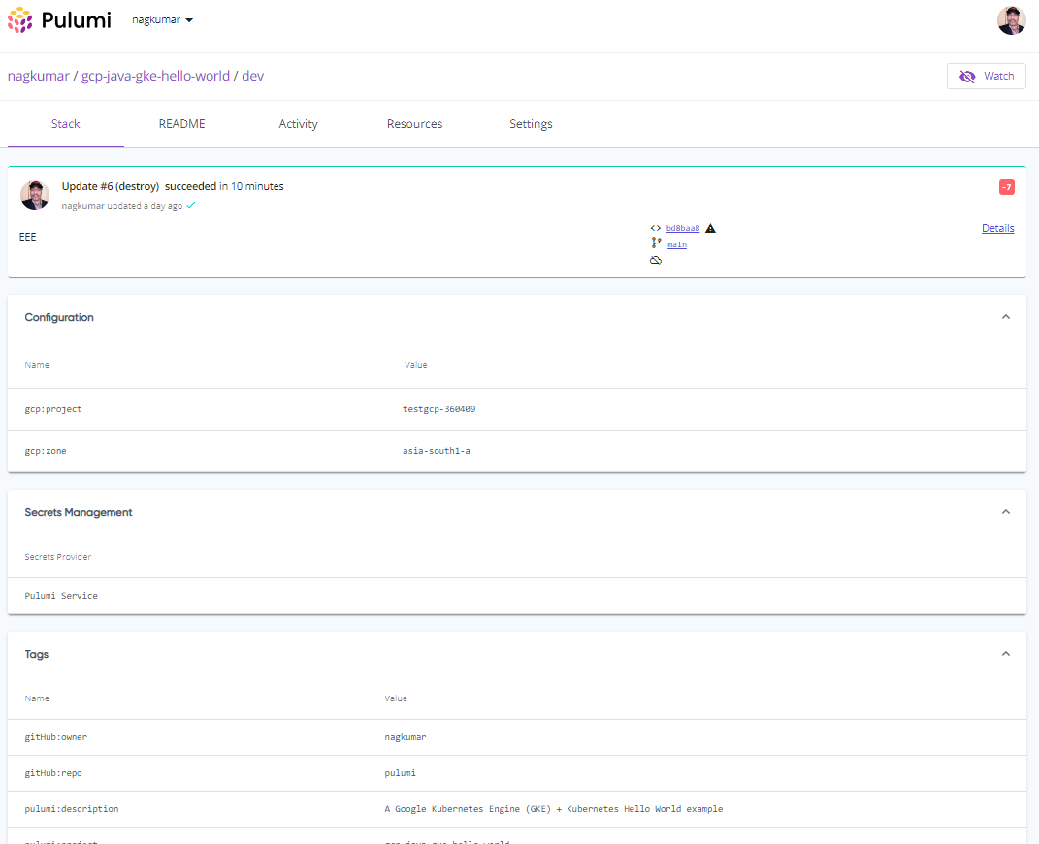

Slide 25
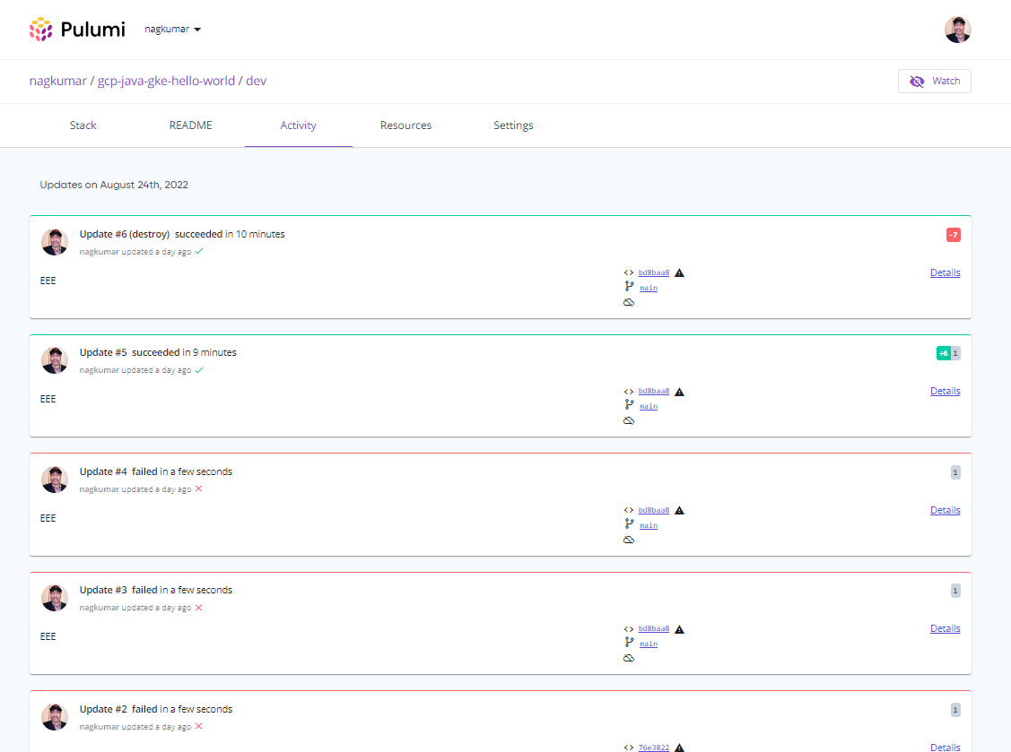

Slide 26
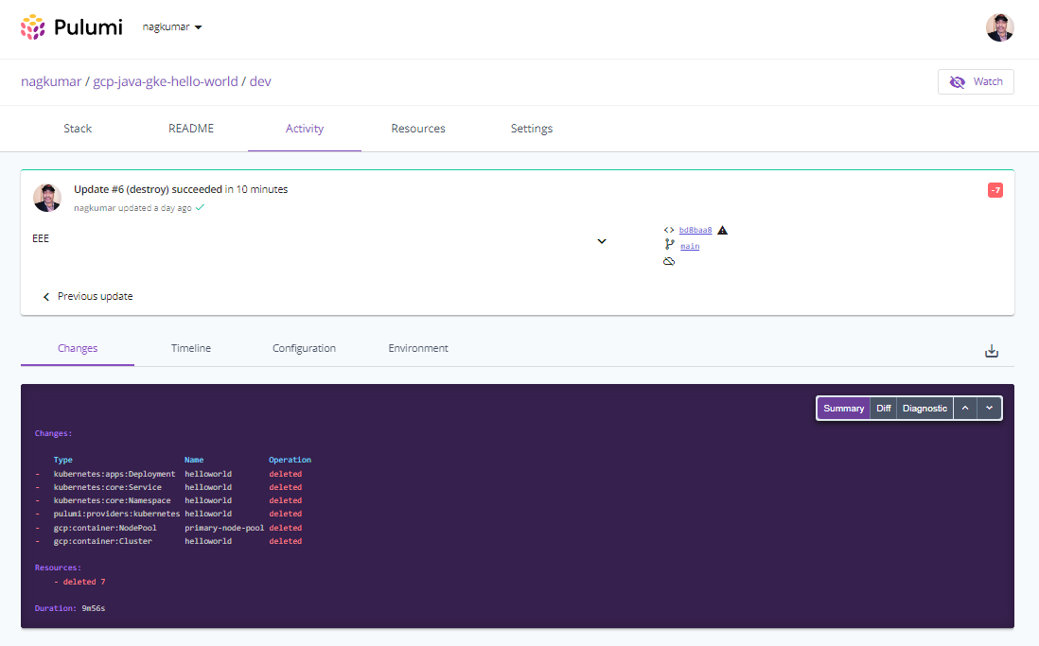

Slide 27
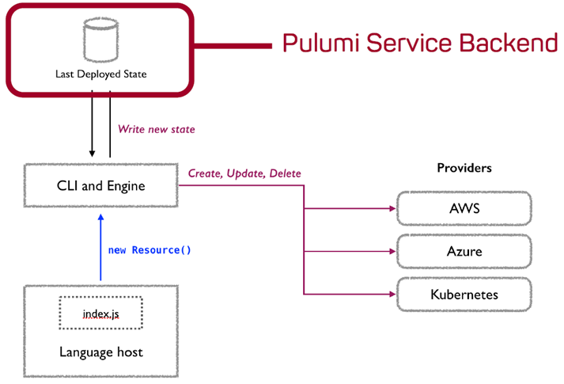

State and Backends
app.pulumi.com
Self-managed backend
on-premise app.pulumi.com (Enterprise version only)
Resource Providers
https://app.pulumi.com/nagkumar/hw/dev/updates/11

Slide 28
marketplace - Pulumi Registry
Packages
There are currently 3 different types of Pulumi Packages:
Native Pulumi Provider Package: Use the full features of the Pulumi resource model to create a provider for a new cloud platform. Examples: the Kubernetes, azure-native, and google-native packages.
Bridged Provider Package: Take an existing resource provider from another supported ecosystem (like a Terraform provider), and bridge it to be exposed as a Pulumi Package. Examples: the aws, tls, and Cloudflare packages.
Component Package: Write a Pulumi Component in your language of choice and expose it to users in all Pulumi languages. Example: the eks package.
Providers
Native Providers
Resource Providers
Component
https://www.pulumi.com/docs/guides/pulumi-packages/how-to-author/

Slide 29
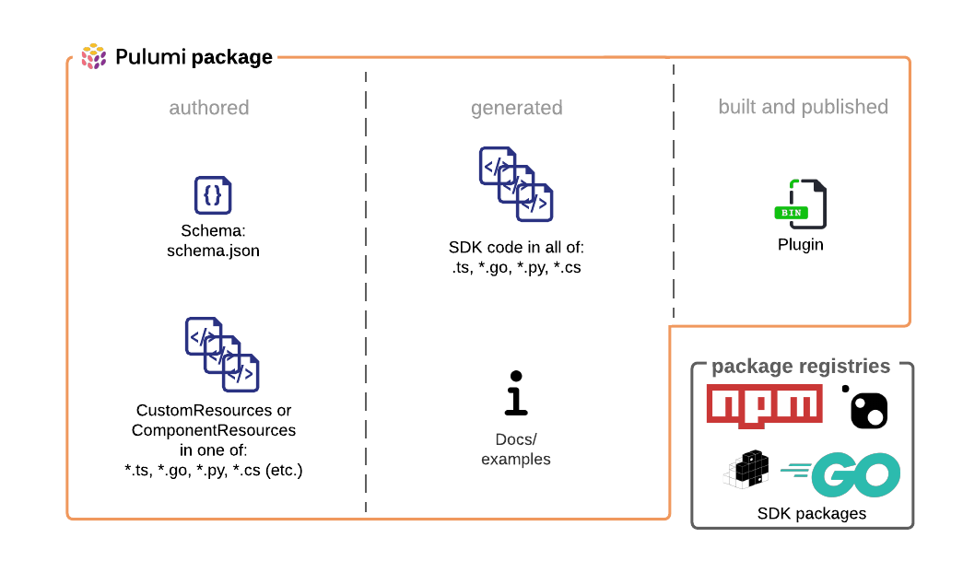

Slide 30
Note on Examples - source
https://github.com/pulumi/examples
Around 320+ examples exists, for various Clouds and Various Languages
Taken parts of the code modified enough for this demo, source of this modified code at https://github.com/nagkumar/pulumi

Slide 31
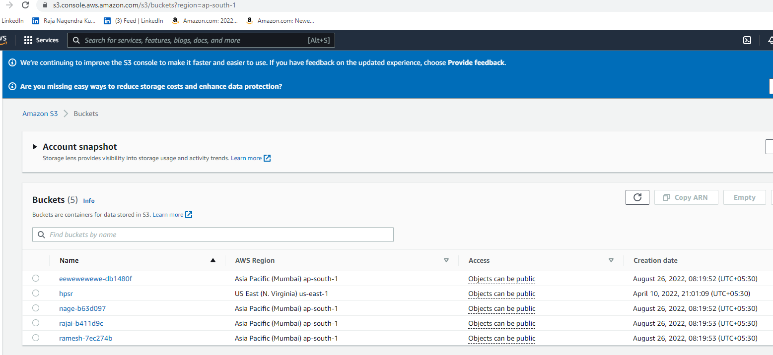
Hw - AWS S3 - java
G:\DWork\osource\cloudc\devops\pulumi\java\aws\hw
https://s3.console.aws.amazon.com/s3/buckets
https://app.pulumi.com/nagkumar/hw/dev/updates/19 - PU
https://app.pulumi.com/nagkumar/hw/dev/updates/20- PD

Slide 32
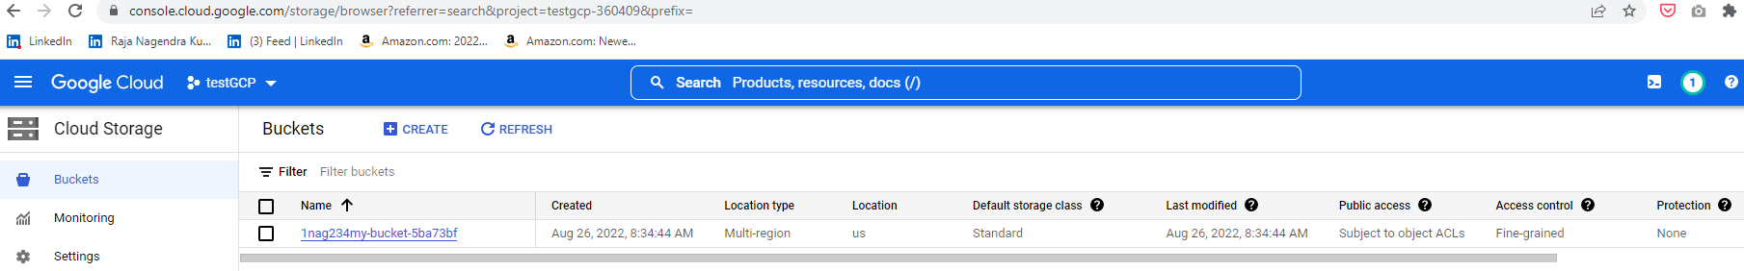
HW - gcp bucket - java
G:\DWork\osource\cloudc\devops\pulumi\java\gcp\hw
https://console.cloud.google.com/storage/browser?referrer=search&project=testgcp-360409&prefix=
https://app.pulumi.com/nagkumar/ramu/dev/updates/16
https://app.pulumi.com/nagkumar/ramu/dev/updates/17

Slide 33
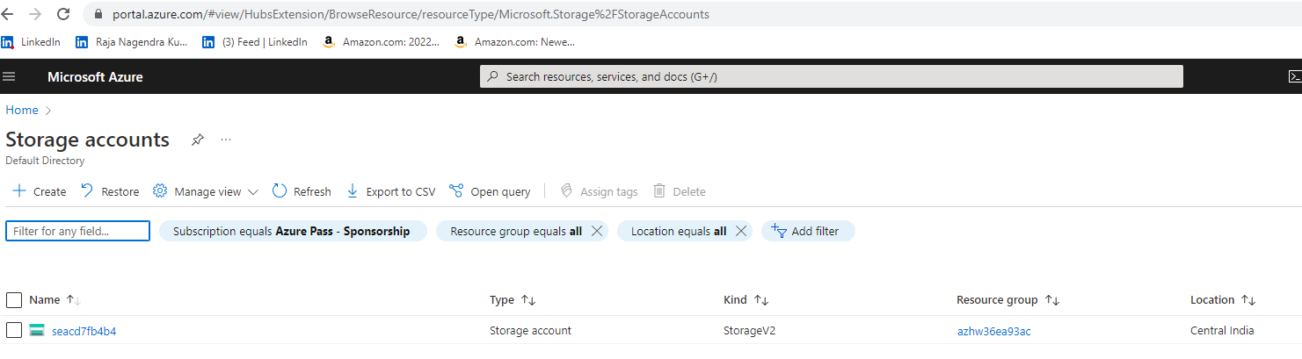
Hw - Azure storage - java
G:\DWork\osource\cloudc\devops\pulumi\java\azure\hw
https://portal.azure.com/#view/HubsExtension/BrowseResource/resourceType/Microsoft.Storage%2FStorageAccounts
https://app.pulumi.com/nagkumar/azure/dev/updates/11
https://app.pulumi.com/nagkumar/azure/dev/updates/12

Slide 34
Automated testing
Provides multiple testing styles
Unit Tests are fast in-memory tests that mock all external calls.
Property Tests run resource-level assertions while infrastructure is being deployed.
Integration Tests deploy ephemeral infrastructure and run external tests against it.
 | Unit Tests | Property Tests | Integration Tests
Provision real infrastructure | No | Yes | Yes
Require the Pulumi CLI | No | Yes | Yes
Time to execute | Milliseconds | Seconds | Minutes
Language | Same as Pulumi program | Node.js or Python | Any language
Validation target | Resource inputs | Resource inputs and outputs | External endpoints
Example | pulumi\ts\aws\test\unit | pulumi\ts\aws\test\props | pulumi\go\aws\test\intg

Slide 35
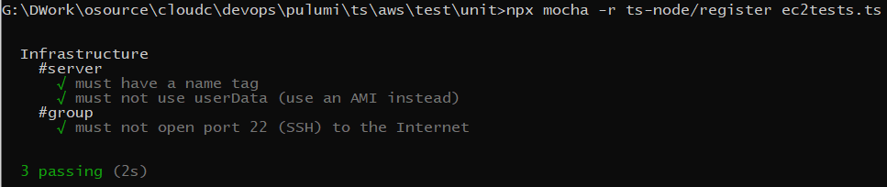
Unit Tests – Typescript - AWS
G:\DWork\osource\cloudc\devops\pulumi\ts\aws\test\unit
https://app.pulumi.com/nagkumar/test-unit-ts/dev/updates/5
npx mocha -r ts-node/register ec2tests.ts
https://app.pulumi.com/nagkumar/test-unit-ts/dev/updates/6

Slide 36
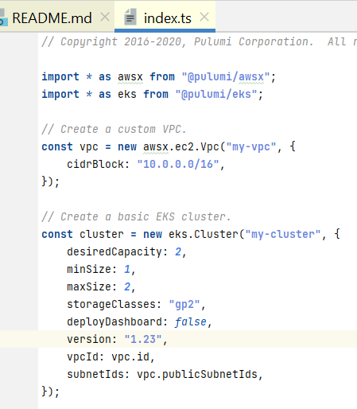
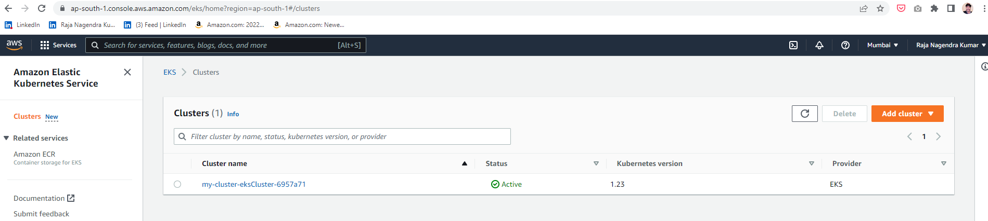
Property tests - TYPESCRIPT – AWS - EKS
Tests that checks before creating the resources
G:\DWork\osource\cloudc\devops\pulumi\ts\aws\test\props
pulumi up --policy-pack ppack -y
https://app.pulumi.com/nagkumar/pac-ts-eks/dev/updates/20
https://ap-south-1.console.aws.amazon.com/eks/home?region=ap-south-1#/clusters
https://app.pulumi.com/nagkumar/pac-ts-eks/dev/updates/21
Edit this verstion from 1.23 to 1.22, then property test fails

Slide 37
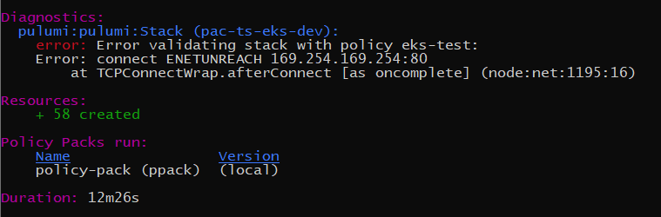
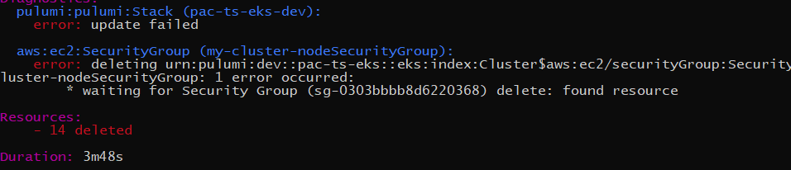

Slide 38
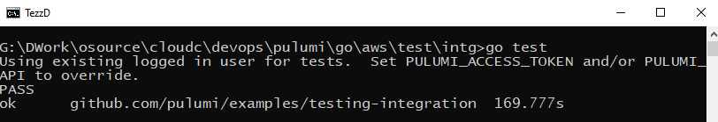
Integration tests – GO - AWS
G:\DWork\osource\cloudc\devops\pulumi\go\aws\test\intg
No need to issue Pulumi Up
Test Summary – it does xyz?
go test

Slide 39
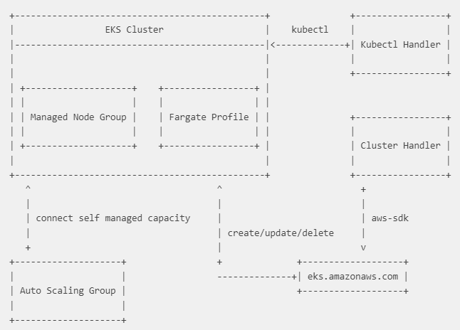
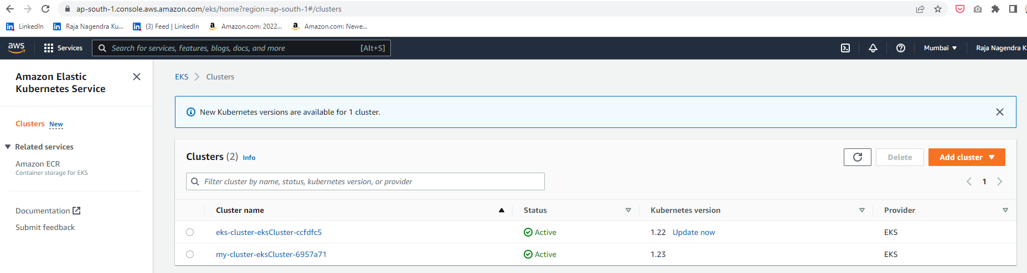
Example aws k8s
G:\DWork\osource\cloudc\devops\pulumi\java\aws\aeks
https://app.pulumi.com/nagkumar/eks/dev/updates/1

Slide 40
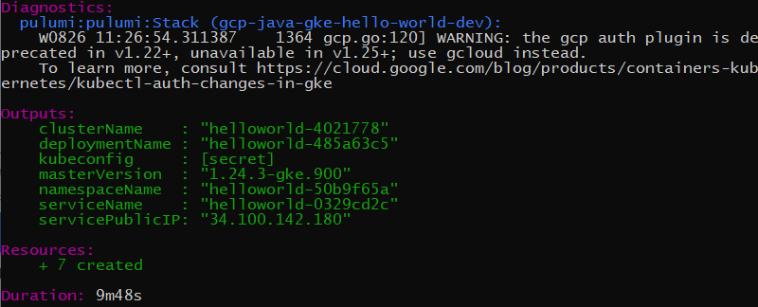
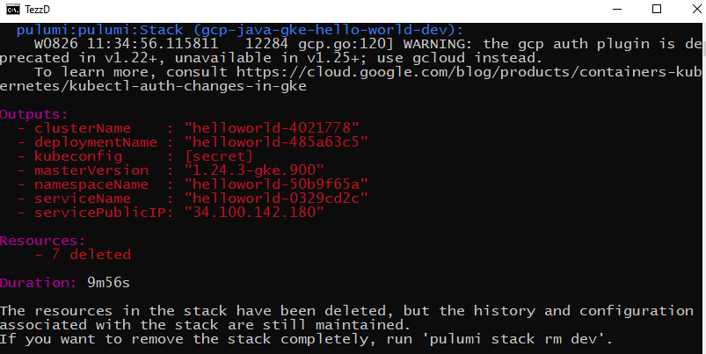
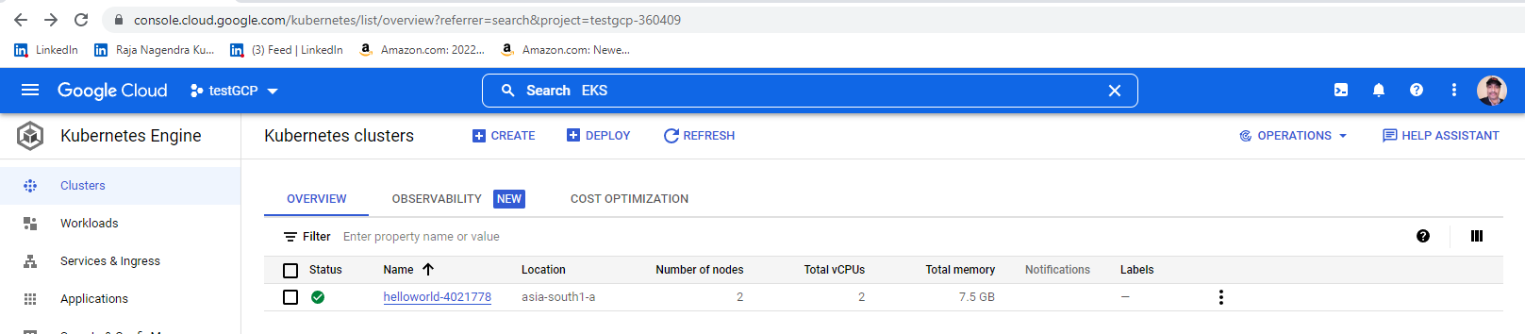
EXAMPLE GCP K8S
G:\DWork\osource\cloudc\devops\pulumi\java\gcp\gke
https://console.cloud.google.com/kubernetes/list/overview?referrer=search&project=testgcp-360409
https://app.pulumi.com/nagkumar/gcp-java-gke-hello-world/dev/updates/7 - PU
https://app.pulumi.com/nagkumar/gcp-java-gke-hello-world/dev/updates/8 - PD

Slide 41
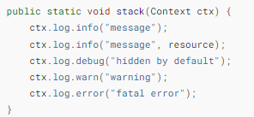
Logging
G:\DWork\osource\cloudc\devops\pulumi\java\aws\logs
https://app.pulumi.com/nagkumar/logs/dev/updates/1
https://app.pulumi.com/nagkumar/logs/dev/updates/2

Slide 42
Example docker

Slide 44
Pulumi Automation API without the need for pulumi CLI
Crossguard – Policy As Code - ISMS
Crosswalk awsx - Wellarchitected
AWS Native

Slide 45
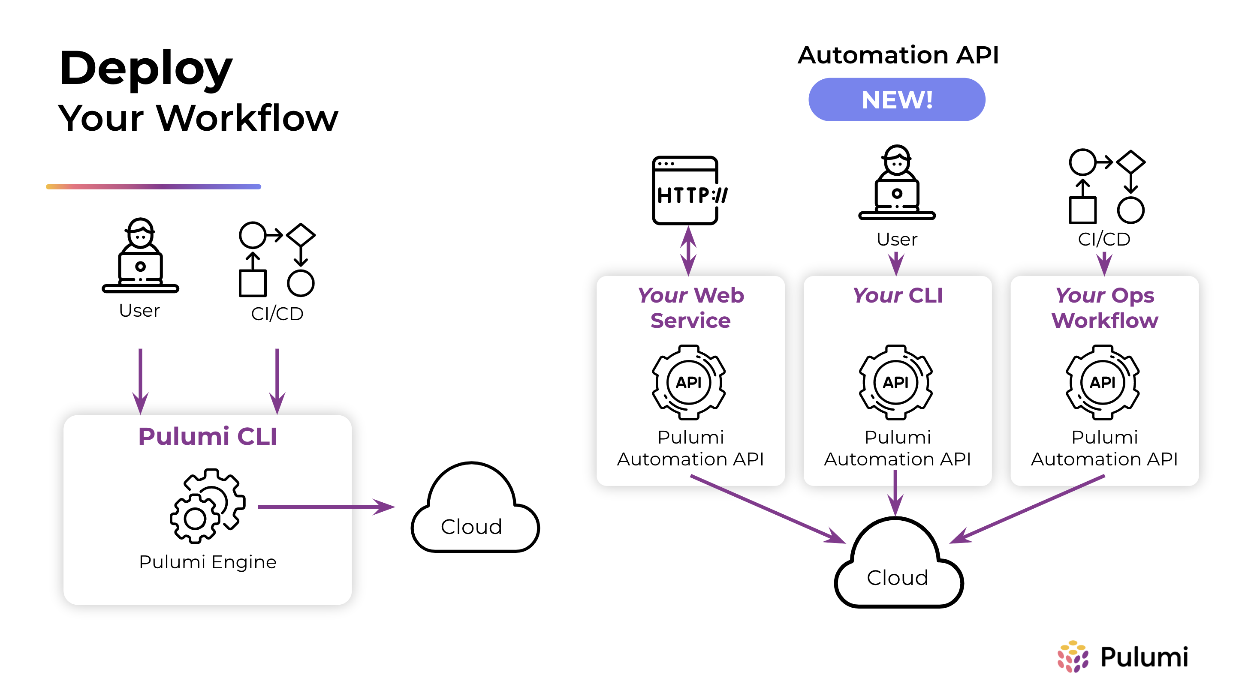

Slide 47
Resources

Slide 48
Inputs and Outputs

Slide 49

Configuration

Slide 50
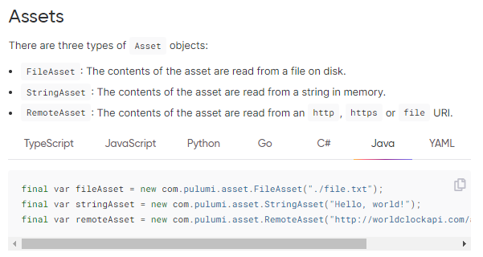
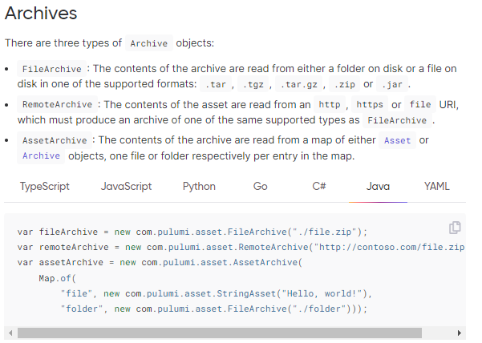
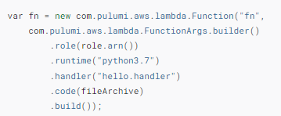
Assets and Archives

Slide 51

In-line code -Function Serialization

Slide 52
Creating Docker images

Slide 53
Cloud skills are code skills

Slide 54
the state of the machine drifts from the baseline due to manual changes and updates

Slide 55
A Stack defines the State
micro-stacks.

