Slide 1
Modern Infrastructure as CODE Cloud Engineering
by
Raja Nagendra Kumar & Naimeesh R +91-9886723872, inquiry@tejasoft.com

Slide 2
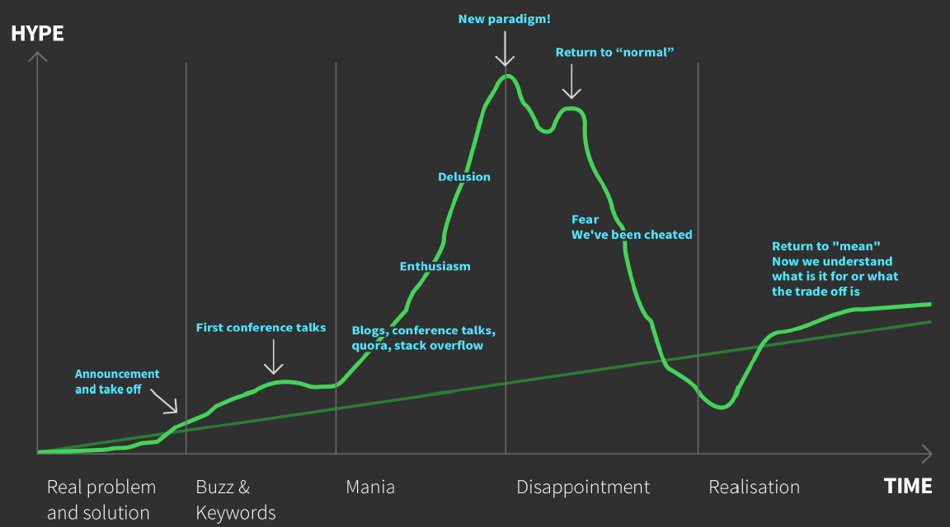
Hype driven development

Slide 3
<Lc/nc> - LOW CODE/NO CODE Devops to Everything as CODE
NO Admins/IT
DevOps
YAML - sick of "programming" in yaml
Docker
IaC
VMs
Serverless

Slide 4
What is infra
Compute Machine

Slide 5
IaC -Infrastructure as Code
Software engineering practices made for the cloud
Apply standard software engineering practices and tools uniformly across infrastructure, development, and compliance teams to tame the complexity of delivering and managing modern cloud applications.

Slide 6
the state of the machine drifts from the baseline due to manual changes and updates

Slide 7
CaC - Configuration as Code

Slide 8
provisioning

Slide 9
configuration drift

Slide 10
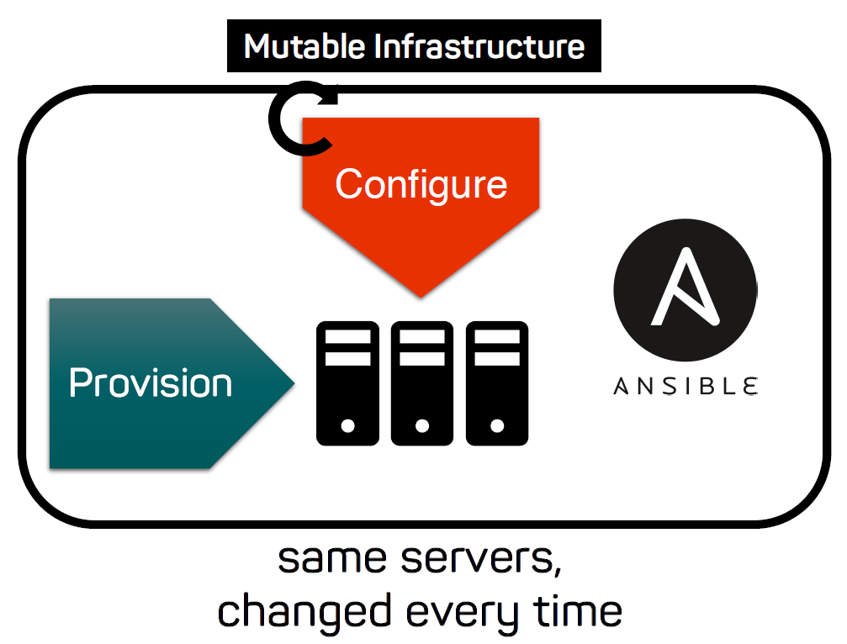

Slide 11
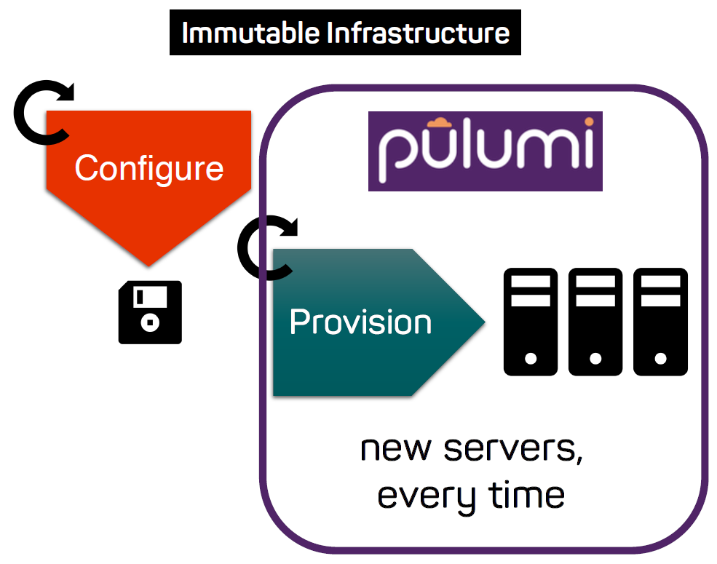

Slide 12
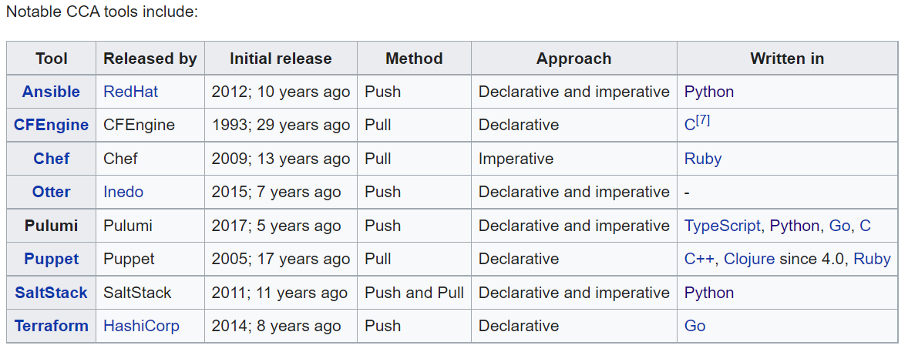
CCA - Continuous Configuration Automation

Slide 13
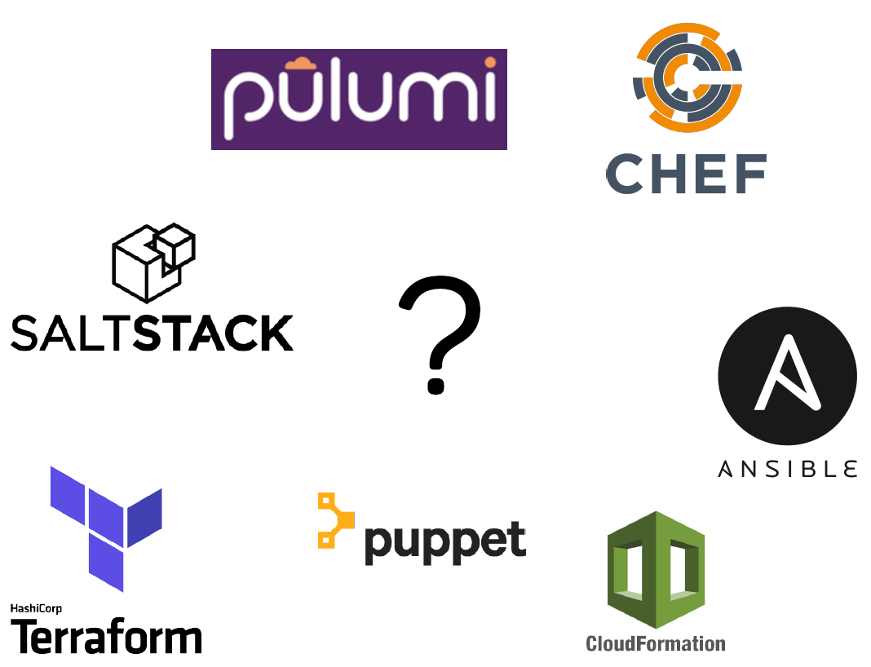

Slide 14
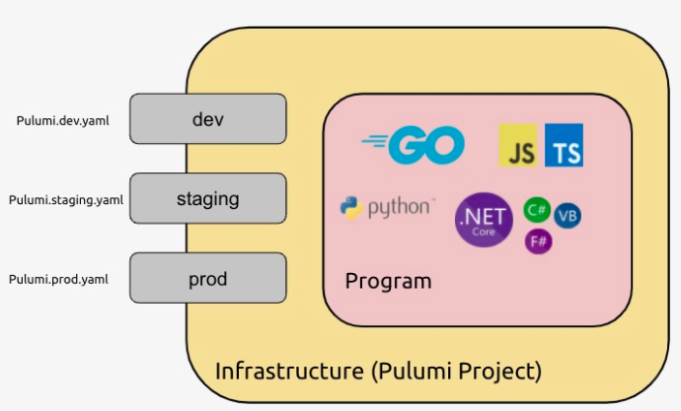
Multi language IaC

Slide 15
Getting started
CLI – Pulumi - https://www.pulumi.com/docs/get-started/install
Login – pulumi login
Create Project – pulumi stack init dev
Compile & Deploy – pulumi up –y
Destroy – pulumi destroy –y & pulumi stack rm dev

Slide 16
concepts

Slide 17
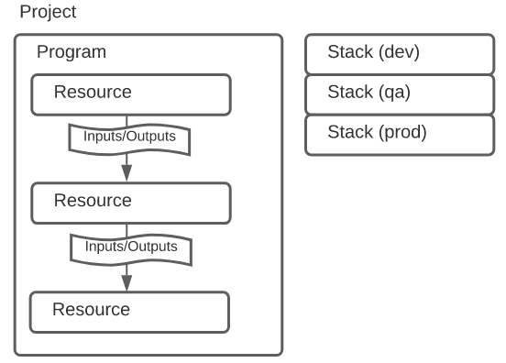
How Pulumi works
pulumi new aws-java

Slide 18
PULUMI Service

Slide 19
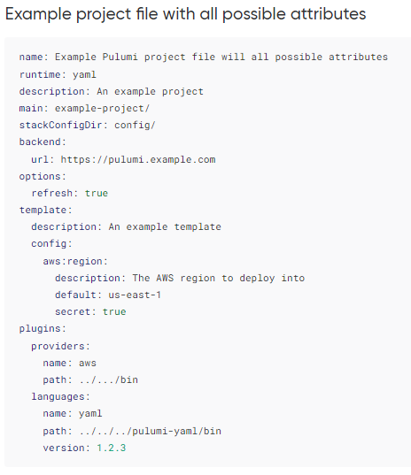
Project - Pulumi.yaml

Slide 20
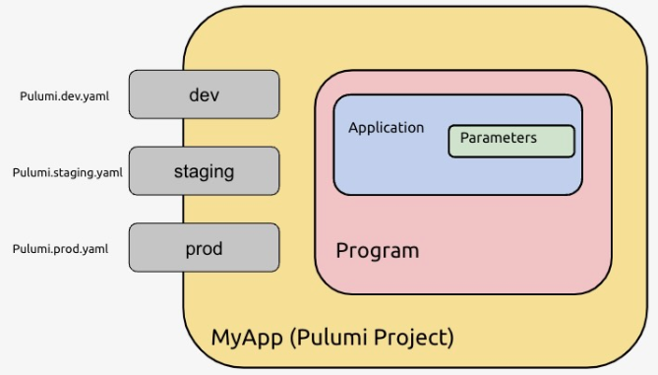

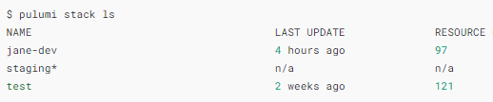
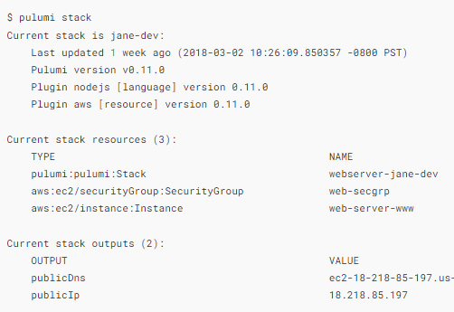
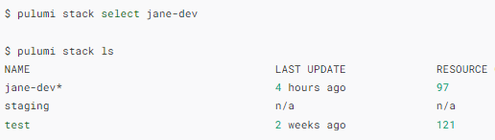

stack

Slide 21
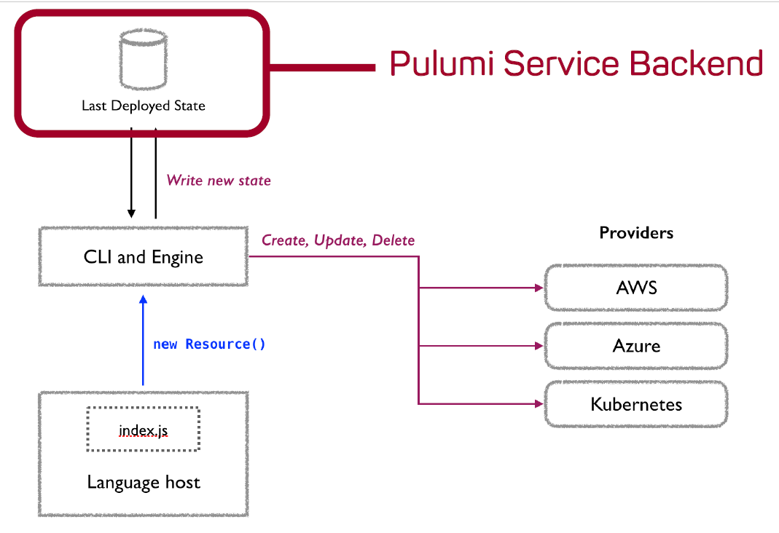
State and Backends
app.pulumi.com
Self-managed backend
on-premise app.pulumi.com (Enterprise version only)
Resource Providers
https://app.pulumi.com/nagkumar/hw/dev/updates/11

Slide 22
Resources

Slide 23
Inputs and Outputs

Slide 24

Configuration

Slide 25

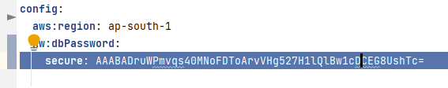
Secrets

Slide 26
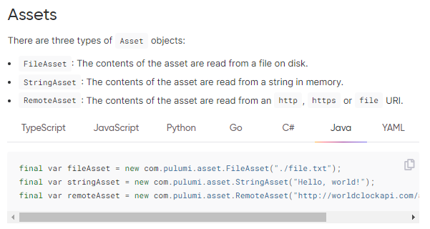
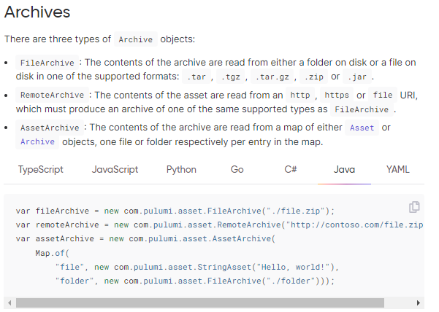
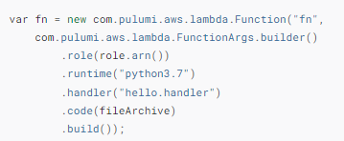
Assets and Archives

Slide 27
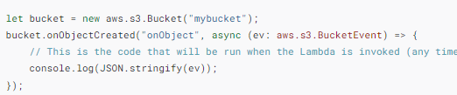
In-line code -Function Serialization

Slide 28
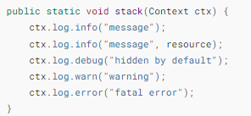
Logging

Slide 29
Creating Docker images

Slide 30
A Stack defines the State
micro-stacks.

Slide 31
Iac testing
Similarly, Pulumi provides multiple testing styles for cloud programs:
Unit Tests are fast in-memory tests that mock all external calls.
Property Tests run resource-level assertions while infrastructure is being deployed.
Integration Tests deploy ephemeral infrastructure and run external tests against it.
The following table summarizes the differences between the three approaches:
 | Unit Tests | Property Tests | Integration Tests
Provision real infrastructure | No | Yes | Yes
Require the Pulumi CLI | No | Yes | Yes
Time to execute | Milliseconds | Seconds | Minutes
Language | Same as Pulumi program | Node.js or Python | Any language
Validation target | Resource inputs | Resource inputs and outputs | External endpoints

Slide 32
Pulumi Registry
Packages
There are currently 3 different types of Pulumi Packages:
Native Pulumi Provider Package: Use the full features of the Pulumi resource model to create a provider for a new cloud platform. Examples: the kubernetes, azure-native, and google-native packages.
Bridged Provider Package: Take an existing resource provider from another supported ecosystem (like a Terraform provider), and bridge it to be exposed as a Pulumi Package. Examples: the aws, tls, and cloudflare packages.
Component Package: Write a Pulumi Component in your language of choice and expose it to users in all Pulumi languages. Example: the eks package.
Providers
Native Providers
Resource Providers
Component
https://www.pulumi.com/docs/guides/pulumi-packages/how-to-author/

Slide 33
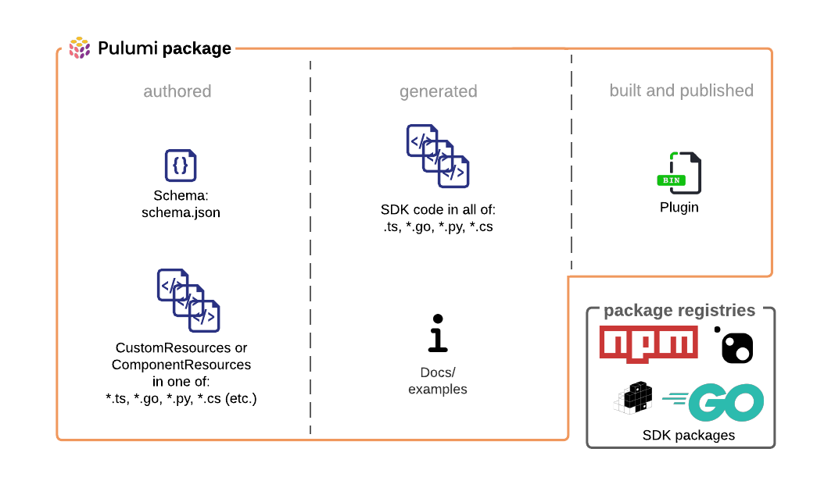

Slide 34
Cloud skills are code skills

Slide 35
