Slide 1
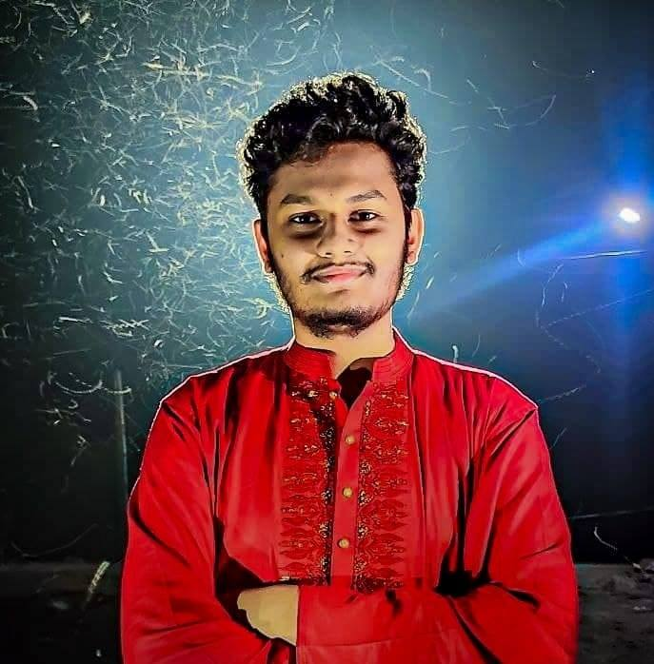



SUMMARY
I am a student currently studying CSE in Khulna University of Engineering & Technology. I am an advanced level Front End Web developer and intermediate level Back End Developer.
NAIMUR RAHMAN
EXPERIENCE
STUDENT
ABC Limited
Front End Developer
2022 – Now
XYZ Inc.
Junior Front End Developer
2020 – 2022
MNO Software Intern Developer
2019 - 2020
+8801751099887
naimur@gmail.com
2/A, Beauty Haven
Society, TR Road,
Saidpur, Nilphamari
LANGUAGES
Bengali
English
Hindi
EDUCATION
Khulna University of Engineering &Technology (KUET)
BSc in Computer Science and
Engineering
2020 – 2023
CGPA: 3.78
Saidpur Govt. Science College
HSC in Science
GPA: 5.00
HOBBIES
Gaming
Writing
Traveling

Slide 2
PROGARAMING
SKILLS
HTML
CSS
JavaScript
Python
C++
C#
Java
PHP
Front End Development
Back End Development
Database
Desktop Application Development
Mobile Application Development
PROJECTS
Job Portal Website (PHP/Laravel)
FIFA Ballon D’OR App (Java/MySQL)
Cardiac Recorder (Android)
UAV Controller (Python)
ACHIEVEMENTS
Dean’s Award
2019-20
2020-21
CERTIFICATIONS
ADDITIONAL SKILLS
Python for Data Science
Issuing Authority: Coursera
Year Obtained: 2022
Java Programming Certification
Issuing Authority: Oracle
Year Obtained: 2023
Time management
Problem-solving
Adaptability

