Slide 1

Bangladesh Army University of Science and Technology
Project: BAUSTian Query (Web based Online Discussion Forum)
Course Code: CSE 2200
Course Title: Software Development Project II
Submitted by:
Name: Naimur Rahman
Roll: 180201055
Batch: 8th
Level: 2
Term: II
Sec and Group: A Sec, G2
Dept. of CSE, BAUST.
Supervised By:
Md. Toukir Ahmed
Lecturer,
Dept. of Computer Science and Engineering,
Bangladesh Army University of Science & Technology (BAUST),
Saidpur Cantonment, Saidpur, Nilphamari

Slide 2

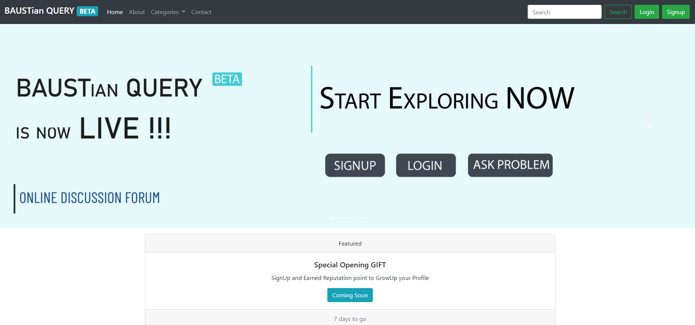

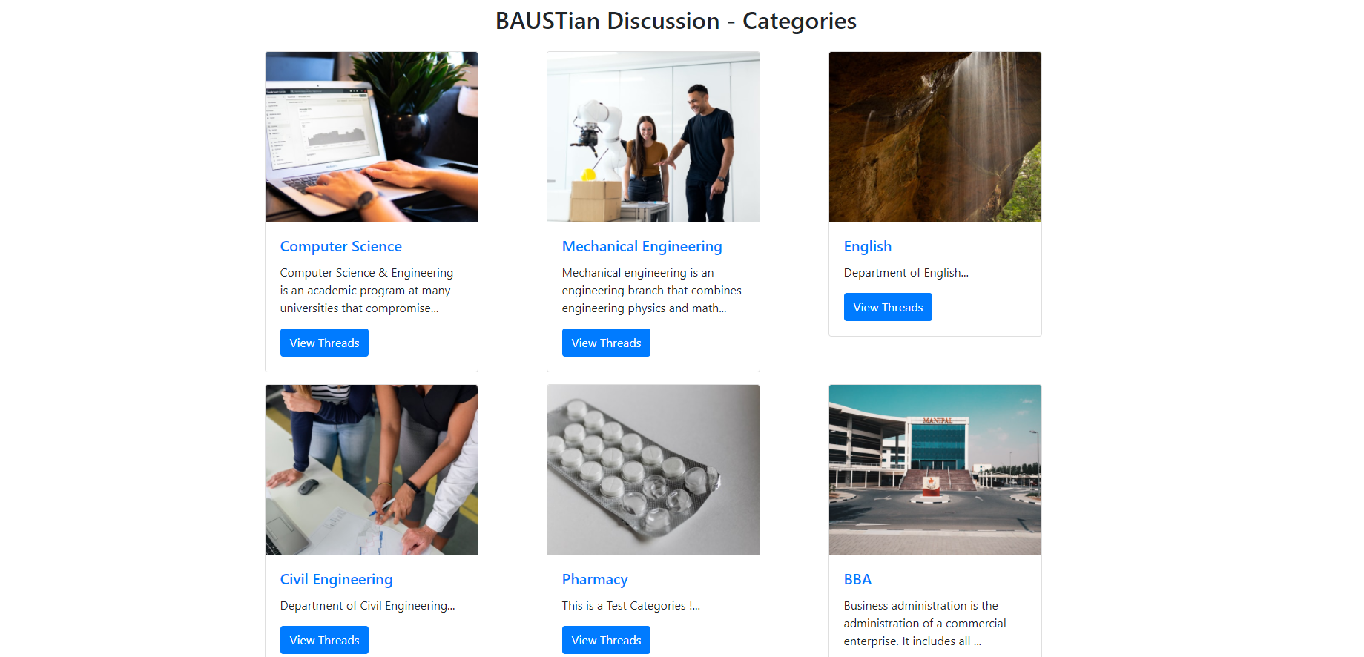
Screenshot From Browser
Features
New User SignUP
Existing User Login
Start a Discussion
Comment on a Discussion
Search on a Topic
Restriction on commenting and Start Discussion without Account

Slide 3

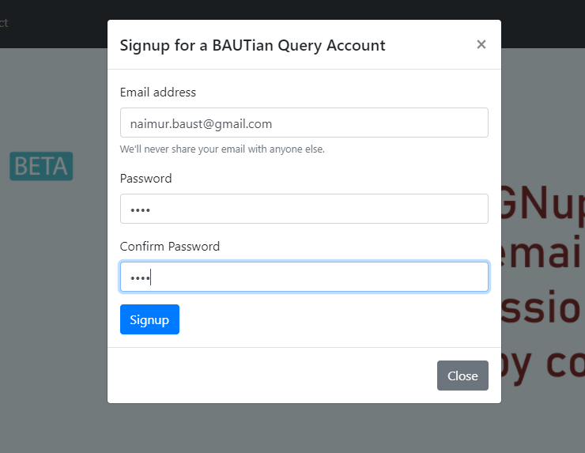
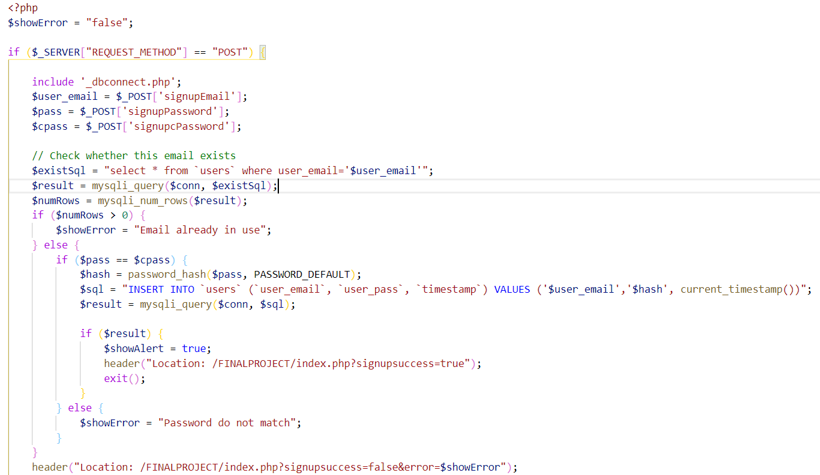

New User SIGNUP
After Clicking Sign UP Button
Backend Code
If Sign Up Success

Slide 4

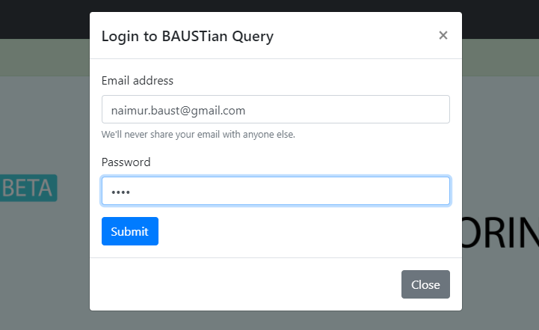
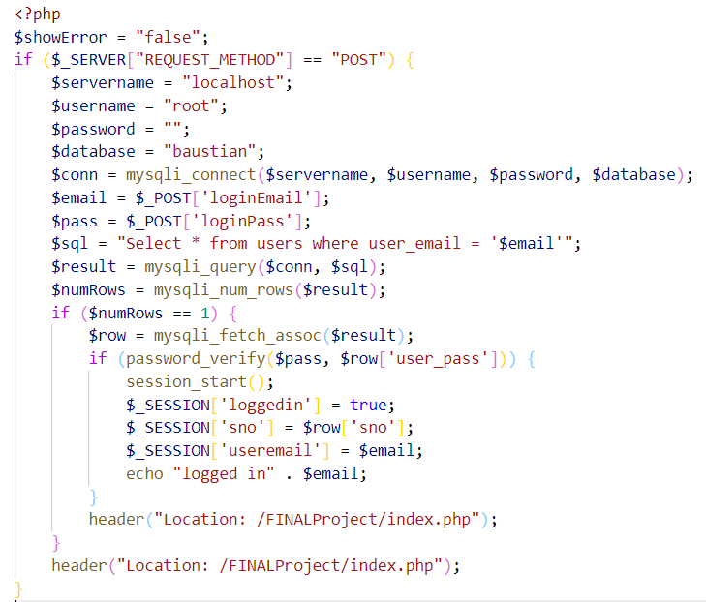

LOGIN for Existing User
After Clicking Login Button
Backend Code
Fetch Existing User from Database
IF it match, a Session will start for the user
If Login Success

Slide 5

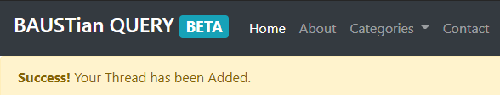
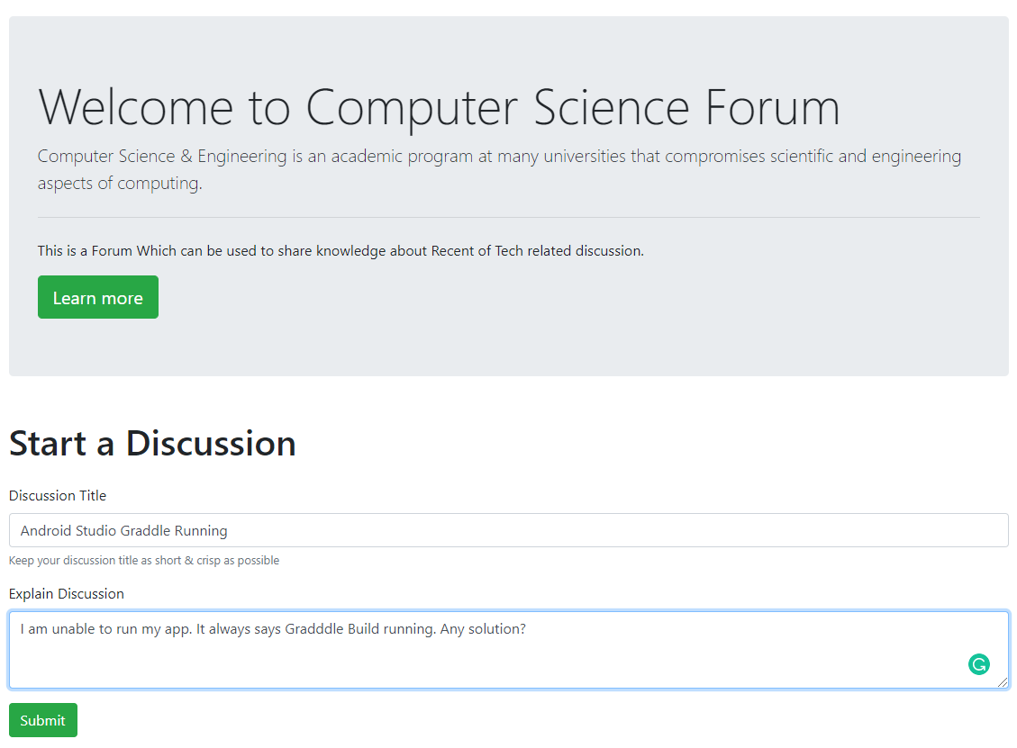
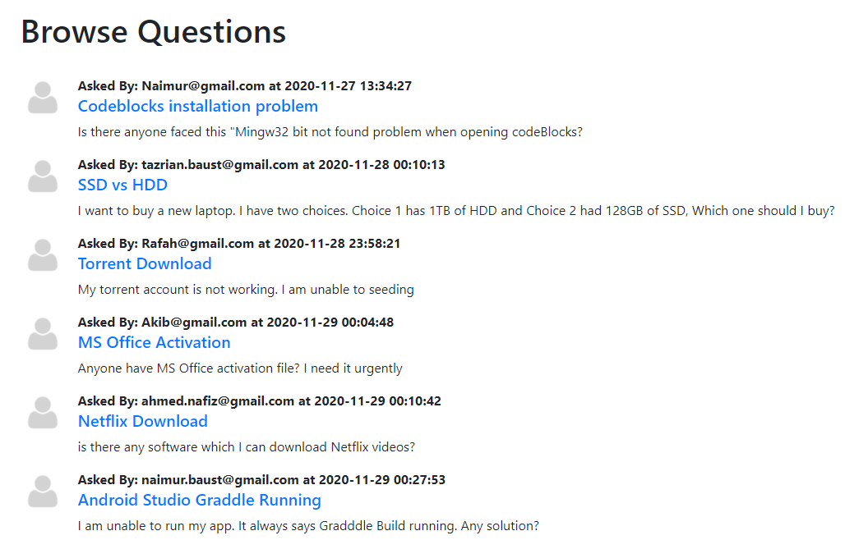
Starting a Discussion (Logged In)
User will get an alert if the Thread successfully published
User must be Logged in to start a Discussion
His/her discussion will be visible to other user

Slide 6

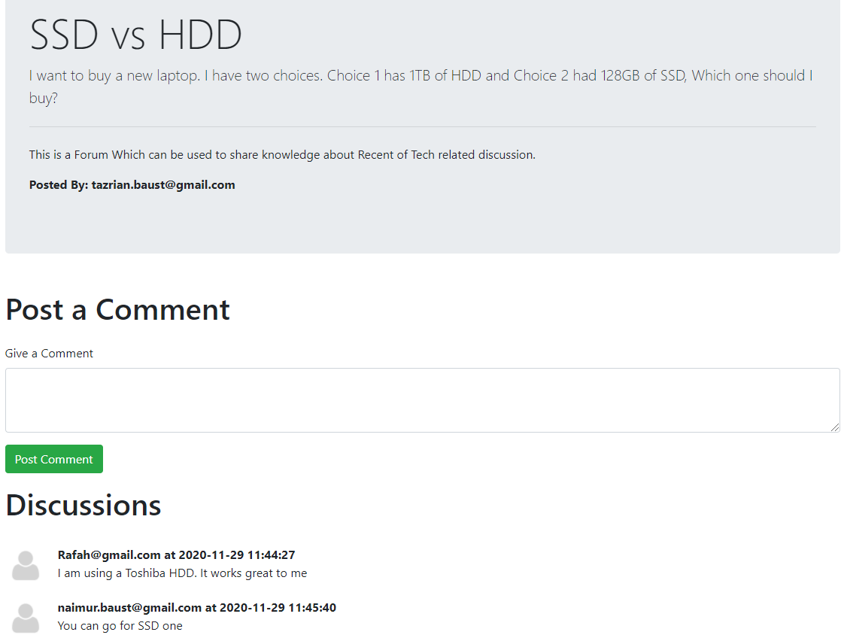
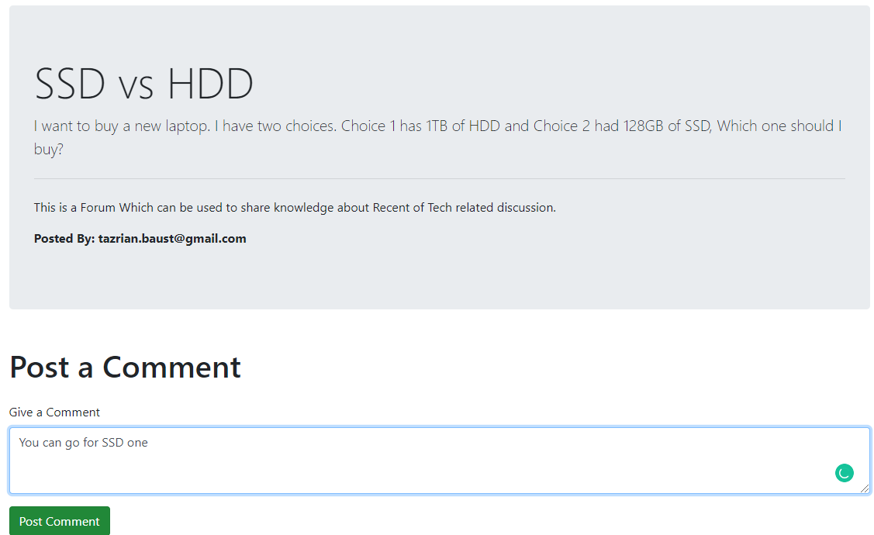
Commenting on a Discussion (Logged In)
User must be Logged in to add a Comment
His/her comment will be visible to other user

Slide 7

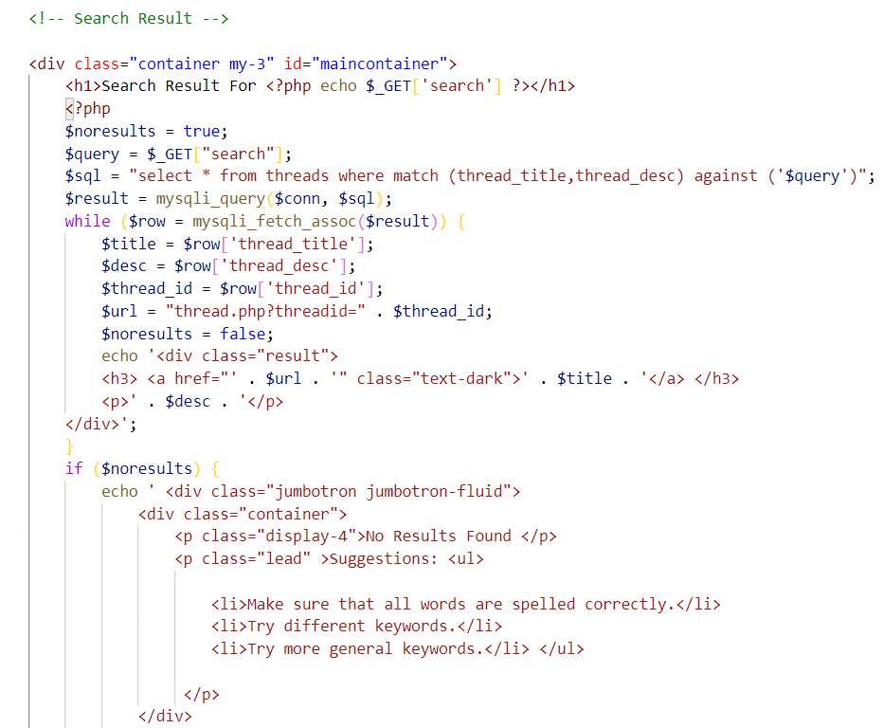

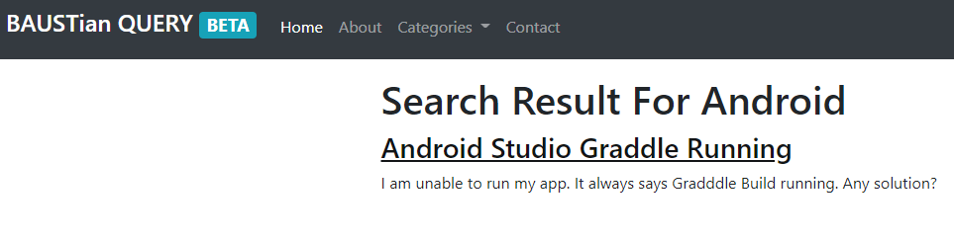
Searching a Discussion
USER can search on a specific existing topic
Backend Code
From the Search Result, user can directly open that specific discussion

Slide 8


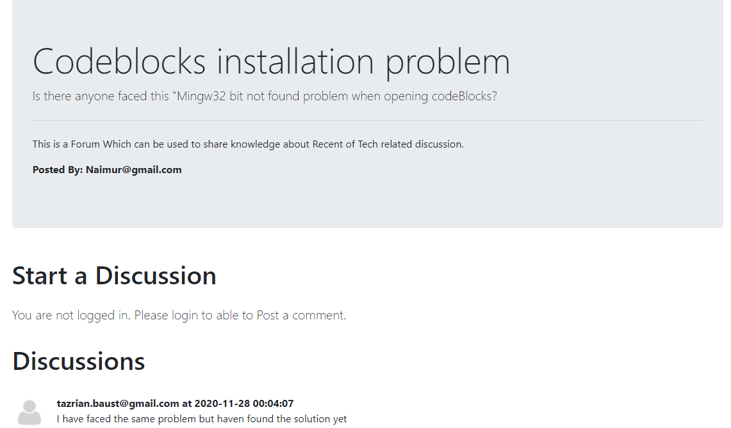
Restriction on Commenting & Starting Discussion
Visitors are not allowed to START a Discussion or Comment on POST
Without Login
Without Login

Slide 9

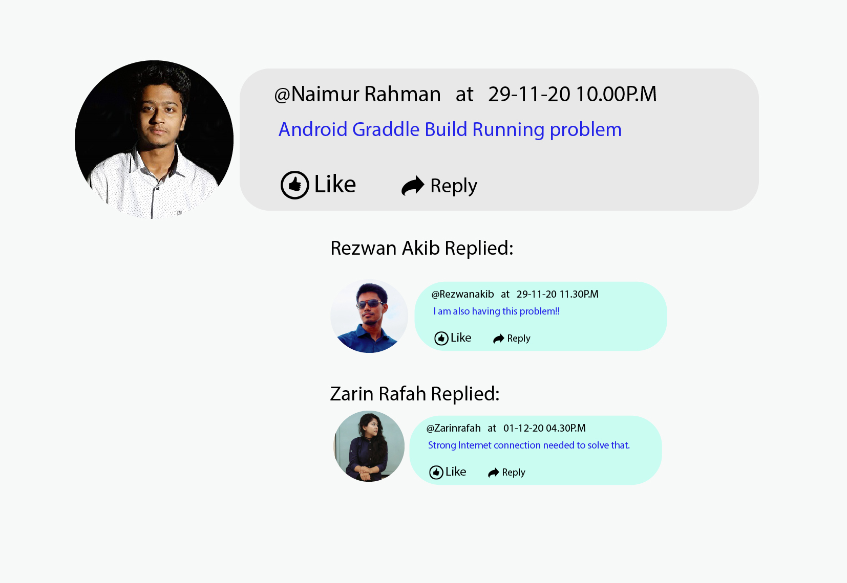

Update
It is Still in beta, it will get many features when a Stable Version will be Released.
Demo Concept
User will be able to change password
Upload images / videos
Will be able Like other’s comment
Profile Picture for Every USER

Slide 10



Tutorial and GitHub Link
https://youtu.be/hY7WeruieAg
https://github.com/Naimurinlife/BAUSTianQuery

Slide 11

Thank You For Watching

