Slide 1

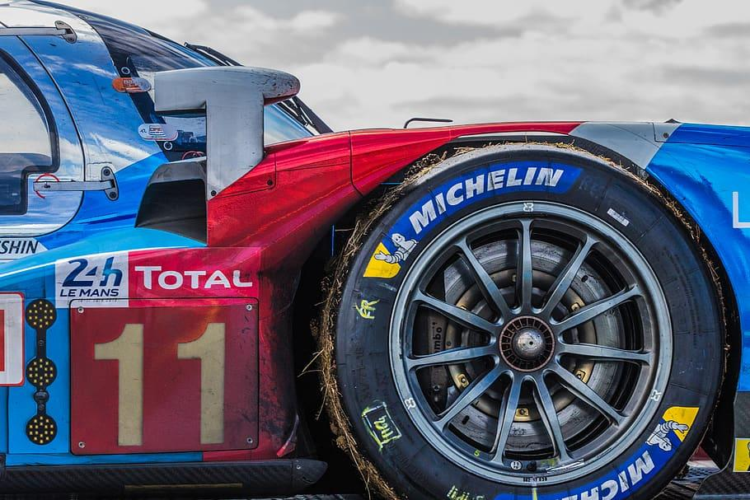
Team 3 Case Study——
Michelin: Building a Digital Service Platform
Haocong Ding, Harry Horowitz, Jing Dai, Mingxin Li,
Naina Grover, Weiwen Qi

Slide 2
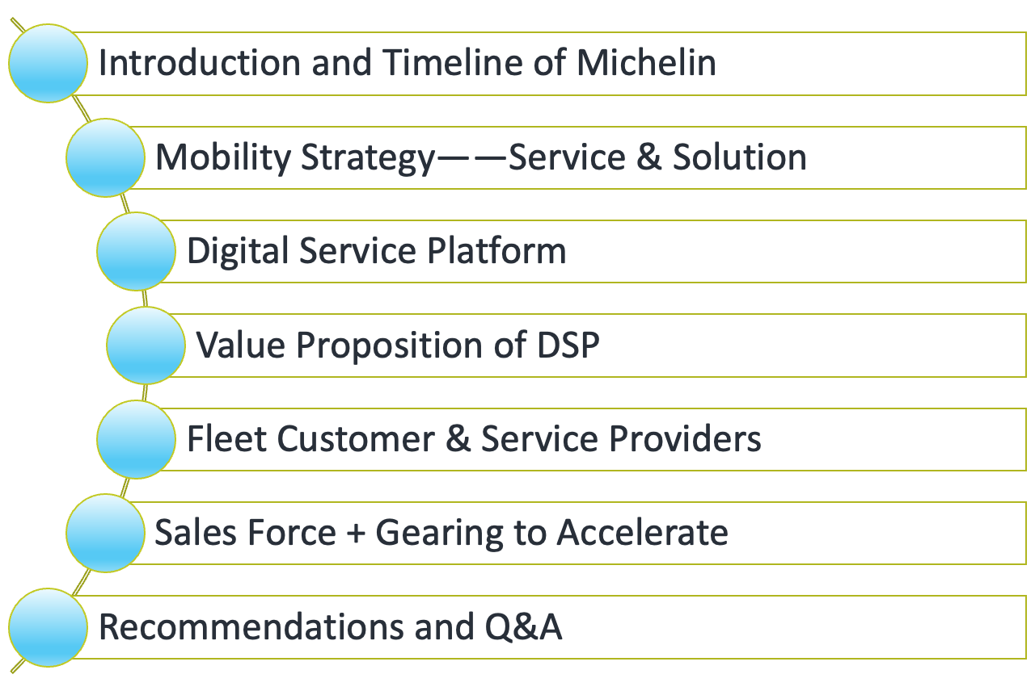

Content

Slide 3
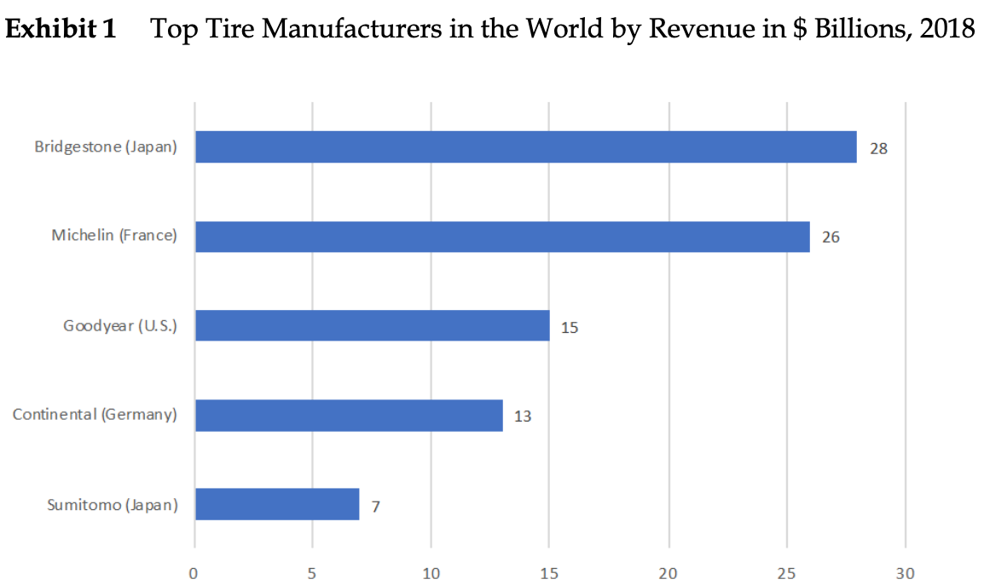
The Global Tire Industry
Automotive, commercial vehicle, agriculture, mining, aircraft tires etc.
Dominated by 5 tire manufacturers ➡️
Top 3 producers and consumers: China, the US and India (China’s production 5 times greater than the US)

Slide 4


Slide 5
Mobility Strategy--Services & Solutions
(2017) 4 areas
Core: Tires
Services & Solutions
Experiences
High-tech Materials
(2019) 14 product lines
“The company was founded as a mobility company, not a tire company.”
(2019) S&S
Have $600 million in revenue globally
4 business units
Tires-as-a-service
Fleet Management
Connected Mobility
Digital Service Platform (DSP)
10% today
25% in 5 or 7 years

Slide 6
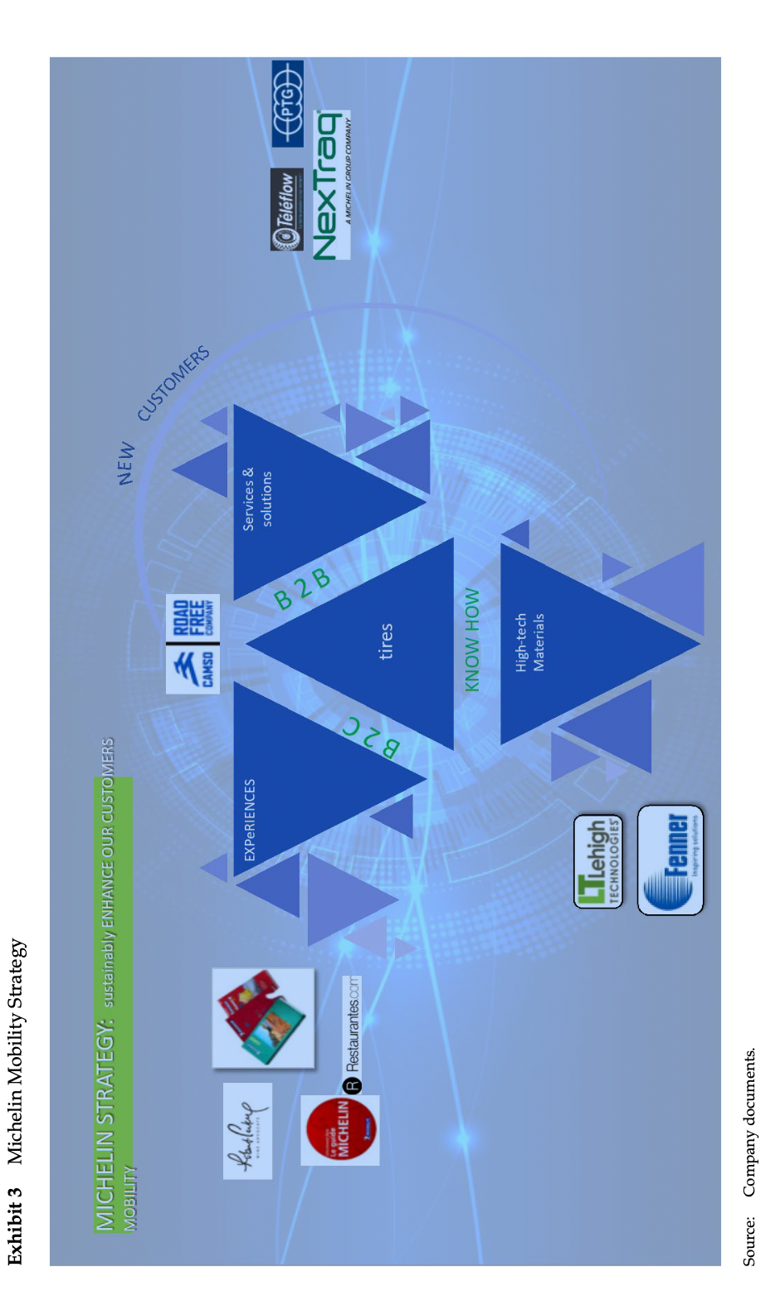

Slide 7
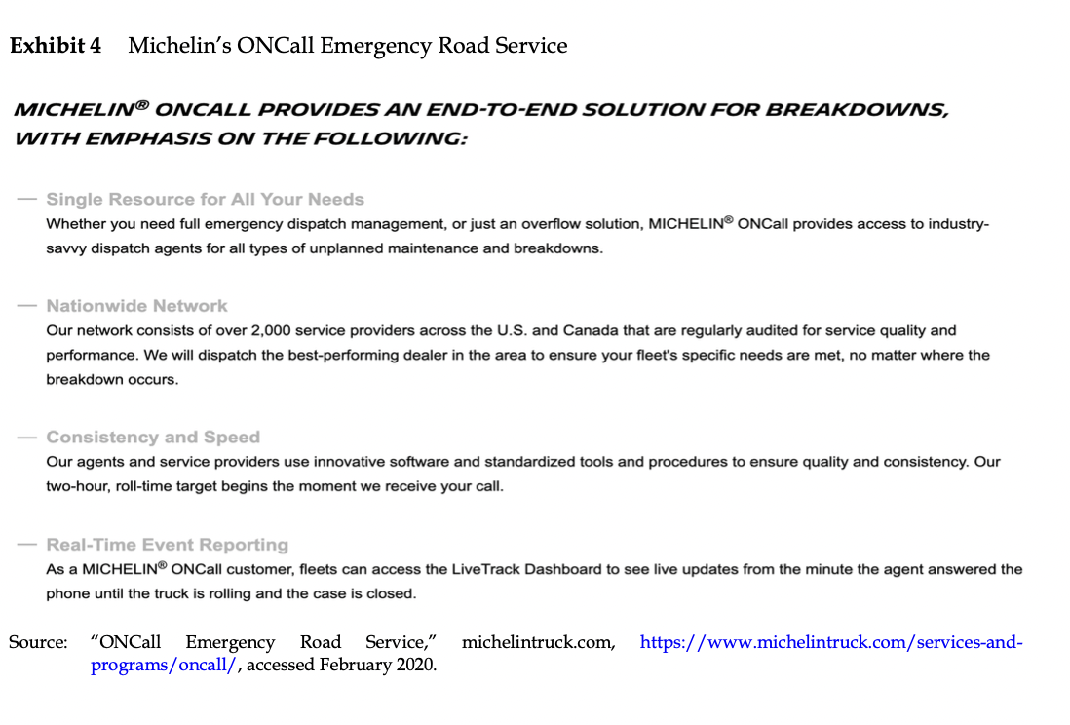
Digital Service Platform (DSP)
Truck Care: The First Attempt
Light mechanical offering
R.Kukanis recalled first attempt
Growth opportunity: 8 SP using in 60 locations
Software not architected well & outsourced
Michelin ONCall 2.0
Emergency Roadside Services product
2019: Became largest service provider
Fundamental pain-point for dealers
Opaque, non-transparent process

Slide 8
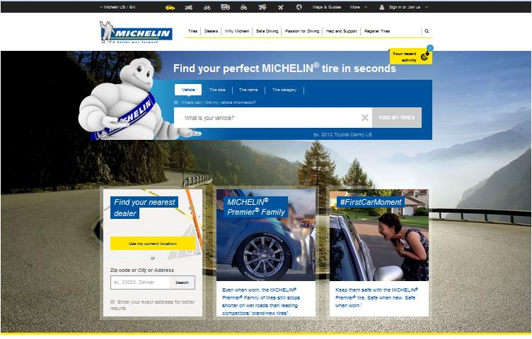
Beginning and Evolution of DSP
Beginning of DSP
Paper-based record keeping process
Need for digital intervention
System different for Services
Evolution of DSP
Mechanical service- only 5% market needed
Development of DSP in 2016
Tested Software Integration-POS
Revenue model unclear
DSP’s value proposition

Slide 9
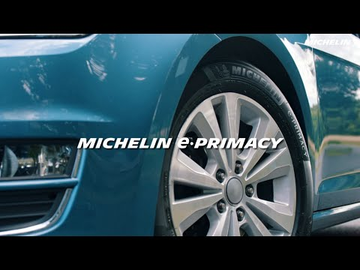
Do you want to know the Michelin’s strategy in March 2021?

Slide 10
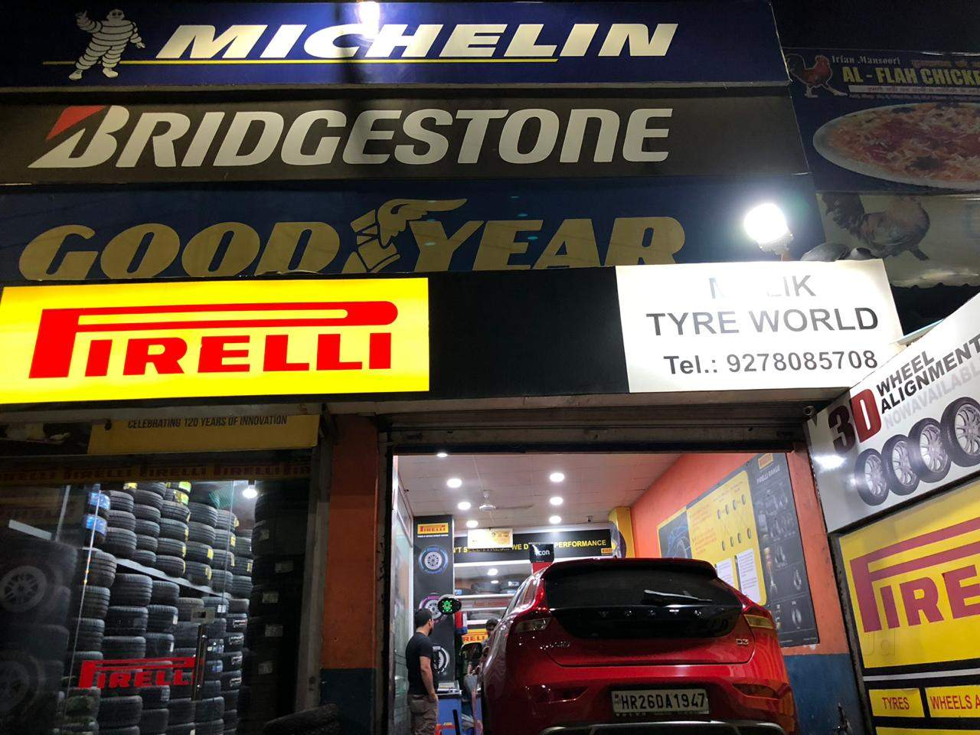
Value Proposition
Benefit of DSP
Improved mechanical-tech productivity
Administrative time savings
Incremental revenue
Improved audit and reduced legal liability
Challenge to DSP
Increasing cost
Unwilling to change
Establishing mechanical care network
Integrating DSP with POS

Slide 11
Fleet Customers and Service Providers (Dealers)
Fleet Customers
Contribute 60% of sales in NA
Tend to be more comfortable with technology
Want robust platform & full coverage across NA
Service Providers (Dealers)
Franchised dealers & small independent dealers
Medium sized & Traditional business model
Revenues came from selling new & retreading tires

Slide 12

Sales Force
Gearing to Accelerate
Small sales force (10%–15% of the sales people)
Different sales strategy - transactional to consultative
Low attention from sales person
Low potential revenue
Free trial for six month & Free training
Monthly subscription or per transaction basis

Slide 13
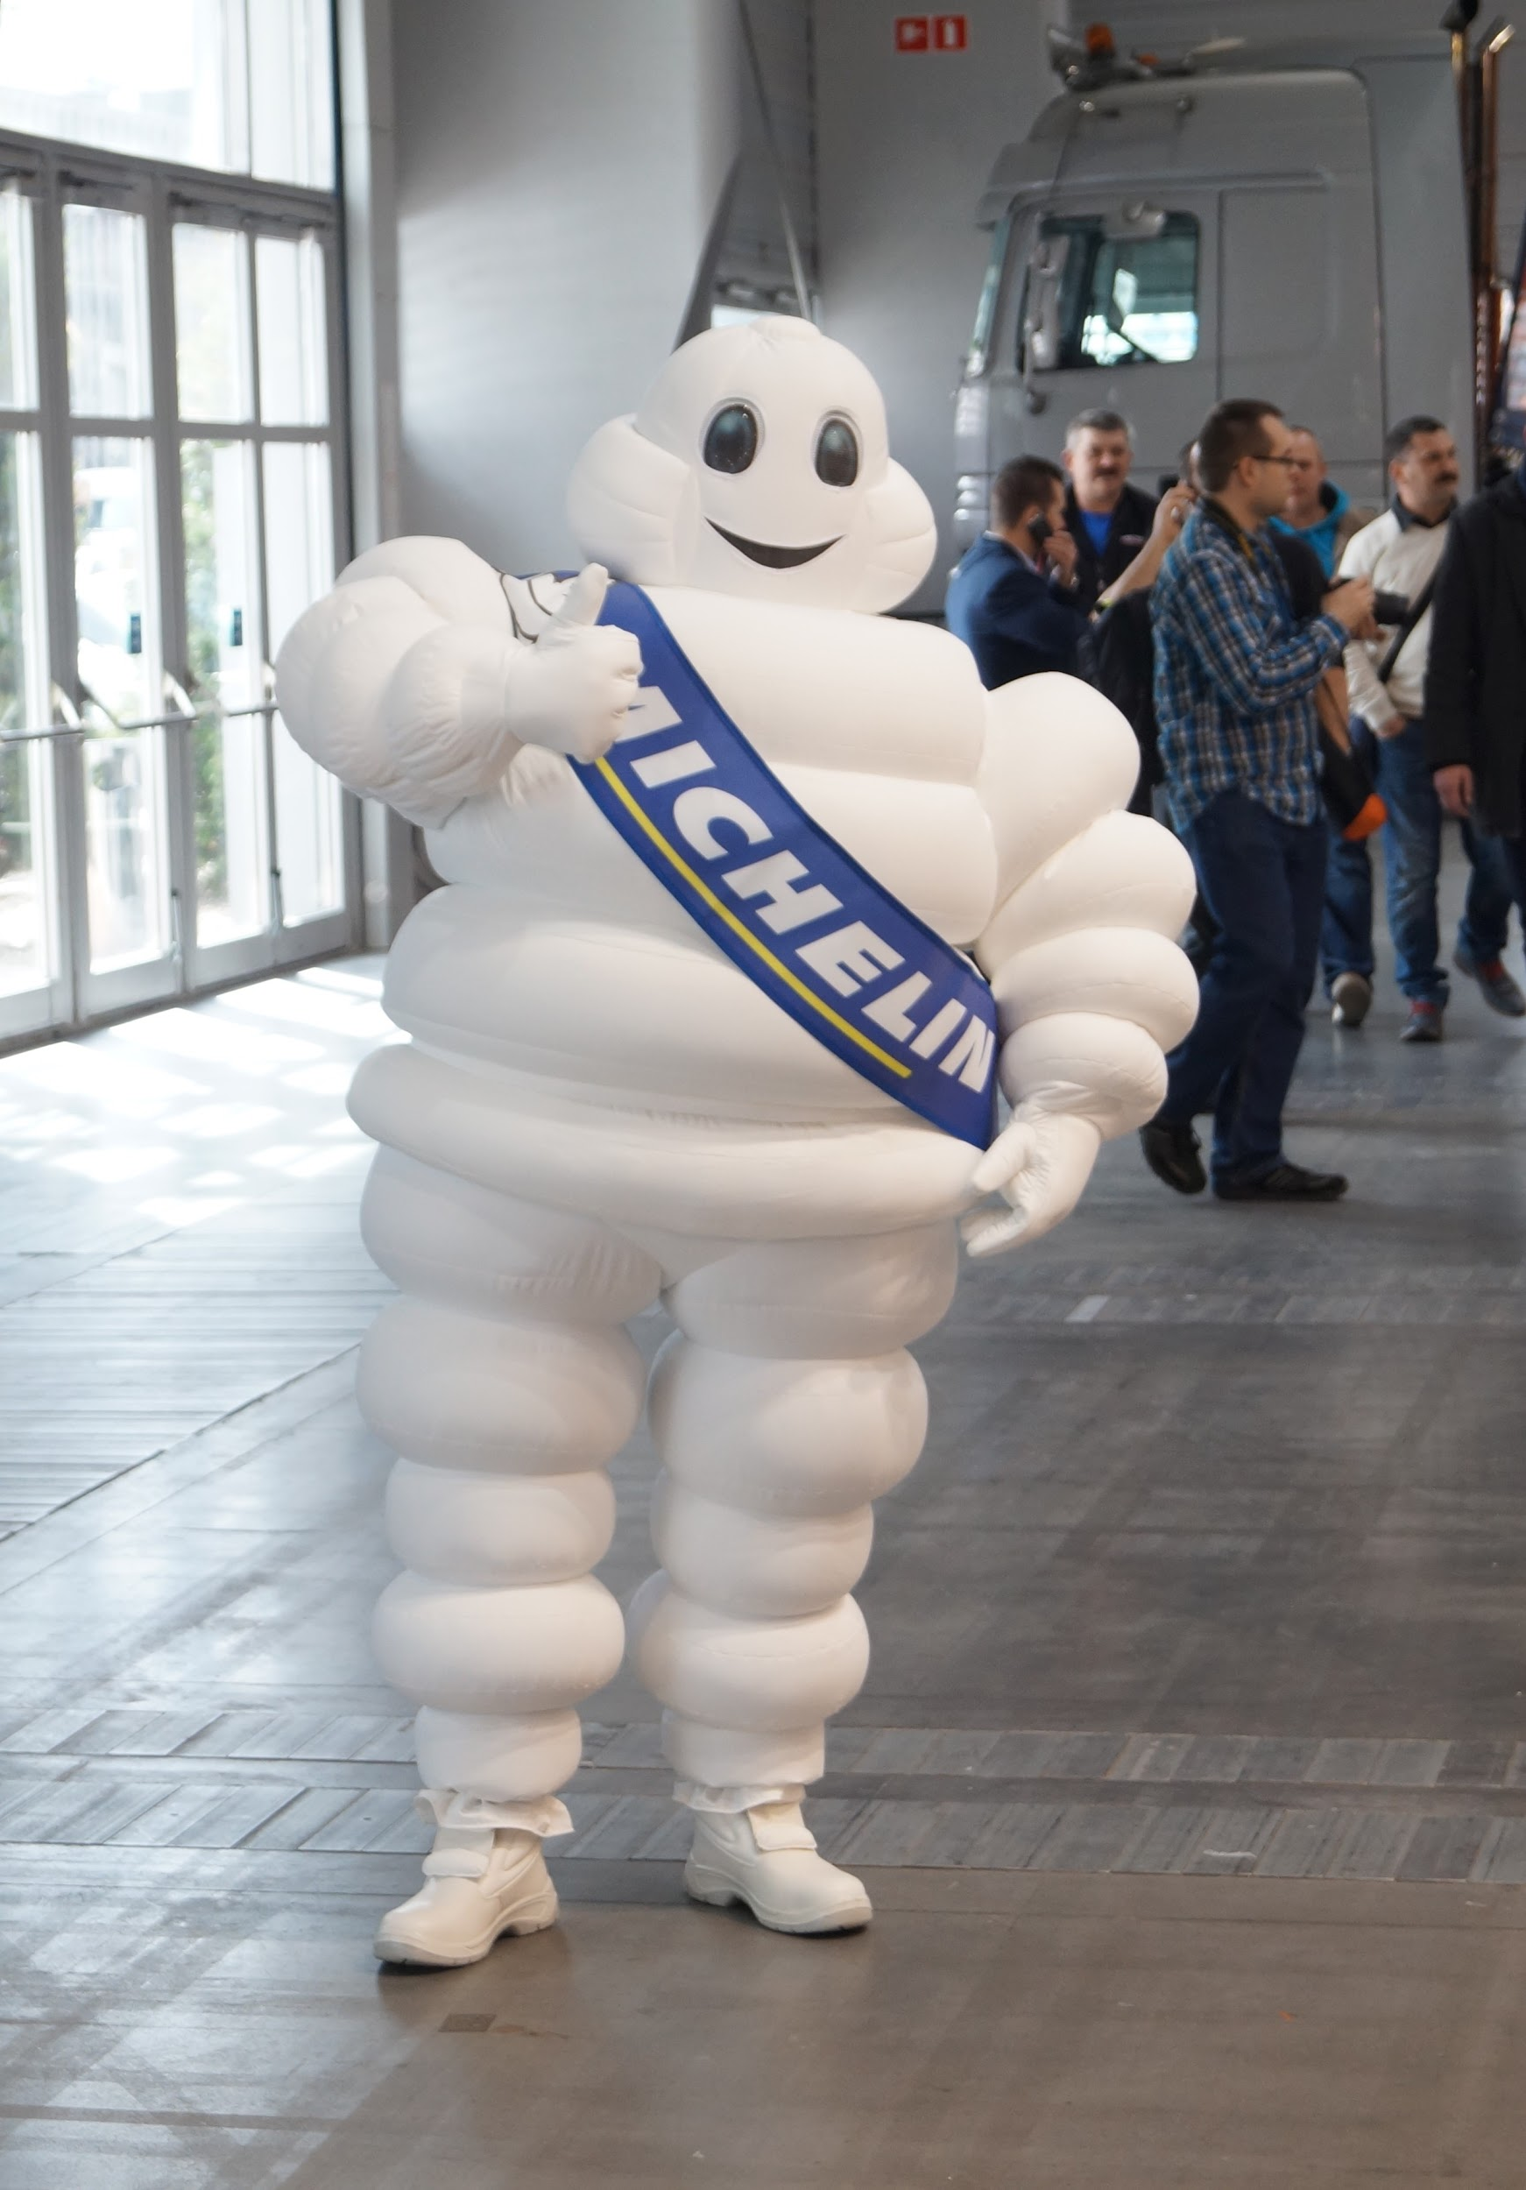
Recommendations
Free Training and installation of DSP platform
Equipment and subscription services paid for only once certain number of transactions have occurred through the DSP system
Enhance value proposition of DSP by focusing on mobility services instead of tires
Changing the sales culture from a simple product based one to services as well

Slide 14
Takeaways
Digital Disruption is not necessarily easy to implement.
Michelin can definitely add value through their DSP but they must first improve its rollout.
Digital transformation has the ability to greatly improve business models.

Slide 15


