Slide 1
UE20CS344 – Network Analysis and Mining
Course Project
Project Title : Graph mining and Complex Social network analysis
PES1UG20CS059 Ankitha N
PES1UG20CS228 Akanksha kurapati
PES1UG20CS237 M Yuktha
PES1UG20CS615 Nayana D Raj

Slide 2
Topic
Conducting graph mining and social network analysis on the Netflix movie titles dataset to learn more about the connections between movies, stars, and directors. by displaying movies as nodes and the connections between them as edges.

Slide 3
Uniqueness
We can learn about hidden links, spot patterns and trends, generate personalised suggestions, and obtain insights into the entertainment sector as a whole by performing graph mining and social network analysis on the dataset of Netflix titles.
It is possible to improve viewers' viewing experiences, learn more about the entertainment industry, and make better decisions regarding content creation and marketing.

Slide 4
Dataset
Size: 5838 rows
12 columns
Attributes: show_id, title, director, cast, country, date_added, release_year, rating, duration, listed_in, description, type
Source: Kaggle platform
Format: Comma separated values(csv)
Variable: Integer, categorical, string, mixed

Slide 5
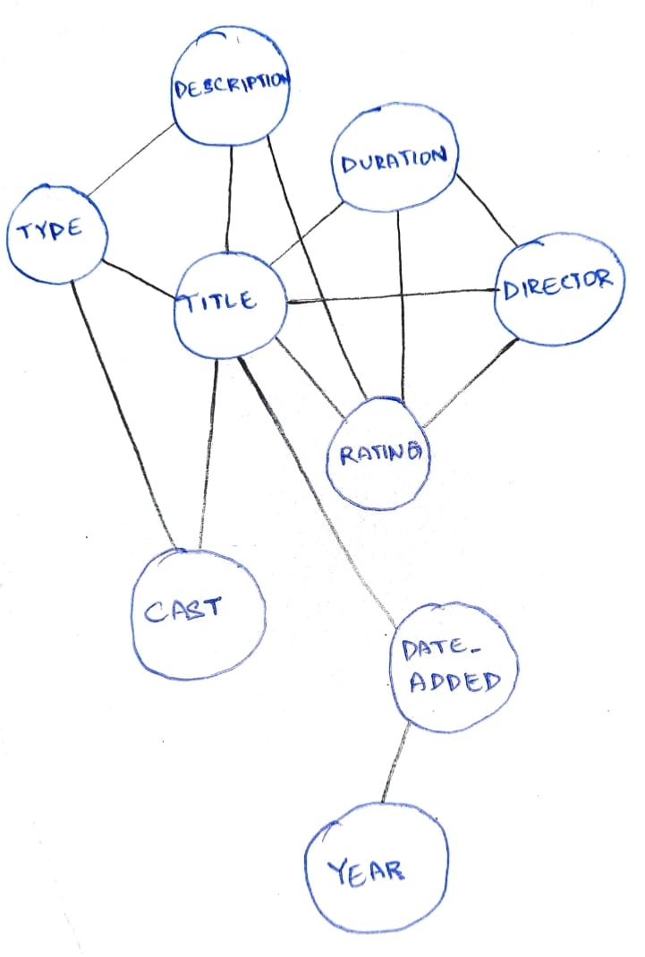
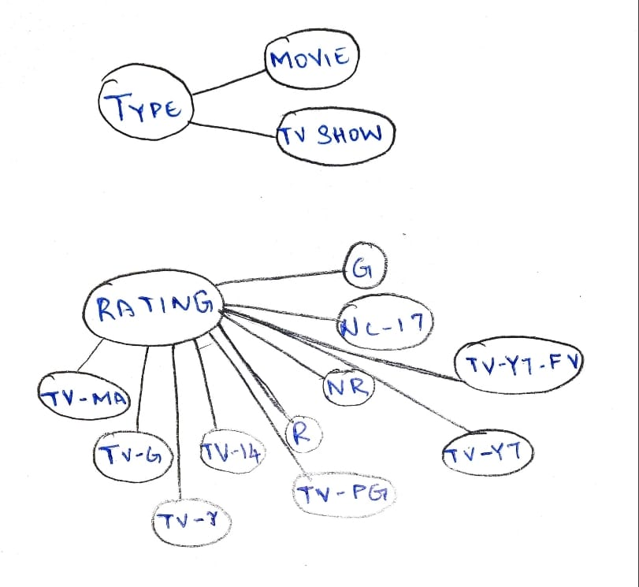
Overall design or approach in a free hand diagram

Slide 6
Final results so far
Visualisation
The ‘best-partition’ function from the ‘community’ module is used to partitioning the graph into different communities based on the modularity optimization. The number of communities is also printed.
The code also defines community_number to select a specific community and then finds all directors belonging to this community by iterating over the partition dictionary. The code then creates a new dataframe, community_data, that contains the frequency of movie ratings for the directors in this community and a bar plot is generated.

Slide 7
Done vs Remaining to be done ?
No | Description | Done or To be done
1 | Data transformation(data cleaning) | Done
2 | Bipartite graph using the NetworkX library in Python | Done
3 | Weighted projected graph from the bipartite graph | Done
4 | Closeness Centrality | Done
5 | Betweenness Centrality | Done
6 | Pagerank | Done
7 | Closeness Centrality - Betweenness Centrality - Pagerank | Done
8 | Detecting communities in the projected graph using python-louvain package | Done

Slide 8
Quantity and quality of work
no | Code functionality | % Complete | Runs without problem (Y/N) | If there are minor issues, indicate
1 | Performs a transformation on a Pandas DataFrame named "df" by splitting the values in the "director" column by comma and creating a new DataFrame where each row represents a unique combination of "director" and "rating". | 100 | Y | None
2 | The code implemented creates a new Graph object using the NetworkX library in Python, where the graph is bipartite, meaning the nodes can be divided into two sets such that nodes in one set cannot be connected to other nodes in the same set. | 100 | Y | None
3 | The code creates a new graph with directors as nodes, where the weight of each edge represents the number of ratings that are shared by two directors. | 100 | Y | None

Slide 9
Quantity and quality of work
4 | Sorting the nodes in the graph by their closeness centrality values, and selects the top 19 nodes with the highest centrality scores. The resulting list of tuples is stored in the "top_closeness" variable. | Y | 100 | None
5 | This code computes the betweenness centrality of each node in the graph using the "betweenness_centrality()" function from the NetworkX library. The code then sorts the nodes in the graph by their betweenness centrality values, and selects the top 19 nodes with the highest centrality scores. The resulting list of tuples is stored in the "top_betweenness" variable. | Y | 100 | None
6 | PageRank is to identify the most important directors in the graph based on their connections with other directors and ratings. Finally, it visualizes the results with a graph where the size and color of the nodes represent the centrality of the directors. The code also generates lists of the top 19 directors based on each centrality algorithm. | Y | 100 | None

Slide 10
Quantity and quality of work
7 | The code is implemented to identify the movie directors that appear in the top 19 lists of all three centrality algorithms (closeness centrality, betweenness centrality, and PageRank) and printing their names. These directors are likely to be the most important and influential in the network of movie ratings and directors. | Y | 100 | None
8 | The code is implemented using the Louvain method from the python-louvain library to detect communities in the graph of movie directors based on their connections with ratings. The code first applies the best_partition function to the graph to detect the communities, and then it assigns a different color to the nodes in each community. The code also prints the number of communities detected in the graph. Finally, it visualizes the communities with a graph where the nodes are colored according to their community membership. | Y | 100 | None

Slide 11
Top few learning
Serial No | Top learning in this project
1 | Centrality measures:Centrality measures are a key aspect of network analysis. You may have learned about different types of centrality measures, such as degree centrality, betweenness centrality, and eigenvector centrality, and how to calculate and interpret them.
2 | Graph algorithms: Graph algorithms are used to analyze and manipulate network data. You may have learned about different graph algorithms, such as shortest path algorithms, minimum spanning tree algorithms, and how to implement them in your project.
3 | Design: Designing the network analysis project requires careful consideration of the research question, the data sources, and the analysis methods. Choosing the appropriate research design can be challenging, particularly when dealing with complex social systems.

Slide 12
Top unresolved challenges
Serial No | Brief description of unresolved challenges | Type of challenge (scope/data/design/implementation / others)
1 | Data quality: Network data may contain errors, missing values, or inconsistencies, which can affect the accuracy of network analysis results. Preprocessing and cleaning the data can be time-consuming and require careful attention to detail. | Data
2 | Scope: Defining the scope of the network analysis project can be challenging. Choosing the appropriate level of detail and deciding which nodes and edges to include in the analysis can affect the accuracy and relevance of the results. | Scope
3 | Design: Designing the network analysis project requires careful consideration of the research question, the data sources, and the analysis methods. Choosing the appropriate research design can be challenging, particularly when dealing with complex social systems. 20CS344 Course Project | Design

Slide 13
Top unresolved challenges
Serial No | Brief description of unresolved challenges | Type of challenge (scope/data/design/implementation / others)
4 | Implementation: Implementing the network analysis project can be challenging, particularly when dealing with large-scale data and complex analysis methods. Choosing the appropriate software tools and programming languages can affect the accuracy, efficiency, and scalability of the implementation. | Implementation
5 | Scalability: Scaling network analysis projects to larger networks and datasets can be challenging. Choosing the appropriate algorithms, data structures, and computational resources can affect the efficiency and effectiveness of the implementation. 20CS344 Course Project | Others

Slide 14
Reference papers (optional)
No | Paper Title | Authors
1 | Han, J., J. Pei, and M. Kamber. "Graph mining, social network analysis, and multirelational data mining." Data Mining: Concepts and Techniques (2006): 535-589. | J Han, J Pei, M Kamber
2 | Vedanayaki, M. (2014). A study of data mining and social network analysis. Indian Journal of Science and Technology, 7(S7), 185-187. | M. Vedanayaki
3 | Fan, C., Xiao, F., Song, M., & Wang, J. (2019). A graph mining-based methodology for discovering and visualizing high-level knowledge for building energy management. Applied Energy, 251, 113395. | C Fan, F Xiao, M Song, J Wang
4 | Stroele, V., Oliveira, J., Zimbrão, G., & Souza, J. M. (2009, August). Mining and analyzing multirelational social networks. In 2009 International Conference on Computational Science and Engineering (Vol. 4, pp. 711-716). IEEE. | V Stroele, J Oliveira, G Zimbrão

