Slide 1

HEssRNA : Heritability based Estimation of Sample size for RNA-Seq

Slide 2
HEssRNA is a shiny based web tool that helps researchers to estimate sample size for conducting an experiment using RNA-Seq data. The estimation of sample size before conducting an experiment is crucial for getting optimum results. This tool incorporates the use of heritability traits of Bos taurus from the CorrDB database and helps in estimating the sample size based on the heritability score of a trait. We have grouped the heritability traits into three different groups based on their mean heritability scores from CorrDB namely, high, mid and low heritable traits. In this study we have derived the relationship between heritability group and power of discrimination of DEGs and thus the sample size.

Slide 3
HEssRNA
Heritability-based Estimation of Sample Size for RNA-Seq

Slide 4
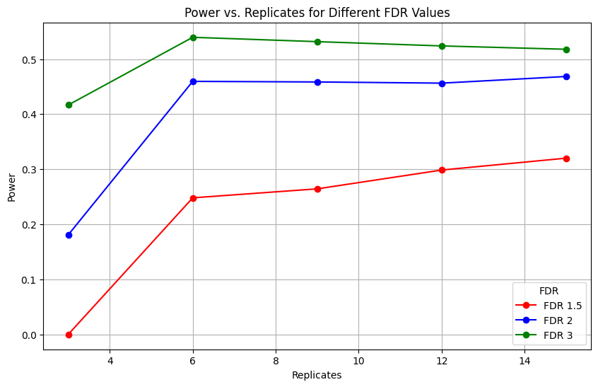
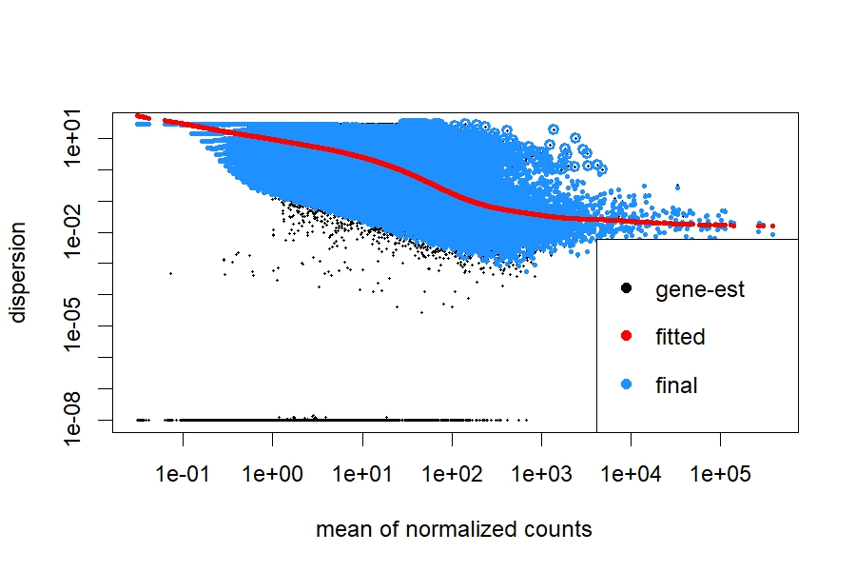
HEssRNA-Shiny
Heritability based estimation of sample size for RNA-Seq
Bovine animals
Heritability
Power of discrimination
Sample size
Heritability scores
RNA sequence
Scores
Fold change
Heritability class
Negative Binomial distribution
Sample size vs. Power
Negative Binomial distribution
High heritability

