Slide 1

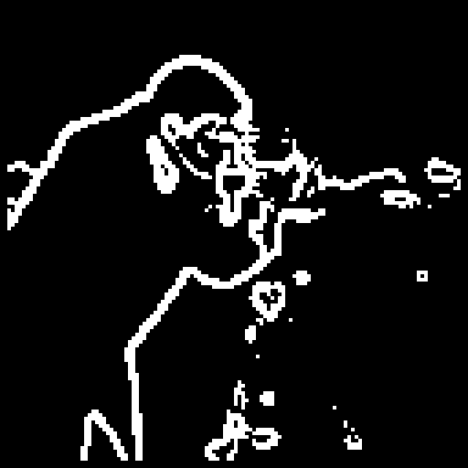
Jaypee Institute of Information Technology, Noida
Department of Electronics and Communication Engineering | Minor Project - 1
Design and Simulation of a Pipelined FPGA-Based Image Processing System for Noise Reduction and Sobel Edge Detection
Median filter + Sobel operator in Verilog HDL, verified bit for bit against a Python model
Submitted by: Naina Sehgal (2401180029, Batch A16)
Submitted to: Dr. Mandeep Narula
Edge map produced after median filtering
Notes:
Good morning. My project designs an FPGA image processing chain that first removes salt-and-pepper noise with a median filter and then finds edges with the Sobel operator. The image on the right is the edge map the system produces from a noisy cameraman image.

Slide 2
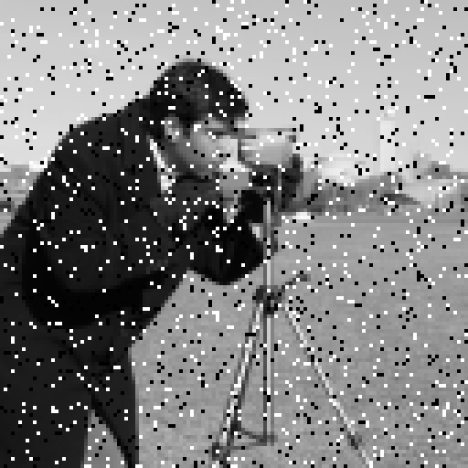
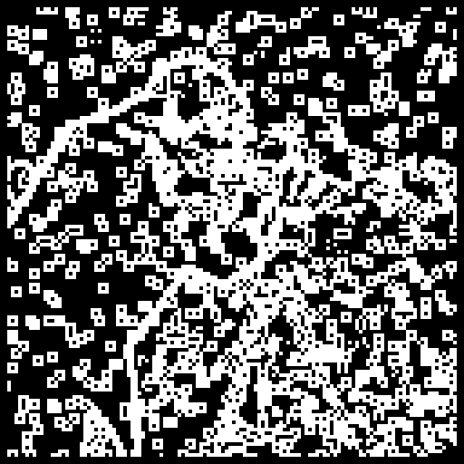
Problem: noise turns into false edges
4,969
false edge pixels in a 124×124 edge map
Salt-and-pepper noise sets random pixels to pure black (0) or white (255).
Sobel measures sudden brightness change, so every noise pixel looks like an edge.
Real-time vision needs a fix that runs in hardware, one pixel per clock.
Input with 10% salt-and-pepper noise
Sobel applied directly to the noisy image
Notes:
This is the problem. With 10 percent noise, Sobel marks almost five thousand pixels as edges that do not exist, and the real outline of the cameraman is lost. Software processes one pixel at a time, so for real-time use we want a hardware pipeline.

Slide 3
Aim and objectives
Aim: Design and simulate an FPGA system that removes salt-and-pepper noise with a pipelined median filter before Sobel edge detection, and evaluate edge quality and hardware behaviour.
1
2
3
4
Software model
Measure the benefit
Hardware design
Verify and measure
Integer-exact Python model of noise, median filter, Sobel and threshold.
Compare edges with and without filtering using PSNR, SSIM, false edges and F1.
Median filter as a streaming, pipelined Verilog circuit with line buffers.
Bit-exact check against Python; measure latency and throughput.
Notes:
The aim has four objectives: build a software reference, use it to measure how much the median filter helps, design the median filter in Verilog, and prove the hardware gives exactly the same output as the software.

Slide 4
Methodology
Software reference model (Python)
Input image
Add noise
Median filter
Sobel + threshold
Evaluate
cameraman, coins, shapes; 128×128, 8-bit gray
salt and pepper 5%, 10%, 20%; seed 2026
3×3 window, integer exact
|Gx| + |Gy| ≥ 200
PSNR, SSIM, false edges, F1
Hardware design and verification (Verilog, Icarus Verilog)
Test vectors
Verilog RTL
Simulation
Compare
Results
noisy image and expected output as .hex files
window_buffer, median_filter, median_stream
one pixel per clock, with and without pauses
every output pixel vs Python
denoised image, waveform, latency
Notes:
The work has two halves. The top row is the Python model that runs the full experiment. Its outputs become test vectors for the hardware, shown in the bottom row, where the Verilog design is simulated and every output pixel is compared automatically with Python.

Slide 5
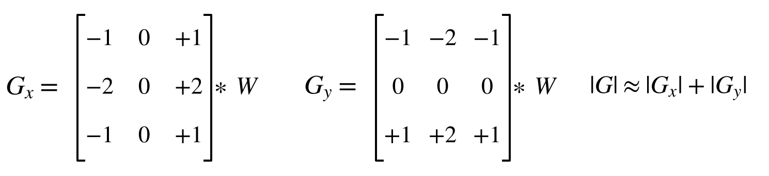
Algorithms: median filter and Sobel operator
3×3 median filter (hardware method)
Sobel edge detection
1
Sort each row of the window into low, middle, high.
2
A = max of lows, B = median of middles, C = min of highs.
3
Median of A, B, C equals the median of all 9 values.
Edge if |Gx| + |Gy| ≥ 200 (no square root)
Gx, Gy range −1020 to +1020: 11-bit signed
×2 is a bit shift, so no multipliers are needed
Runs in the software model in this phase
3 pipeline stages, 31 eight-bit comparators
A new window enters every clock
An isolated 0 or 255 can never be the median
Notes:
The median filter does not sort all nine values. It sorts each row, combines the rows into three values A, B and C, and takes their median. This gives the exact median with only 31 comparators in three pipeline stages. Sobel uses two 3 by 3 kernels; we add the absolute values instead of taking a square root, so the arithmetic is only additions and shifts.

Slide 6
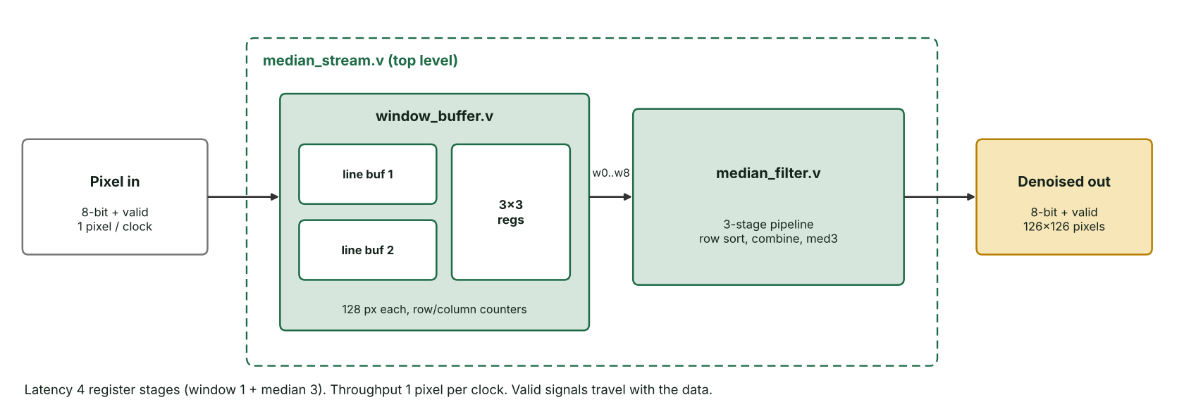
Hardware architecture in Verilog
Module | What it does | Clocks
window_buffer.v | Two line buffers keep the previous two rows; 9 registers hold the sliding 3×3 window | 1
median_filter.v | Row sort, row combine, final median of three | 3
median_stream.v | Top level: pixel and valid flag in, denoised pixel and valid flag out | 4 total
Notes:
This is the implemented hardware. Pixels arrive one per clock with a valid flag. The window buffer stores the previous two rows in line buffers, so a full 3 by 3 window is ready for every new pixel without storing the whole frame. The median filter is a three-stage pipeline, so the total latency is four register stages.

Slide 7
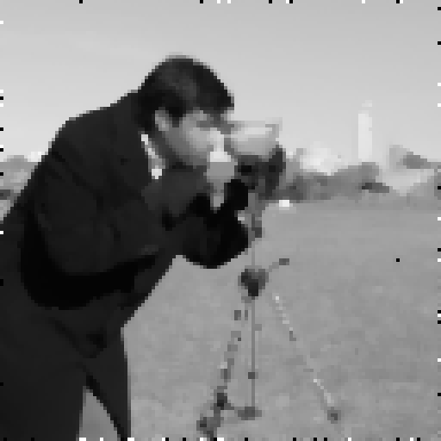
Result: median filtering removes the false edges
Noisy input (10%)
After median filter
Sobel only
Median, then Sobel
94 to 99%
0.42 → 0.81
15.2 → 26.3 dB
fewer false edge pixels across all 9 test cases
edge F1 score, cameraman at 10% noise
PSNR of the image after filtering
Notes:
Here is the cameraman image at 10 percent noise. Sobel on the noisy image is full of false edges, while Sobel after the median filter shows clean outlines. Across all nine test cases, false edges dropped by 94 to 99 percent.

Slide 8
Edge accuracy across images and noise levels
≥ 0.76
F1 with the median filter, in every case
0.22
worst F1 without it (shapes, 20% noise)
The gap widens as noise increases.
At 20% noise some windows hold 5+ noise pixels, so a few clusters remain.
Notes:
This chart shows the F1 edge accuracy for all nine cases. Grey is Sobel alone, green is median then Sobel. With the filter the score stays at 0.76 or above everywhere, while without it the score falls to 0.22 at 20 percent noise.

Slide 9
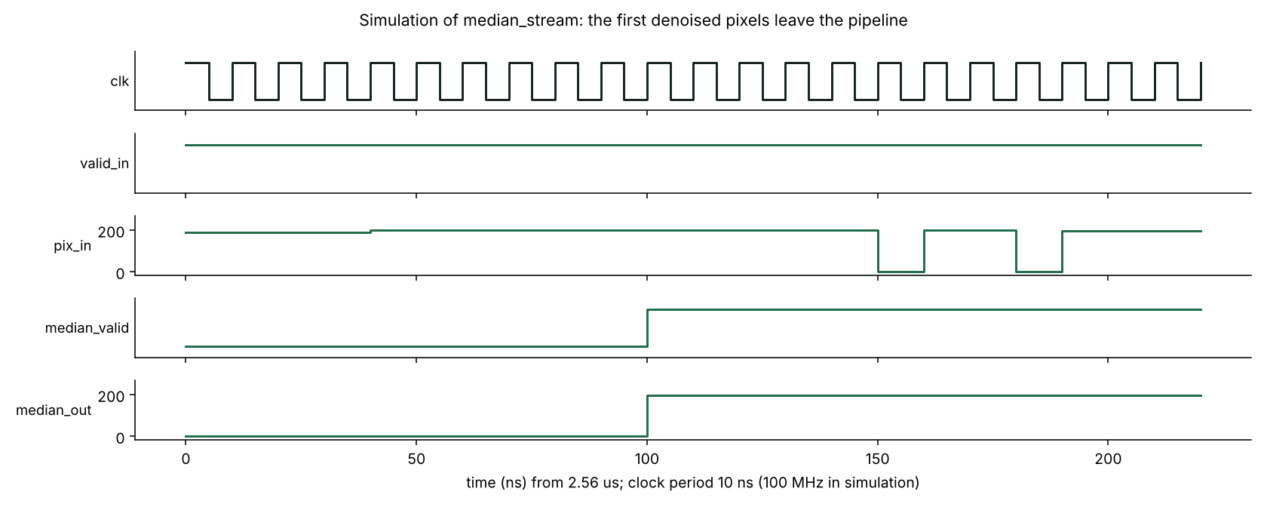
Hardware verification: bit-exact with Python
2,000 / 2,000
unit-test windows match the Python model
0 errors
on all 15,876 pixels of a full image, with and without input pauses
1 pixel / clock
Icarus Verilog waveform: two black noise pixels enter on pix_in, but median_out stays near 200
throughput (16,384 pixels in 16,389 clocks)
Testbenches read the noisy image from .hex files and compare every output automatically.
The rebuilt hardware output image is identical to the Python result.
4 stages
latency: window 1 + median 3
Notes:
To prove the hardware is correct, the testbench streams the noisy image into the Verilog design and compares every output pixel with Python. All 15,876 pixels matched, including a run with random pauses in the input. The waveform shows noise pixels going in while the output stays clean.

Slide 10
Conclusion and future scope
What this phase achieved
Next steps
Median filtering before Sobel cut false edges by 94 to 99% and kept edge F1 at 0.76 or above.
Pipelined Verilog median filter: 1 pixel per clock, 4-stage latency, only two line buffers.
Hardware matches the software model on every pixel, even with irregular input.
Implement Sobel and threshold in Verilog for a complete hardware pipeline.
Synthesise for Artix-7: resources, maximum clock frequency, power.
Adaptive median filter for noise above 20%; test on an FPGA board.
Thank you
Code: github.com/NainaS28/FPGA
Notes:
To conclude: the median filter makes Sobel robust to impulse noise, and the hardware median filter works at one pixel per clock and is verified bit for bit. In the next phase I will add Sobel in hardware and synthesise the full design. Thank you, I am happy to take questions.

