Slide 1


M.Tech/MCA Program
Advanced Industry Integrated Programs
Jointly offered by University and LTIMindTree
Review III
Data Narrator: NL-to-SQL BI Copilot with Auto-Insights
Natural Language → SQL → Data → Visualization → Insight
Nainshi Tikait
T9919
M.Tech Artificial Intelligence and Machine Learning
VIT Vellore | 2025–2027
Knowledge partner | Implementation partner

Slide 2
Data Narrator: NL-to-SQL BI Copilot with Auto-Insights
Introduction
Business users often depend on analysts or technical staff for data-driven answers.
SQL knowledge is a barrier to independent data exploration.
Data Narrator lets users ask analytical questions in plain English on their own CSV / Excel data.
The app converts the question into SQL, retrieves results, builds a chart, and writes a concise insight.
Core idea: from question to insight
Natural Language
SQL
Data
Visualization
Insight

Slide 3
Data Narrator: NL-to-SQL BI Copilot with Auto-Insights
Objectives
1
Convert natural-language questions into SQL queries
2
Support analysis across different uploaded dataset schemas
3
Validate generated SQL before execution
4
Retrieve information from DuckDB
5
Generate data-driven business insights
6
Automatically select appropriate Plotly visualizations
7
Support follow-up questions and session-level query history
8
Package the application using Docker

Slide 4
Data Narrator: NL-to-SQL BI Copilot with Auto-Insights
Modules
1
Dataset Upload & Processing
CSV / XLS / XLSX read with Pandas and registered as a queryable DuckDB table
2
Natural Language-to-SQL Generation
Question sent over HTTP to Ollama (Llama 3.1 8B), which returns DuckDB-compatible SQL
3
SQL Validation & Execution
Blocks INSERT/UPDATE/DELETE/DROP and multi-statement SQL; checks table use; DuckDB runs only validated SQL
4
Business Insight Generation
Short insights written from the actual query results
5
Dynamic Visualization
Plotly: KPI for scalar, bar, pie, or line (date) chosen from the result type
6
Follow-up Handling & Session History
Application-side context and filter safeguards; in-memory history for the current session
7
Docker Containerization
Dockerfile + requirements; image built and tested end-to-end; Ollama stays on the host

Slide 5
Data Narrator: NL-to-SQL BI Copilot with Auto-Insights
Problem Statement
The Problem
Project Goal
Traditional data analysis often requires users to know SQL or rely on technical analysts.
This can slow down access to business information.
Users also need a convenient path from a natural-language question to query results, visualizations, and understandable insights.
To develop an interactive natural-language-based data analysis application that generates SQL, applies safety validation, retrieves results, and presents meaningful insights and visualizations from uploaded datasets.

Slide 6
Data Narrator: NL-to-SQL BI Copilot with Auto-Insights
Methodology
1
2
3
4
5
User uploads CSV / Excel dataset
Pandas loads and processes data
DuckDB table is created
User enters a natural-language question
Ollama + Llama 3.1 8B generates SQL
SQL text only
10
9
8
7
6
Results displayed in Streamlit
Business insights + dynamic Plotly charts
Query results are retrieved
DuckDB executes the validated query
Application-side SQL safety validation
The LLM only generates SQL text. The application validates it, and DuckDB executes it. Insights and charts come from the returned results.
Data preparation / input
LLM processing
SQL validation & execution
Result presentation
Supporting features: follow-up question handling and session-level (in-memory) query history

Slide 7
Data Narrator: NL-to-SQL BI Copilot with Auto-Insights
Approach / Algorithms / Tools
Technology | Actual role
Python | Core application logic
Streamlit | User interface
Pandas | Data loading and processing
DuckDB | Query execution
Ollama + Llama 3.1 8B | SQL generation
SQL validation | Application-side safety checks
Plotly | Dynamic visualizations
Docker | Containerization
Component architecture
Windows host
Docker container (Python app)
Ollama
Llama 3.1 8B
HTTP
Streamlit UI
SQL validation (app-side)
Container reaches host via host.docker.internal
results
DuckDB
Plotly
Generate: LLM writes SQL
Validate: App checks SQL safety
Execute: DuckDB runs validated SQL
Present: Insights + Plotly charts
Docker: application containerized; image built and tested end-to-end with Ollama on the host

Slide 8
Data Narrator: NL-to-SQL BI Copilot with Auto-Insights
Findings and Results
Verified in the implemented application
Tested on the original Superstore dataset
Tested on a second retail dataset with a different schema
Natural-language question → SQL → DuckDB result
Application-side SQL safety checks implemented
Tables, charts, and business insights shown in the app
Follow-up handling and in-memory session history
Docker image built and tested end-to-end

Slide 9
Data Narrator: NL-to-SQL BI Copilot with Auto-Insights
Conclusion
Key Contributions
Future Scope
Natural-language access to uploaded data
LLM-generated SQL with application-side safety checks
DuckDB query execution
Result-driven business insights
Dynamic Plotly visualizations
Support for different dataset schemas
Follow-up question handling
Docker containerization
Formal evaluation across multiple questions and datasets
Measure SQL correctness, result correctness, and chart suitability
Better context handling for complex follow-ups
Complete documentation and GitHub README
Optional cloud deployment and hosted AI integration

Slide 10
Data Narrator: NL-to-SQL BI Copilot with Auto-Insights
References
[1]
Streamlit Documentation
https://docs.streamlit.io
[2]
pandas Documentation
https://pandas.pydata.org/docs/
[3]
DuckDB Documentation
https://duckdb.org/docs/
[4]
Plotly Python Graphing Library
https://plotly.com/python/
[5]
Ollama Documentation
https://docs.ollama.com
[6]
Docker Documentation
https://docs.docker.com
[7]
Meta, “Introducing Llama 3.1”
https://ai.meta.com/blog/meta-llama-3-1/

Slide 11
M.Tech/MCA Program
Advanced Industry Integrated Programs
Jointly offered by University and LTIMindTree
Review III
RAG-Based Intelligent Defect Detection and Knowledge Assistance for Smart Manufacturing with Azure Cloud Deployment and Interactive Visualization
Nainshi Tikait
T9919
M.Tech Artificial Intelligence and Machine Learning
VIT Vellore | 2025–2027
Knowledge partner | Implementation partner

Slide 12
Smart Manufacturing: RAG-Based Defect Detection & Knowledge Assistance
Introduction
Manufacturing processes generate multiple sensor readings that interact with one another.
Engineers need to identify defect severity and find relevant troubleshooting guidance.
Machine learning classifies the defect category from sensor features.
RAG retrieves relevant manufacturing knowledge.
An LLM turns the prediction and retrieved knowledge into a readable recommendation.
This project combines all of these in an interactive Streamlit application.
Sensor Data
ML (SVM)
RAG Retrieval
LLM Recommendation
Streamlit Dashboard

Slide 13
Smart Manufacturing: RAG-Based Defect Detection & Knowledge Assistance
Objectives
1
Analyse manufacturing sensor features
2
Compare machine learning models for defect classification
3
Select an effective classification model
4
Retrieve relevant troubleshooting knowledge through RAG
5
Generate understandable corrective recommendations using an LLM
6
Display predictions, confidence, and knowledge in an interactive dashboard
7
Support sequential batch monitoring and defect-severity summaries
8
Explore Azure cloud deployment as a planned enhancement

Slide 14
Smart Manufacturing: RAG-Based Defect Detection & Knowledge Assistance
Modules
1
Dataset Generation & Preprocessing
Synthetic data: 10,000 rows, 5 sensor features, 4 defect classes
2
Exploratory Data Analysis
Shape, types, missing values, duplicates, statistics, distributions
3
ML Training & Evaluation
Four classifiers compared on a stratified 80/20 split; SVM selected
4
Defect Prediction
Saved SVM returns category, confidence, and class probabilities
5
RAG Retrieval & Reranking
ChromaDB retrieval of 8 chunks; keyword severity-aware rerank to top 3
6
LLM Recommendation Generation
Ollama explains and recommends from the prediction and retrieved knowledge
7
Streamlit Visualization & Batch Monitoring
Five-input dashboard; sequential batches of 10 with severity status
8
Azure Deployment (Planned Enhancement)
Cloud deployment of the working local prototype is a planned next step

Slide 15
Smart Manufacturing: RAG-Based Defect Detection & Knowledge Assistance
Problem Statement
The Problem
Project Goal
Manufacturing sensor data can contain multiple interacting features, making defect severity difficult to assess manually.
Identifying a defect alone may not give the engineer relevant troubleshooting knowledge or an understandable corrective recommendation.
To develop an intelligent prototype that classifies defect severity from sensor data, retrieves relevant manufacturing knowledge, generates recommendations, and presents results through an interactive dashboard.
Current prototype: built on synthetic sensor data and running on local services (Streamlit, ChromaDB, Ollama).

Slide 16
Smart Manufacturing: RAG-Based Defect Detection & Knowledge Assistance
Methodology
1
2
3
4
5
Synthetic manufacturing sensor data
Data preprocessing and exploratory analysis
Train and compare ML models
Select trained SVM model
Enter sensor values in Streamlit
10
9
8
7
6
Display prediction, knowledge, recommendation, batch status
Generate recommendation with Ollama LLM
Severity-aware RAG reranking
Retrieve manufacturing knowledge from ChromaDB
Predict defect category and confidence
Batch monitoring (supporting): readings processed sequentially in batches of 10; counts per class; status = highest severity (rule-based)
Data and ML classification (SVM)
RAG knowledge retrieval
LLM recommendation and dashboard

Slide 17
Smart Manufacturing: RAG-Based Defect Detection & Knowledge Assistance
Approach / Algorithms / Tools
Tool / Technique | Role
Python | Core application logic
Pandas and NumPy | Data processing
scikit-learn | Model training and evaluation
SVM | Final defect classification model
Sentence Transformers | Generate knowledge embeddings
all-MiniLM-L6-v2 | Text embedding model
ChromaDB | Store and retrieve knowledge chunks
Ollama | Run the local LLM
Streamlit | Interactive application
Matplotlib | Evaluation visualizations
joblib | Save and load the trained model
Key algorithms and processes
Stratified 80/20 train-test split
Comparison of four classifiers
SVM-based defect classification
Vector similarity retrieval (8 candidates)
Severity-aware keyword reranking (top 3)
LLM recommendation generation
Rule-based batch status calculation

Slide 18
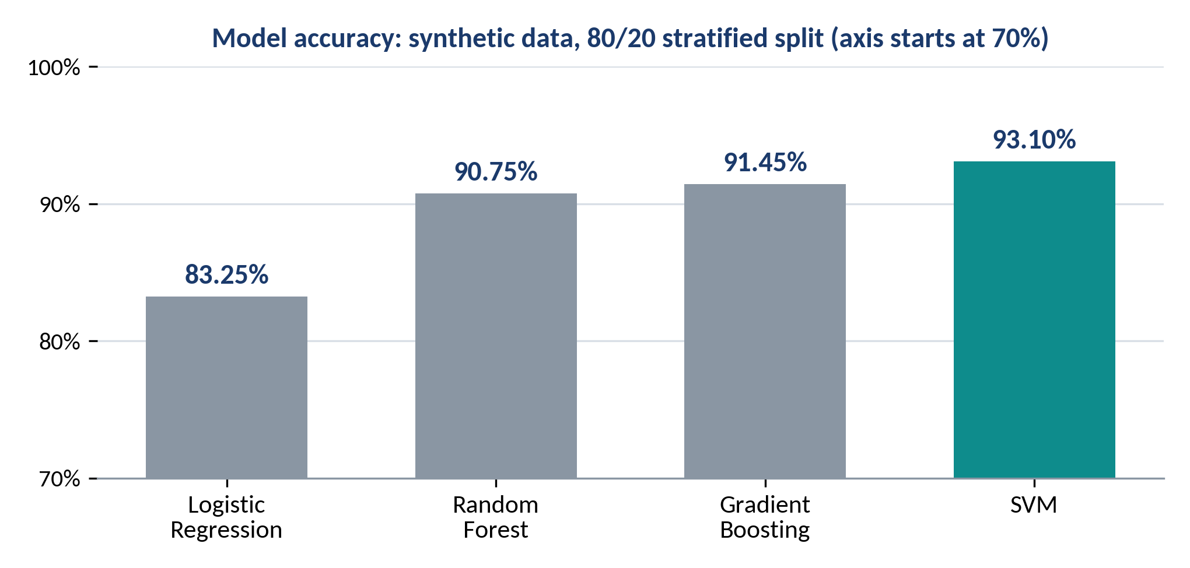
Smart Manufacturing: RAG-Based Defect Detection & Knowledge Assistance
Findings and Results
10,000 synthetic records
5 sensor features
4 defect classes
0 missing / duplicate
Selected model: SVM | Result
Accuracy | 93.10%
Weighted F1-score | 93.11%
Recall: Critical Defect | 94%
Recall: Minor Defect | 90%
Recall: Moderate Defect | 86%
Recall: No Defect | 97%
Illustrative prediction: Moderate Defect, 63.29% confidence
Implemented app: prediction with confidence and probabilities • knowledge retrieval • LLM recommendation • dashboard • batch monitoring

Slide 19
Smart Manufacturing: RAG-Based Defect Detection & Knowledge Assistance
Conclusion and Future Work
Implemented prototype
SVM Classification
Best of four models: 93.10% accuracy, 93.11% weighted F1
RAG Knowledge Retrieval
ChromaDB over 32 chunks using all-MiniLM-L6-v2 embeddings
Severity-Aware Reranking
8 retrieved candidates reranked by keywords to the top 3
Ollama Recommendations
Local LLM explains and advises from prediction and knowledge
Streamlit Dashboard
Sensor inputs, confidence, probabilities, knowledge, and advice
Batch Monitoring
Sequential batches of 10 with severity-based status
Future Enhancements
Cloud deployment
Deploy the application to Azure
Real-data validation
Evaluate on real or approved manufacturing datasets
Further evaluation
Assess retrieval relevance and recommendation quality with domain experts

Slide 20
Smart Manufacturing: RAG-Based Defect Detection & Knowledge Assistance
Acknowledgement
I sincerely thank my project guide and faculty for their guidance, feedback, and encouragement throughout this project.
I am grateful to VIT Vellore for the academic support provided during the M.Tech Artificial Intelligence and Machine Learning programme.
I also thank the university and industry partners of this jointly offered programme, VIT and LTIMindtree (with L&T EduTech), for the learning platform and review opportunity.
Thank you

Slide 21
Smart Manufacturing: RAG-Based Defect Detection & Knowledge Assistance
References
[1]
scikit-learn Documentation
https://scikit-learn.org/stable/
[2]
pandas Documentation
https://pandas.pydata.org/docs/
[3]
NumPy Documentation
https://numpy.org/doc/
[4]
Sentence Transformers Documentation
https://www.sbert.net
[5]
all-MiniLM-L6-v2 Model Card (Hugging Face)
https://huggingface.co/sentence-transformers/all-MiniLM-L6-v2
[6]
Chroma Documentation
https://docs.trychroma.com
[7]
Ollama Documentation
https://docs.ollama.com
[8]
Streamlit Documentation
https://docs.streamlit.io
[9]
Matplotlib Documentation
https://matplotlib.org/stable/

