Slide 1


M.Tech/MCA Program
Advanced Industry Integrated Programs
Jointly offered by University and LTIMindTree
Review III
RAG-Based Intelligent Defect Detection and Knowledge Assistance for Smart Manufacturing with Azure Cloud Deployment and Interactive Visualization
Nainshi Tikait
T9919
M.Tech Artificial Intelligence and Machine Learning
VIT Vellore | 2025–2027
Knowledge partner | Implementation partner

Slide 2
Smart Manufacturing: RAG-Based Defect Detection & Knowledge Assistance
Introduction
Manufacturing processes generate multiple sensor readings that interact with one another.
Engineers need to identify defect severity and find relevant troubleshooting guidance.
Machine learning classifies the defect category from sensor features.
RAG retrieves relevant manufacturing knowledge.
An LLM turns the prediction and retrieved knowledge into a readable recommendation.
This project combines all of these in an interactive Streamlit application.
Sensor Data
ML (SVM)
RAG Retrieval
LLM Recommendation
Streamlit Dashboard

Slide 3
Smart Manufacturing: RAG-Based Defect Detection & Knowledge Assistance
Objectives
1
Analyse manufacturing sensor features
2
Compare machine learning models for defect classification
3
Select an effective classification model
4
Retrieve relevant troubleshooting knowledge through RAG
5
Generate understandable corrective recommendations using an LLM
6
Display predictions, confidence, and knowledge in an interactive dashboard
7
Support sequential batch monitoring and defect-severity summaries
8
Explore Azure cloud deployment as a planned enhancement

Slide 4
Smart Manufacturing: RAG-Based Defect Detection & Knowledge Assistance
Modules
1
Dataset Generation & Preprocessing
Synthetic data: 10,000 rows, 5 sensor features, 4 defect classes
2
Exploratory Data Analysis
Shape, types, missing values, duplicates, statistics, distributions
3
ML Training & Evaluation
Four classifiers compared on a stratified 80/20 split; SVM selected
4
Defect Prediction
Saved SVM returns category, confidence, and class probabilities
5
RAG Retrieval & Reranking
ChromaDB retrieval of 8 chunks; keyword severity-aware rerank to top 3
6
LLM Recommendation Generation
Ollama explains and recommends from the prediction and retrieved knowledge
7
Streamlit Visualization & Batch Monitoring
Five-input dashboard; sequential batches of 10 with severity status
8
Azure Deployment (Planned Enhancement)
Cloud deployment of the working local prototype is a planned next step

Slide 5
Smart Manufacturing: RAG-Based Defect Detection & Knowledge Assistance
Problem Statement
The Problem
Project Goal
Manufacturing sensor data can contain multiple interacting features, making defect severity difficult to assess manually.
Identifying a defect alone may not give the engineer relevant troubleshooting knowledge or an understandable corrective recommendation.
To develop an intelligent prototype that classifies defect severity from sensor data, retrieves relevant manufacturing knowledge, generates recommendations, and presents results through an interactive dashboard.
Current prototype: built on synthetic sensor data and running on local services (Streamlit, ChromaDB, Ollama).

Slide 6
Smart Manufacturing: RAG-Based Defect Detection & Knowledge Assistance
Methodology
1
2
3
4
5
Synthetic manufacturing sensor data
Data preprocessing and exploratory analysis
Train and compare ML models
Select trained SVM model
Enter sensor values in Streamlit
10
9
8
7
6
Display prediction, knowledge, recommendation, batch status
Generate recommendation with Ollama LLM
Severity-aware RAG reranking
Retrieve manufacturing knowledge from ChromaDB
Predict defect category and confidence
Batch monitoring (supporting): readings processed sequentially in batches of 10; counts per class; status = highest severity (rule-based)
Data and ML classification (SVM)
RAG knowledge retrieval
LLM recommendation and dashboard

Slide 7
Smart Manufacturing: RAG-Based Defect Detection & Knowledge Assistance
Approach / Algorithms / Tools
Tool / Technique | Role
Python | Core application logic
Pandas and NumPy | Data processing
scikit-learn | Model training and evaluation
SVM | Final defect classification model
Sentence Transformers | Generate knowledge embeddings
all-MiniLM-L6-v2 | Text embedding model
ChromaDB | Store and retrieve knowledge chunks
Ollama | Run the local LLM
Streamlit | Interactive application
Matplotlib | Evaluation visualizations
joblib | Save and load the trained model
Key algorithms and processes
Stratified 80/20 train-test split
Comparison of four classifiers
SVM-based defect classification
Vector similarity retrieval (8 candidates)
Severity-aware keyword reranking (top 3)
LLM recommendation generation
Rule-based batch status calculation

Slide 8
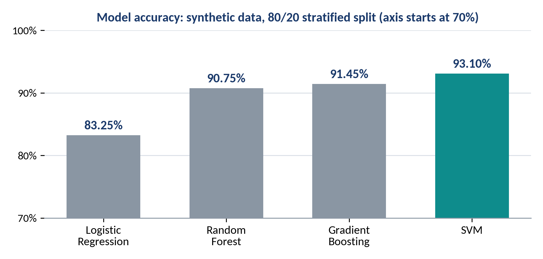
Smart Manufacturing: RAG-Based Defect Detection & Knowledge Assistance
Findings and Results
10,000 synthetic records
5 sensor features
4 defect classes
0 missing / duplicate
Selected model: SVM | Result
Accuracy | 93.10%
Weighted F1-score | 93.11%
Recall: Critical Defect | 94%
Recall: Minor Defect | 90%
Recall: Moderate Defect | 86%
Recall: No Defect | 97%
Illustrative prediction: Moderate Defect, 63.29% confidence
Implemented app: prediction with confidence and probabilities • knowledge retrieval • LLM recommendation • dashboard • batch monitoring

Slide 9
Smart Manufacturing: RAG-Based Defect Detection & Knowledge Assistance
Conclusion and Future Work
Implemented prototype
SVM Classification
Best of four models: 93.10% accuracy, 93.11% weighted F1
RAG Knowledge Retrieval
ChromaDB over 32 chunks using all-MiniLM-L6-v2 embeddings
Severity-Aware Reranking
8 retrieved candidates reranked by keywords to the top 3
Ollama Recommendations
Local LLM explains and advises from prediction and knowledge
Streamlit Dashboard
Sensor inputs, confidence, probabilities, knowledge, and advice
Batch Monitoring
Sequential batches of 10 with severity-based status
Future Enhancements
Cloud deployment
Deploy the application to Azure
Real-data validation
Evaluate on real or approved manufacturing datasets
Further evaluation
Assess retrieval relevance and recommendation quality with domain experts

Slide 10
Smart Manufacturing: RAG-Based Defect Detection & Knowledge Assistance
Acknowledgement
I sincerely thank my project guide and faculty for their guidance, feedback, and encouragement throughout this project.
I am grateful to VIT Vellore for the academic support provided during the M.Tech Artificial Intelligence and Machine Learning programme.
I also thank the university and industry partners of this jointly offered programme, VIT and LTIMindtree (with L&T EduTech), for the learning platform and review opportunity.
Thank you

Slide 11
Smart Manufacturing: RAG-Based Defect Detection & Knowledge Assistance
References
[1]
scikit-learn Documentation
https://scikit-learn.org/stable/
[2]
pandas Documentation
https://pandas.pydata.org/docs/
[3]
NumPy Documentation
https://numpy.org/doc/
[4]
Sentence Transformers Documentation
https://www.sbert.net
[5]
all-MiniLM-L6-v2 Model Card (Hugging Face)
https://huggingface.co/sentence-transformers/all-MiniLM-L6-v2
[6]
Chroma Documentation
https://docs.trychroma.com
[7]
Ollama Documentation
https://docs.ollama.com
[8]
Streamlit Documentation
https://docs.streamlit.io
[9]
Matplotlib Documentation
https://matplotlib.org/stable/

