Slide 1
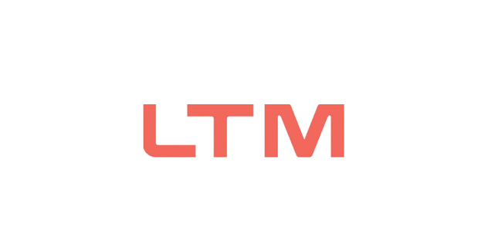

M.Tech Program
Advanced Industry Integrated Programs
Jointly offered by University and LTIMindTree
Project Title
Data Narrator: NL-to-SQL BI Copilot with Auto-Insights
Team Member
NAINSHI TIKAIT
VIT 2025-27
Knowledge partner | Implementation partner

Slide 2

Data Narrator: NL-to-SQL BI Copilot with Auto-Insights
Introduction
Why this project?
Business users often depend on analysts to obtain data-driven answers.
SQL skill gaps can create delays in accessing business information.
Data Narrator lets users ask analytical questions in natural language.
The system converts the question into SQL, retrieves real database results, creates a visualization and generates a concise business insight.

Slide 3
Natural Language → SQL → Data → Visualization → Insight
Objective
Project objectives
Convert natural-language questions into SQL queries.
Validate generated SQL before database execution.
Retrieve business information from DuckDB.
Generate automatic Plotly visualizations.
Provide short natural-language business insights.
Build the foundation for conversational BI and follow-up questions.

Slide 4
Current stage: working prototype + EDA + database integration
Scope
Initial scope
Retail/e-commerce business analytics prototype using Tableau Sample Superstore data.
10,194 records and 21 business attributes.
Natural-language interaction with a structured database.
Read-only SQL execution for safer prototype operation.
Interactive visualization and automated business insight generation.
Future scope: conversational context, stronger validation, Vanna.AI integration and deployment.

Slide 5
Data Narrator: NL-to-SQL BI Copilot with Auto-Insights
Literature Review
Key research relevant to NL-to-SQL
Spider (Yu et al., EMNLP 2018) — established a challenging cross-domain benchmark for natural-language-to-SQL over multiple databases.
RAT-SQL (Wang et al., ACL 2020) — highlighted schema encoding and schema linking as important challenges in text-to-SQL.
DIN-SQL (Pourreza & Rafiei, NeurIPS 2023) — showed that decomposed prompting and self-correction can improve LLM-based text-to-SQL.
BIRD (Li et al., NeurIPS 2023) — introduced a larger database-grounded benchmark closer to real-world text-to-SQL complexity.

Slide 6
Research Gap & Project Direction
Summary of Literature
Research gap
Existing text-to-SQL research focuses strongly on query generation and benchmark accuracy.
A practical BI assistant also needs safe SQL execution, understandable visual outputs and business-oriented explanations.
Data Narrator combines these components into a single user-facing workflow.
Current prototype validates the core path from natural language to database result, visualization and insight.

Slide 7
Data Acquisition & Database Understanding
Additional Information
Dataset & database configuration
Dataset: Tableau Sample Superstore Sales.
Rows: 10,194 | Columns: 21.
Missing values: 0 | Duplicate records: 0.
Database: DuckDB.
Table: superstore.
Key business fields: Order Date, Customer, Segment, Region, Category, Sales, Quantity, Discount and Profit.
Schema is supplied to the LLM so it can map the natural-language question to available tables and columns.

Slide 8
Data Narrator: NL-to-SQL BI Copilot with Auto-Insights
Modules to cover
Data Acquisition & Database
NL Understanding & SQL Generation
1
2
SQL Validation & Safe Execution
Visualization & Business Insight
3
4
Streamlit User Interface
EDA & Data Understanding
5
6
Conversational Follow-up Context
Future Deployment & Integration
7
8

Slide 9
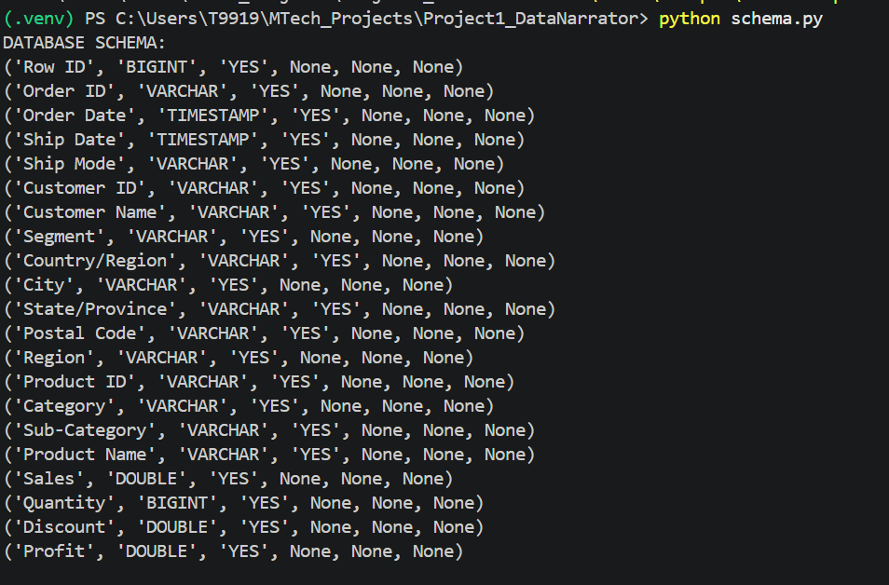
RAG for Secure Enterprise Document Intelligence Using Role-Based Access Control (RBAC)
1. Data Acquisition & Database
Dataset → DuckDB → Schema
Tableau Sample Superstore data was downloaded and loaded into DuckDB.
A table named superstore contains 10,194 records and 21 attributes.
Schema inspection verified column names and data types.
SQL queries were tested directly against the database.
Example: West region has the highest total sales in the current dataset.

Slide 10
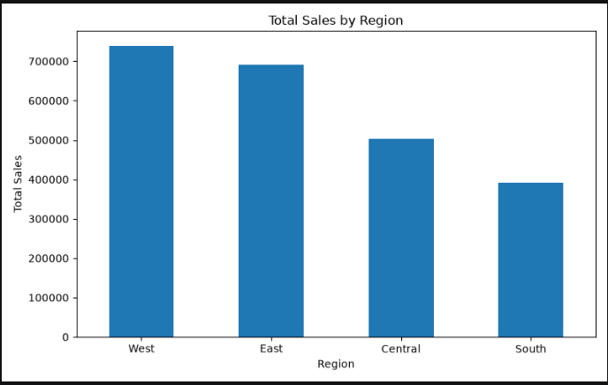
RAG for Secure Enterprise Document Intelligence Using Role-Based Access Control (RBAC)
2. EDA & Data Understanding
Exploratory Data Analysis
Dataset shape: 10,194 × 21.
Missing values: 0.
Duplicate records: 0.
Sales by region, sales/profit by category and monthly sales trend were analysed.
West region recorded the highest sales.
Technology recorded the highest sales and profit among the three categories.

Slide 11
RAG for Secure Enterprise Document Intelligence Using Role-Based Access Control (RBAC)
3. NL-to-SQL Working Prototype
Implemented pipeline
User question → Llama 3.1 8B via Ollama.
Generated SQL → read-only SQL validation.
Validated SQL → DuckDB execution.
Query result → Plotly visualization.
Result → concise natural-language business insight.
Current baseline directly integrates Llama 3.1 through Ollama; Vanna.AI remains a planned enhancement.

Slide 12
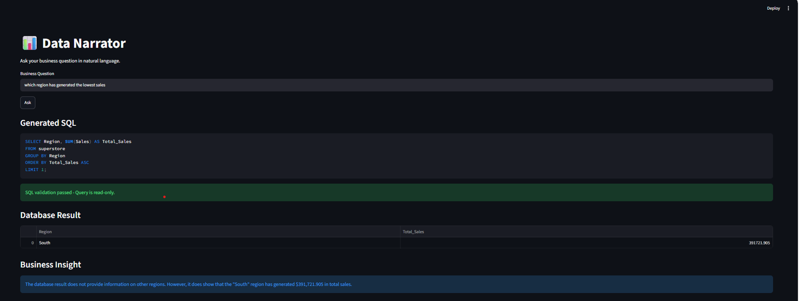

Slide 13
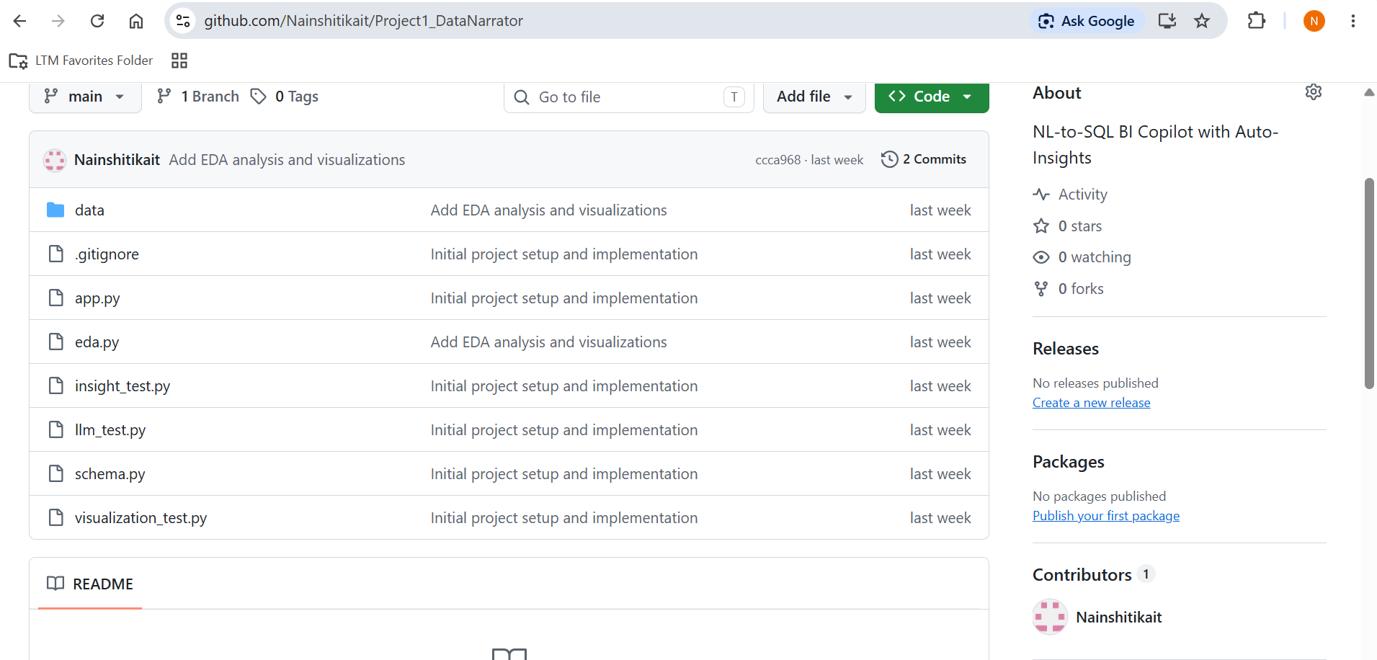
RAG for Secure Enterprise Document Intelligence Using Role-Based Access Control (RBAC)
4. Current Progress & GitHub
Review 1 evidence
Working Streamlit application demonstrated locally.
DuckDB database and schema configured.
EDA completed and visualizations generated.
NL-to-SQL baseline implemented and tested.
GitHub repository created and maintained.
Current repository contains 2 commits.

Slide 14
Next Steps
Next implementation phase
Improve SQL validation and handling of more question types.
Add conversational follow-up context.
Improve chart selection and business insight formatting.
Integrate the planned Vanna.AI component.
Refine project structure and testing.
Explore containerization/deployment after the prototype is stabilized.

