Slide 1


M.Tech Program
Advanced Industry Integrated Programs
Jointly offered by University and LTIMindTree
Project Title
RAG-Based Intelligent Defect Detection and Knowledge Assistance for Smart Manufacturing
Team Member
NAINSHI TIKAIT
VIT 2025-27
Knowledge partner | Implementation partner

Slide 2

Smart Manufacturing: ML + RAG + LLM
Introduction
Why this project?
Manufacturing processes generate complex sensor data with multiple interacting measurements.
Engineers need fast identification of defect severity and relevant troubleshooting information.
Important engineering knowledge may be distributed across SOPs, quality manuals and troubleshooting documents.
The proposed system combines Machine Learning, RAG and an LLM to support defect analysis and knowledge-assisted recommendations.

Slide 3
Sensor Data → ML Prediction → RAG Retrieval → LLM Recommendation
Objective
Project objectives
Generate realistic synthetic manufacturing sensor data.
Classify defect severity using Machine Learning.
Build a manufacturing troubleshooting knowledge base.
Retrieve relevant engineering knowledge using semantic search.
Generate explanations and corrective recommendations using an LLM.
Develop an interactive application for defect analysis.

Slide 4
Current stage: working ML + RAG + LLM prototype
Scope
Initial scope
Smart manufacturing / industrial quality-inspection use case.
Synthetic dataset with 10,000 sensor records.
Five numerical sensor attributes and four defect categories.
Random Forest baseline for defect-severity classification.
Semantic retrieval using Sentence Transformers and ChromaDB.
Llama 3.1 8B used for explanation and recommendation generation.
Future scope: stronger physical constraints, advanced models, visualization and Azure deployment.

Slide 5
Literature focus: Manufacturing ML + RAG + LLM assistance
Literature Review
Key research areas
Machine Learning for predictive quality and defect classification supports automated identification of manufacturing anomalies.
RAG-based systems improve LLM responses by grounding generation in retrieved domain knowledge.
Sentence-transformer embeddings enable semantic retrieval of relevant engineering documents.
LLM-based assistance can convert retrieved technical information into human-readable explanations and recommended actions.
The project combines these capabilities into a single manufacturing knowledge-assistance workflow.

Slide 6
Research Gap & Project Direction
Summary of Literature
Project direction
ML models can identify defect categories from sensor measurements, but prediction alone does not provide domain guidance.
RAG can retrieve relevant engineering knowledge, but retrieval alone does not classify the current sensor condition.
The proposed workflow connects sensor-based ML prediction with domain knowledge retrieval and LLM explanation.
The current prototype validates this integrated ML → RAG → LLM pipeline.

Slide 7
Data Acquisition, EDA & Knowledge Base Preparation
Additional Information
Dataset & knowledge base
Synthetic manufacturing sensor dataset: 10,000 records × 6 columns.
Inputs: Surface Roughness Index, Vibration Level, Temperature Deviation, Dimensional Deviation and Material Stress Indicator.
Target: No Defect, Minor Defect, Moderate Defect, Critical Defect.
Knowledge base: manufacturing troubleshooting guide.
Knowledge base is split into 32 text chunks and stored in persistent ChromaDB.
Sentence Transformer embeddings are used for semantic retrieval.

Slide 8
RAG-Based Intelligent Defect Detection for Smart Manufacturing
Modules to cover
Synthetic Sensor Data Generation
Data Preprocessing & EDA
1
2
Defect Severity ML Classification
Knowledge Base & Document Chunking
3
4
Semantic Retrieval with ChromaDB
LLM Explanation & Recommendation
5
6
Interactive Streamlit Application
Future Azure Cloud Deployment
7
8

Slide 9
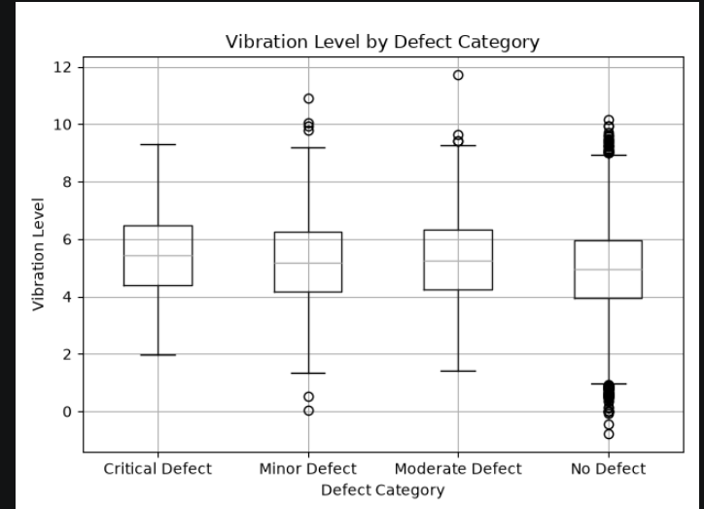
RAG for Secure Enterprise Document Intelligence Using Role-Based Access Control (RBAC)
1. Data Ingestion & Chunking
Dataset understanding
Dataset shape: 10,000 × 6.
Missing values: 0.
Duplicate records: 0.
Defect distribution: 7,738 No Defect; 1,198 Minor; 652 Moderate; 412 Critical.
EDA includes defect distribution, sensor distributions and vibration by defect category.
Current data is synthetic and used for initial model and pipeline validation.

Slide 10
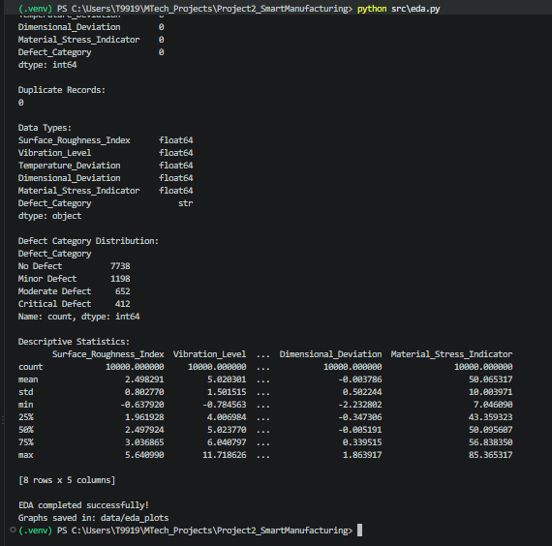
RAG for Secure Enterprise Document Intelligence Using Role-Based Access Control (RBAC)
2. Vector Database & Embedding Storage
Random Forest Classifier
Purpose: predict manufacturing defect severity from sensor measurements.
Initial accuracy: 96.25%.
Critical Defect — Precision 0.93 | Recall 0.87 | F1 0.90.
Minor Defect — Precision 0.90 | Recall 0.85 | F1 0.87.
Moderate Defect — Precision 0.84 | Recall 0.88 | F1 0.86.
No Defect — Precision 0.98 | Recall 0.99 | F1 0.99.
Example test input predicted Minor Defect with 90% confidence.

Slide 11
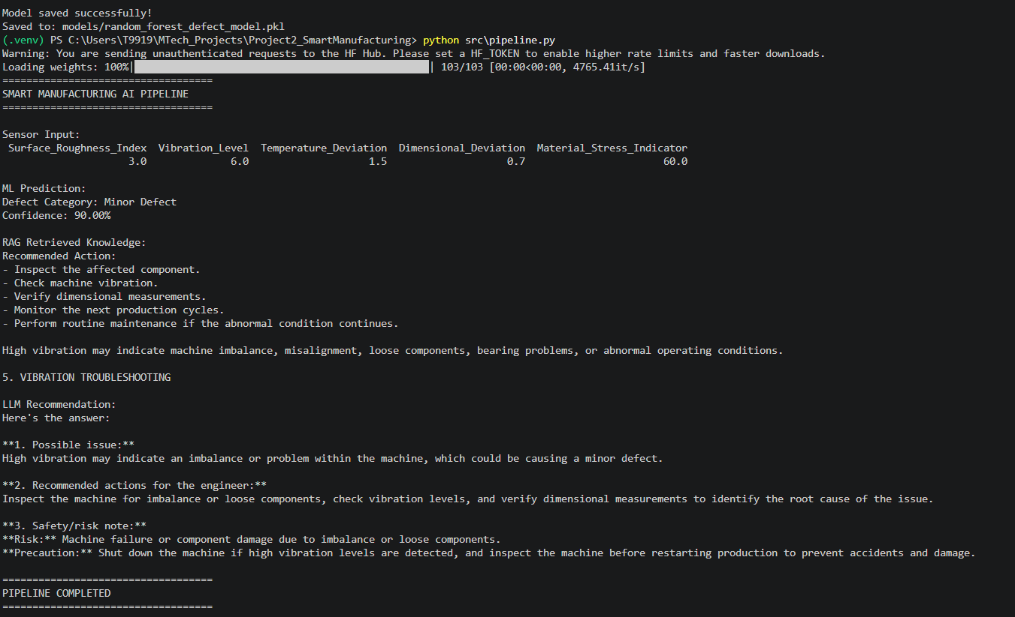
RAG for Secure Enterprise Document Intelligence Using Role-Based Access Control (RBAC)
3. RBAC Policy Engine
Implemented intelligent pipeline
Sensor Inputs → Random Forest prediction.
Prediction + sensor condition → RAG query.
Sentence Transformer → semantic embeddings.
ChromaDB → retrieve relevant manufacturing knowledge.
Llama 3.1 8B → explanation, recommended actions and risk note.
Example: Minor Defect + high vibration retrieves vibration troubleshooting guidance.

Slide 12
RAG for Secure Enterprise Document Intelligence Using Role-Based Access Control (RBAC)
4. Secure Authentication
Review 1 evidence
Streamlit application integrates sensor input, ML prediction, RAG retrieval and LLM recommendation.
Knowledge base and ChromaDB configured locally.
Model and pipeline tested successfully.
GitHub repository created and maintained.
Current repository contains 2 commits.

Slide 13
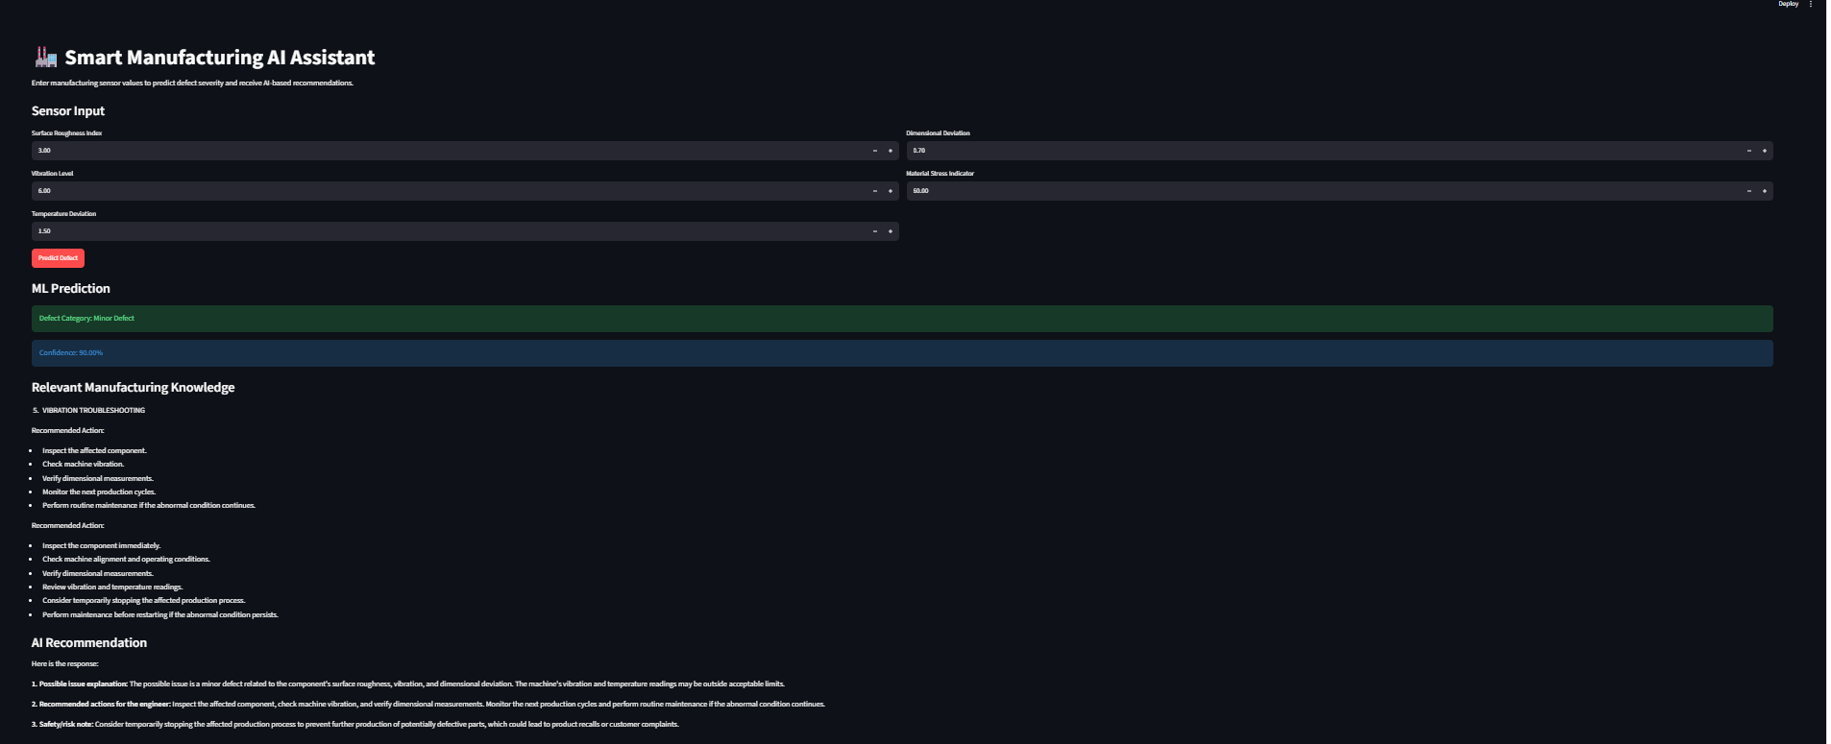
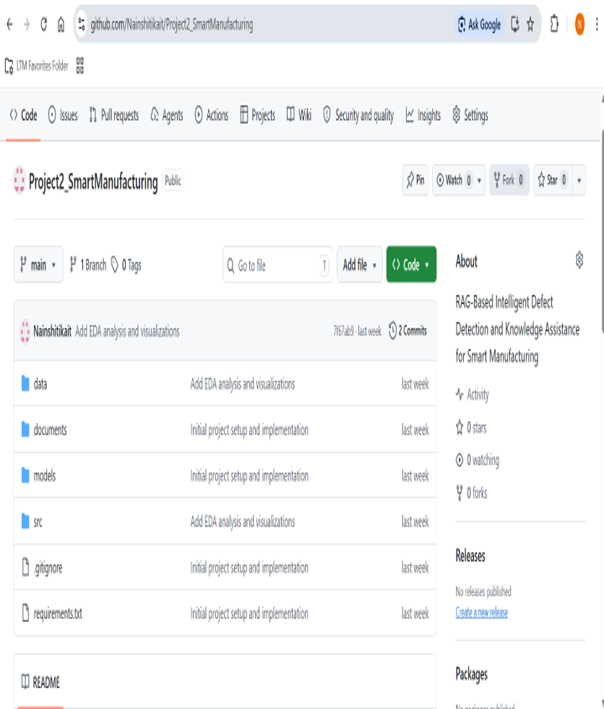

Slide 14
Current Prototype
Synthetic Sensor Data
↓
Random Forest
↓
ChromaDB RAG
↓
Llama 3.1 8B
↓
Streamlit Application
Next Steps
Next implementation phase
Refine synthetic data with stronger physical/domain constraints.
Address class imbalance and improve data realism.
Evaluate additional ML models and metrics.
Improve RAG retrieval quality and knowledge organization.
Refine LLM recommendations and interactive visual analytics.
Explore Azure cloud architecture and deployment in later stages.

