Slide 1
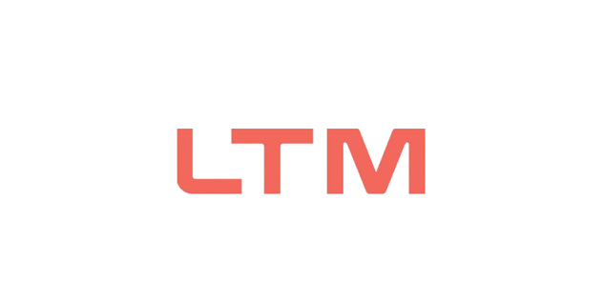

M.Tech Program
Advanced Industry Integrated Programs
Jointly offered by University and LTIMindTree
Project Title
Data Narrator: NL-to-SQL BI Copilot with Auto-Insights
Team Member
NAINSHI TIKAIT
VIT 2025-27
Knowledge partner | Implementation partner

Slide 2

Data Narrator: NL-to-SQL BI Copilot with Auto-Insights
Introduction
Why this project?
Business users often depend on analysts to obtain data-driven answers.
SQL skill gaps can create delays in accessing business information.
Data Narrator lets users ask analytical questions in natural language.
The system converts the question into SQL, retrieves real database results, creates a visualization and generates a concise business insight.

Slide 3
Natural Language → SQL → Data → Visualization → Insight
Objective
Project objectives
Convert natural-language questions into SQL queries.
Validate generated SQL before database execution.
Retrieve business information from DuckDB.
Generate automatic Plotly visualizations.
Provide short natural-language business insights.
Build the foundation for conversational BI and follow-up questions.

Slide 4
Current stage: working prototype + EDA + database integration
Scope
Initial scope
Retail/e-commerce business analytics prototype using Tableau Sample Superstore data.
10,194 records and 21 business attributes.
Natural-language interaction with a structured database.
Read-only SQL execution for safer prototype operation.
Interactive visualization and automated business insight generation.
Future scope: conversational context, stronger validation, Vanna.AI integration and deployment.

Slide 5
Data Narrator: NL-to-SQL BI Copilot with Auto-Insights
Literature Review
Key research relevant to NL-to-SQL
Spider (Yu et al., EMNLP 2018) — established a challenging cross-domain benchmark for natural-language-to-SQL over multiple databases.
RAT-SQL (Wang et al., ACL 2020) — highlighted schema encoding and schema linking as important challenges in text-to-SQL.
DIN-SQL (Pourreza & Rafiei, NeurIPS 2023) — showed that decomposed prompting and self-correction can improve LLM-based text-to-SQL.
BIRD (Li et al., NeurIPS 2023) — introduced a larger database-grounded benchmark closer to real-world text-to-SQL complexity.

Slide 6
Research Gap & Project Direction
Summary of Literature
Research gap
Existing text-to-SQL research focuses strongly on query generation and benchmark accuracy.
A practical BI assistant also needs safe SQL execution, understandable visual outputs and business-oriented explanations.
Data Narrator combines these components into a single user-facing workflow.
Current prototype validates the core path from natural language to database result, visualization and insight.

Slide 7
Data Acquisition & Database Understanding
Additional Information
Dataset & database configuration
Dataset: Tableau Sample Superstore Sales.
Rows: 10,194 | Columns: 21.
Missing values: 0 | Duplicate records: 0.
Database: DuckDB.
Table: superstore.
Key business fields: Order Date, Customer, Segment, Region, Category, Sales, Quantity, Discount and Profit.
Schema is supplied to the LLM so it can map the natural-language question to available tables and columns.

Slide 8
Data Narrator: NL-to-SQL BI Copilot with Auto-Insights
Modules to cover
Data Acquisition & Database
NL Understanding & SQL Generation
1
2
SQL Validation & Safe Execution
Visualization & Business Insight
3
4
Streamlit User Interface
EDA & Data Understanding
5
6
Conversational Follow-up Context
Future Deployment & Integration
7
8

Slide 9
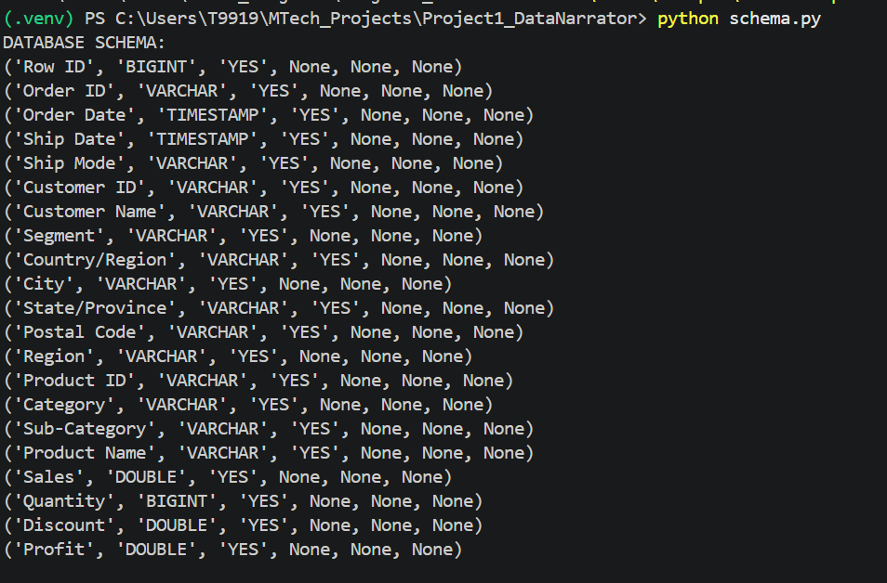
RAG for Secure Enterprise Document Intelligence Using Role-Based Access Control (RBAC)
1. Data Acquisition & Database
Dataset → DuckDB → Schema
Tableau Sample Superstore data was downloaded and loaded into DuckDB.
A table named superstore contains 10,194 records and 21 attributes.
Schema inspection verified column names and data types.
SQL queries were tested directly against the database.
Example: West region has the highest total sales in the current dataset.

Slide 10
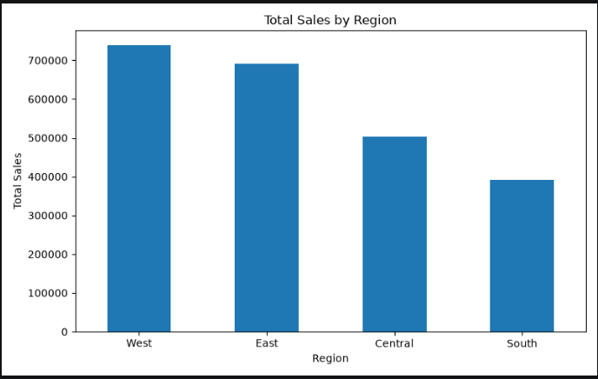
RAG for Secure Enterprise Document Intelligence Using Role-Based Access Control (RBAC)
2. EDA & Data Understanding
Exploratory Data Analysis
Dataset shape: 10,194 × 21.
Missing values: 0.
Duplicate records: 0.
Sales by region, sales/profit by category and monthly sales trend were analysed.
West region recorded the highest sales.
Technology recorded the highest sales and profit among the three categories.

Slide 11
RAG for Secure Enterprise Document Intelligence Using Role-Based Access Control (RBAC)
3. NL-to-SQL Working Prototype
Implemented pipeline
User question → Llama 3.1 8B via Ollama.
Generated SQL → read-only SQL validation.
Validated SQL → DuckDB execution.
Query result → Plotly visualization.
Result → concise natural-language business insight.
Current baseline directly integrates Llama 3.1 through Ollama; Vanna.AI remains a planned enhancement.

Slide 12
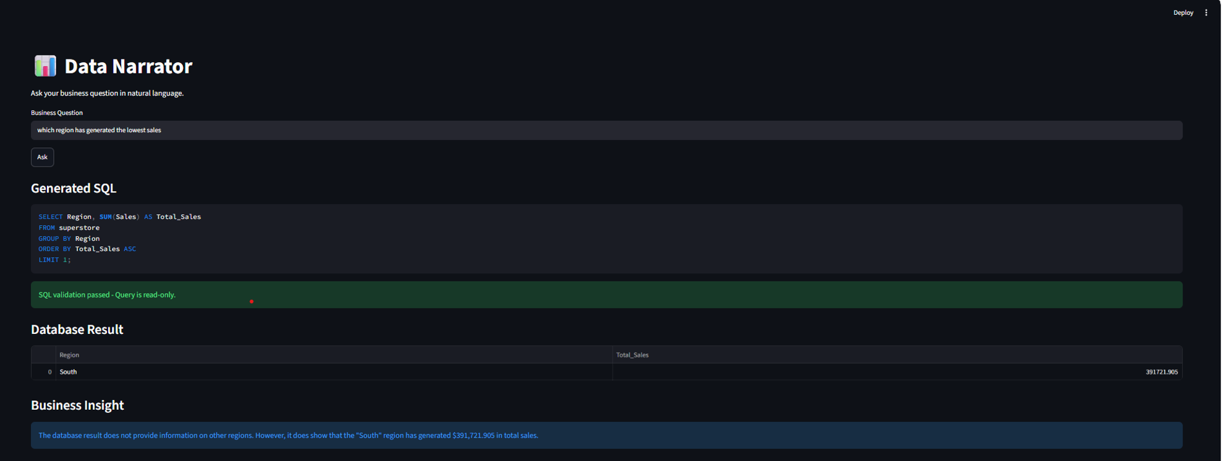

Slide 13
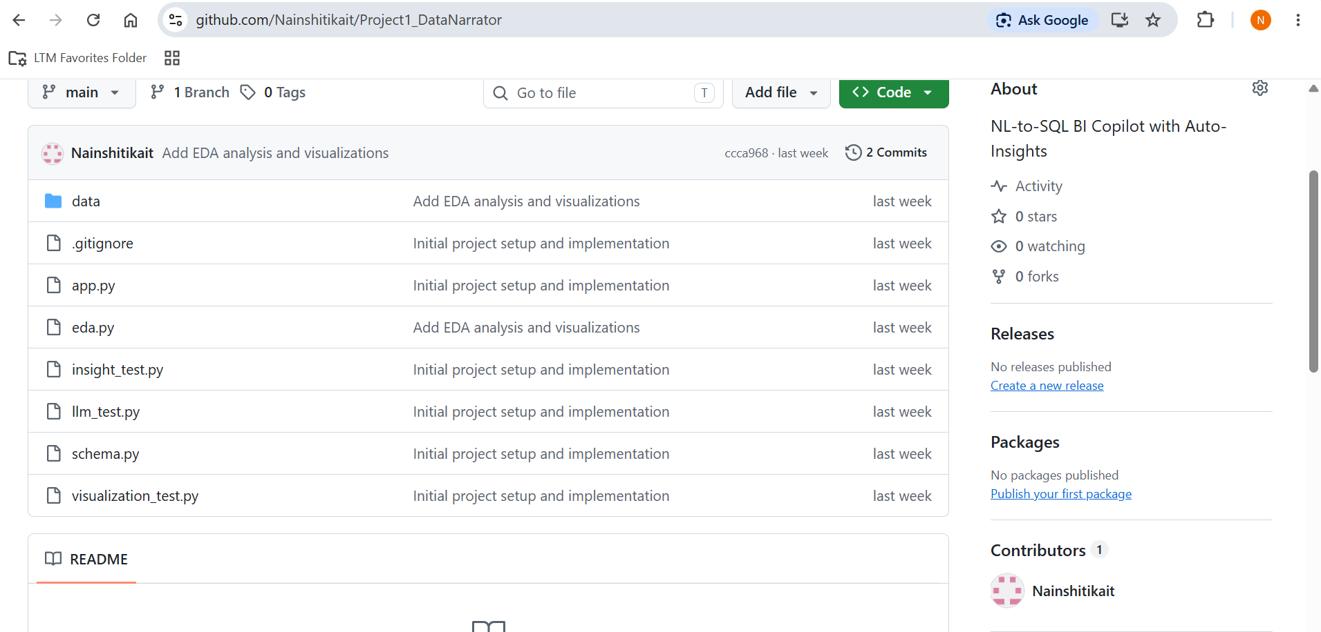
RAG for Secure Enterprise Document Intelligence Using Role-Based Access Control (RBAC)
4. Current Progress & GitHub
Review 1 evidence
Working Streamlit application demonstrated locally.
DuckDB database and schema configured.
EDA completed and visualizations generated.
NL-to-SQL baseline implemented and tested.
GitHub repository created and maintained.
Current repository contains 2 commits.

Slide 14
Next Steps
Next implementation phase
Improve SQL validation and handling of more question types.
Add conversational follow-up context.
Improve chart selection and business insight formatting.
Integrate the planned Vanna.AI component.
Refine project structure and testing.
Explore containerization/deployment after the prototype is stabilized.

Slide 15
M.Tech Program
Advanced Industry Integrated Programs
Jointly offered by University and LTIMindTree
Project Title
RAG-Based Intelligent Defect Detection and Knowledge Assistance for Smart Manufacturing
Team Member
NAINSHI TIKAIT
VIT 2025-27
Knowledge partner | Implementation partner

Slide 16
Smart Manufacturing: ML + RAG + LLM
Introduction
Why this project?
Manufacturing processes generate complex sensor data with multiple interacting measurements.
Engineers need fast identification of defect severity and relevant troubleshooting information.
Important engineering knowledge may be distributed across SOPs, quality manuals and troubleshooting documents.
The proposed system combines Machine Learning, RAG and an LLM to support defect analysis and knowledge-assisted recommendations.

Slide 17
Sensor Data → ML Prediction → RAG Retrieval → LLM Recommendation
Objective
Project objectives
Generate realistic synthetic manufacturing sensor data.
Classify defect severity using Machine Learning.
Build a manufacturing troubleshooting knowledge base.
Retrieve relevant engineering knowledge using semantic search.
Generate explanations and corrective recommendations using an LLM.
Develop an interactive application for defect analysis.

Slide 18
Current stage: working ML + RAG + LLM prototype
Scope
Initial scope
Smart manufacturing / industrial quality-inspection use case.
Synthetic dataset with 10,000 sensor records.
Five numerical sensor attributes and four defect categories.
Random Forest baseline for defect-severity classification.
Semantic retrieval using Sentence Transformers and ChromaDB.
Llama 3.1 8B used for explanation and recommendation generation.
Future scope: stronger physical constraints, advanced models, visualization and Azure deployment.

Slide 19
Literature focus: Manufacturing ML + RAG + LLM assistance
Literature Review
Key research areas
Machine Learning for predictive quality and defect classification supports automated identification of manufacturing anomalies.
RAG-based systems improve LLM responses by grounding generation in retrieved domain knowledge.
Sentence-transformer embeddings enable semantic retrieval of relevant engineering documents.
LLM-based assistance can convert retrieved technical information into human-readable explanations and recommended actions.
The project combines these capabilities into a single manufacturing knowledge-assistance workflow.

Slide 20
Research Gap & Project Direction
Summary of Literature
Project direction
ML models can identify defect categories from sensor measurements, but prediction alone does not provide domain guidance.
RAG can retrieve relevant engineering knowledge, but retrieval alone does not classify the current sensor condition.
The proposed workflow connects sensor-based ML prediction with domain knowledge retrieval and LLM explanation.
The current prototype validates this integrated ML → RAG → LLM pipeline.

Slide 21
Data Acquisition, EDA & Knowledge Base Preparation
Additional Information
Dataset & knowledge base
Synthetic manufacturing sensor dataset: 10,000 records × 6 columns.
Inputs: Surface Roughness Index, Vibration Level, Temperature Deviation, Dimensional Deviation and Material Stress Indicator.
Target: No Defect, Minor Defect, Moderate Defect, Critical Defect.
Knowledge base: manufacturing troubleshooting guide.
Knowledge base is split into 32 text chunks and stored in persistent ChromaDB.
Sentence Transformer embeddings are used for semantic retrieval.

Slide 22
RAG-Based Intelligent Defect Detection for Smart Manufacturing
Modules to cover
Synthetic Sensor Data Generation
Data Preprocessing & EDA
1
2
Defect Severity ML Classification
Knowledge Base & Document Chunking
3
4
Semantic Retrieval with ChromaDB
LLM Explanation & Recommendation
5
6
Interactive Streamlit Application
Future Azure Cloud Deployment
7
8

Slide 23
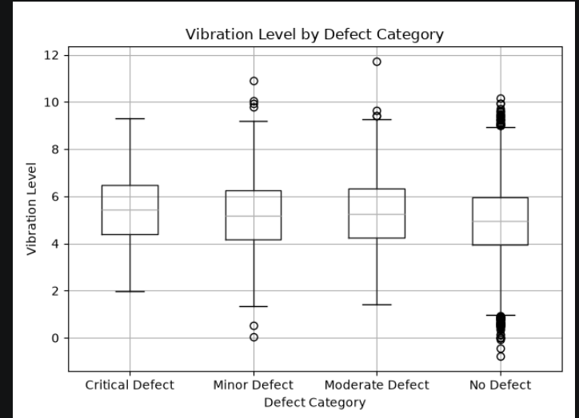
RAG for Secure Enterprise Document Intelligence Using Role-Based Access Control (RBAC)
1. Data Ingestion & Chunking
Dataset understanding
Dataset shape: 10,000 × 6.
Missing values: 0.
Duplicate records: 0.
Defect distribution: 7,738 No Defect; 1,198 Minor; 652 Moderate; 412 Critical.
EDA includes defect distribution, sensor distributions and vibration by defect category.
Current data is synthetic and used for initial model and pipeline validation.

Slide 24
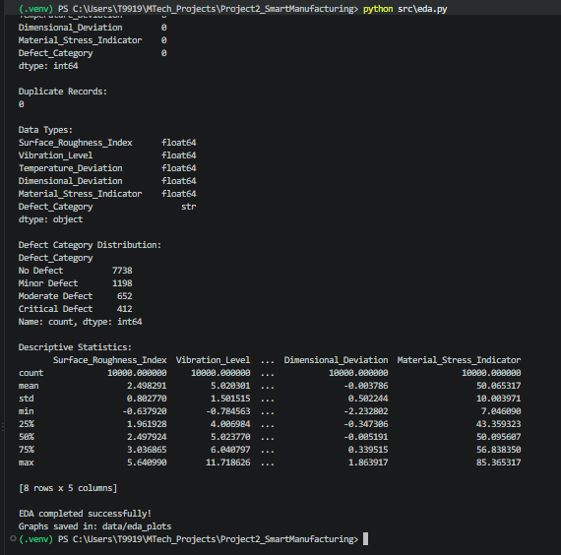
RAG for Secure Enterprise Document Intelligence Using Role-Based Access Control (RBAC)
2. Vector Database & Embedding Storage
Random Forest Classifier
Purpose: predict manufacturing defect severity from sensor measurements.
Initial accuracy: 96.25%.
Critical Defect — Precision 0.93 | Recall 0.87 | F1 0.90.
Minor Defect — Precision 0.90 | Recall 0.85 | F1 0.87.
Moderate Defect — Precision 0.84 | Recall 0.88 | F1 0.86.
No Defect — Precision 0.98 | Recall 0.99 | F1 0.99.
Example test input predicted Minor Defect with 90% confidence.

Slide 25
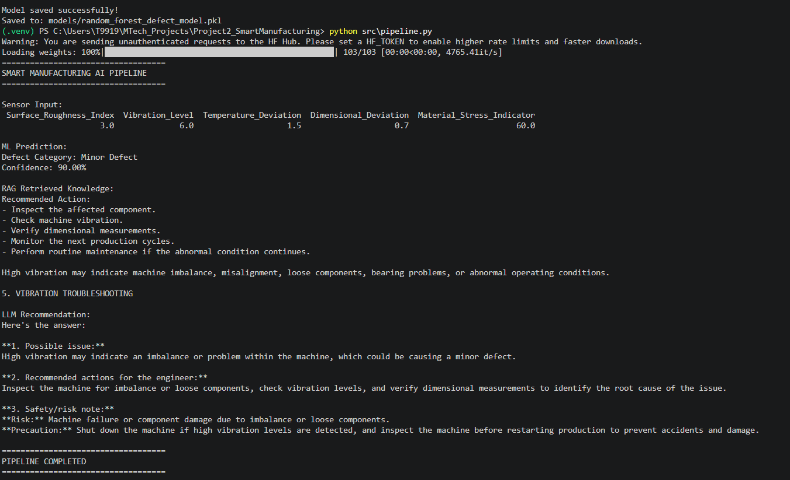
RAG for Secure Enterprise Document Intelligence Using Role-Based Access Control (RBAC)
3. RBAC Policy Engine
Implemented intelligent pipeline
Sensor Inputs → Random Forest prediction.
Prediction + sensor condition → RAG query.
Sentence Transformer → semantic embeddings.
ChromaDB → retrieve relevant manufacturing knowledge.
Llama 3.1 8B → explanation, recommended actions and risk note.
Example: Minor Defect + high vibration retrieves vibration troubleshooting guidance.

Slide 26
RAG for Secure Enterprise Document Intelligence Using Role-Based Access Control (RBAC)
4. Secure Authentication
Review 1 evidence
Streamlit application integrates sensor input, ML prediction, RAG retrieval and LLM recommendation.
Knowledge base and ChromaDB configured locally.
Model and pipeline tested successfully.
GitHub repository created and maintained.
Current repository contains 2 commits.

Slide 27
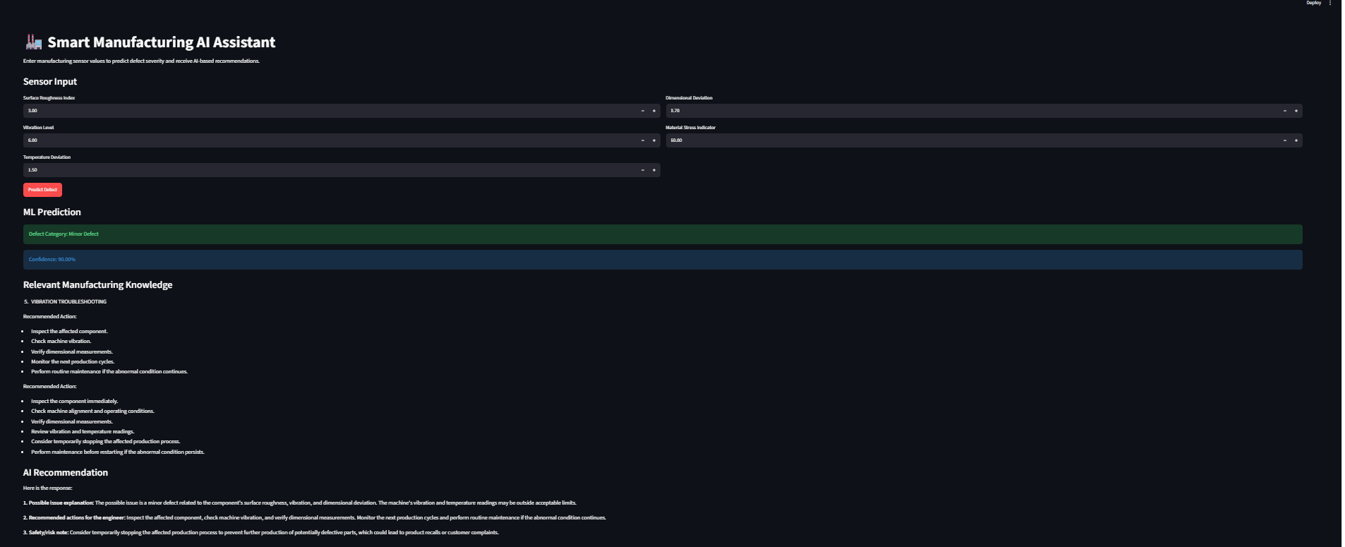
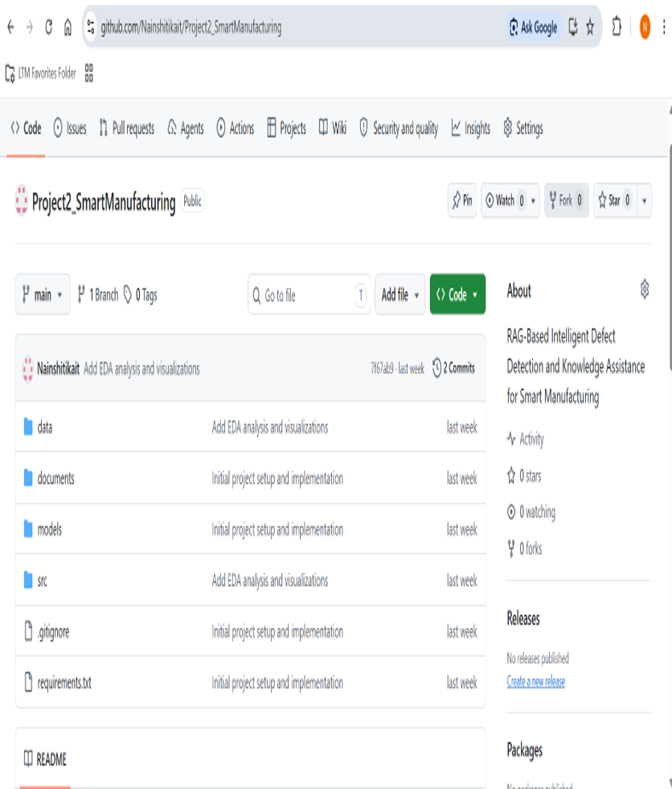

Slide 28
Current Prototype
Synthetic Sensor Data
↓
Random Forest
↓
ChromaDB RAG
↓
Llama 3.1 8B
↓
Streamlit Application
Next Steps
Next implementation phase
Refine synthetic data with stronger physical/domain constraints.
Address class imbalance and improve data realism.
Evaluate additional ML models and metrics.
Improve RAG retrieval quality and knowledge organization.
Refine LLM recommendations and interactive visual analytics.
Explore Azure cloud architecture and deployment in later stages.

