Slide 1

PIXEL GRID
PIXEL GRID
By Context Vectors

Slide 2

TECHSTACK
1)
REACT.JS
2)
OPENCV
3)
FLASK
4)
PYTORCH
5)
PYTHON
6)
POSTMAN
7)
CLOUDINARY
8)
GSAP AND LOCOMOTIVE

Slide 3

PLANAR DETECTION
OBJECT
FILTERING
INTERACTIVE
WEBSITE
GENERATIVE
TEXT-TO-IMG

Slide 4
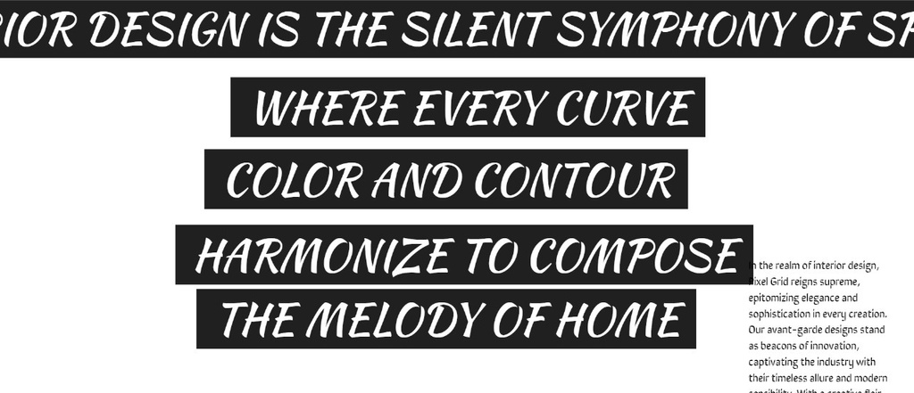

website
FUNCTIONALITIES
Edge detection and contour filling.
Background and texture picking.
Various texture libraries.
Image generation using text.
Colour palette picker.

Slide 5

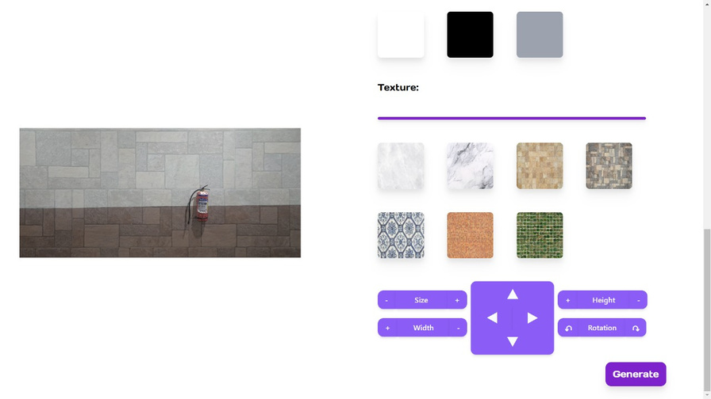
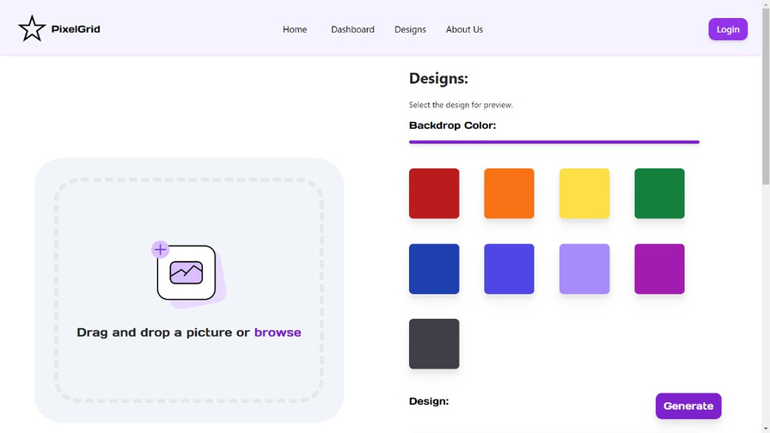
EXPERIENCE
MAGIC!
This website uses opencv to detect objects and wrap a
background behind them.

Slide 6
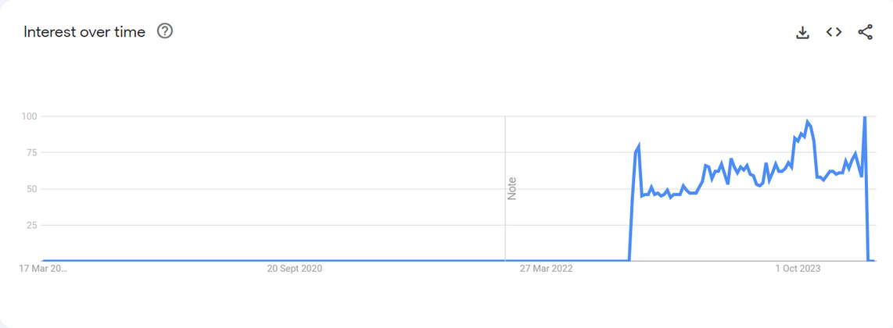

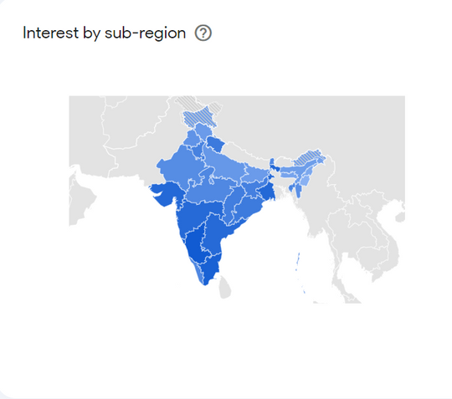
TRENDS OF ONLINE PAINT VISUALIZATIONS IN INDIA:
We have collected data from google trends about the recent increase in ‘paint’ searches from 2022-present

Slide 7
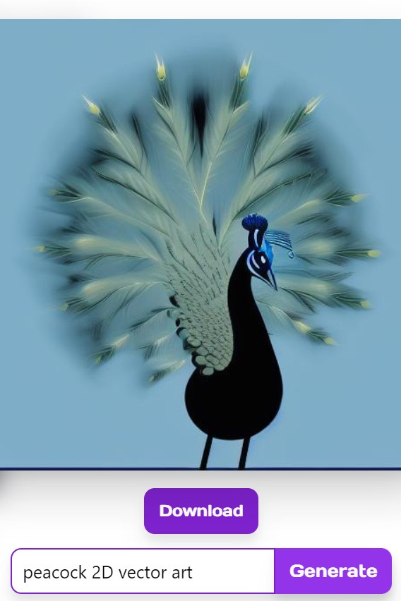
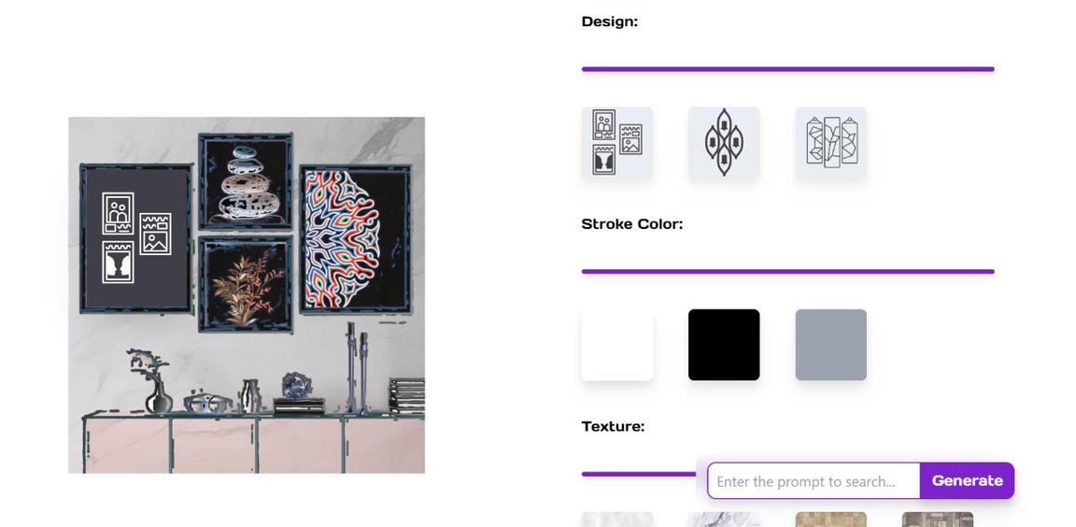
USAGE OF CUTTING-EDGE GENERATIVE AI:
In pixel grid, we have implemented text to image generative models to satisfy user’s interests.

Slide 8
01
Design suggestions:
We plan to use llms like llava to show predictions based on the images uploaded.
FUTURE
PROSPECTS:
02
User uploaded design:
Users can add their textures and designs along with a highly curated library.
These are certain propects which we plan to implement in Pixel Grid.
03
Gaining customers:
We plan to implement a billing plan for use of the designs which are provided
by the library.

Slide 9
THANK
YOU!
Get the code at:
www.github.com/AbhinavNair7404

