Slide 1
Configure SAS/ACCESS to Oracle
SAS

Slide 2
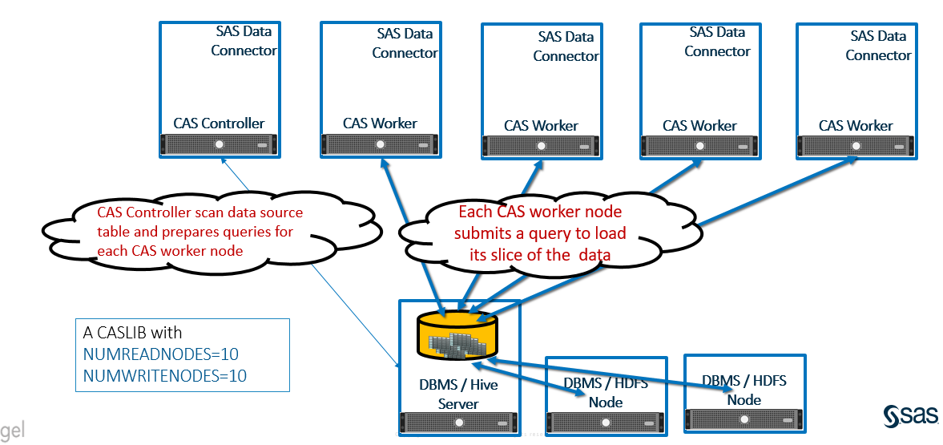
MultiNode Data Transfer to CAS

Slide 3
Steps of Configuration
Overview
Install Oracle Client (Version 11gR2 or later)
Configure Network Configuration File “tnsnames.ora”
Configure OS Environment Variable
Configure SAS Environment Variable
Run Test Script

Slide 4
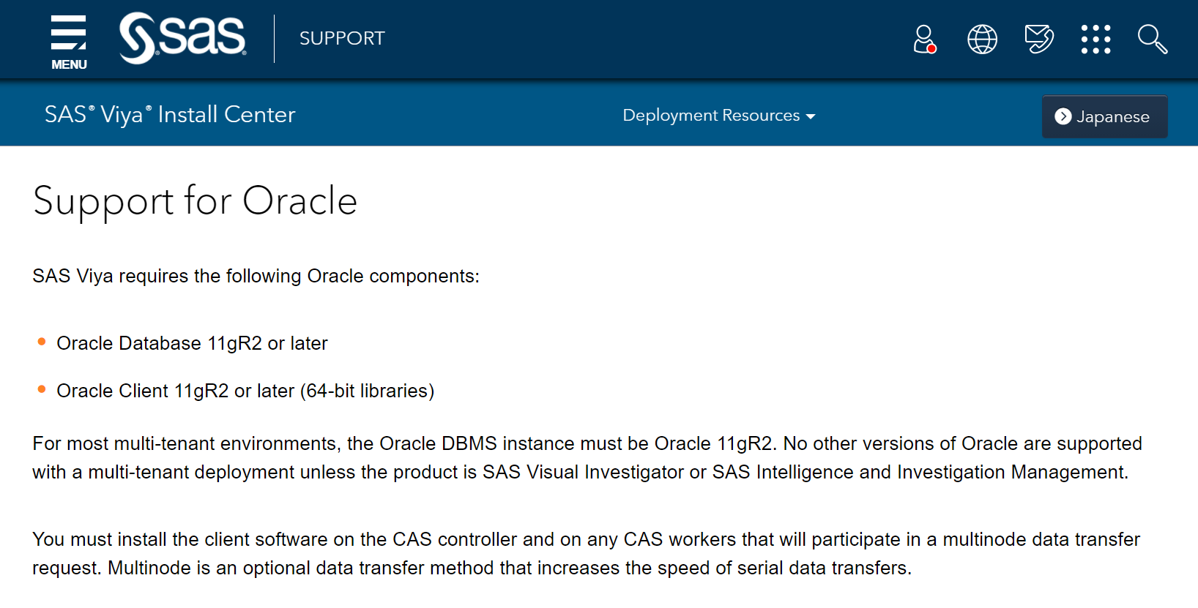
Steps of Configuration
Install Oracle Client
sudo yum install libaio
sudo rpm -ivh oracle-instantclient18.5-basic-18.5.0.0.0-3.x86_64.rpm
sudo rpm -ivh oracle-instantclient18.5-sqlplus-18.5.0.0.0-3.x86_64.rpm

Slide 5
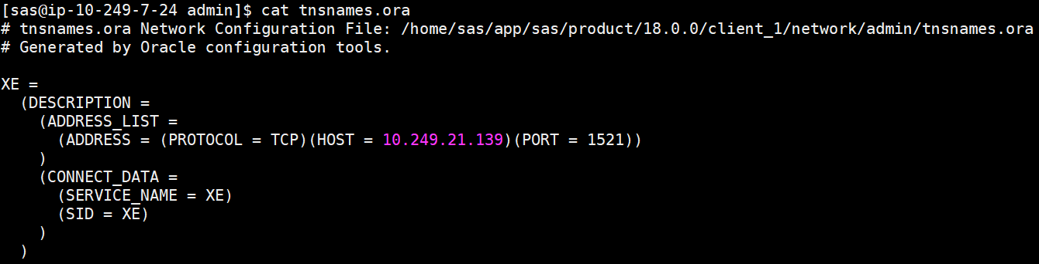
Steps of Configuration
Configure tnsnames.ora

Slide 6
Steps of Configuration
Configure OS Environment Variable
vi ~/.bash_profile
export ORACLE_HOME=/usr/lib/oracle/18.5/client64
export LD_LIBRARY_PATH=$ORACLE_HOME/lib
export TNS_ADMIN=/home/sas/app/sas/product/18.0.0/client_1/network/admin/
PATH=$PATH:$HOME/.local/bin:$HOME/bin:$ORACLE_HOME/bin
export PATH

Slide 7
Steps of Configuration
Configure SAS Environment Variable(1)
For each host that is specified in the [programming] host group
/opt/sas/viya/config/etc/workspaceserver/default/workspaceserver_usermods.sh
/opt/sas/viya/config/etc/sysconfig/compsrv/default/sas-compsrv
Add the following lines to each file
export ORACLE_HOME=/usr/lib/oracle/18.5/client64
export TWO_TASK=XE
export ORAENV_ASK=NO
export SASORA=V9
export PATH=$PATH:$ORACLE_HOME/bin
export LD_LIBRARY_PATH=$ORACLE_HOME/lib:$LD_LIBRARY_PATH

Slide 8
Steps of Configuration
Configure SAS Environment Variable(2)
On each CAS node, use a text editor to edit the cas_usermods.settings file
sudo vi /opt/sas/viya/config/etc/cas/default/cas_usermods.settings
Add the following lines to each file
export ORACLE_HOME=/usr/lib/oracle/18.5/client64
export LD_LIBRARY_PATH=$ORACLE_HOME/lib:$LD_LIBRARY_PATH

Slide 9
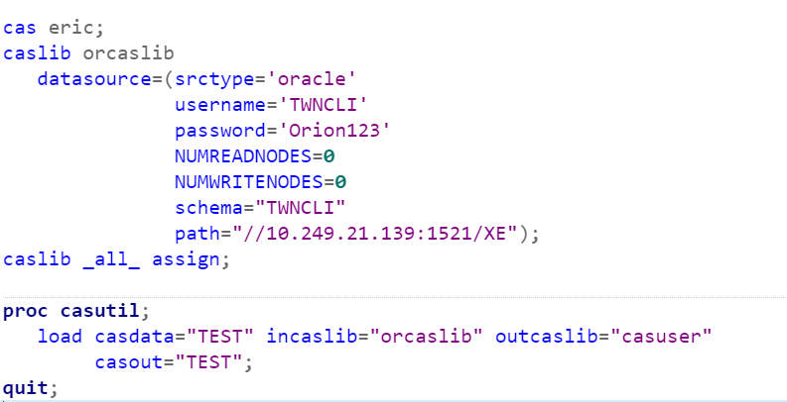
Steps of Configuration
Run Test Script(1)
Initiate CAS session
Connect Information
Multinode data transfer
Load data from Oracle to CAS

Slide 10
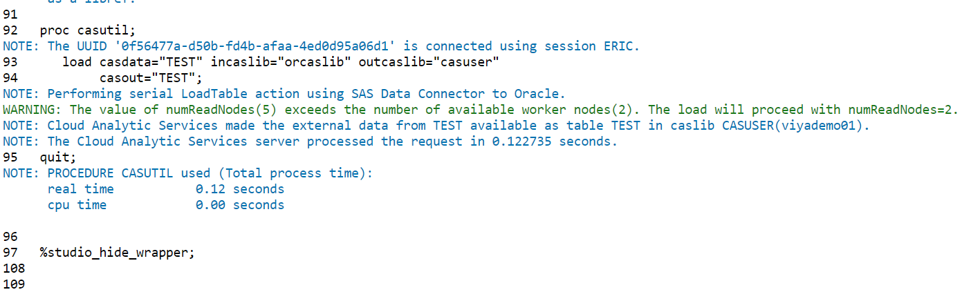
Steps of Configuration
Run Test Script(2)

