Slide 1
Configure SAS/ACCESS to Oracle
SAS

Slide 2
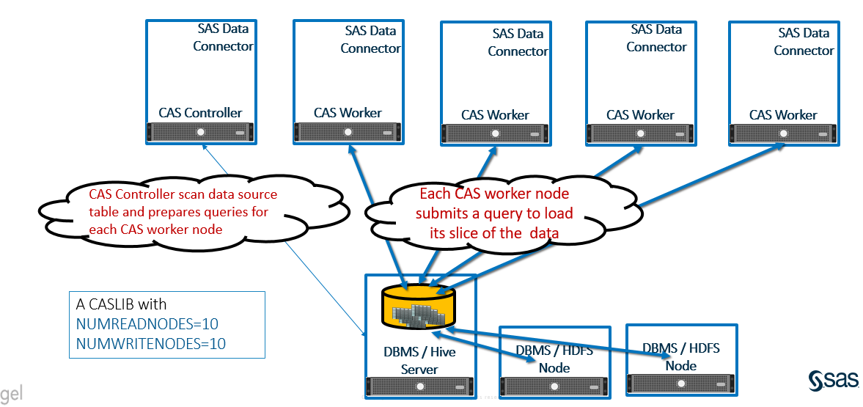
MultiNode Data Transfer to CAS

Slide 3
Steps of Configuration
Overview
Install Oracle Client (Version 11gR2 or later)
Configure Network Configuration File “tnsnames.ora”
Configure OS Environment Variable
Configure SAS Environment Variable
Configure SAS Authentication Domain and Credential
Run Test Script

Slide 4
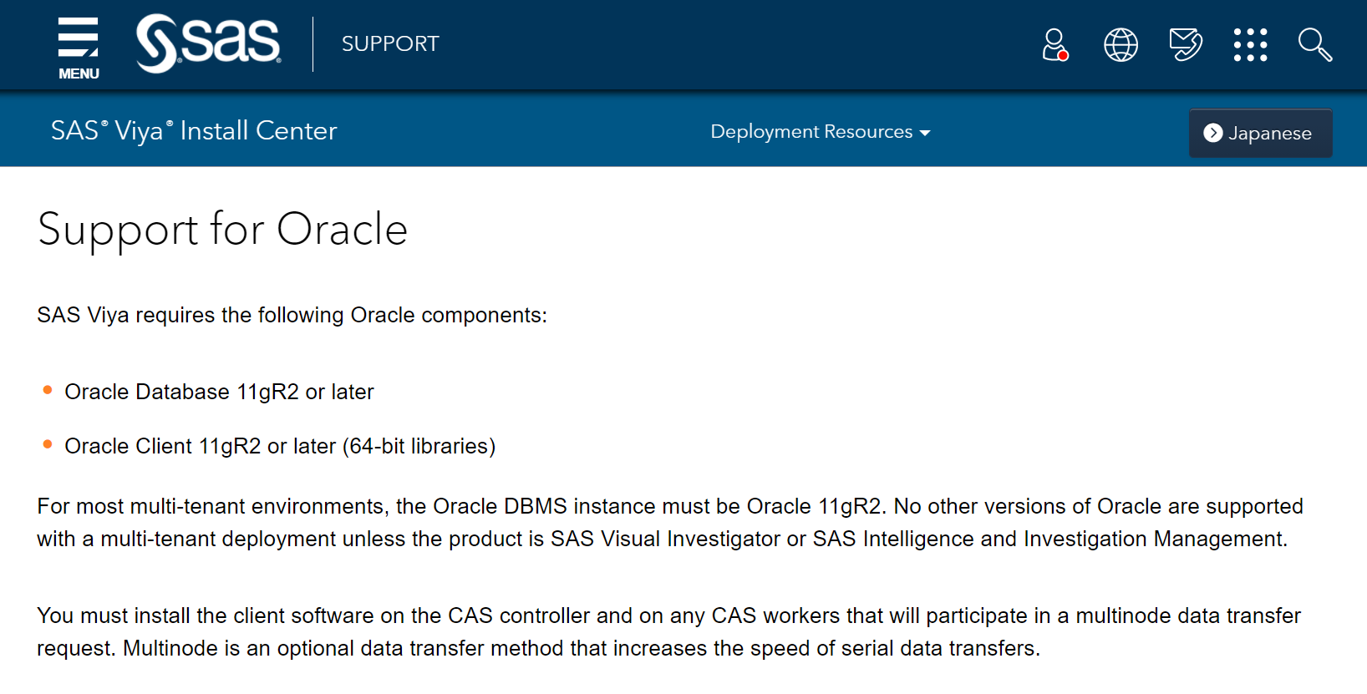
Steps of Configuration
Install Oracle Client
sudo yum install libaio
sudo rpm -ivh oracle-instantclient18.5-basic-18.5.0.0.0-3.x86_64.rpm
sudo rpm -ivh oracle-instantclient18.5-sqlplus-18.5.0.0.0-3.x86_64.rpm

Slide 5
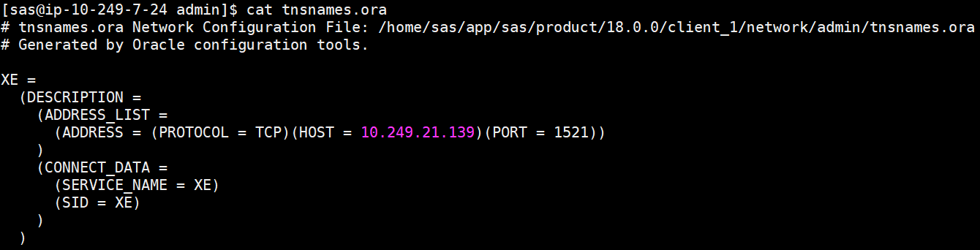
Steps of Configuration
Configure tnsnames.ora

Slide 6
Steps of Configuration
Configure OS Environment Variable
vi ~/.bash_profile
export ORACLE_HOME=/usr/lib/oracle/18.5/client64
export LD_LIBRARY_PATH=$ORACLE_HOME/lib
export TNS_ADMIN=/home/sas/app/sas/product/18.0.0/client_1/network/admin/
PATH=$PATH:$HOME/.local/bin:$HOME/bin:$ORACLE_HOME/bin
export PATH

Slide 7
Steps of Configuration
Configure SAS Environment Variable(1)
For each host that is specified in the [programming] host group
/opt/sas/viya/config/etc/workspaceserver/default/workspaceserver_usermods.sh
/opt/sas/viya/config/etc/sysconfig/compsrv/default/sas-compsrv
Add the following lines to each file
export ORACLE_HOME=/usr/lib/oracle/18.5/client64
export TWO_TASK=XE
export ORAENV_ASK=NO
export SASORA=V9
export PATH=$PATH:$ORACLE_HOME/bin
export LD_LIBRARY_PATH=$ORACLE_HOME/lib:$LD_LIBRARY_PATH

Slide 8
Steps of Configuration
Configure SAS Environment Variable(2)
On each CAS node, use a text editor to edit the cas_usermods.settings file
sudo vi /opt/sas/viya/config/etc/cas/default/cas_usermods.settings
Add the following lines to each file
export ORACLE_HOME=/usr/lib/oracle/18.5/client64
export LD_LIBRARY_PATH=$ORACLE_HOME/lib:$LD_LIBRARY_PATH

Slide 9
Steps of Configuration
Configure SAS Authentication Domain and Credential
Configure Authentication Domain and Credential by SAS Environment Manager
Create a custom group called ‘orausers’ include Oracle users
Create a domain called ‘Oracle’ and add ‘orausers’ into domain
Create a credential for Oracle users

Slide 10
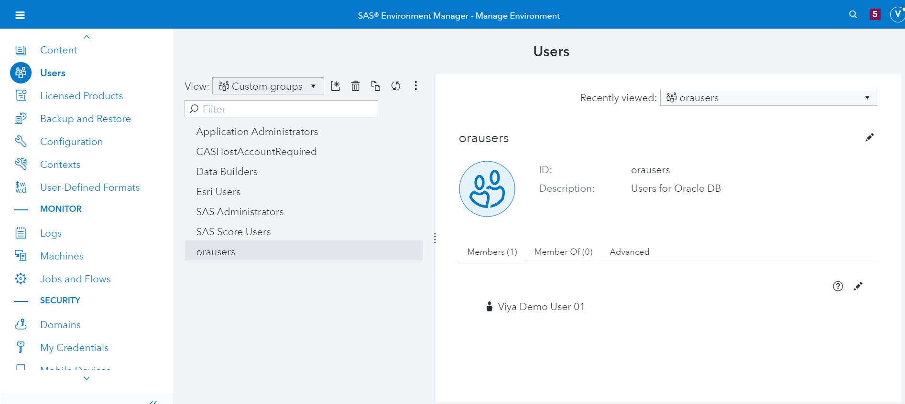
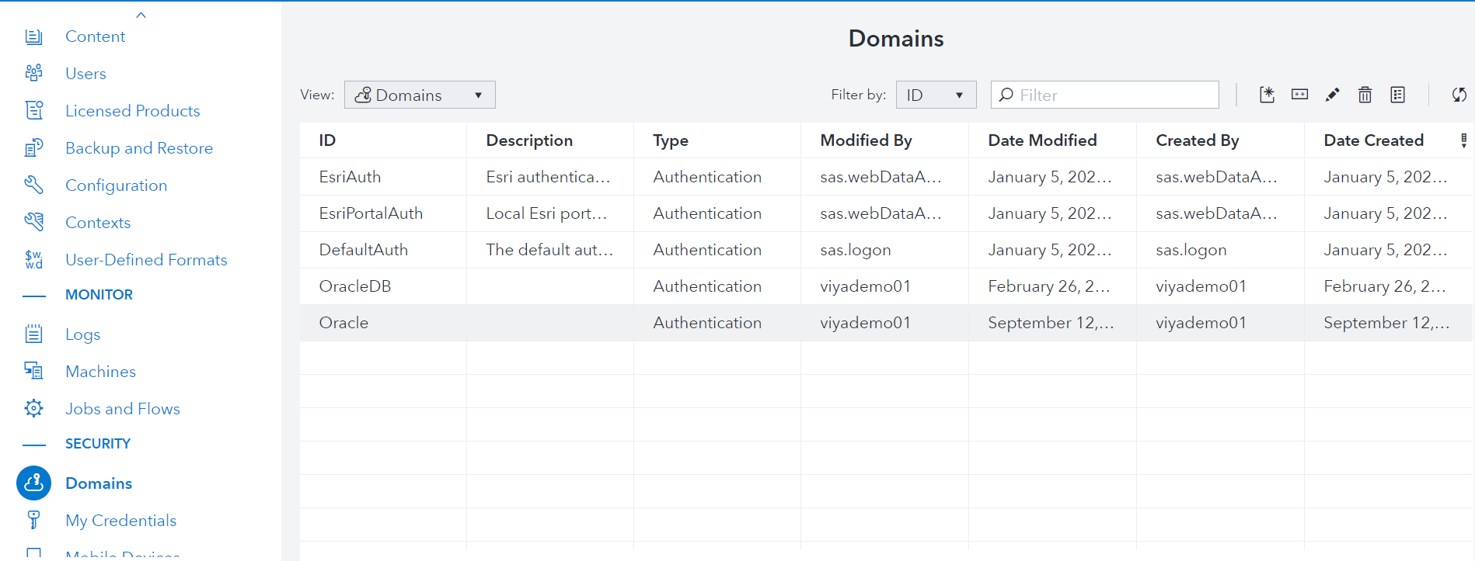
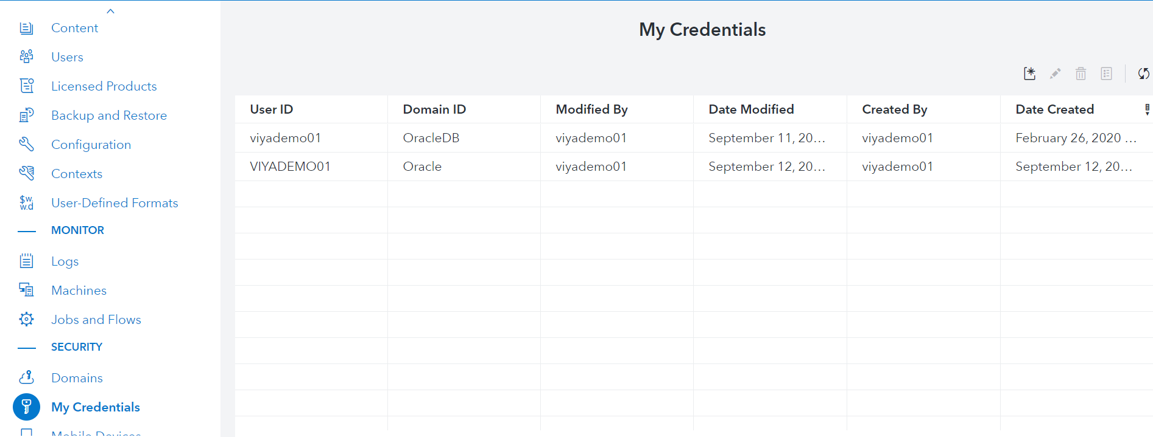
Steps of Configuration
Configure SAS Authentication Domain and Credential
1
2
3

Slide 11
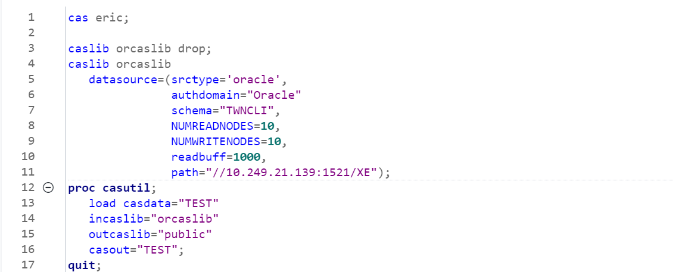
Steps of Configuration
Run Test Script(1)
Initiate CAS session
Connect Information
Multinode data transfer
Load data from Oracle to CAS

Slide 12
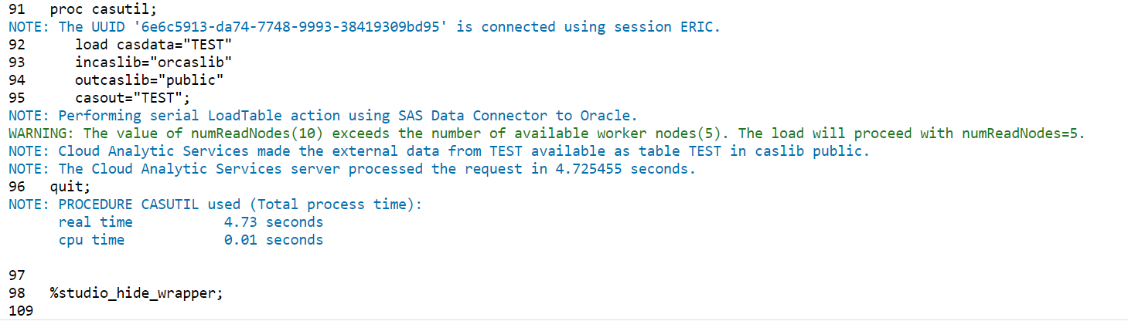
Steps of Configuration
Run Test Script(2)
Notice in this log that SAS says it’s performing a serial LoadTable action where multi-node transfer occurs. The word “serial” in this usage is just another way of saying that the SAS Data Connector software is used. The workers do indeed perform a multi-node load where each queries its assigned allotment of data from the source.
Notes:
https://www.sas.com/content/dam/SAS/support/en/sas-global-forum-proceedings/2019/3479-2019.pdf

