Slide 1
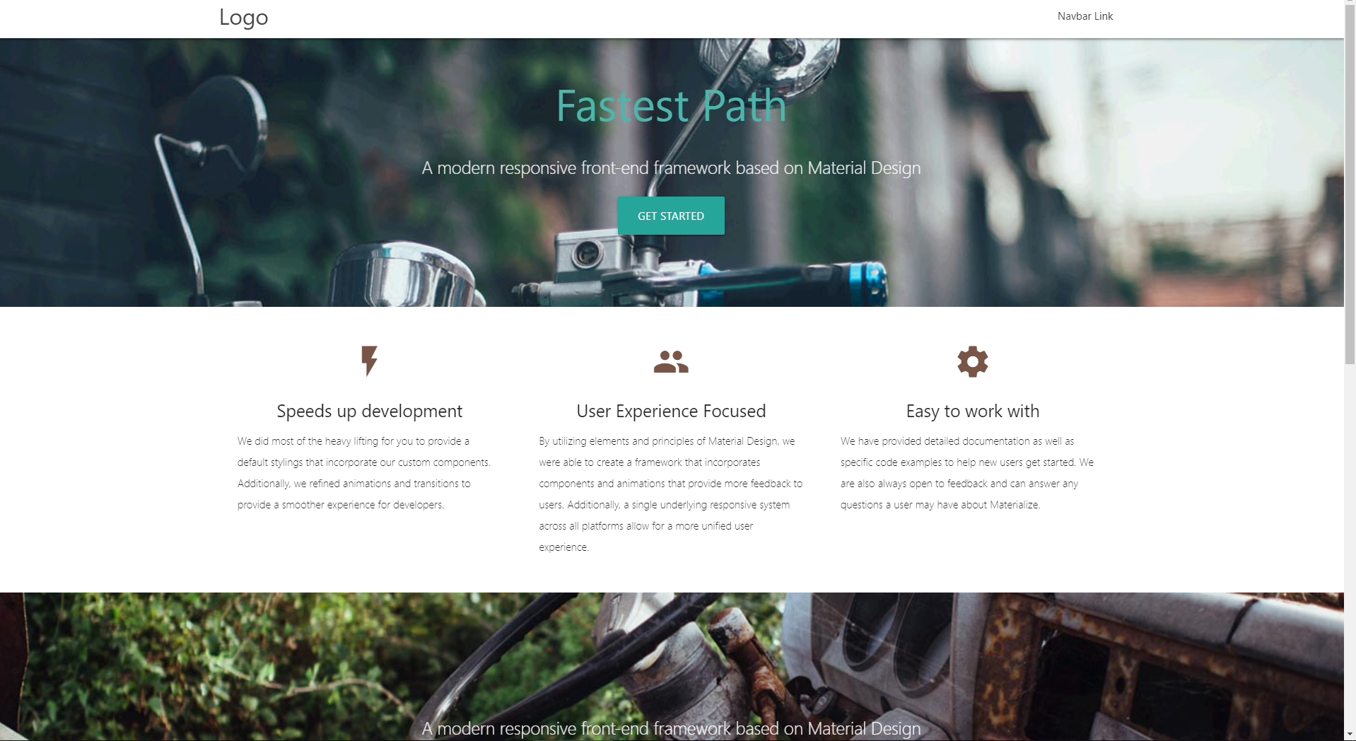
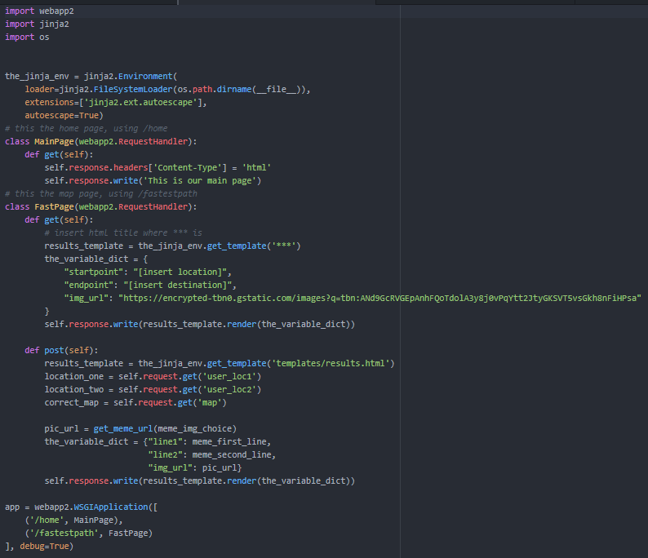

Day1M-Team 3: Fastest Path
Front End
Back End
Created Parallax Template ;)

