Slide 1

ASL Alphabet
Egyptian Hieroglyphic

Slide 2
Team Members
Batoul Adel Hussein Dina Zakaria Mostafa Mai Mohammad Abdrabo Sharkas Naira Hassan Mohamed Marouf Sara Ibrahim Fayed

Slide 3
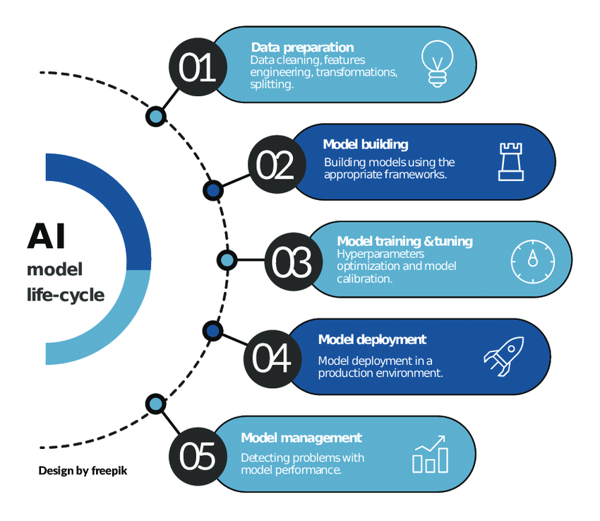
AI Models
CNN
Vgg-16
Vgg-19
Resnet 50

Slide 4
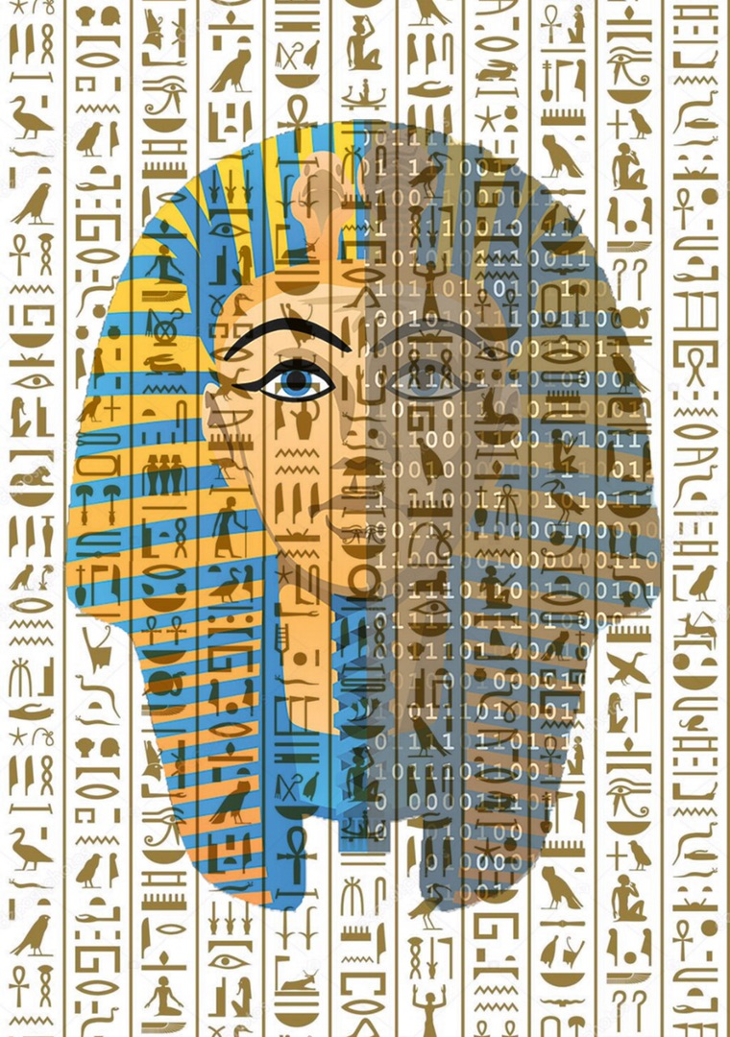
Egyptian Hieroglyphic

Slide 5
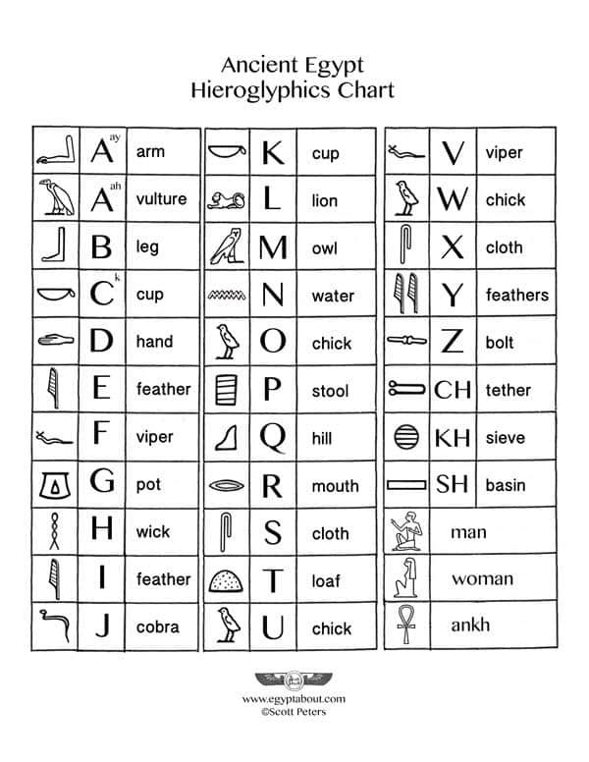
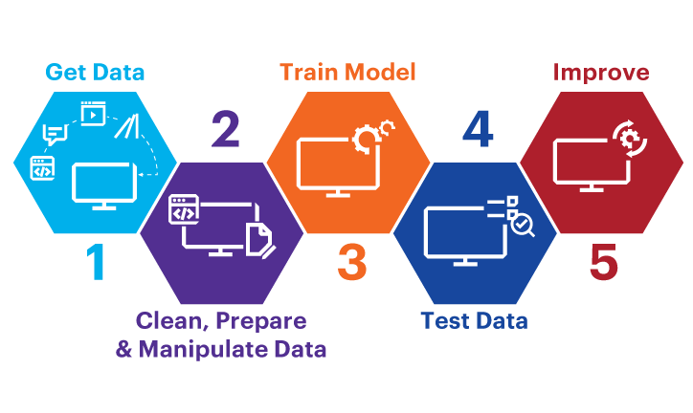
Egyptian Hieroglyphic Dataset
95 Class
Train / Test / Validation

Slide 6
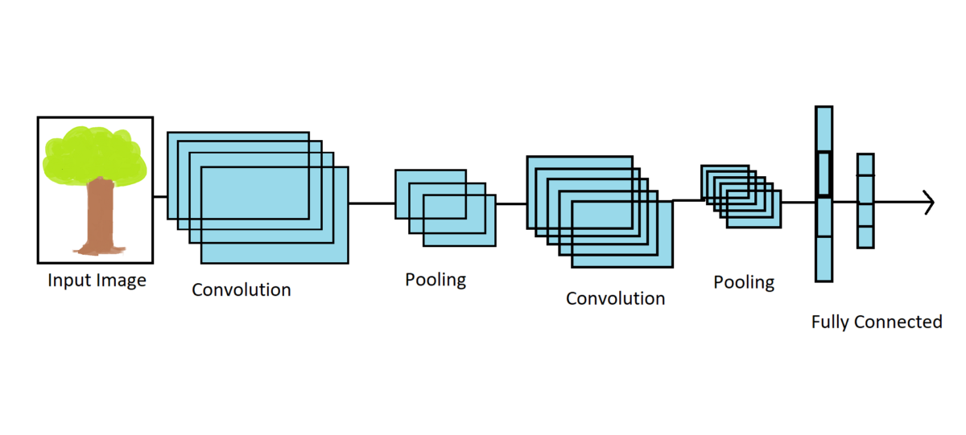
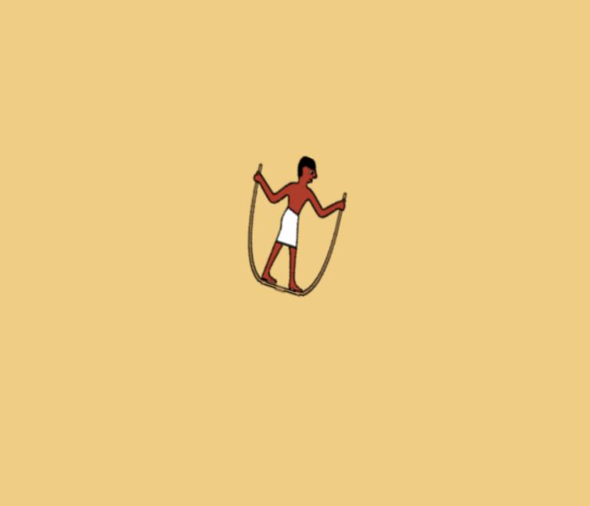
CNN

Slide 7
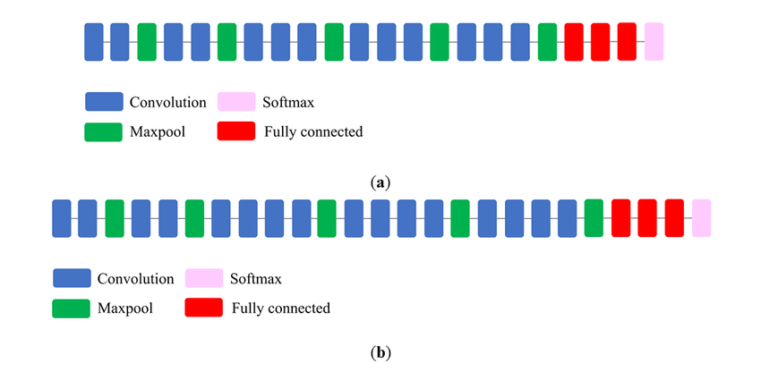
Vgg-16 | Vgg-19

Slide 8
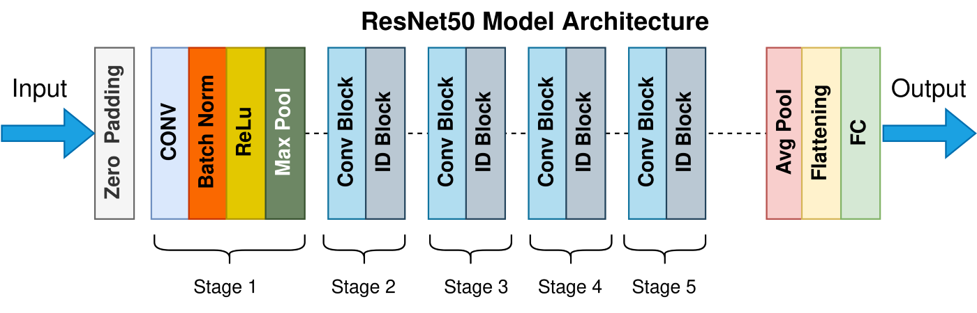
Resnet 50

Slide 9
Models
Vgg-16
Vgg-19
Resent 50
CNN
Val. Accuary: 92.11%
Test Acc. :
92.1%
Val. Accuary:
78.95%
Test Acc.:
78.94%
Val. Accuary: 98%
Test Acc.:
97.36%
Val. Accuary: 31.58%
Test Acc. :
31.57%

Slide 10
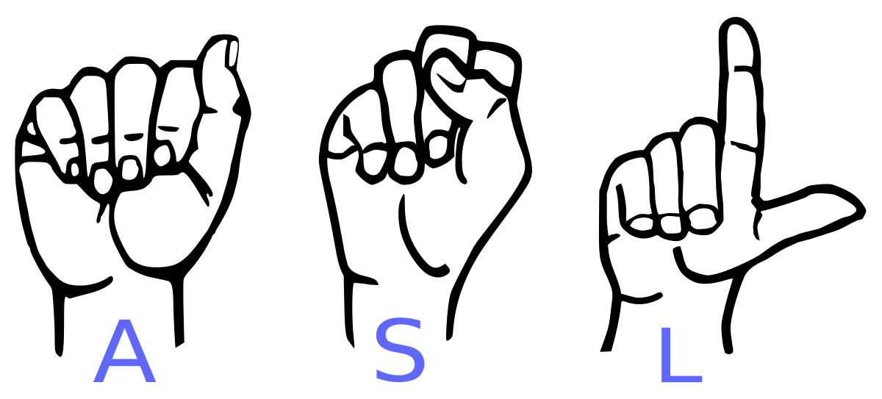
ASL Alphabet

Slide 11
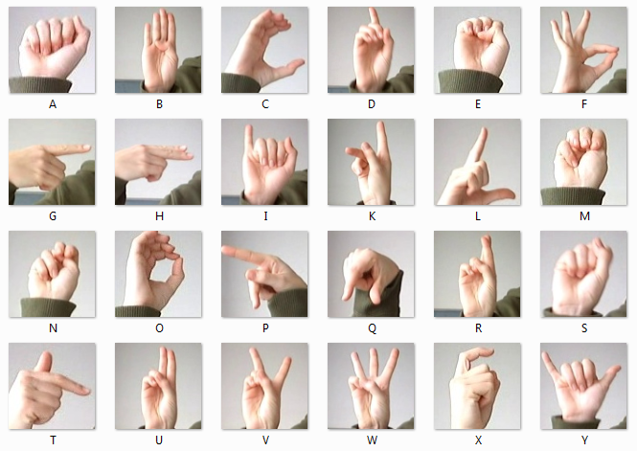
ASL Alphabet Dataset
29 Class
Train / Test / Validation

Slide 12
Models
Vgg-16
Vgg-19
Resent 50
CNN
Val. Accuary: 99.43%
Test Acc. :
99.425%
Val. Accuary:
98.71%
Test Acc.:
99.425%
Val. Accuary: 99.86%
Test Acc.:
99.195%
Val. Accuary: 99.94%
Test Acc. :
99.885%

