Slide 1
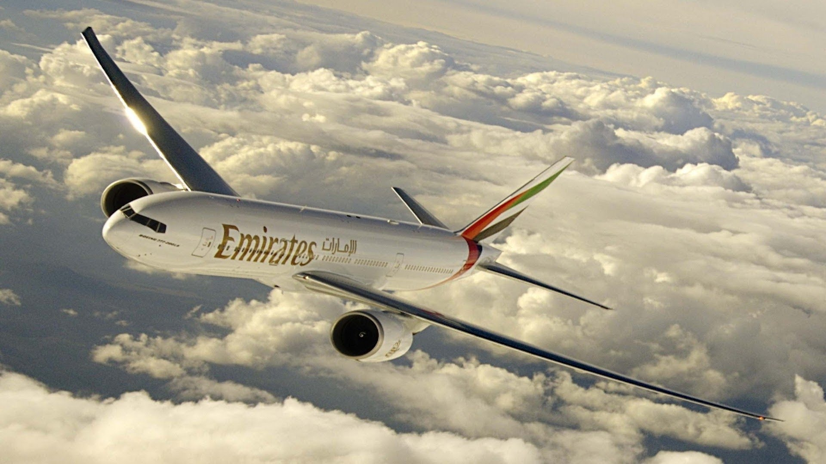
OOM MINI PROJECT
GROUP-38
TOPIC: AIRLINE TICKETING SYSTEM

Slide 2
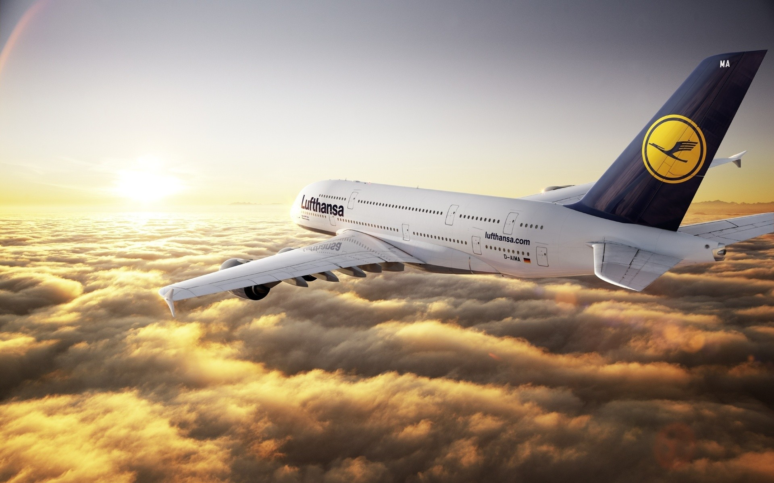
GROUP MEMBERS
Nairit Banerjee-IIT2016505
Anirudh Singh Rathore-IIT2016091
Yaver-LIT2016032
Nandan Raj-IIT2016066
Shubhrajit Mandal-IIT2016098

Slide 3
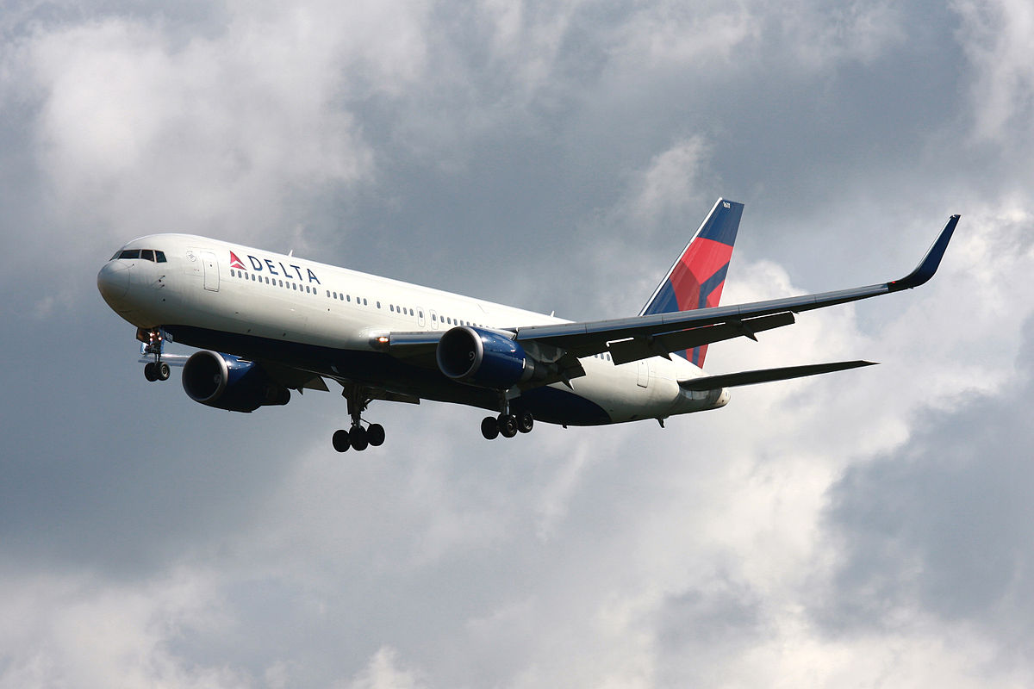
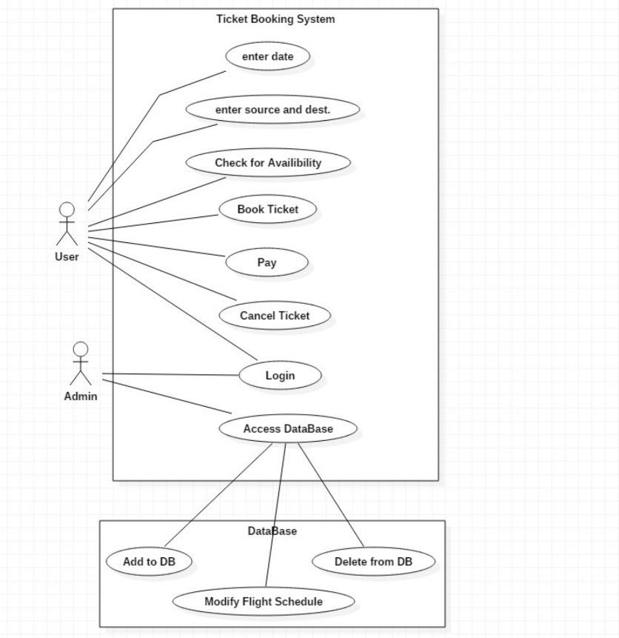
USE CASE DIAGRAM

Slide 4
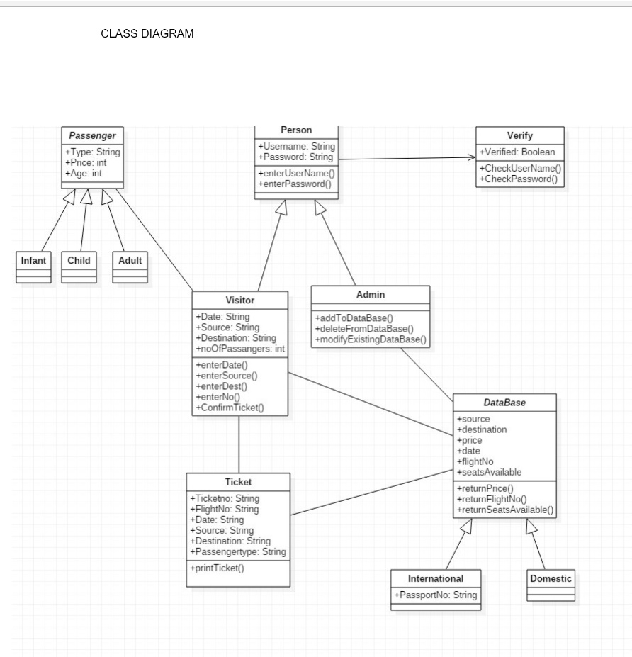
CLASS DIAGRAM

Slide 5
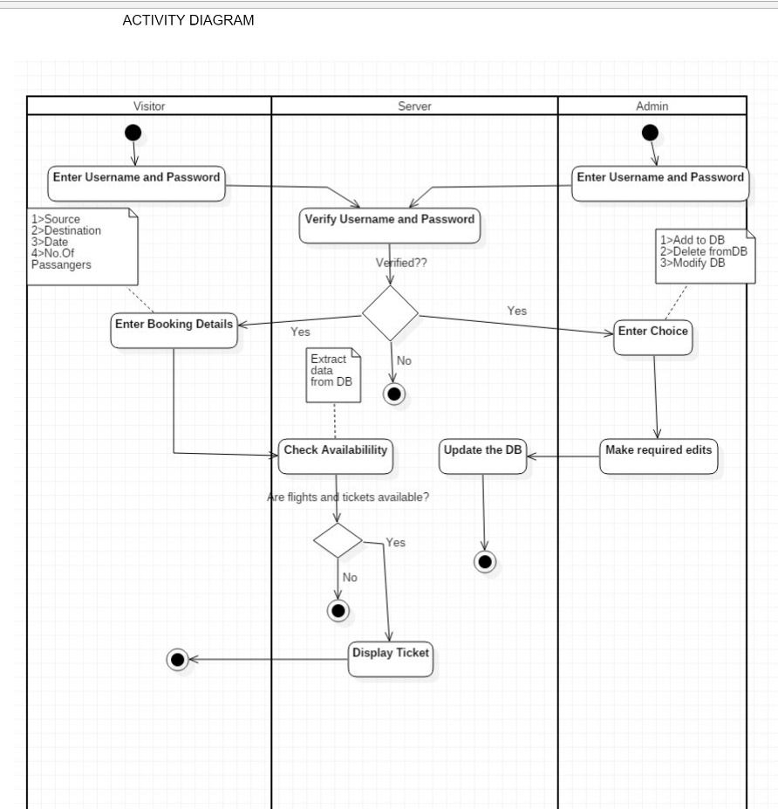
ACTIVITY DIAGRAM

Slide 6
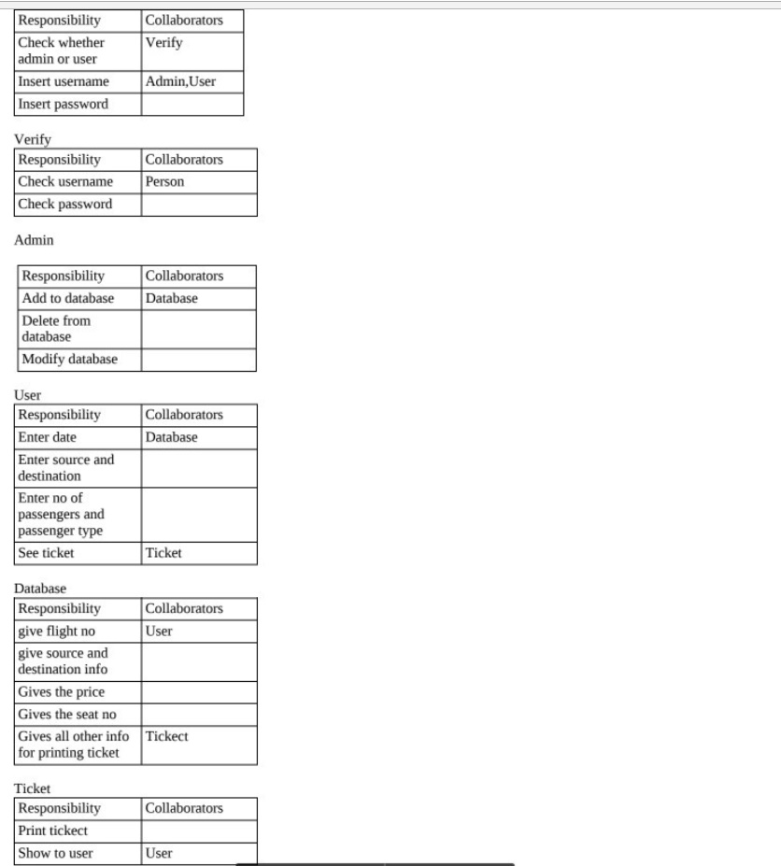
CRC DIAGRAM

Slide 7
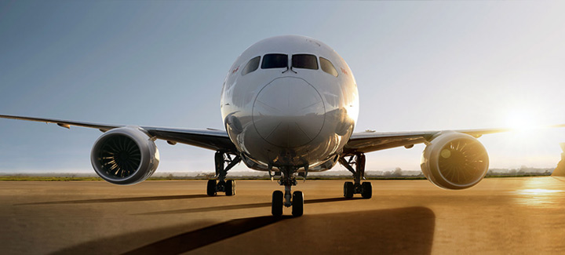
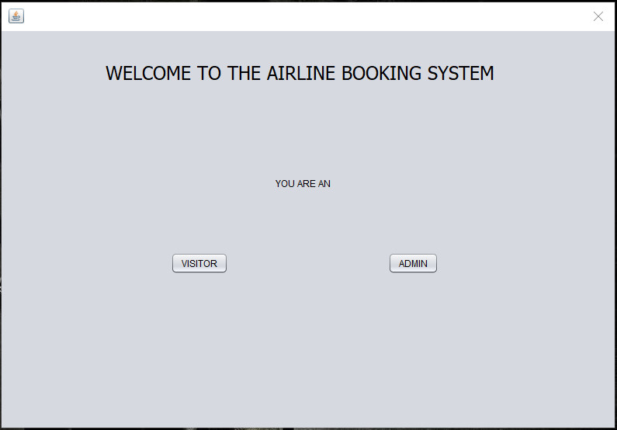
HOW IT WORKS!!
At first we check whether the user is an admin or a visitor.

Slide 8
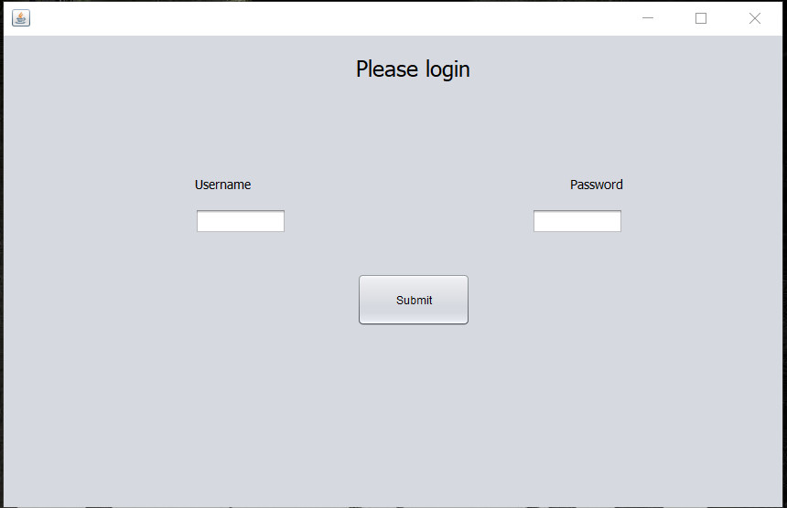
HOW IT WORKS!!
If the user is an admin, user logs in-

Slide 9
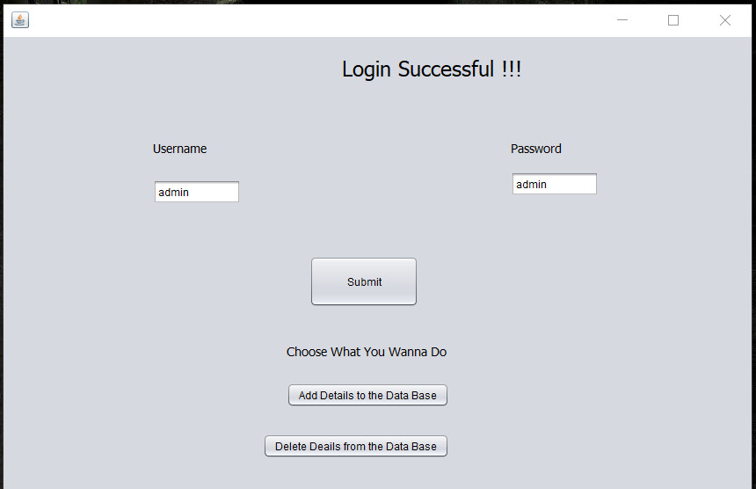
HOW IT WORKS!!
After the admin logs in, he needs to choose whether he adds to the database or delete from the database

Slide 10
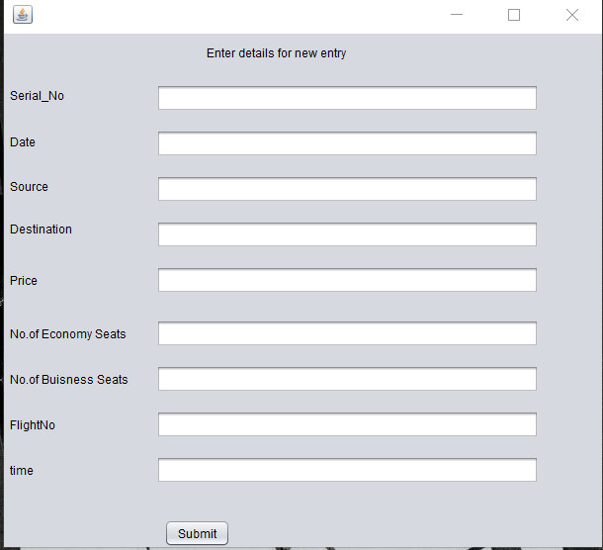
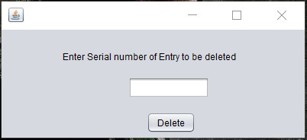
HOW IT WORKS!!
Admin adding to the database or deleting from the database-

Slide 11
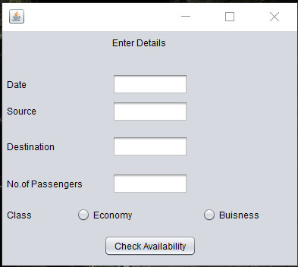
HOW IT WORKS!!
The Visitor will enter the journey details-

Slide 12
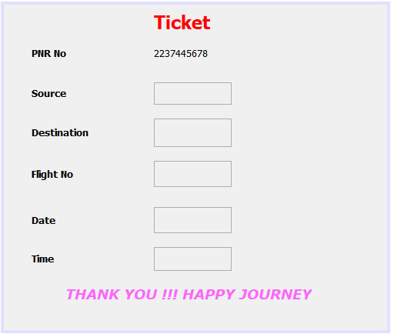
HOW IT WORKS!!
If the flight is available, ticket gets printed-

