Slide 1
Object Oriented Methodologies
Indian Institute of Information Technology, Allahabad

Slide 2
OOM
Think in Object Oriented manner !
  Objects rather than Procedures…
Model /Design in Object Oriented Methodology !
  Use UML diagrams for Model-Design…
Develop in Object Oriented Programming !!
  Use of Java programming…..
Maintain/ReUse using Object Oriented Features !!
  Use of JAR, Design Patterns etc…

Slide 3
OOM for Software Projects
Software Projects & Design: Design Patterns
  OOM Design, UML & GoF dictum
  Analysis Model to Design Model
  Patterns in Engineering: Concepts wrt Software Engineering
    Why we need good Design..& What is the good Design..?
    What are Design objectives..?
    UML-Unified Modeling Language
  Design Patterns: GoF and after effects….
Design Principles: Design & OO relationships
  Inheritance, Composition & Aggregation
    Advantages and Disadvantages of Inheritance
    How to Create Quality Classes
    Design Patterns: Concepts
OOM: GUI, Applets & Mobile Apps
  Implementation issues
Recent trends in OOSE

Slide 4
OOM
It’s believed that Java is more effective in Large & Mid sized software projects and Web based applications, specially involving Large number of classes and thus design..
If we develop big Software project with OOM, then what’s the significance of design ?
How will be OOM useful in Design..?
UML- Unified Modeling Language…..!!
OOM & Software design..
What exactly GoF contributed in OO Design !!

Slide 5
OOM for Software Projects
As OOM has become de-facto software paradigm today, it is required for medium sized or large sized project follow Software Engineering approach for successful software project implementation.
  One can not directly jump right into the coding phase, without spending adequate time on Understanding the Requirement Analysis of Software, Modeling & Design of the project.
  And then only Implementation of the agreed Design.
A group of approaches are developed for Object Oriented Software development….
OO provides many specific design principles based on Object Oriented characteristics, these principles are implemented using UML-Unified Modeling Languages
Notes:
Ranjana vyas

Slide 6
OO Design
Software Design in general deals with having specific design objectives being fulfilled to have Software with
  Flexibility
  Maintainability
  Usability
  Highest performance
General/Structured software design emphasizes on design of software modules with functional independence
  Cohesion
  Coupling
OO provides many specific design principles based on Object Oriented characteristics

Slide 7
Modeling, Design & GoF
Java GUI, Applets
&
Apps development

Slide 8
Modeling & Design in Engineering
If a Car company has been asked to design Racing car Wheels then what should Company do…start with Laws of Physics and Automobile Engineering or study the existing design specifications of existing Wheels and incorporate desired changes in the Wheels..

Slide 9
Software Design & Standard Design Patterns
Which Class is to become Parent Class, Which are to be chosen as Child Class..?
Do we always need to design Software with designing various software modules such that we achieve design objectives or can we have some standard design patterns ??
Pattern-based design was introduced into architecture and engineering in the 1950's
Almost immediately, software engineers began using patterns for designing software
It wasn't until a Group of Four professionals combined forces that pattern-based design became well-known and commonplace
  This group was known as the Gang of Four (GoF)

Slide 10
GoF has significant impact on OO practices and Researches
The Concept of OO Design Patterns was introduced by GoF and became instantly popular worldwide. The book has the first two chapters exploring the capabilities and pitfalls of object-oriented programming, and the remaining chapters describing 23 classic software design patterns.

Slide 11
GoF & OO Software
GoF proposed many useful techniques related to Object Oriented Software in the popular Book
  Authors Erich Gamma, Richard Helm, Ralph Johnson and John Vlissides with a foreword by Grady Booch. They are often referred to as the Gang of Four, or GoF.
The book has been influential to the field of OO Software and is regarded as an important source for object-oriented design theory and practice. More than 500,000 copies have been sold in English and in 13 other languages.
  Effective software design requires considering issues that may not become visible until later in the implementation and thus Principles of OO Design and Design Patterns provides a tested Solution paradigm to many often occurring situations.
What are the significant influences of GoF in Object Orientation?

Slide 12

GoF-Design Patterns
Design Patterns: Elements of Reusable Object-Oriented Software
Book by Ralph Johnson, John Vlissides, Richard Helm, and Erich Gamma
Published: October 21, 1994
  Describing 23 classic software design patterns.
  Regarded as an important source for object-oriented design theory and practice.

Slide 13
Shall we expect next GoF from IIIT..??
Looking at enormous talent in our students…We can definitely keep the hope..

Slide 14
GoF Dictum…
GoF based on their working experience proposed some significant concepts;
  "Favor 'object composition' over 'class inheritance'." (Gang of Four 1995:20)
  "Program to an 'interface', not an 'implementation'." (Gang of Four 1995:18)
The GoF refer to inheritance as white-box reuse, with white-box referring to visibility, because the internals of parent classes are often visible to subclasses.
In contrast, the authors refer to object composition as black-box reuse because no internal details of composed objects need be visible in the code using them.

Slide 15
OO Design
Knowing concepts like Abstraction, Inheritance, Polymorphism is necessary but not sufficient to make you good OO Designer !
  A designer has objectives of creating Flexible designs that are maintainable with appropriate Re-Use provisions.
  How can we make Software fulfilling above attributes?
  How to proceed from the OO Analysis to Design

Slide 16
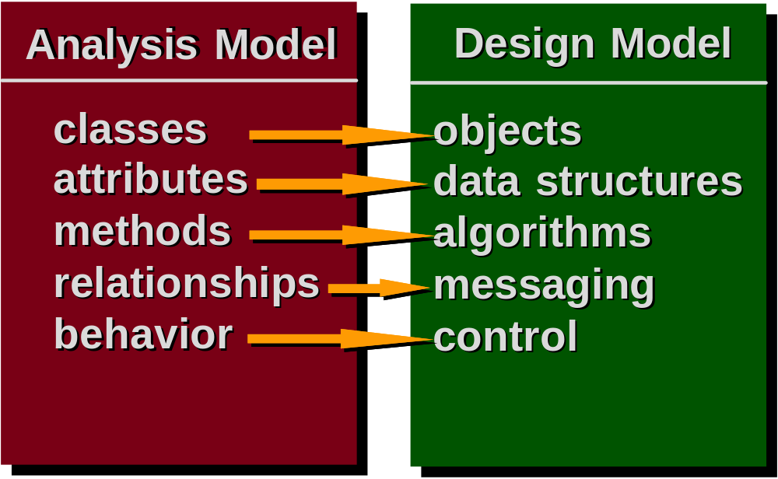
OOA to OOD

Slide 17
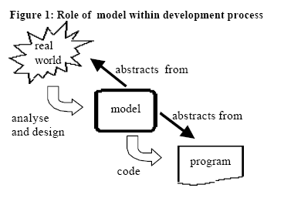
Real World: Modeling to Design

Slide 18
Design in OO & Class Relationships
Though there are many OOM characteristics but when asked to design the system, we tend to consider Inheritance first and think that we should design SuperClass and SubClass structure
But we need to study the problem domain with other design possibilities of existing OO relationship and accordingly incorporate desired changes..

Slide 19
OOM Features
Generally OO software designers model the given situation in terms of OO characteristics like Inheritance…
Can we model the situation ONLY as Inheritance…
Can we have some other relationships between classes other than as Inheritance ?
What about Aggregation or Composition ???

Slide 20
Inheritance in Class
&
Object instantiation

Slide 21
Inheritance in Java
A Class inheriting Parent Class gets both data and methods (or Functions) of Parent Class and can add new Data3 for Child Class .
Data1
Data2
ParentClass
Method1
But When we want to instantiate objects from these two classes then
How will we instantiate the two objects?
what are the different possibilities??
Data3
Method1
ChildClass

Slide 22
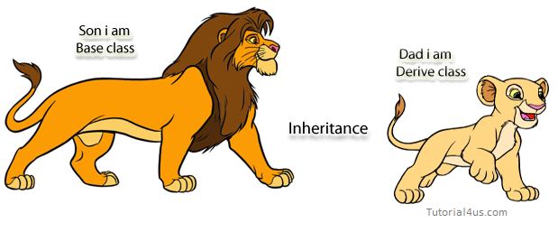
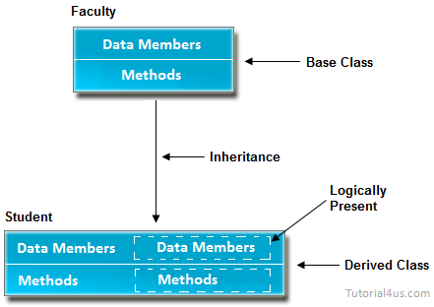
Real life example of inheritance
The real life example of inheritance is child and parents, all the properties of father are inherited by his son.

Slide 23
Inheritance in Java
Inheritance relation between Employee Class (Parent Class) and Salary Class (Child Class) can be done by using the extends relationship:
Also similarly Hourly class should also use extend another class A if and only if
Employee
Salary
Hourly

Slide 24
Suppose there is simple Class Inheritance method "Employee“ with Child Classes Hourly and Salary ,
How will be objects instantiated ??

Slide 25
Objects instantiation in Multi level Inheritance
Consider a situation when we have Multi level Inheritance and Object instantiation;
  Objects of Class A with reference type A.
  Objects of Class B with reference type B and also of type A.
  Objects of Class C with reference type C and/or of type B , type A.
In OOP the ability of an object to have many forms, which is a direct result of inheritance is known as Polymorphism.
A
B
C

Slide 26
Simple Class Example:OOM design
Let us continue with the simple example of preparing software for Employee Pay roll calculation.
The design of the Employee class might seem fine initially.
The Employee class has a field named salary, which implies that an employee has a salary; however, hourly employees have an hourly rate, which is quite different from a salary.
  Instant idea: A tempting fix for this situation is to add a Boolean field to the Employee class named isSalary that is true for salary employees and false for hourly employees.
The salary field could be used to represent an annual salary when isSalary is true or an hourly rate when isSalary is false.

Slide 27
Employee Class with 02 methods and 05 Fields
public class Employee
{
public String name;
public String address;
public int number;
public int SSN;
public double salary;
public void mailCheck()
{
System.out.println(“Mailing check to “ + name
+ “\n” + address);
}
public double computePay()
{
return salary/52;
}
}

Slide 28
OOPS….
For example, The isSalary field could also be used within the computePay() method to determine which arithmetic to use because computing pay for salaried employees is different than for hourly employees.
public float computePay()
{
if(isSalary)
{
//Perform arithmetic for salaried employee
}
else
{
//Perform arithmetic for hourly employee
}
}

Slide 29
OOM design
Adding a field such as isSalary and trying to use one class to represent two different types of objects is not a good OOP design.
We could make it work, but we are not taking advantage of the benefits of OOPS.
If we use a field to determine the type of an object, your end result is a class that looks object-oriented but is really procedural.
For example, an Employee object will need to check this added Boolean field just to know what type of object it is, causing the design of the program to not be focused on objects.

Slide 30
OOM Design
A bigger problem arises when something needs to be changed. What happens to the isSalary field when a new type of employee needs to be added?
Suppose that the company starts hiring contractors who are paid by the day. The Boolean no longer works because it can’t be used to distinguish between three types.
You could change the field to an int, name it employeeType, and use an enumeration like 0 for salary, 1 for hourly, and 2 for contractor.
Again, you could make this work, but you have to make serious modifications to the Employee class. The computePay() method will have to entirely rewritten:

Slide 31
Revised computePay method
public float computePay()
{
switch(employeeType)
{
case 0:
//Perform arithmetic for salaried employee
break;
case 1:
//Perform arithmetic for hourly employee
break;
case 2:
//Perform arithmetic for contractor employee
break;
//and so on if necessary
}
}

Slide 32
Example:OOM design
And the computePay() method will keep getting longer and longer as different types of employees arise.
Any time you find yourself writing classes that do not know what type they are, you probably should rethink your design.
We need to realize that although employees are objects in our problem domain, there are actually two different types of employee objects: salaried employees and hourly employees
Therefore, we should write two classes: Salary and Hourly.

Slide 33
Two Classes
public class Hourly
{
public String name;
public String address;
public int SSN;
public int number;
public float hourlyRate;
public float hoursWorked
public void mailCheck()
{
System.out.println(“Mailing a check to “ + name + “ “ + address);
}
public float computePay()
{ return (float) hoursWorked * hourlyRate;
}
}
public class Salary
{
public String name;
public String address;
public int SSN;
public int number;
public float salary;
public void mailCheck()
{
System.out.println(“Mailing a check to “ + name
+ “ “ + address);
}
public float computePay()
{
return (float) salary/52.0;
}
}

Slide 34
Example: OOM design
As you can see, the Salary and Hourly classes are repeating code. Salary and hourly employees are still employees, and there is a lot of information in common between the two.
Although Salary and Hourly employees are different types, they are not entirely different. Which is seen by the repetition of fields and methods in these two classes.
The Salary and Hourly classes demonstrate the need for inheritance.
Using inheritance will improve this design considerably, not only to avoid repeating code, but also to create a program design that allows for better maintenance and code changes later.
Therefore, writing two separate classes for the two different types of employees is not yet a satisfactory solution.
Appropriate Use of Inheritance is definitely an issue….

Slide 35
OO Design…
A better design for the Salary and Hourly classes is to take their common elements and put them in a parent class, leaving the unique elements in the child classes.
  Ex. the mailCheck() method could appear in the Employee parent class, and the computePay() method could appear in each of the child classes.
The assumption is that the process of mailing a check is the same for all employees, but computing their pay is directly affected by how they are paid.
Employees do not share a common computePay() method. By placing computePay() in each child class, the method will be written twice.
This is not repeating code, though, because computePay() in Salary is quite different than computePay() in Hourly.

Slide 36
Inheritance in Class
&
Object instantiation

Slide 37
Inheritance in Java
A Class inheriting Parent Class gets both data and methods (or Functions) of Parent Class and can add new Data3 for Child Class .
Data1
Data2
ParentClass
Method1
But When we want to instantiate objects from these two classes then
How will we instantiate the two objects?
what are the different possibilities??
Data3
Method1
ChildClass

Slide 38
Inheritance in Java
Inheritance relation between Employee Class (Parent Class) and Salary Class (Child Class) can be done by using the extends relationship:
Also similarly Hourly class should also use extend another class A if and only if
Employee
Salary
Hourly

Slide 39
Suppose there is simple Class Inheritance method "Employee“ with Child Classes Hourly and Salary ,
How will be objects instantiated ??

Slide 40
Implementing Inheritance
A class uses the extends keyword to inherit from another class.
It appears after the class name when declaring the class and is followed by the name of the class being extended.
For Ex, the Salary class is a child of the Employee class:
public class Salary extends Employee
Similarly, the Hourly class can extend Employee with the statement:
public class Hourly extends Employee
The following Employee class will be used as the parent of Salary and Hourly. No special code to denote that Employee is a parent class.
public class Employee
{ public String name;
public String address;
public int SSN;
public int number;
public void mailCheck()
{
System.out.println(“Mailing a check to “ + name
+ “ “ + address);
} }

Slide 41
The following Salary class uses the extends keyword to denote Salary is a child class of Employee.
public class Salary extends Employee
{
public float salary; //Annual salary
public float computePay()
{
System.out.println(“Computing salary pay for “ + name);
return salary/52;
}
}

Slide 42
Similarly, the following Hourly class extends the Employee class using the extends keyword.
public class Hourly extends Employee
{
public float hourlyRate; //Pay rate
public float hoursWorked; //Weekly hours worked
public float computePay()
{
System.out.println(“Computing hourly pay for “ + name);
float pay = 0.0F;
if(hoursWorked <= 40)
{
pay = hourlyRate * hoursWorked;
}
else //Need to compute overtime
{
pay = (hourlyRate * 40) +
(hourlyRate * (hoursWorked - 40) * 1.5F);
}
return pay;
}}

Slide 43
We have defined the Employee, Salary, and Hourly classes,
Let’s look at a program that instantiates and uses these classes.
The following Inherit-
Demo program creates an Employee, Salary, and Hourly object.
Study the program carefully and try to determine its output

Slide 44
public class InheritDemo
{public static void main(String [] args)
{System.out.println(“Instantiating an Employee”);
Employee e = new Employee();
e.name = “Robert Smith”;
e.address = “111 Java Street”;
e.SSN = 999001111;
e.number = 1;
System.out.println(“Instantiating a Salary”);
Salary s = new Salary();
s.name = “Jane Smith”;
s.address = “222 Oak Drive”;
s.SSN = 111009999;
s.number = 2;
s.salary = 100000.00F;
System.out.println(“Instantiating an Hourly”);
Hourly h = new Hourly();
h.name = “George Washington”;
h.address = “333 Espresso Lane”;
h.SSN = 111990000;
h.number = 3;
h.hourlyRate = 10.00F;
h.hoursWorked = 50;
System.out.println(“Payingemployees”);
//e.computePay(); //Does not compile!
System.out.println(s.number + “ “ + s.computePay());
System.out.println(h.number + “ “ + h.computePay());
System.out.println(“Mailing checks”);
e.mailCheck();
s.mailCheck();
h.mailCheck();
}}

Slide 45
The InheritDemo program starts by instantiating each of the three employee types and initializing their fields.
Up until the “Paying employees” statement, the only output is:
Instantiating an Employee
Instantiating a Salary
Instantiating an Hourly

Slide 46
Invoking the computePay() methods on the Salary and Hourly objects generates the following output:
Paying employees
Computing salary pay for Jane Smith
2 1923.0769
Computing hourly pay for George Washington
3 550.0
Notice that the Employee object referenced by e in the InheritDemo program cannot invoke the computePay() method because the object does not have a computePay() method.
In fact, there is no place to put information about how or what Robert Smith is paid.
It is safe to say that no employee at the company will want to be of type Employee.

Slide 47
The mailCheck() method is available to all three objects in the InheritDemo program.
Invoking them causes the following output:
Mailing checks
Mailing a check to Robert Smith 111 Java Street
Mailing a check to Jane Smith 222 Oak Drive
Mailing a check to George Washington 333 Espresso Lane

Slide 48
Object Instantiation in Inheritance
Consider following :
1) Can Class A instantiates the object of type B ?
2) Can Class B instantiates the object of type A ? Or of type C ??
3) Can Class C instantiates the object of type A or type B or type C?
Above possibilities give many Interesting programming constructs
A
B
C

Slide 49
Object Class and
Methods

Slide 50
Example: OOM design
This benefit is difficult to achieve with procedural programming and also with poorly designed OOP applications.
For appropriate use and also to avoid these situations, constantly test your OOP design against these simple rules:
An object “has” an attribute, and an object “does” a behavior.
In our employee example, if it is not true that an employee “has” a salary, an Employee class should not have a salary field, and we should redesign our program.
None of the existing code needs to be touched.
With OOPS Characteristics - inheritance, all of these issues are avoided.
The common features of employees appear in a parent class. Each different type of employee is represented by a child class.
When a new type of employee such as a contractor comes along, a new child class is written that extends the parent class.
Using inheritance will improve this design considerably, not only to avoid repeating code, but also to create a program design that allows for better maintenance and code changes later but it should be used only when it is really existing !!.

Slide 51
Inheritance in Class
&
Object instantiation

Slide 52
OOM Design
Inheritance
  When & Why ?
Composition
  What & How?
Aggregation
  What & How ?

Slide 53
Inheritance Vs Composition
One of the fundamental activities of an object-oriented design is establishing relationships between classes. Two fundamental ways to relate classes are
  inheritance and composition
Composition is also one of the effective ways of relating Classes.
Although the compiler and Java virtual machine (JVM) will do a lot of work for you when you use inheritance, you can also get the functionality of inheritance when you use composition.
Why Composition ?
Are there any specific disadvantages in Inheritance..?

Slide 54
Inheritance and Code Reuse..
Using inheritance to achieve code reuse suffers from the following problems:
  You cannot change the reused behaviour at runtime. Inheritance is a compile-time dependency, You cannot change this at runtime.
  You cannot replace the reused behaviour from the outside for the sake of testing..
  You are dependent on multiple inheritance for all but the most simple applications. This opens the door for diamond shaped inheritance trees which increase the code complexity a lot.
Preferring composition over inheritance to reuse code avoids all these issues.

Slide 55
Objects in Multi level Inheritance
Consider a situation when we have Multi level Inheritance and Object instantiation;
  Objects of Class A will have all the attributes and methods that may be common to all of Class B.
  Objects of Class B instantiated with reference type B and also of type A will have all the attributes-Methods of Class A
  Objects of Class C with reference type C or of type B , type A will have all that’s in Class A and Class B..
If now wish to change something in Class A then all the classes B &C will be effected as direct result of inheritance…and if we have similarly many more child classes then..?
A
B
C

Slide 56
Dynamic binding, polymorphism & change
When you establish an inheritance relationship between two classes, you get to take advantage of dynamic binding and polymorphism.
  In Polymorphism we can use a variable of a superclass type to hold a reference to an object whose class is any of its subclasses.
Dynamic binding means the JVM will decide at runtime which method implementation to invoke based on the class of the object.
In inheritance, superclasses are often said to be "fragile," because one little change to a superclass can ripple out and require changes in many other places in the application's code.
It turns out that when you change in Superclass and you are not careful about its effect in Subclasses, there is possible error and this does not yields easier-to-change code.

Slide 57
OOM Design
Inheritance
  When & Why ?
Composition
  What & How?
Aggregation
  What & How ?

Slide 58
Use inheritance only when all of the following are satisfied:
A subclass expresses "is a special kind of" relationship but not “has a “ relationship.
  A subclass extends, rather than overrides or nullifies, the responsibilities of its superclass.
  For a class in the actual Problem Domain, the subclass specializes a role, transaction or device

Slide 59
Inheritance vs. Composition
Inheritance means that one class inherits the characteristics of another class.
This is also called a “is a” relationship:
Composition describes a “has a” relationship. One object is a part of another object.
A car is a vehicle
A student is a person
A car has wheels
A person has legs
08/11/26 08/11/26
Marc Conrad - University of Luton

Slide 60
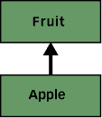
About Inheritance
class Fruit {
// Return int number of pieces of peel that
// resulted from the peeling activity.
public int peel() {
System.out.println("Peeling is appealing.");
return 1;
}
}
class Apple extends Fruit {
}
class Example1 {
public static void main(String[] args) {
Apple apple = new Apple();
int pieces = apple.peel();
}
}

Slide 61
Inheritance:
When you run the Example1 application, it will print out "Peeling is appealing.", because Apple inherits (reuses) Fruit's implementation of peel().
If at some point in the future, however, you wish to change the return value of peel() to type Peel, you will break the code for Example1.
Your change to Fruit breaks Example1's code even though Example1 uses Apple directly and never explicitly mentions Fruit.
For example, if you change the return type of a public method in class Fruit (a part of Fruit's interface), you can break the code that invokes that method on any reference of type Fruit or any subclass of Fruit.
In addition, you break the code that defines any subclass of Fruit that overrides the method. Such subclasses won't compile until you go and change the return value of the overridden method to match the changed method in superclass Fruit

Slide 62
Inheritance…
class Peel
{
private int peelCount;
public Peel(int peelCount) {
this.peelCount = peelCount;
}
public int getPeelCount() {
return peelCount;
}
//...
}
class Fruit {
// Return a Peel object that
// results from the peeling activity.
public Peel peel() {
System.out.println("Peeling is appealing.");
return new Peel(1);
}
}
// Apple still compiles and works fine
class Apple extends Fruit {
}
// This old implementation of Example1
// is broken and won't compile.
class Example1 {
public static void main(String[] args) {
Apple apple = new Apple();
int pieces = apple.peel();
}
}

Slide 63
The composition alternative
Given that the inheritance relationship makes it hard to change the interface of a superclass, it is worth looking at an alternative approach provided by Composition.
  It turns out that when your goal is code reuse, composition provides an approach that yields easier-to-change code.
  What is Composition, can we compare it with inheritance?

Slide 64
Composition
Object composition is a way to combine simple objects or data types into more complex ones.
A real-world example of composition may be seen in an automobile:
  the objects wheel, steering wheel, seat, gearbox and engine may have no functionality by themselves, but an object called automobile containing all of those objects would serve a higher function, greater than the sum of its parts.
A class can have references to objects of other classes as members.
Composited (composed) objects are often referred to as having a "has a" relationship.

Slide 65
About Inheritance
Here We'll be talking about single inheritance through class extension, as in:
class Fruit {
//...
}
class Apple extends Fruit {
//...
}
In this simple example, class Apple is related to class Fruit by inheritance, because Apple extends Fruit.

Slide 66
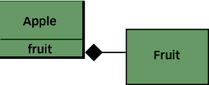
About Composition
We simply mean using instance variables that are references to other objects. For example:
class Fruit {
//...
}
class Apple {
private Fruit fruit = new Fruit();
//...
}
In the example above, class Apple is related to class Fruit by Composition, because Apple has an instance variable fruit that holds a reference to a Fruit object.
In this example, Apple is what we will call the Front-end class and Fruit is what we will call the Back-end class.
In a composition relationship, the Front-end class holds a reference in one of its instance variables to a Back-end class.

Slide 67
class Engine
{
}
class Automobile
{
}
class Car extends Automobile // car "is a" automobile //inheritance here
{
Engine engine; // car "has a" engine //composition here }
Composition - Functionality of an object is made up of an aggregate of different classes. In practice, this means holding a pointer to another class to which work is deferred.
Inheritance - Functionality of an object is made up of it's own functionality plus functionality from its parent classes.

Slide 68
Example
Construct a similar example of composition for the example of Automobile composed of wheel, steering wheel, seat, gearbox and engine

Slide 69
Composition
In programming languages, composite objects are usually expressed by means of references from one object to another;
  depending on the language, such references may be known as fields, members, properties or attributes, and the resulting composition as a structure, storage record, tuple, user-defined type (UDT), or composite type.
However, having such references doesn't necessarily mean that an object is a composite.
It is only called composite if the objects it refers to are really its parts, i.e. have no independent existence.

Slide 70
Advantages/Disadvantages Of Inheritance
Advantages:
- New implementation is easy, since most of it is inherited
- Easy to modify or extend the implementation being reused
Disadvantages:
- Breaks encapsulation, since it exposes a subclass to implementation details of its superclass
- "White-box" reuse, since internal details of superclasses are often visible to subclasses
- Subclasses may have to be changed if the implementation of the superclass changes
- Implementations inherited from superclasses can not be changed at runtime

Slide 71
The composition alternative
Given that the inheritance relationship makes it hard to change the interface of a superclass, it is worth looking at an alternative approach provided by composition.
It turns out that when your goal is code reuse, composition provides an approach that yields easier-to-change code.

Slide 72
Favor Composition Over Inheritance
Method of reuse in which new functionality is obtained by creating an object composed of other objects
The new functionality is obtained by delegating functionality to one of the objects being composed
Sometimes called aggregation or containment, although some authors give special meanings to these terms

Slide 73
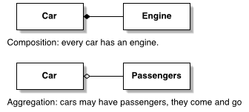
Aggregation
Aggregation differs from ordinary composition in that it does not imply ownership.
    In composition, when the owning object is destroyed, so are the contained objects. In aggregation, this is not necessarily true.

Slide 74
Composition..revisited
Object composition is a way to combine simple objects or data types into more complex ones.
Compositions are a critical building block of many basic data structures, including the tagged union, the linked list, and the binary tree, as well as the object used in object-oriented programming.
Composited (composed) objects are often referred to as having a "has a" relationship.
A real-world example of composition may be seen in an automobile:
  the objects wheel, steering wheel, seat, gearbox and engine may have no functionality by themselves, but an object called automobile containing all of those objects would serve a higher function, greater than the sum of its parts.

Slide 75
Aggregation
Aggregation differs from ordinary composition in that it does not imply ownership.
In composition, when the owning object is destroyed, so are the contained objects. In aggregation, this is not necessarily true.
  For example, a university owns various departments (e.g., chemistry), and each department has a number of professors.
  If the university closes, the departments will no longer exist, but the professors in those departments will continue to exist.
Therefore, a University can be seen as a composition of departments, whereas departments have an aggregation of professors.
In addition, a Professor could work in more than one department, but a department could not be part of more than one university.

Slide 76
Advantages/Disadvantages Of Composition
Advantages:
- Contained objects are accessed by the containing class solely through their interfaces
- "Black-box" reuse, since internal details of contained objects are not visible
- Good encapsulation
- Fewer implementation dependencies
- Each class is focused on just one task
- The composition can be defined dynamically at run-time through objects acquiring references to other objects of the same type
Disadvantages:
- Resulting systems tend to have more objects
- Interfaces must be carefully defined in order to use many different objects as composition blocks

Slide 77
For example:
Aggregation - when one object owns or is responsible for another object and both objects have identical lifetimes (GoF)
Aggregation - when one object has a collection of objects that can exist on their own (UML)
Aggregation is a special form of association. It is also a relationship between two classes like association, however its a directional association, which means it is strictly a one way association. It represents a Has-A relationship.
Containment - a special kind of composition in which the contained object is hidden from other objects and access to the contained object is only via the container object

Slide 78
Inner Class
Design Patterns

Slide 79
OOM for Software Project: ATM
After Use Case Diagram now…
Class Diagrams: Difficulties & Risks
  Analyzing Class Diagrams for Design purpose
Class Analysis
  CRC & Class Diagram
Notes:
Ranjana vyas

Slide 80
OOM for OOM
( Object Oriented Modeling for
Object Oriented Methodology )
Notes:
Ranjana vyas

Slide 81
OOM for Software Project
Requirement Analysis: Use Case diagram
Design: Class & Object Modeling
Class Analysis
  CRC & Class Diagram
  Class Responsibility Collaboration
  Class Diagrams: Difficulties & Risks
Algorithm, Software Design & Design Patterns
  GoF & Design Pattern
  MVC & Java Struts
Notes:
Ranjana vyas

Slide 82
UML : Use Case & Class diagram
Use case diagrams describe what a system does from the standpoint of an external observer.
The emphasis is on what a system does rather than how.
Use case diagrams are closely connected to scenarios.
A scenario is an example of what happens when someone interacts with the system
Class Diagrams:
A class diagram describes the static structure of a system. It shows how a system is structured rather than how it behaves.
The static structure of a system comprises of a number of class diagrams and their dependencies.
Notes:
Ranjana vyas

Slide 83
OO Design & Class Analysis
Creating Classes based on the analysis of Use-Case diagrams will be significant step towards successful project design.
Creating Class diagram requires thinking at appropriate level of abstraction !
Making sure that our design is good means our Software developed thus fulfills objectives and avoids characteristics of a bad design :
  Rigidity - It is hard to change because every change affects too many other parts of the system.
  Fragility - When you make a change, unexpected parts of the system break.
  Immobility - It is hard to reuse in another application because it cannot be disentangled from the current application.
Notes:
Ranjana vyas

Slide 84
Class diagrams
A Class diagram gives an overview of a system by showing its classes and the relationships among them.
Class diagrams are static -- they display what interacts but not what happens when they do interact.
The main symbols shown on class diagrams are:
  Classes
      represent the types of data themselves
  Associations
      represent linkages between instances of classes
  Attributes
      are simple data found in classes and their instances
  Operations
      represent the functions performed by the classes and their instances
  Generalizations :group classes into inheritance hierarchies
Notes:
Ranjana vyas

Slide 85
Activities during Object Modeling
Main goal: Find the important abstractions
Steps during object modeling
  1. Class identification
    Based on the fundamental assumption that we can find abstractions
  2. Find the attributes
  3. Find the methods
  4. Find the associations between classes
Order of steps
  Goal: get the desired abstractions
  Order of steps secondary, only a heuristic
Notes:
Start with review: What is a model? What is an abstraction? They are used synonymously and mean they provide a simplified view of a complex system that we cannot understand by looking at all of its components simultaneously. Models by their definition abstract away important characteristics of a system by emphasizing other aspects.
Example: Clay model concentrates on the form of the car, nobody can sit in it.
Prototypes are models.
Iterate and correct the model: A scientific model is always like a hypothesis. The important part of a scientific model is that it is falsifiable. This is an important aspect of prototyping. They are immediately understandable and can be falsified (that is our theory of how the application should work!). This is one of the main strengths of prototyping: End user falsifiability.
Redesign (Falsification principle in science: Work with model until it is proven to be false)

Slide 86
Class Identification
Class identification is crucial to Object-Oriented modeling
  Helps to identify the important entities of a system
Basic assumptions:
  1. We can find the classes for a new software system (Forward Engineering)
  2. We can identify the classes in an existing system (Reverse Engineering)
Why we do this?
  Good design…...

Slide 87
Class Identification
Approaches
  Application domain approach
    Ask application domain experts to identify relevant abstractions
  Syntactic approach
    Start with use cases
    Analyze the text to identify the objects
    Extract participating objects from flow of events
  Design patterns approach
    Use reusable design patterns
  Component-based approach
    Identify existing solution classes.
Notes:
Finding objects is the key in object modeling
Application domain approach (not a special lecture, examples):
Syntactic approach (this lecture):
Design patterns approach (Lecture on design patterns)
Component-based approach (Lecture on object design):

Slide 88
Class identification is a Hard Problem
One problem: Definition of the system boundary:
  Which abstractions are outside, which abstractions are inside the system boundary?
    Actors are outside the system
    Classes/Objects are inside the system.
An other problem: Classes/Objects are not just found by taking a picture of a scene or domain
  The application domain has to be analyzed
  Depending on the purpose of the system different objects might be found
    How can we identify the purpose of a system?
    Scenarios and use cases => Functional model

Slide 89
There are different types of Objects
Entity Objects
  Represent the persistent information tracked by the system. (Application domain objects, also called “Business objects”)
Boundary Objects
  Represent the interaction between the user and the system
Control Objects
  Represent the control tasks performed by the system.
Notes:
Be prepared that some objects are still missing and need to be found:
Model the flow of events with a sequence diagram
Always use the clients or end users terminology

Slide 90
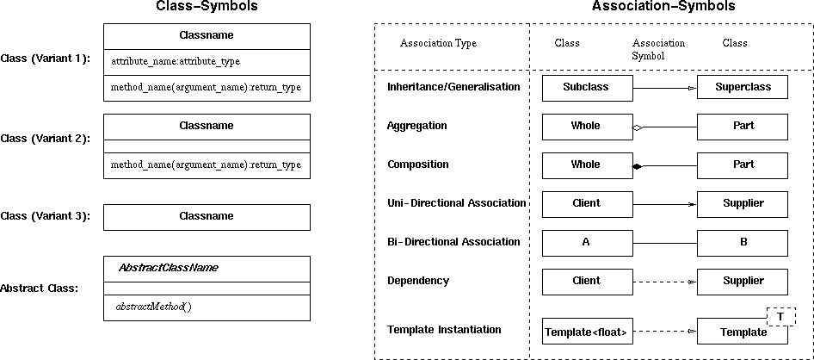
Symbols for Class And Association
11
2003
SJSU – CmpE --- M.E. Fayad

Slide 91
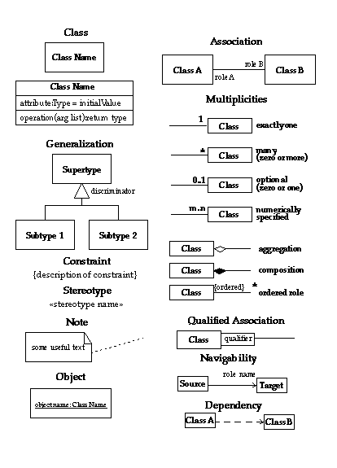
Class and Association’s Notation
8
2003
SJSU – CmpE --- M.E. Fayad

Slide 92
Classes
ClassName
A class is a description of a set of objects that share the same attributes, operations, relationships, and semantics.
Graphically, a class is rendered as a rectangle, usually including its name, attributes, and operations in separate,
designated compartments.
attributes
operations
Software Design (UML)

Slide 93
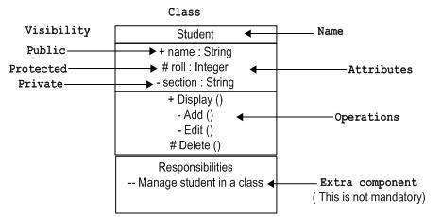
Class Notation
Classes are used to represent objects. Objects can be anything having properties and responsibility.

Slide 94
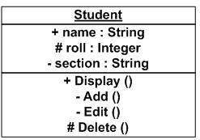
Object Notation
The object is represented in the same way as the class. The only difference is the name which is underlined.
As the object is an actual implementation of a class, which is known as the instance of a class. Hence, it has the same usage as the class.

Slide 95
Class Names
ClassName
The name of the class is the only required tag in the graphical representation of a class. It always appears in the top-most compartment.
attributes
operations
Software Design (UML)

Slide 96
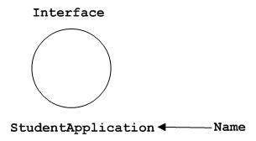
Interface Notation
Interface is used to describe the functionality without implementation. Interface is just like a template where you define different functions, not the implementation.
When a class implements the interface, it also implements the functionality as per requirement.

Slide 97
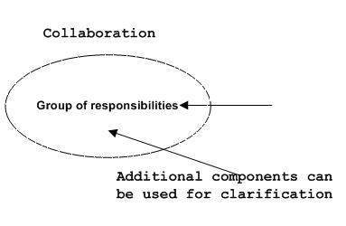
Collaboration Notation
Collaboration is represented by a dotted eclipse. It has a name written inside the eclipse.

Slide 98
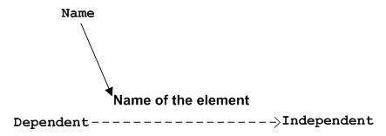
Dependency Notation
Dependency is an important aspect in UML elements. It describes the dependent elements and the direction of dependency.
Dependency is represented by a dotted arrow as shown in the following figure.
The arrow head represents the independent element and the other end represents the dependent element.

Slide 99
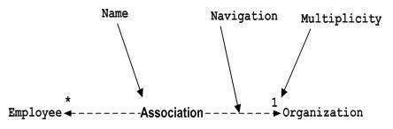
Association Notation
Association describes how the elements in a UML diagram are associated. In simple words, it describes how many elements are taking part in an interaction.
Association is represented by a dotted line with (without) arrows on both sides. The two ends represent two associated elements as shown in the following figure. The multiplicity is also mentioned at the ends (1, *, etc.) to show how many objects are associated.

Slide 100

Generalization Notation
Generalization describes the inheritance relationship of the object-oriented world. It is a parent and child relationship.
Generalization is represented by an arrow with a hollow arrow head as shown in the following figure. One end represents the parent element and the other end represents the child element.
Generalization is used to describe parent-child relationship of two elements of a system.

Slide 101
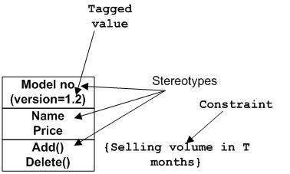
Extensibility Notation
All the languages (programming or modeling) have some mechanism to extend its capabilities such as syntax, semantics, etc. UML also has the following mechanisms to provide extensibility features.
Stereotypes (Represents new elements)
Tagged values (Represents new attributes)
Constraints (Represents the boundaries)
Extensibility notations are used to enhance the power of the language. It is basically additional elements used to represent some extra behavior of the system. These extra behaviors are not covered by the standard available notations.

Slide 102
Class Diagram
Class diagram is a static diagram. It represents the static view of an application. Class diagram is not only used for visualizing, describing, and documenting different aspects of a system but also for constructing executable code of the software application.
Class diagram describes the attributes and operations of a class and also the constraints imposed on the system. The class diagrams are widely used in the modeling of object oriented systems because they are the only UML diagrams, which can be mapped directly with object-oriented languages.
Class diagram shows a collection of classes, interfaces, associations, collaborations, and constraints. It is also known as a structural diagram.

Slide 103
Purpose of Class Diagrams
The purpose of class diagram is to model the static view of an application. Class diagrams are the only diagrams which can be directly mapped with object-oriented languages and thus widely used at the time of construction.
UML diagrams like activity diagram, sequence diagram can only give the sequence flow of the application, however class diagram is a bit different. It is the most popular UML diagram in the coder community.
The purpose of the class diagram can be summarized as −
Analysis and design of the static view of an application.
Describe responsibilities of a system.
Base for component and deployment diagrams.
Forward and reverse engineering.

Slide 104
How to Draw a Class Diagram?
Class diagrams are the most popular UML diagrams used for construction of software applications. It is very important to learn the drawing procedure of class diagram.
Class diagrams have a lot of properties to consider while drawing but here the diagram will be considered from a top level view.
Class diagram is basically a graphical representation of the static view of the system and represents different aspects of the application. A collection of class diagrams represent the whole system.

Slide 105
The following points should be remembered while drawing a class diagram −
The name of the class diagram should be meaningful to describe the aspect of the system.
Each element and their relationships should be identified in advance.
Responsibility (attributes and methods) of each class should be clearly identified.
For each class, minimum number of properties should be specified, as unnecessary properties will make the diagram complicated.
Use notes whenever required to describe some aspect of the diagram. At the end of the drawing it should be understandable to the developer/coder.
Finally, before making the final version, the diagram should be drawn on plain paper and reworked as many times as possible to make it correct

Slide 106
The following diagram is an example of an Order System of an application. It describes a particular aspect of the entire application.
First of all, Order and Customer are identified as the two elements of the system. They have a one-to-many relationship because a customer can have multiple orders.
Order class is an abstract class and it has two concrete classes (inheritance relationship) SpecialOrder and NormalOrder.
The two inherited classes have all the properties as the Order class. In addition, they have additional functions like dispatch () and receive ().
The following class diagram has been drawn considering all the points mentioned above.

Slide 107
Class diagram
UML class notation is a rectangle divided into three parts: class name, attributes, and operations.
Names of abstract classes, such as Payment, are in italics.
Relationships between classes are the connecting links.
association -- a relationship between instances of the two classes.
There is an association between two classes if an instance of one class must know about the other in order to perform its work.
In a diagram, an association is a link connecting two classes.
Notes:
Ranjana vyas

Slide 108
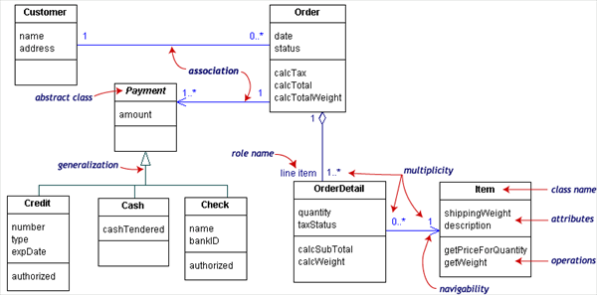
Class diagram
The class diagram showed below models a customer order from a retail catalog.
The central class is the Order. Associated with it are the Customer making the purchase and the Payment. A Payment is one of three kinds: Cash, Check, or Credit. The order contains OrderDetails (line items), each with its associated Item.
Notes:
Ranjana vyas

Slide 109
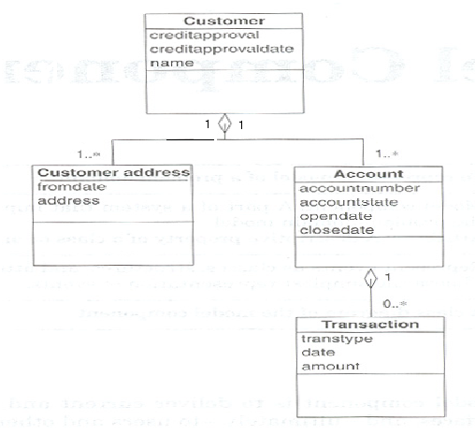
Class Diagram: Example (1)
9
2003
SJSU – CmpE --- M.E. Fayad

Slide 110
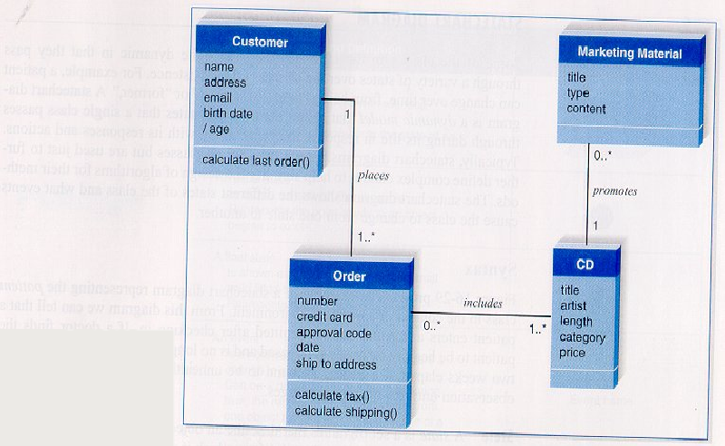
Class Diagram: Example (2)
10
2003
SJSU – CmpE --- M.E. Fayad

Slide 111
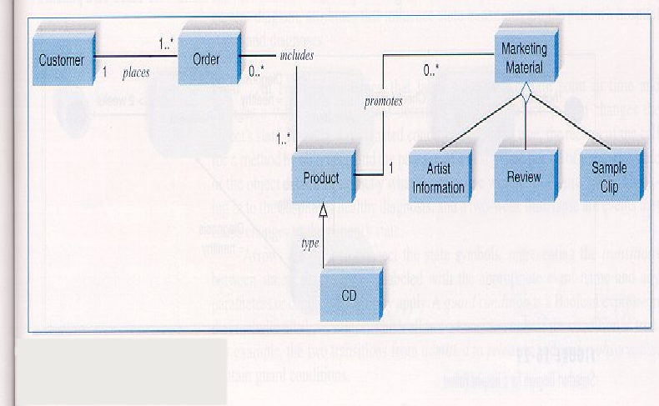
Class Diagram: Example (3)
2003
SJSU – CmpE --- M.E. Fayad

Slide 112
Class Responsibilities
A class may also include its responsibilities in a class diagram.
A responsibility is a contract or obligation of a class to perform a particular service.
SmokeAlarm
Responsibilities
-- sound alert and notify guard station
when smoke is detected.
-- indicate battery state
Software Design (UML)

Slide 113
Relationships
In UML, object interconnections (logical or physical), are
modeled as relationships.
There are three kinds of relationships in UML:
  dependencies
  generalizations
  associations
Software Design (UML)

Slide 114
Class Diagram: Example (3)
2003
SJSU – CmpE --- M.E. Fayad

Slide 115
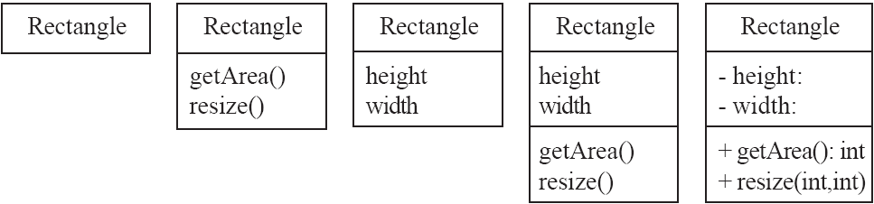
Classes
A class is simply represented as a box with the name of the class inside
  The diagram may also show the attributes and operations
  The complete signature of an operation is:
    operationName(parameterName: parameterType …): returnType

Slide 116
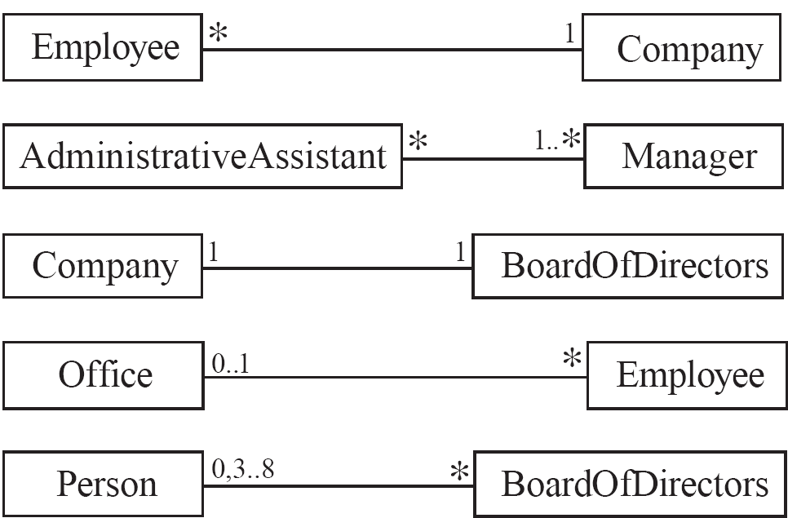
Associations and Multiplicity
An association is used to show how two classes are related to each other
  Symbols indicating multiplicity are shown at each end of the association

Slide 117
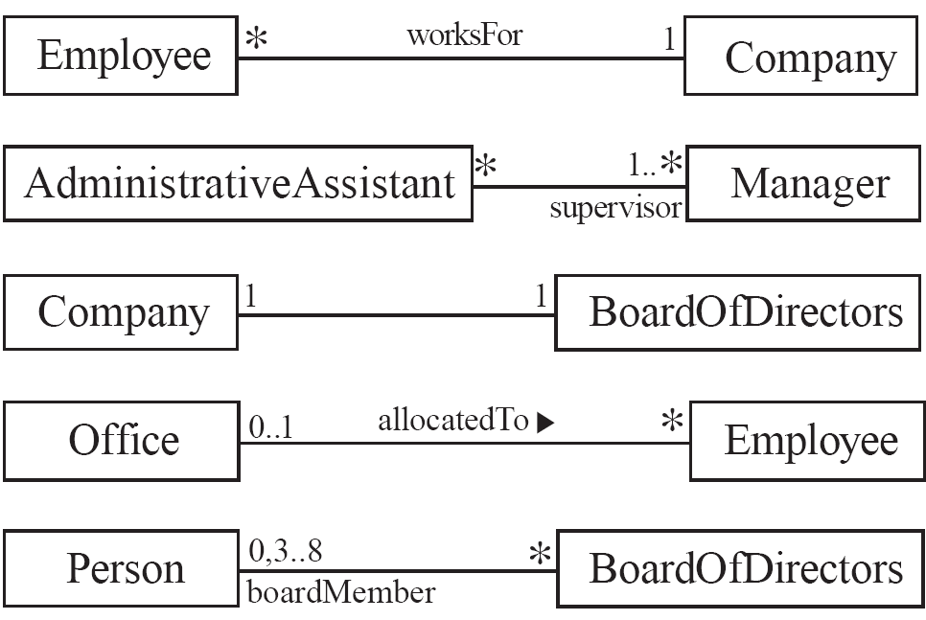
Labelling associations
  Each association can be labelled, to make explicit the nature of the association

Slide 118
Analyzing and validating associations
  Many-to-one
    A company has many employees,
    An employee can only work for one company.
      This company will not store data about the moonlighting activities of employees!
    A company can have zero employees
      E.g. a ‘shell’ company
    It is not possible to be an employee unless you work for a company
Employee
*
worksFor
1
Company

Slide 119
Analyzing and validating associations
  Many-to-many
    An assistant can work for many managers
    A manager can have many assistants
    Assistants can work in pools
    Managers can have a group of assistants
    Some managers might have zero assistants.
    Is it possible for an assistant to have, perhaps temporarily, zero managers?
*
1..*
*
*
*
*
Assistant
*
Manager
supervisor

Slide 120
Analyzing and validating associations
  One-to-one
    For each company, there is exactly one board of directors
    A board is the board of only one company
    A company must always have a board
    A board must always be of some company
1
1

Slide 121
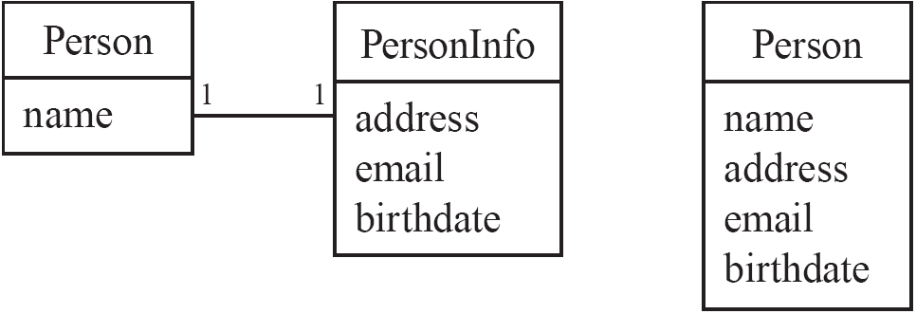
Analyzing and validating associations
Avoid unnecessary one-to-one associations
Avoid this do this

Slide 122
Steps in Generating Class Diagrams
Class identification (textual analysis, domain expert)
Identification of attributes and operations (sometimes before the classes are found!)
Identification of associations between classes
Identification of multiplicities
Identification of roles
Identification of inheritance
Notes:
This is a list of activities you need to perform when generating class diagrams, not necessarily in this order.

Slide 123
UML Class Diagrams and Examples
Vehicle
All Vehicles have some common attributes (speed and colour) and common behaviour (turnLeft, turnRight)

Slide 124
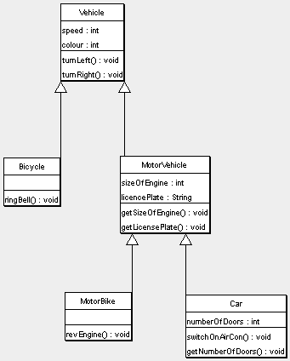

Slide 125
Students and Courses
Students and Courses
This example demonstrates relationships between classes. It’s from an imaginary application that models university courses.

Slide 126
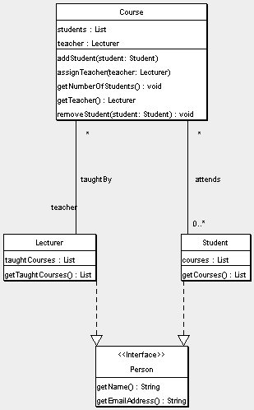

Slide 127
ATM System Class Diagram
ATMs are deceptively simple: there are many layers of security that a safe and effective ATM must pass through to prevent fraud and provide value for banking customers.
The various human and inanimate parts of an ATM system are illustrated by this easy-to-read diagram—every class has its title, and the attributes

Slide 128
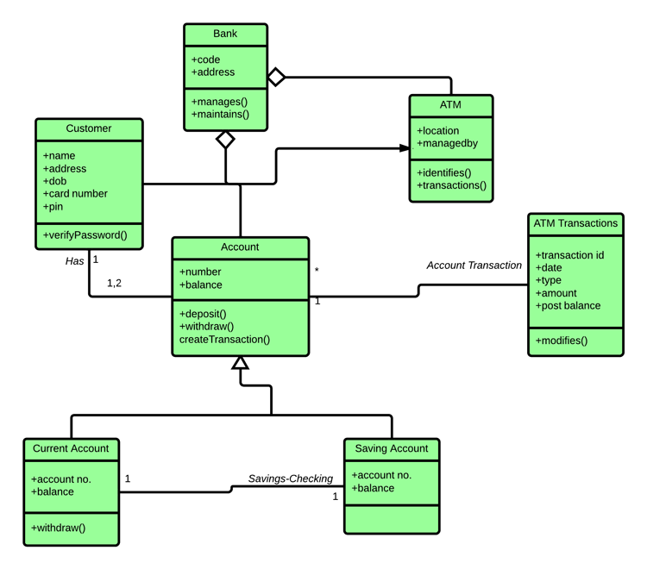

Slide 129
Library domain model
Purpose: Describe domain area for an Integrated Library System (ILS), also known as a Library Management System (LMS) - Library, Catalog, Book, Patron, Account.
Summary: Library Domain Model describes main classes and relationships which could be used during analysis phase to better understand domain area for ILS or LMS.

