Slide 1
Module-4 ( Loader and Linker)
Basic Loader Functions - Design of Absolute Loader, Simple Bootstrap Loader.
Machine Dependent Loader Features- Relocation, Program Linking, Algorithm and Data Structures of Two Pass Linking Loader.
Machine Independent Loader Features -Automatic Library Search, Loader Options. Loader Design Options.

Slide 2
Basic Loader functions
Loading
Brings object program into memory
Relocation
Modifies the object program so that it can be loaded at an address
different from the location originally specified
Linking
Combines two or more separate object programs and supplies
information needed to allow cross-references.

Slide 3
Absolute loader
No linking and relocation needed
All functions are accomplished in a single pass

Slide 4
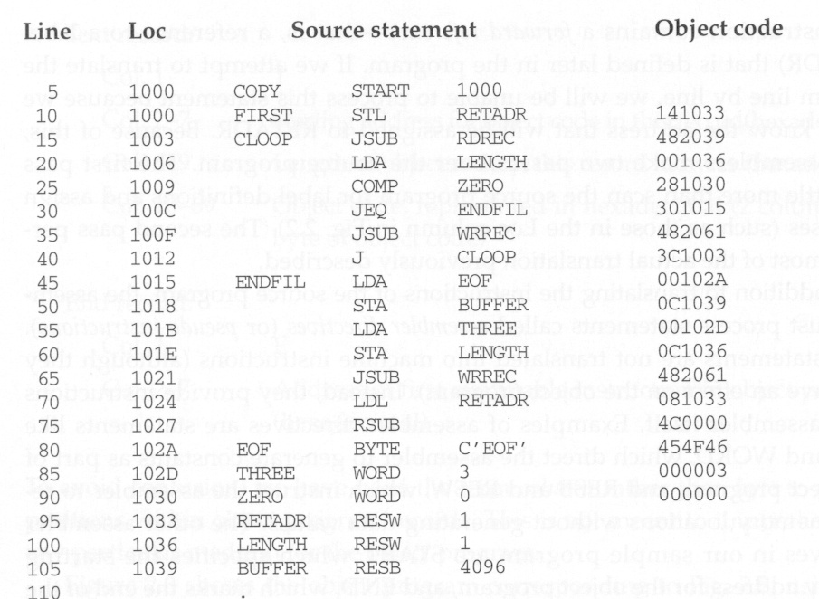

Slide 5
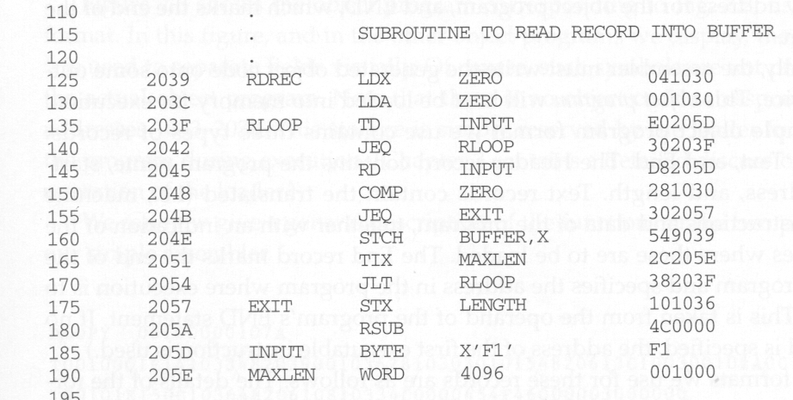

Slide 6
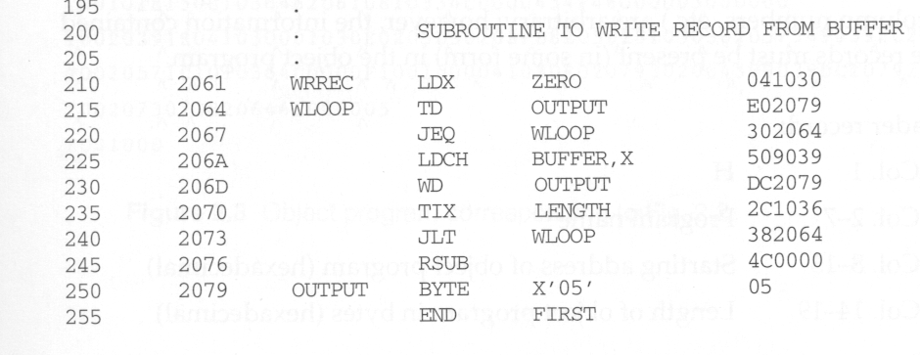

Slide 7
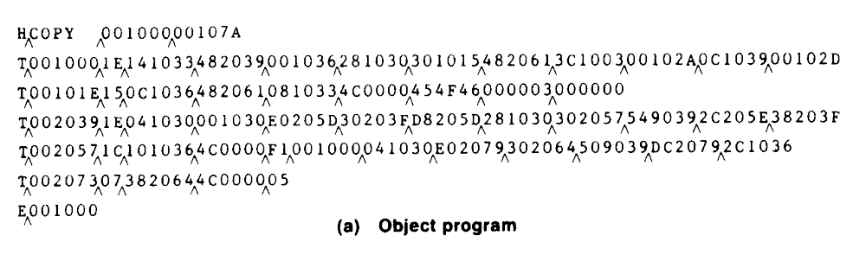

Slide 8
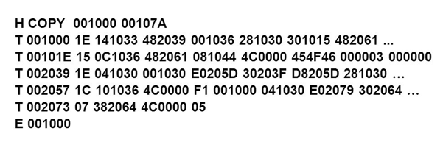
Object Program

Slide 9
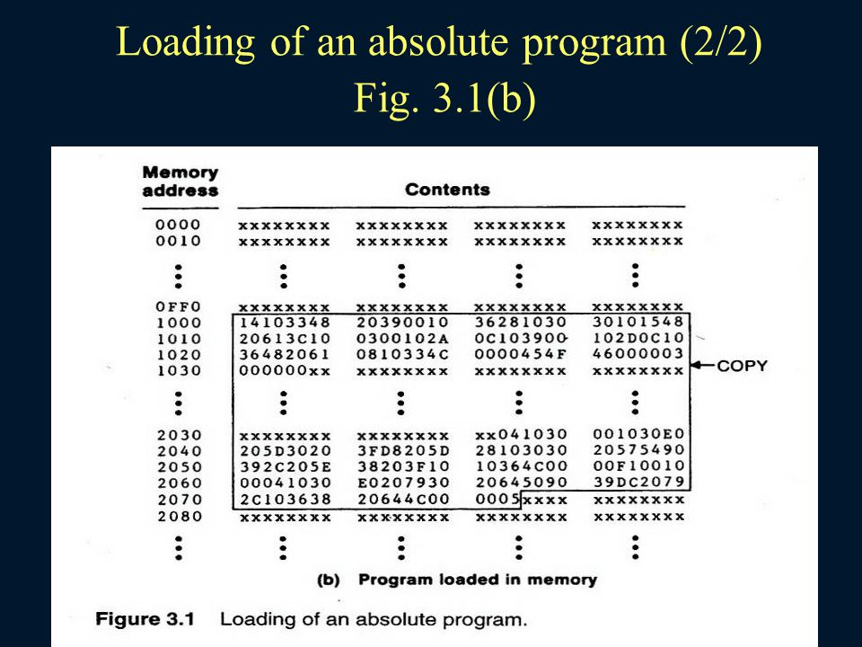

Slide 10
Loading an object program using absolute loader
Header record
Check the Header record for program name, starting address, and length (available
Memory)
Text record
Bring the object program contained in the Text record to the indicated address
End record
Transfer control to the address specified in the End record

Slide 11
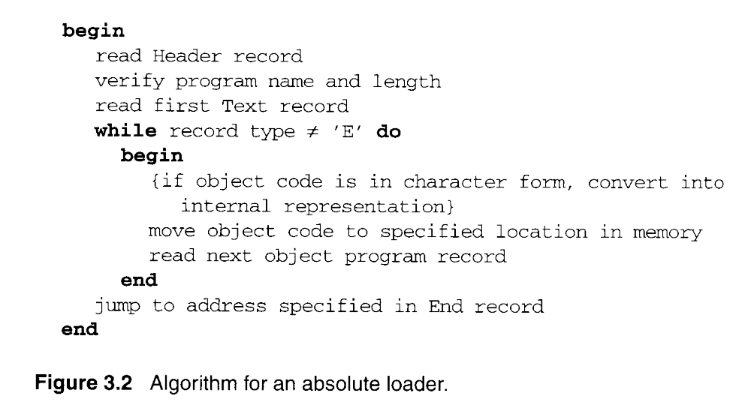
Algorithm

Slide 12
Relocating Loaders
Two methods for specifying relocation
modification record (for SIC/XE)
relocation bit (for SIC)

Slide 13
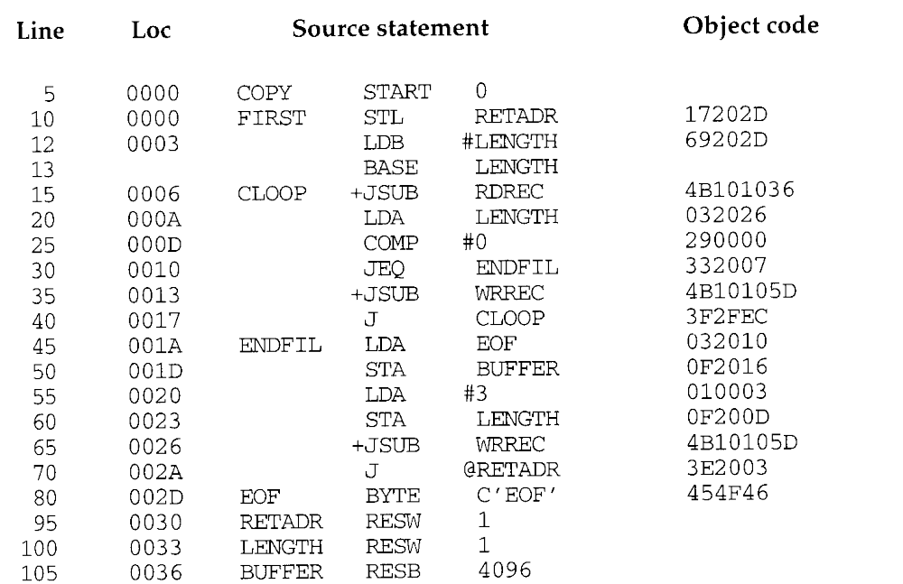
Modification Record(for SIC/XE)

Slide 14
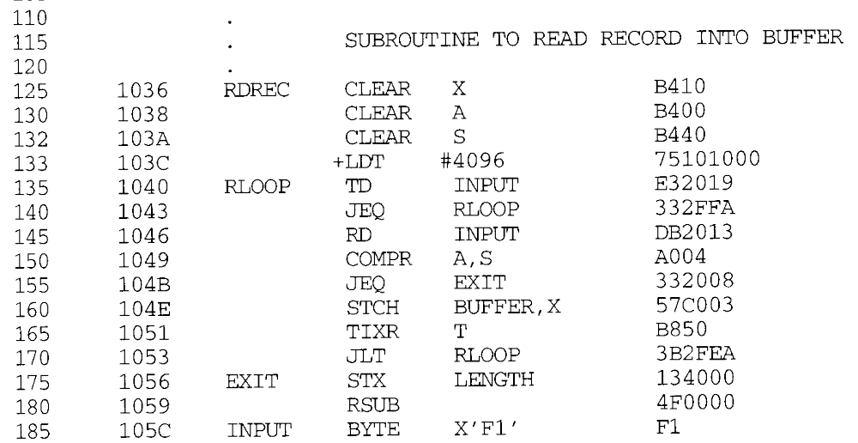

Slide 15
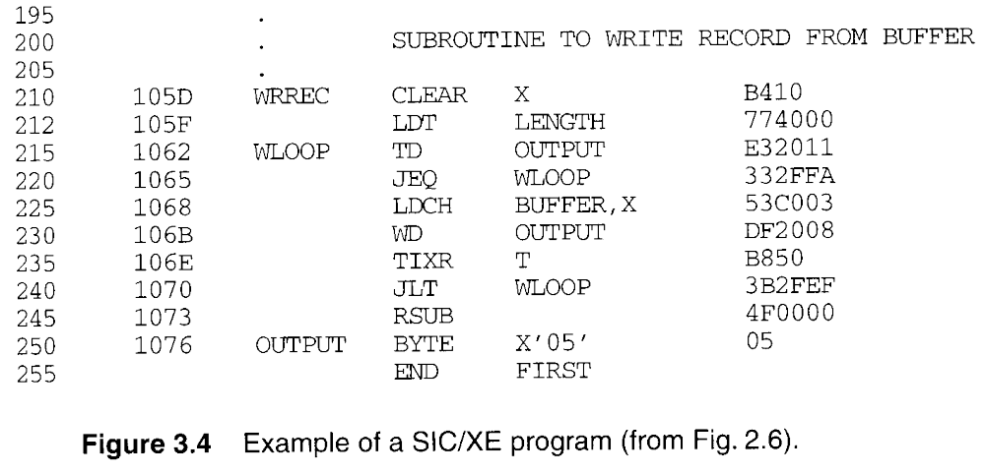

Slide 16
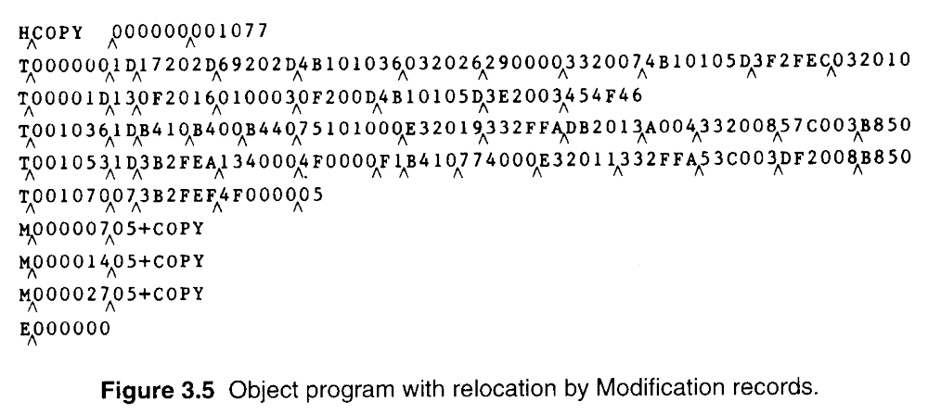
Modification Record
Modification record
  col 1: M
  col 2-7: relocation address
  col 8-9: length (halfbyte)
  col 10: flag (+/-)
  col 11-17: segment name

Slide 17
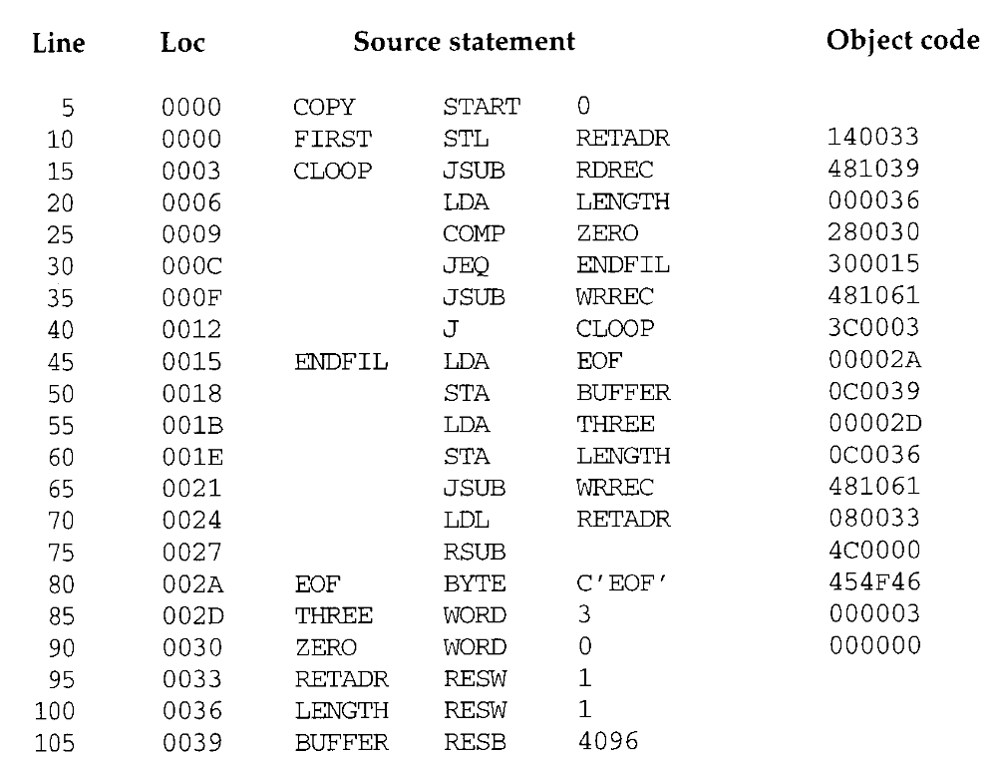
Relocation bit (for SIC)

Slide 18
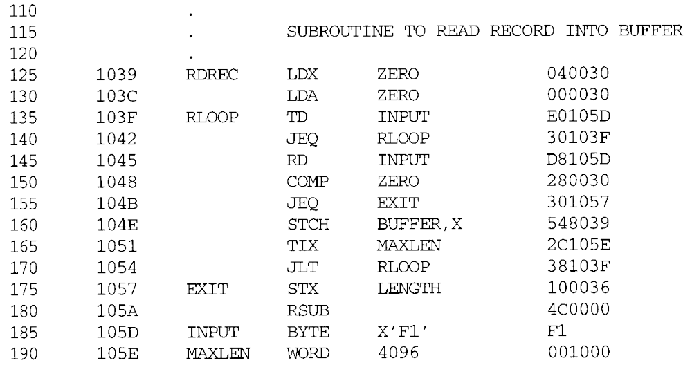

Slide 19
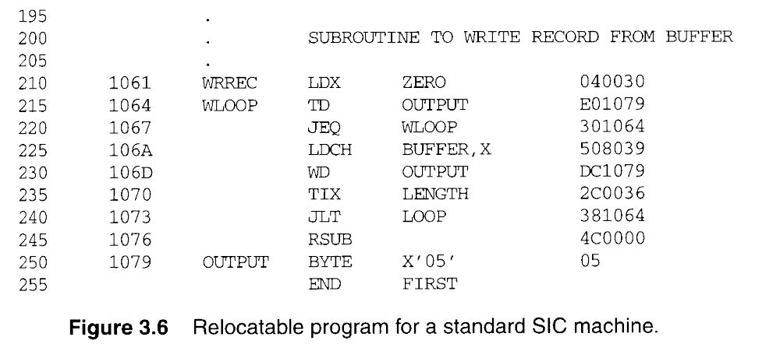

Slide 20
Relocation bit (for SIC)
A relocation bit associated with each word of object code.
The relocation bits are gathered together into a bit mask following the length indicator in each Text record.
If bit=1, the corresponding word of object code needs relocation.

Slide 21
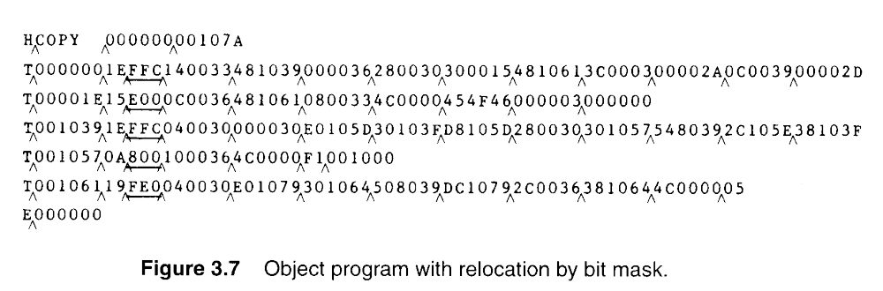
1111 1111 1100

Slide 22
Program Linking
Example:
Three programs-PROGA,PROGB,PROGC
Six labels in each pgm-LISTA,ENDA,
LISTB,ENDB,LISTC,ENDC

Slide 23
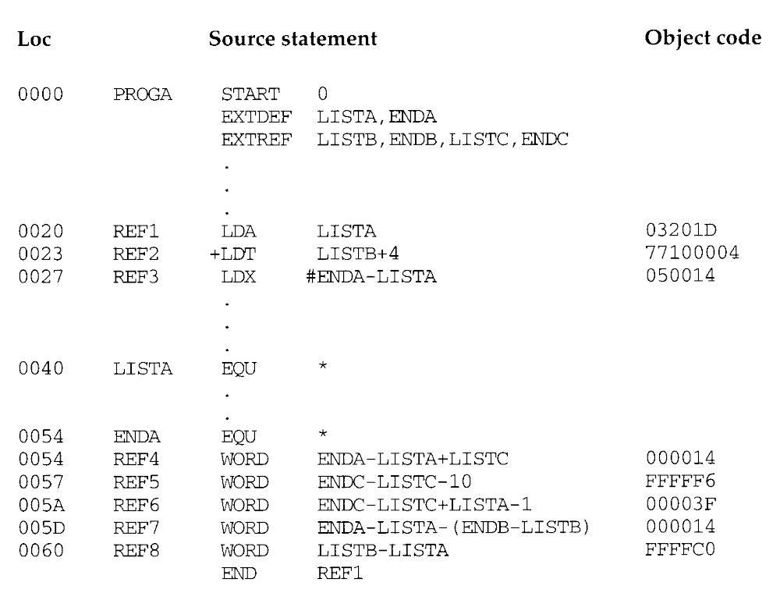
Program Linking

Slide 24
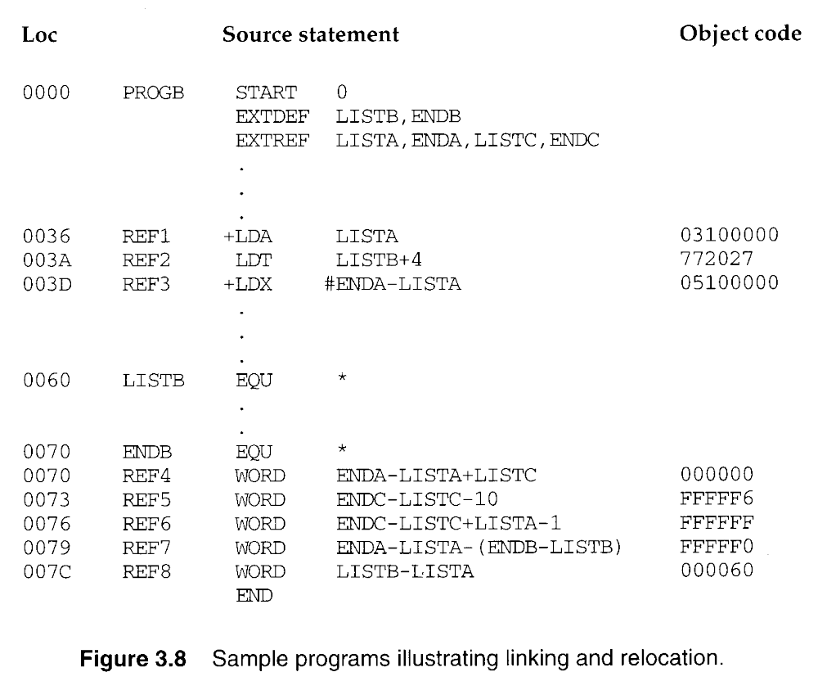

Slide 25
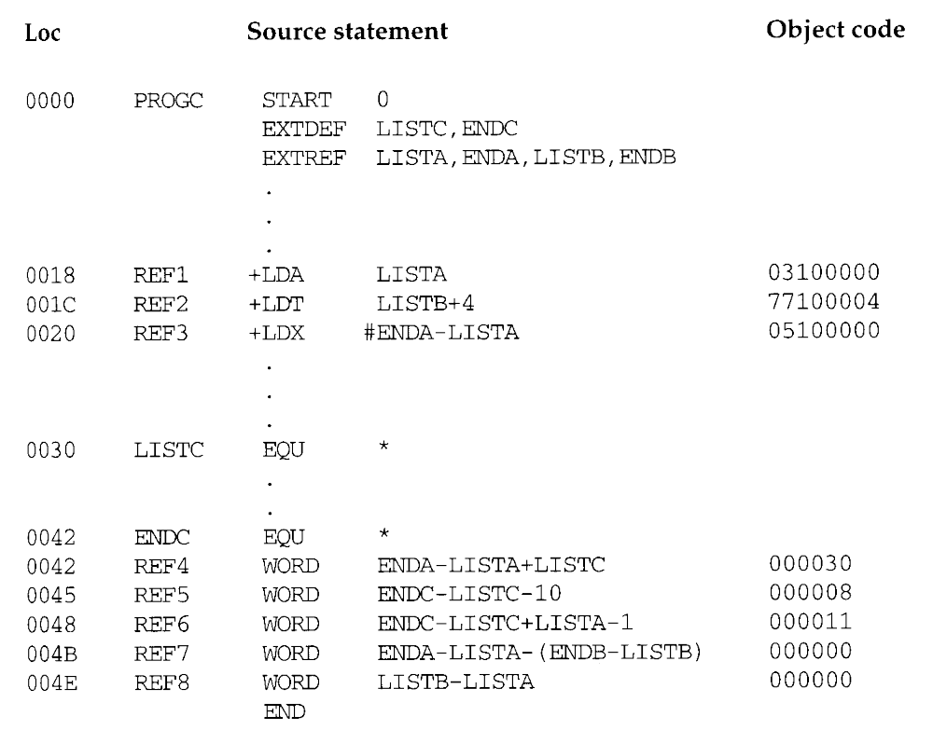

Slide 26
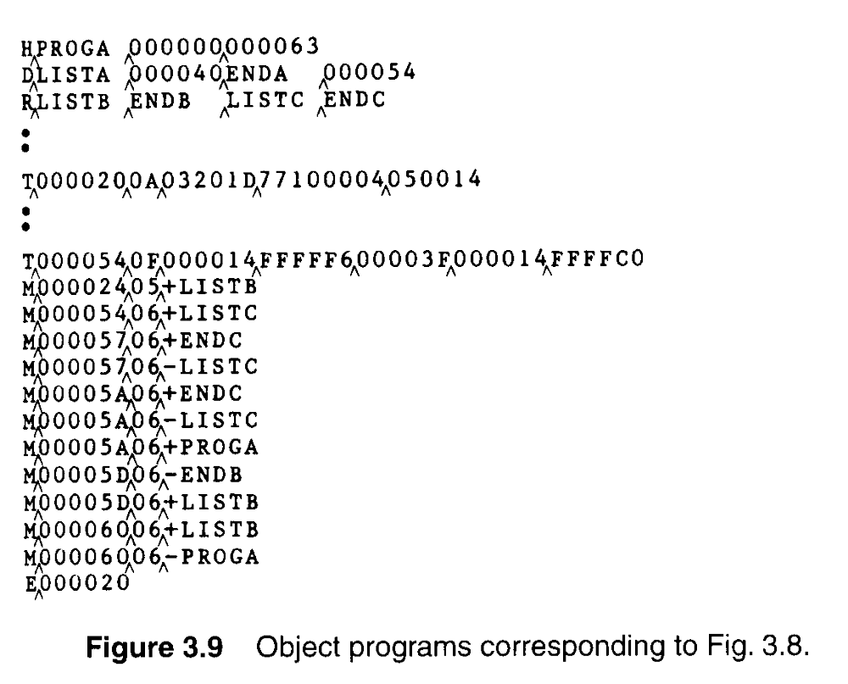

Slide 27
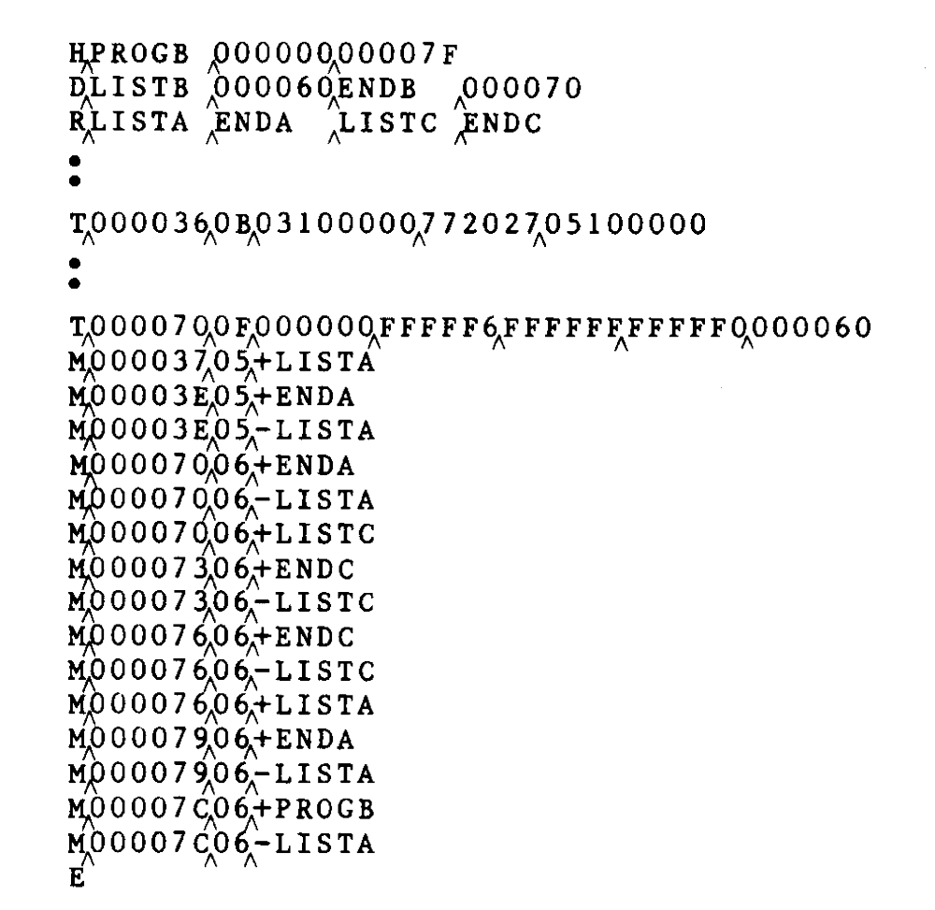

Slide 28
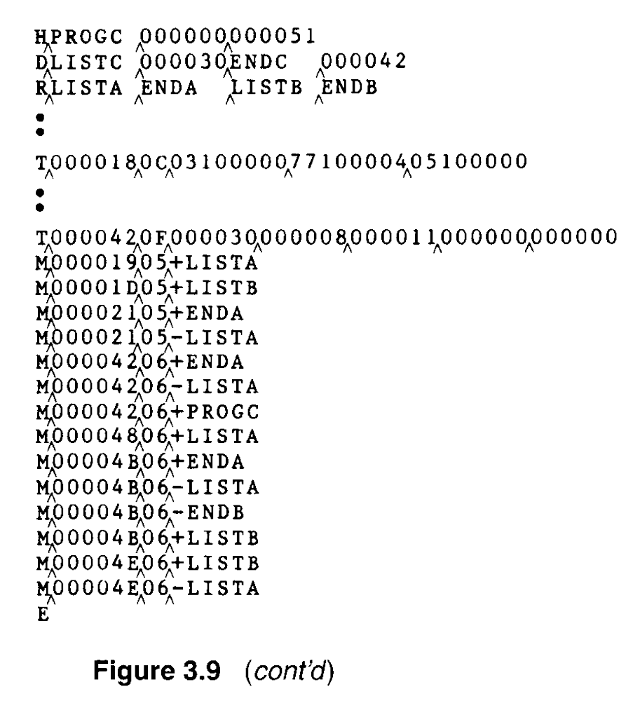

Slide 29
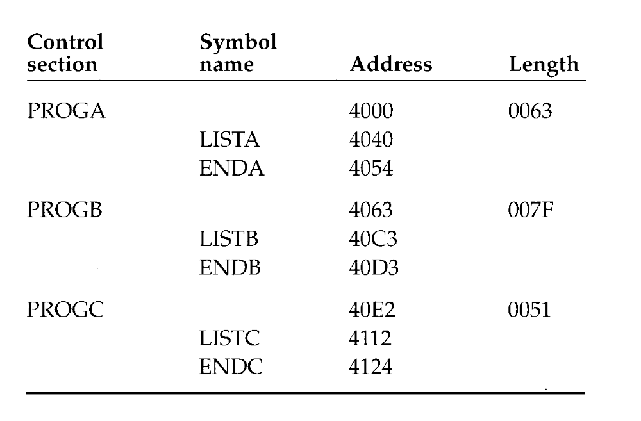

Slide 30
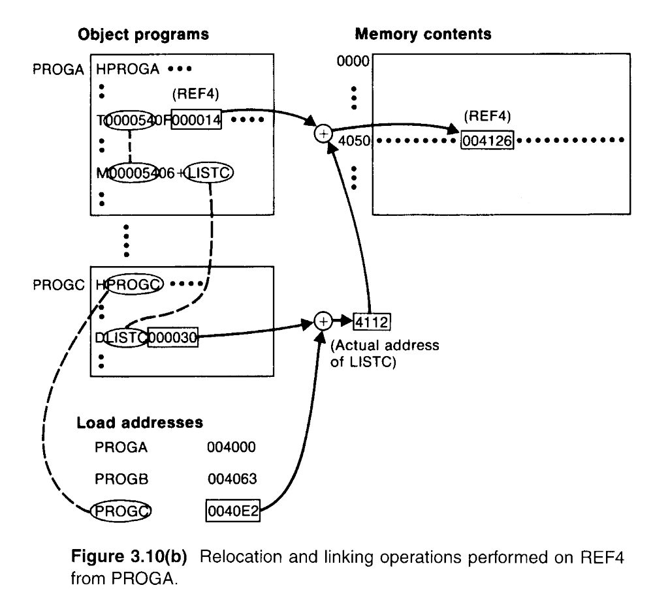

Slide 31
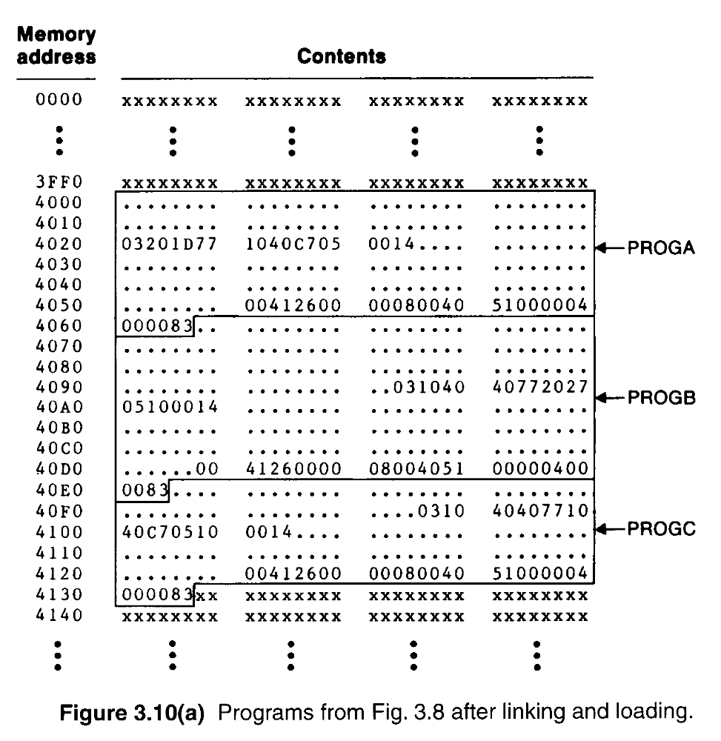

Slide 32
Algorithm and Data Structure for a Linking Loader
A linking loader usually makes two passes
  Pass 1 assigns addresses to all external symbols.
  Pass 2 performs the actual loading, relocation, and linking.
  DATA STRUCTURES used in Linking loader
  The main data structure is ESTAB ( External Symbol TABle).
  Two variables :
  PROGADDR (PROGram load ADDRess)
  CSADDR (Control Section ADDRess)

Slide 33
Algorithm and Data Structure for a Linking Loader
A linking loader makes two passes
  ESTAB is used to store the name and address of each external symbol in the set of control sections being loaded.
  Two variables PROGADDR and CSADDR.
  PROGADDR is the beginning address in memory where the linked program is to be loaded.
  CSADDR contains the starting address assigned to the control section currently being scanned by the loader.

Slide 34
Algorithm and Data Structure for a Linking Loader
In Pass 1, concerned only Header and Define records.
  CSADDR+CSLTH = the next CSADDR.
  A load map is generated.
  In Pass 2, as each Text record is read, the object code is moved to the (specified address plus the current value of CSADDR).
  When a Modification record is encountered, the symbol whose value is to be used for modification is looked up in ESTAB.
  This value is then added to or subtracted from the indicated location in memory.

Slide 35
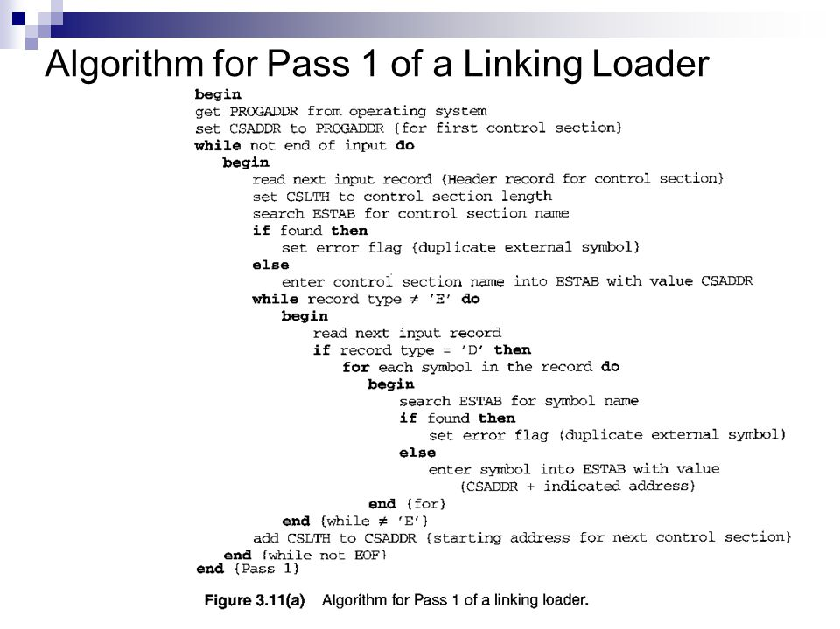

Slide 36
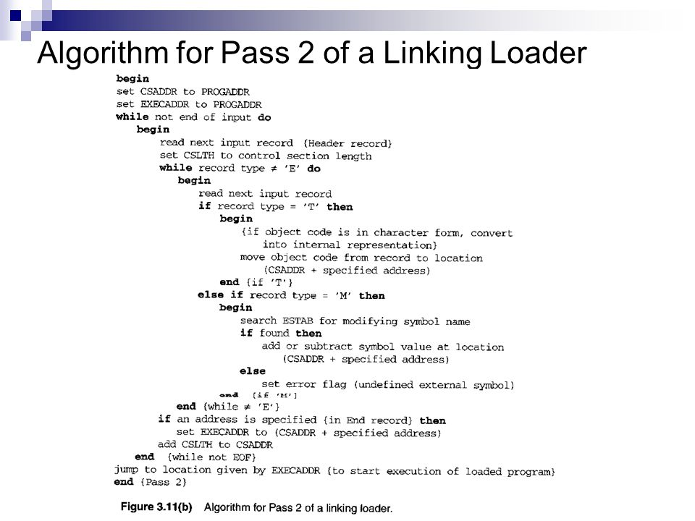

Slide 37
The algorithm can be made more efficient.
  A reference number, is used in Modification records.
  The number 01 to the control section name.
  The main advantage of this reference-number mechanism is that it avoids multiple searches of ESTAB for the same symbol during the loading of a control section.

Slide 38
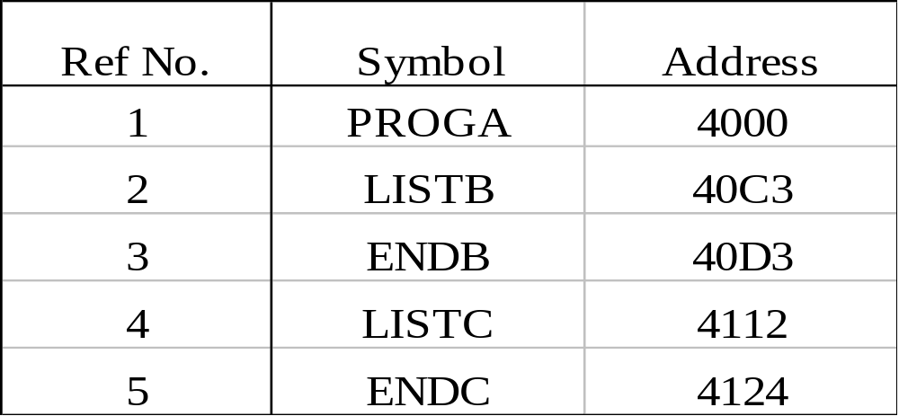
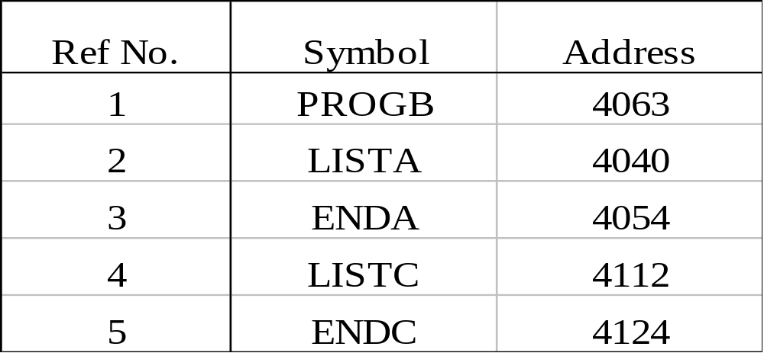
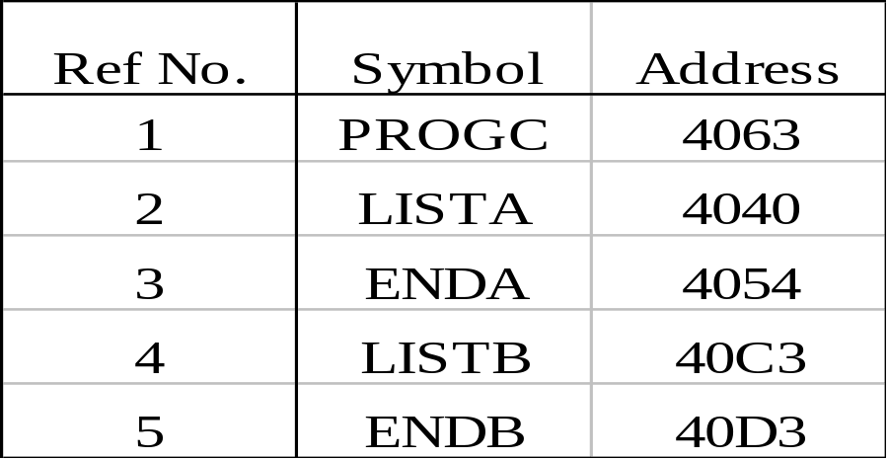
PROGA
PROGB PROGC

Slide 39
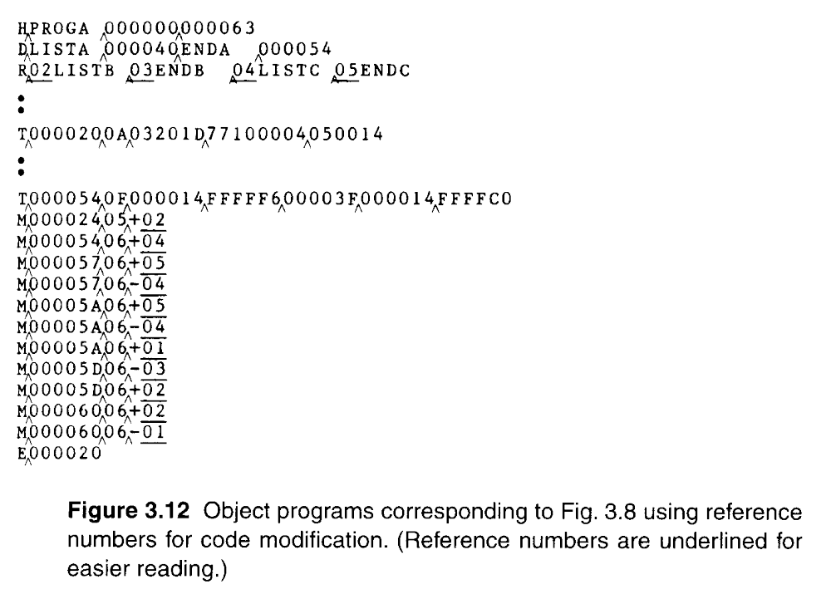

Slide 40
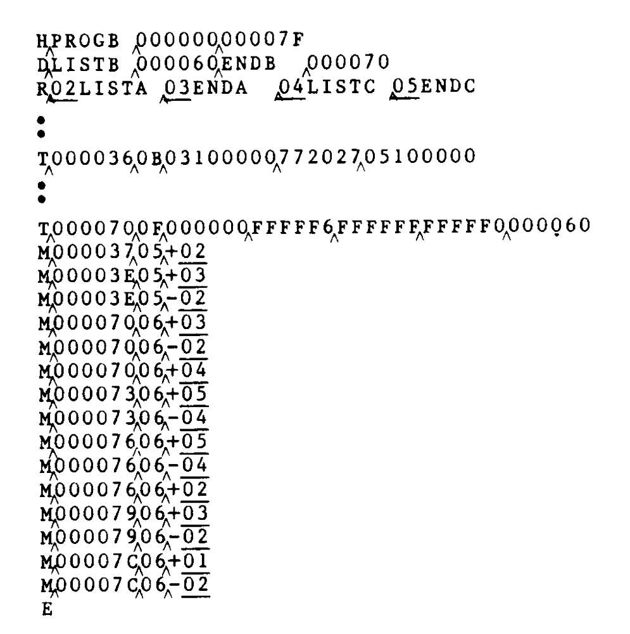

Slide 41
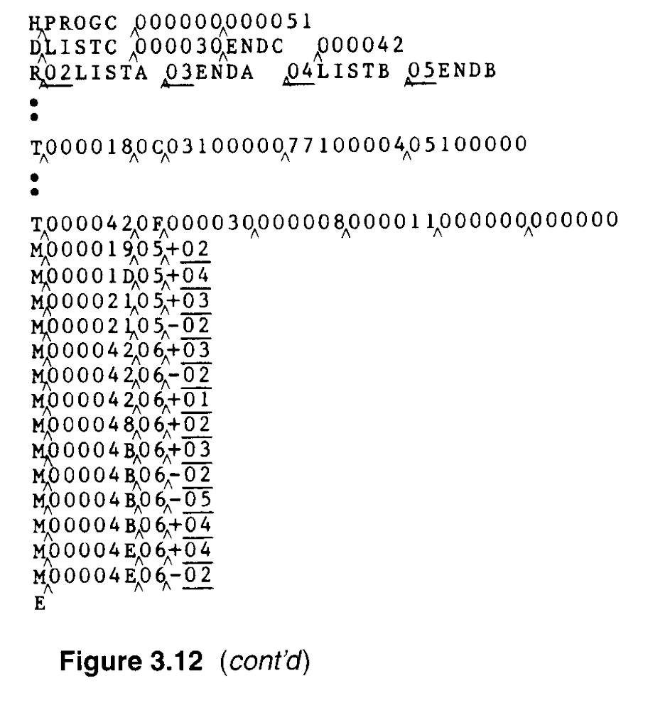

Slide 42
Machine-Independent Loader Features
Automatic Library Search
Many linking loaders can automatically incorporate routines from a library into the program being loaded.
  Allows the programmer to use subroutines from standard system library.
  The subroutines called by the program being loaded are automatically fetched from the library, linked with the main program, and loaded.
  The programmer doesnot need to take any action beyond mentioning the subroutine names as external references in the source program.

Slide 43
Automatic Library Search (Automatic library call)
At the end of Pass 1, the symbols in ESTAB that remain undefined represent unresolved external references.
The loader searches the library for the routines that contain the definitions of these symbols.
Repeat the library search process until all references are resolved.

Slide 44
Loader Options
Many loaders allow the user to specify options that modify the standard processing.
  Special command language to specify options
  Separate file
  OR
  include in source program (assembler retains these commands as part of the object program)
  Example:
  INCLUDE program-name(library-name)
  -to read the object program from a library.
  INCLUDE READ(UTLIB)
  INCLUDE WRITE(UTLIB)

Slide 45
Loader Options
  DELETE csect-name – delete CS
    DELETE RDREC, WRREC
  CHANGE name1, name2- ext. symbol name1 to be changed to name2
  CHANGE RDREC, READ
    CHANGE WRREC, WRITE
    LIBRARY MYLIB – user specified libraries.(searched before standard system libraries)
    NOCALL STDEV, PLOT, CORREL- not loading and linking in a particular execution.

Slide 46
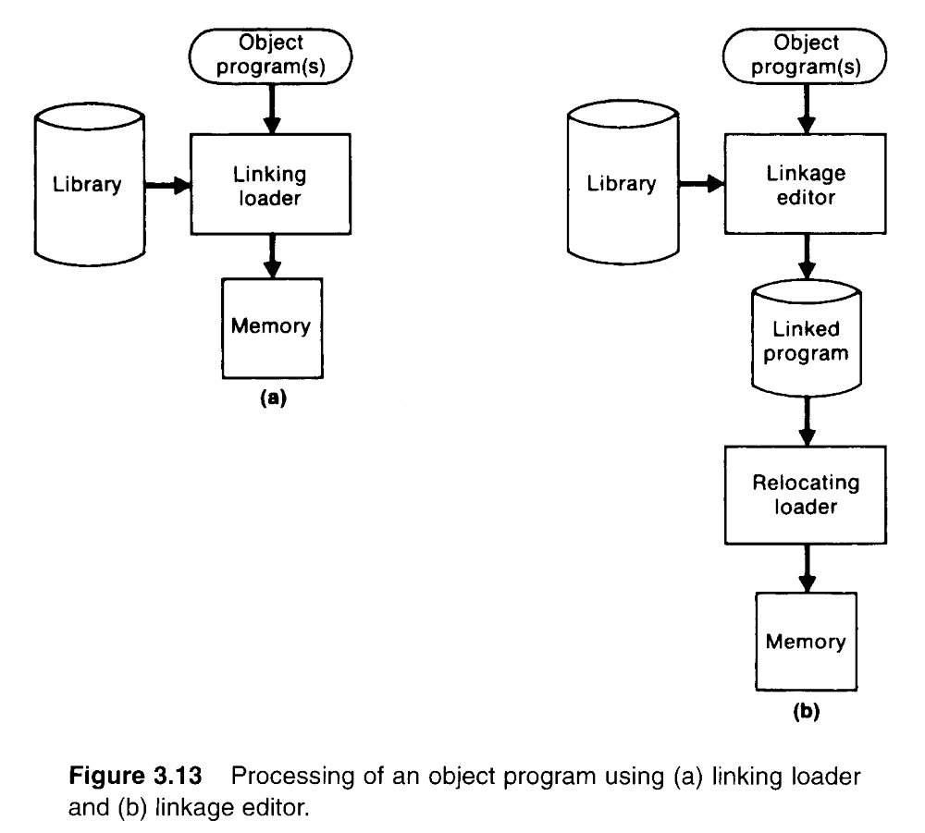
Loader Design Options
1. Linkage Editors
The difference between a linkage editor and a linking loader

Slide 47
Linking loader
  A linking loader performs all linking and relocation operations, including automatic library search if specified, and loads the linked program directly into memory for execution.
Linkage Editors
  A linkage editor produces a linked version of the program (load module or executable image), which is written to a file or library for later execution.
  When the user is ready to run the linked program, a simple relocating loader can be used to load the program into memory.

Slide 48
Linkage editor
  The only object code modification necessary is the addition of an actual load address to relative values within the program.
  The LE performs relocation of all control sections relative to the start of the linked program.
  All items that need to be modified at load time have values that are relative to the start of the linked program.
  If a program is to be executed many times without being reassembled, the use of a LE substantially reduces the overhead required.

Slide 49
2. Dynamic Linking
Linking loaders perform linking and relocation operations at load time.
Linkage editors perform linking operations before the program is load for execution.
Dynamic linking the linking function performs at execution time.

Slide 50
2. Dynamic Linking
(dynamic loading, load on call)
  Postpones the linking function until execution time.
  Dynamic linking is often used to allow several executing program to share one copy of a subroutine or library.
  Dynamic linking provides the ability to load the routines only when (and if) they are needed.
  Dynamic linking avoids the necessity of loading the entire library for each execution.

Slide 51
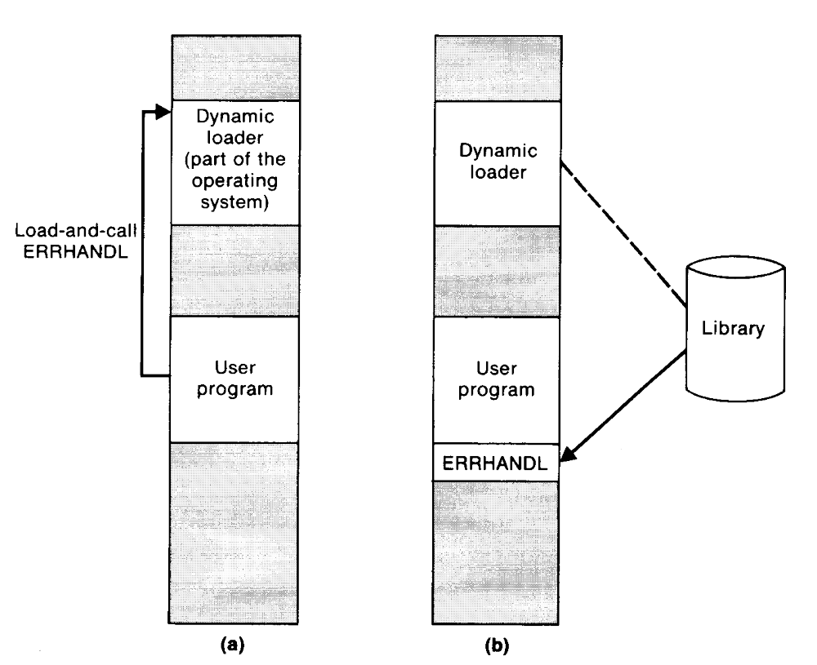

Slide 52
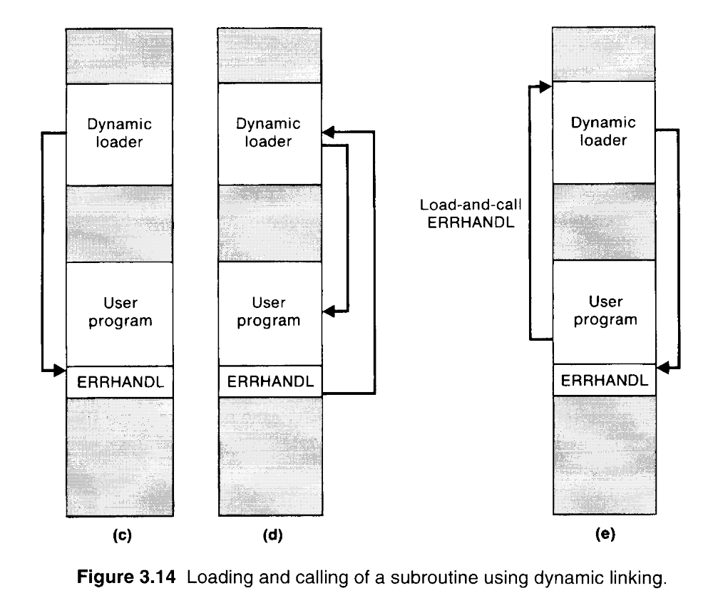

Slide 53
3. Bootstrap Loaders
An absolute loader program is permanently resident in a read-only memory (ROM)
  when Hardware signal occurs
The program is executed directly in the ROM
or
The program is copied from ROM to main memory and executed there.

Slide 54
  Reads a fixed-length record form some device into memory at a fixed location.
  After the read operation is complete, control is automatically transferred to the address in memory.
  If the loading process requires more instructions than can be read in a single record, this first record causes the reading of others, and these in turn can cause the reading of more records(Bootstrap).

Slide 55
A Simple Bootstrap Loader
Bootstrap Loader
  When a computer is first tuned on or restarted, a special type of absolute loader, called bootstrap loader is executed
  This bootstrap loads the first program to be run by the computer -- usually an operating system

Slide 56
Example (SIC/XE bootstrap loader)
The bootstrap itself begins at address 0
It loads the OS starting address 0x80
Input (OS) is read from device F1
End-of-file is indicated as 04
Address of the next memory location is located in register X
Skip all other input characters that have ASCII codes less than decimal 48(character ‘0’).

Slide 57
Example (SIC/XE bootstrap loader)
Read a pair of characters from device F1
These two hexadecimal digit values are combined in to a single byte.(using SHIFTL and ADDR)
Resulting byte is stored at address currently in register X (STCH)
Add 1 to the value in register X (TIXR).
GETC-reads one character from device F1.
GETC jumps to 80 when end-of-file (04) is read.

Slide 58
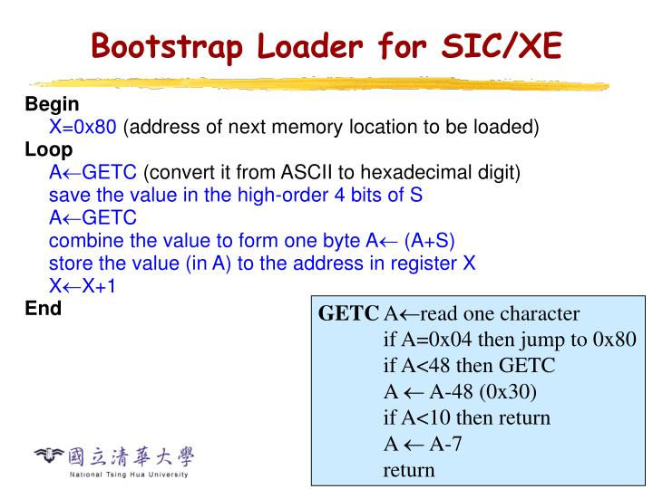

Slide 59
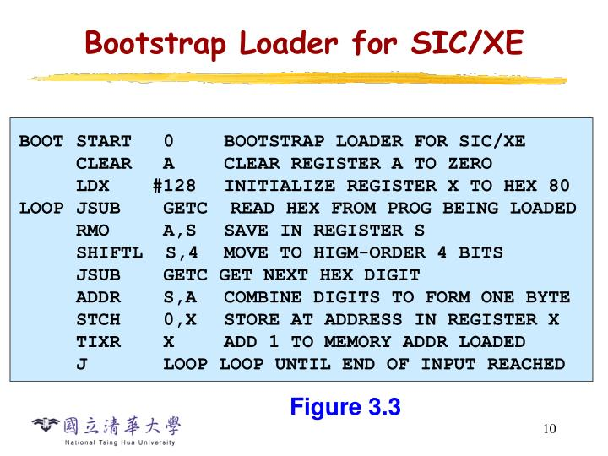

Slide 60
