Slide 1

JUBIS MARKETING
Enterprise B2B ERP & Client E-Commerce Portal
Comprehensive System Feature Architecture & Operational Walkthrough
LIVE CLOUD PRODUCTION URL:
https://jubis-marketing-production-m2g1zm.laravel.cloud/

Slide 2
EXECUTIVE OVERVIEW
Bridging B2B Electrical Distribution & Digital ERP Automation
Traditional Industry Bottlenecks
Fragmented Quotations: B2B clients rely on manual phone calls, Viber chats, and paper RFQs for fluctuating electrical prices.
Phantom Stock & Inventory Inaccuracy: High-SKU warehouses frequently suffer from overselling and unrecorded adjustments.
Delayed Invoicing & Credit Reconciliation: Offline billing leads to friction in collecting receivables and tracking Net-30 credit.
Zero Logistics Traceability: Customers have no real-time visibility into whether wholesale deliveries are dispatched or in transit.
The Integrated Jubis ERP Solution
Self-Service Client RFQ Portal: B2B buyers browse dynamic electrical catalogs, configure technical variants, and submit quotes directly.
Role-Based Departmental Automation: Dedicated workspaces for Sales, Finance, Purchasing, Warehouse, and Executive Super Admins.
Real-Time Immutable Inventory Audit: Live stock reservation upon quote approval and automatic PO stock increments.
Dual Settlement Engine: Digital checkout via PayMongo (GCash, Maya, Cards) and automated Net-30 credit terms for bulk orders.
Live Delivery & Warranty Tracking: Built-in delivery tracking simulator and structured RMA (Return Merchandise Authorization) workflows.

Slide 3
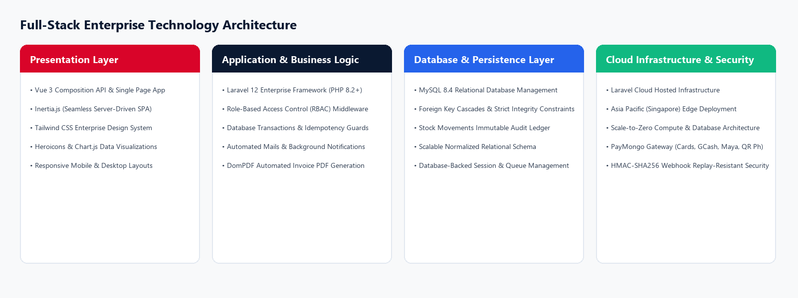
SYSTEM ARCHITECTURE
Modern Multi-Tier Enterprise Cloud Architecture

Slide 4
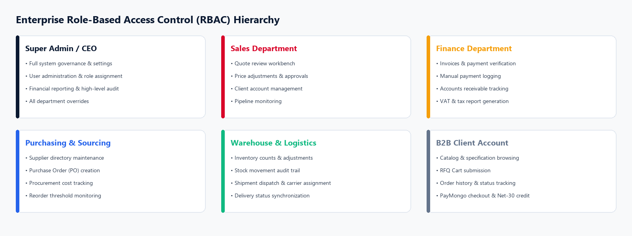
GOVERNANCE & SECURITY
Departmental Role-Based Access Control (RBAC)

Slide 5
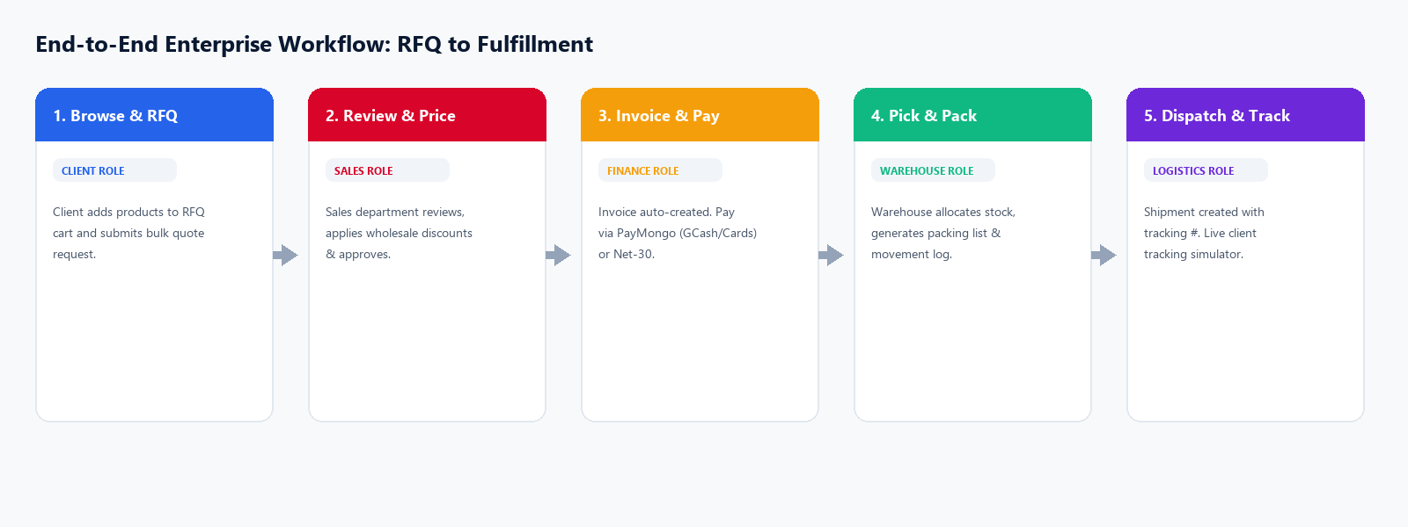
OPERATIONAL WORKFLOW
Complete Enterprise Lifecycle: From Catalog to Delivery

Slide 6
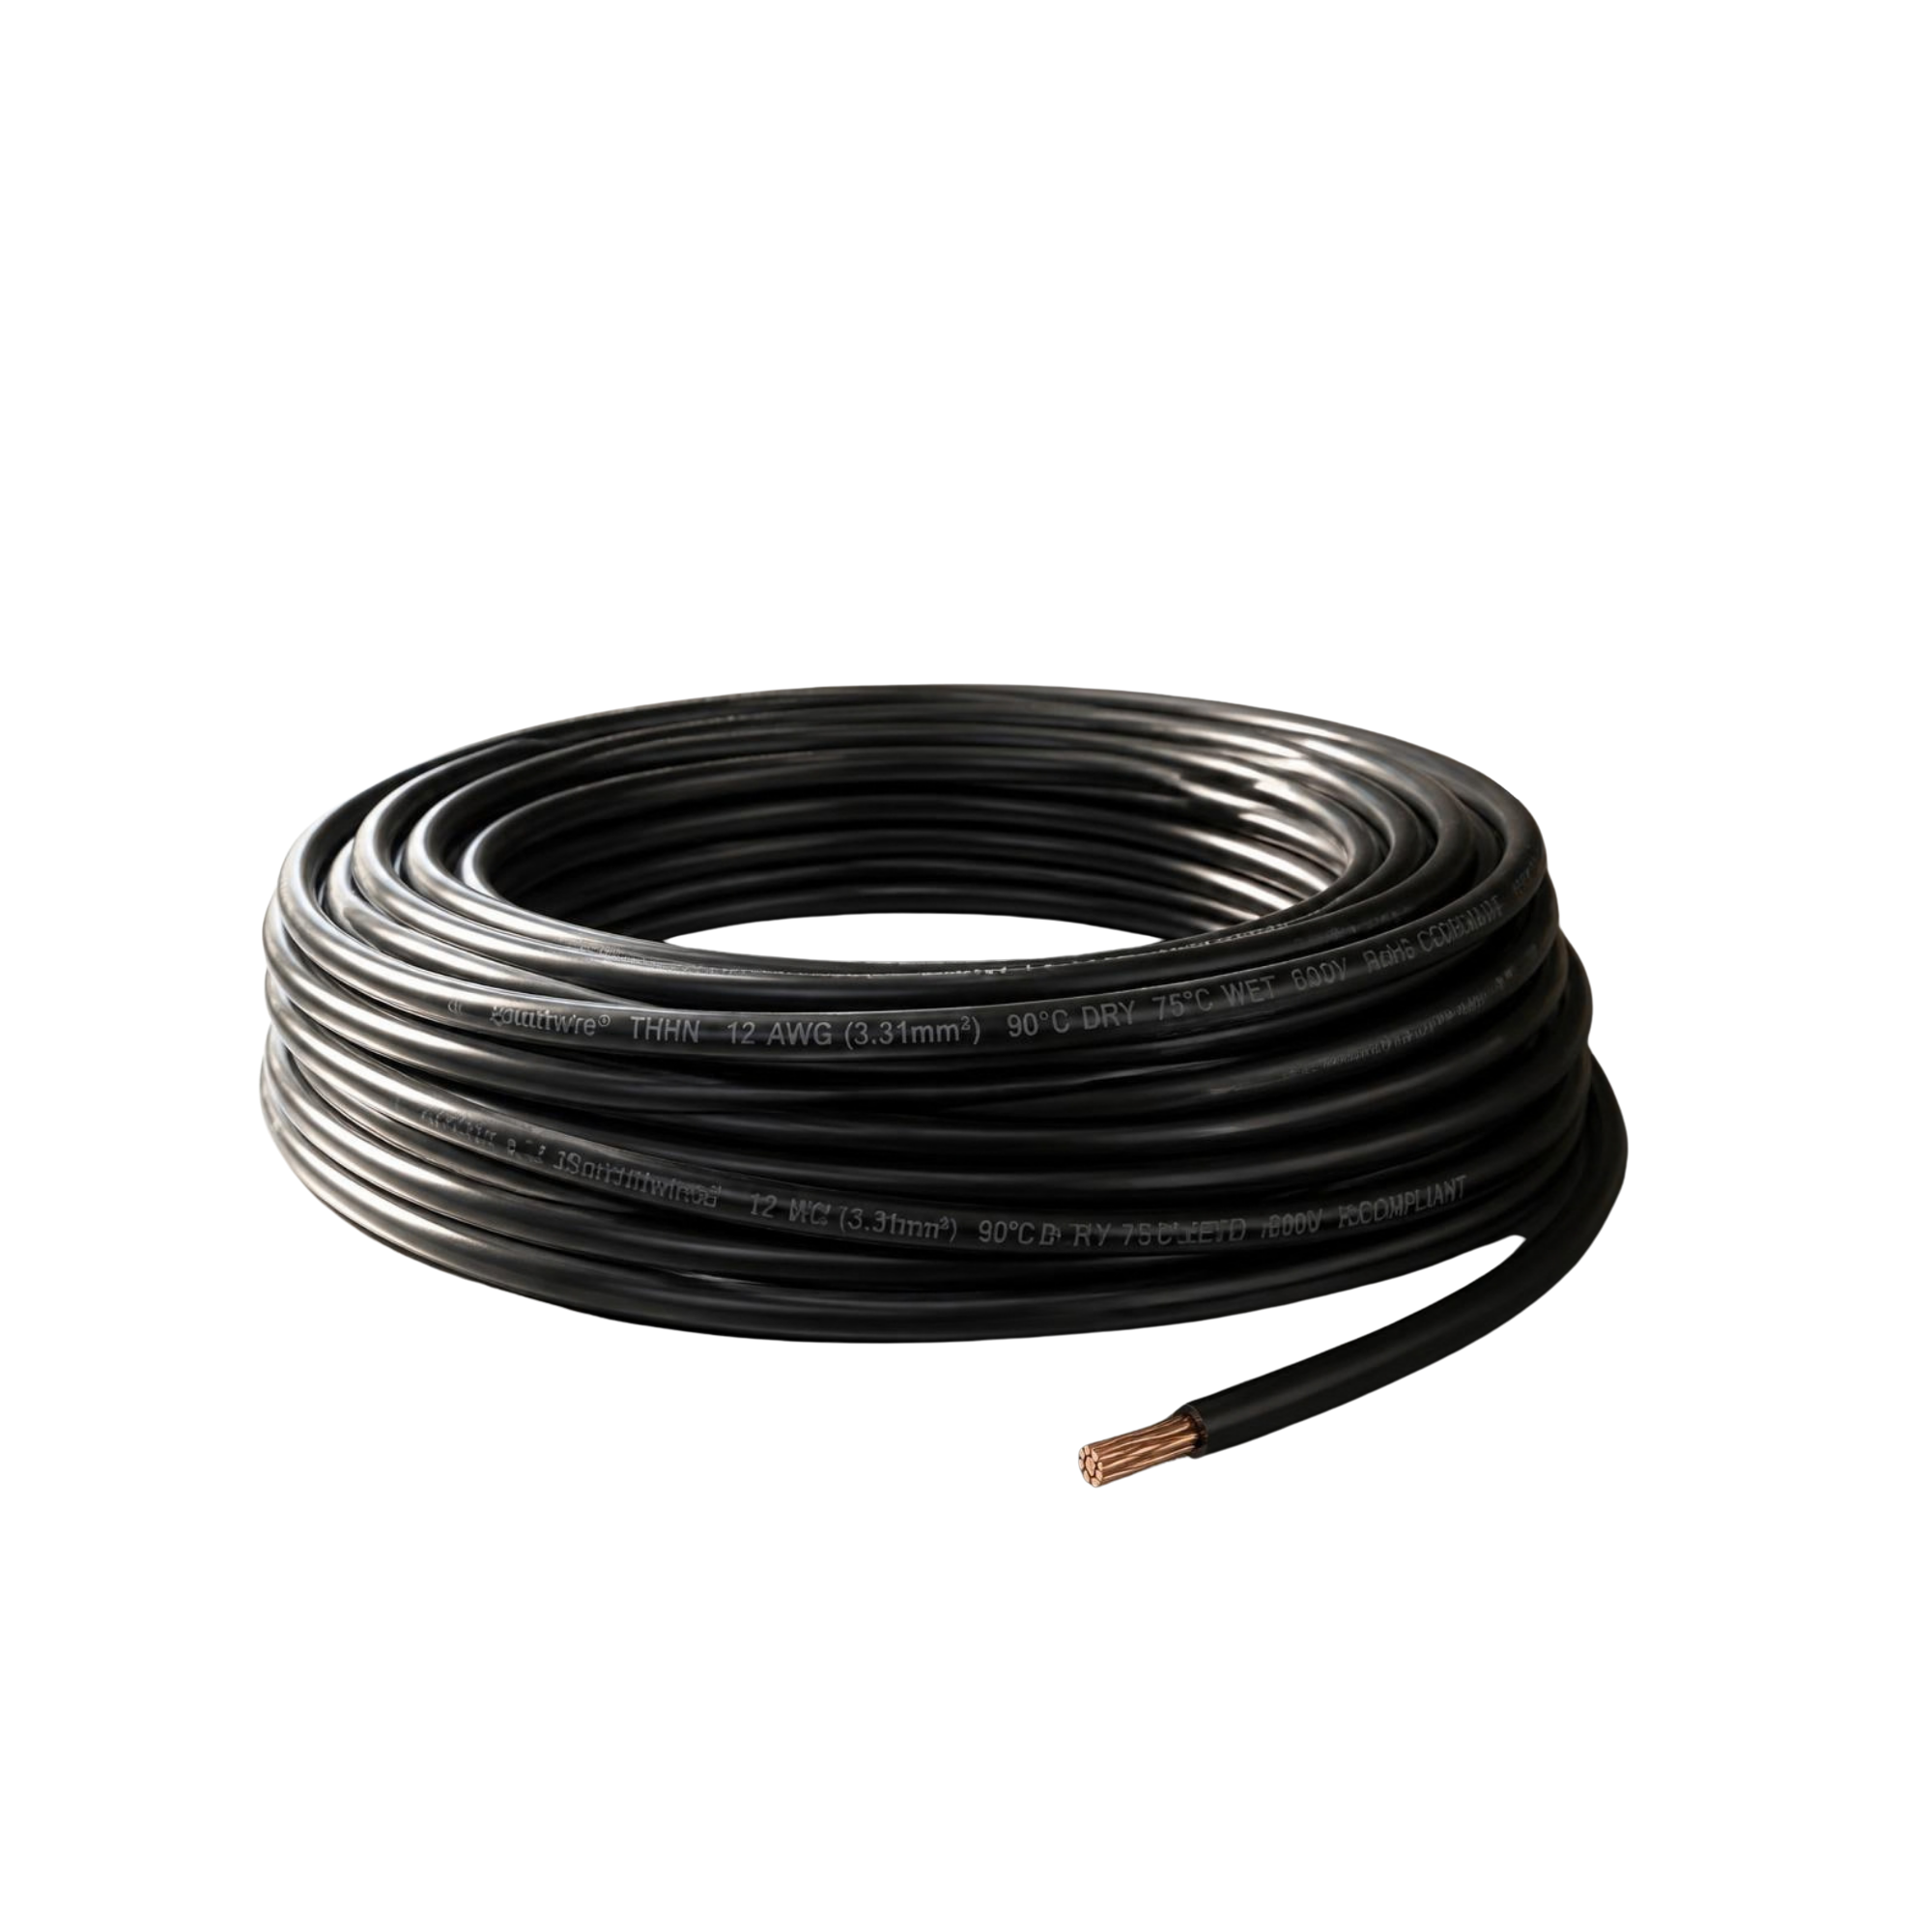

CLIENT PORTAL
Product Discovery, Smart Search & Faceted Filtering
E-Commerce Catalog Capabilities
Real-Time Keyword Search: Instant search across thousands of SKUs, brand names, and technical product descriptions with URL query synchronization.
Multi-Faceted Category Filter: Filter through Wire & Cables, Control Components, Circuit Protection, Lighting, Industrial Connectors, and Hardware.
Brand Priority Sorting: Intelligent catalog ranking prioritizing strategic partners (OMNI, Jubis, Schneider Electric, Phelps Dodge, Fuji, Philips).
Live Inventory Status Indicators: Real-time badge display ('In Stock', 'Out of Stock') preventing client frustration before quote generation.
Corporate Storytelling & Inquiries: Dedicated About Us CMS and Contact Inquiry form with throttled mail notifications to Jubis management.
Phelps Dodge THHN
Building Wire
High-spec industrial cable with nylon jacket.
Philips LED Fixture
Commercial Lighting
Energy-efficient industrial bulb & ceiling luminaires.

Slide 7
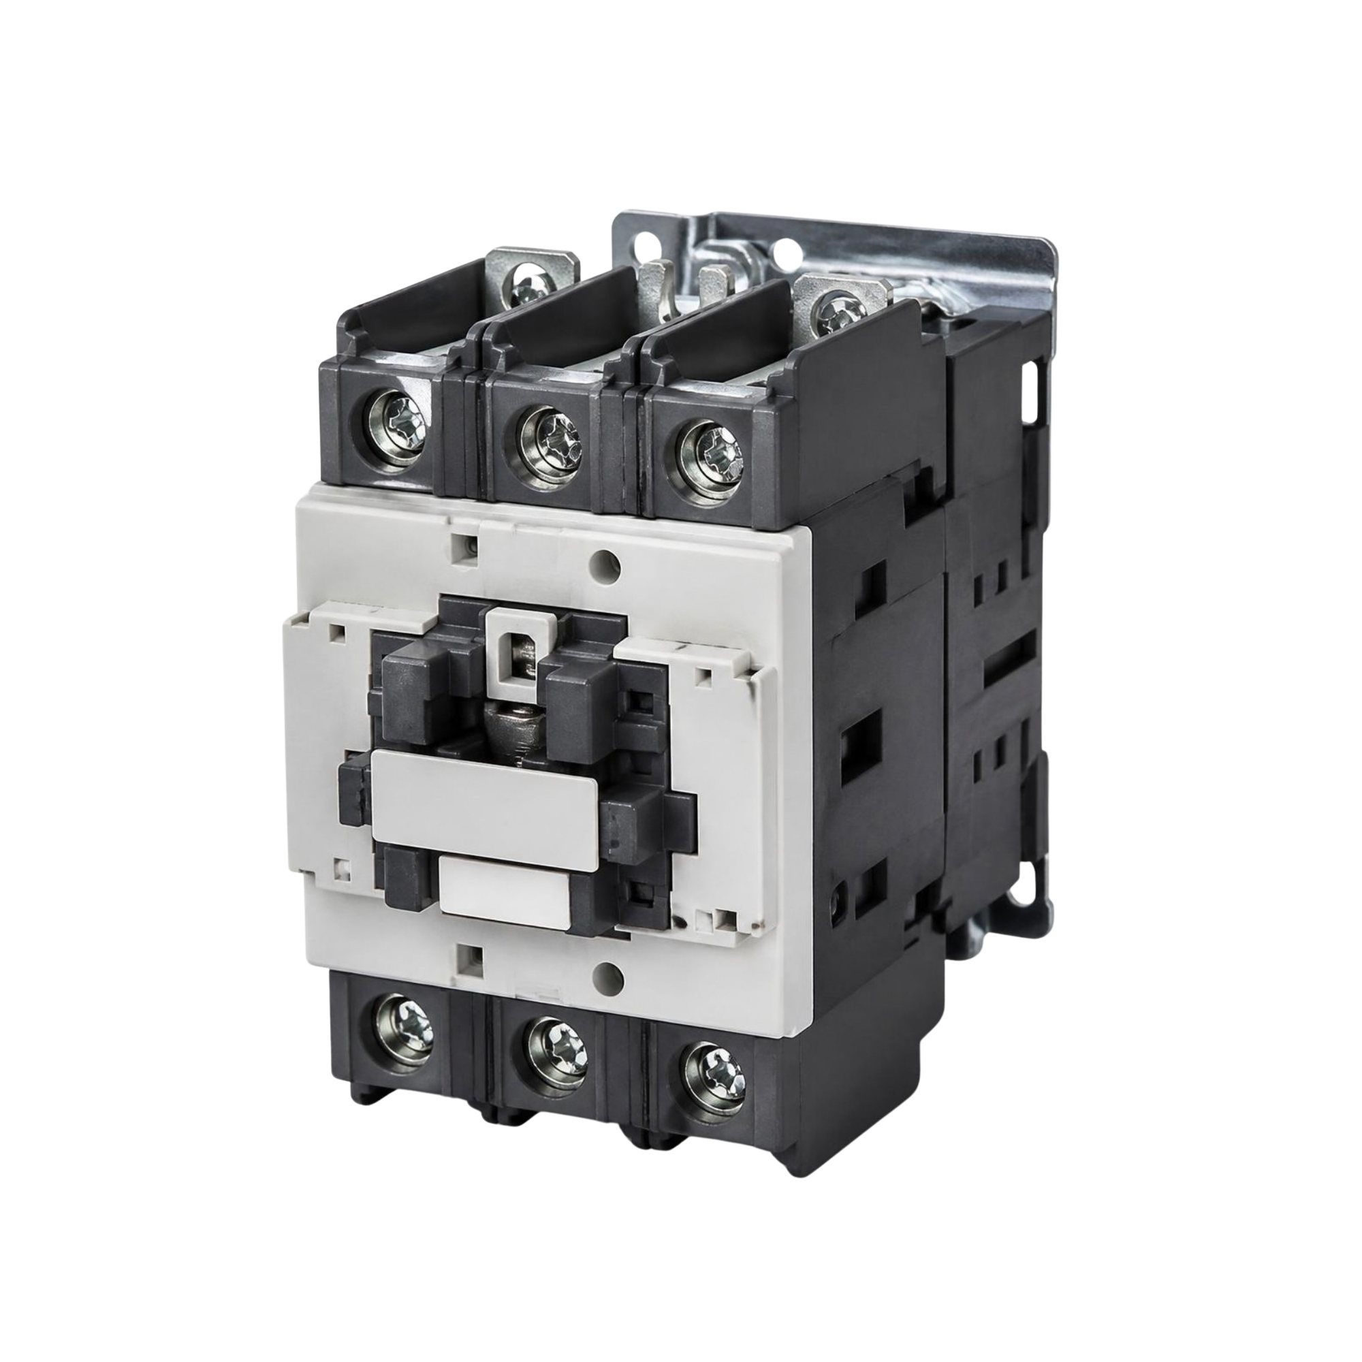
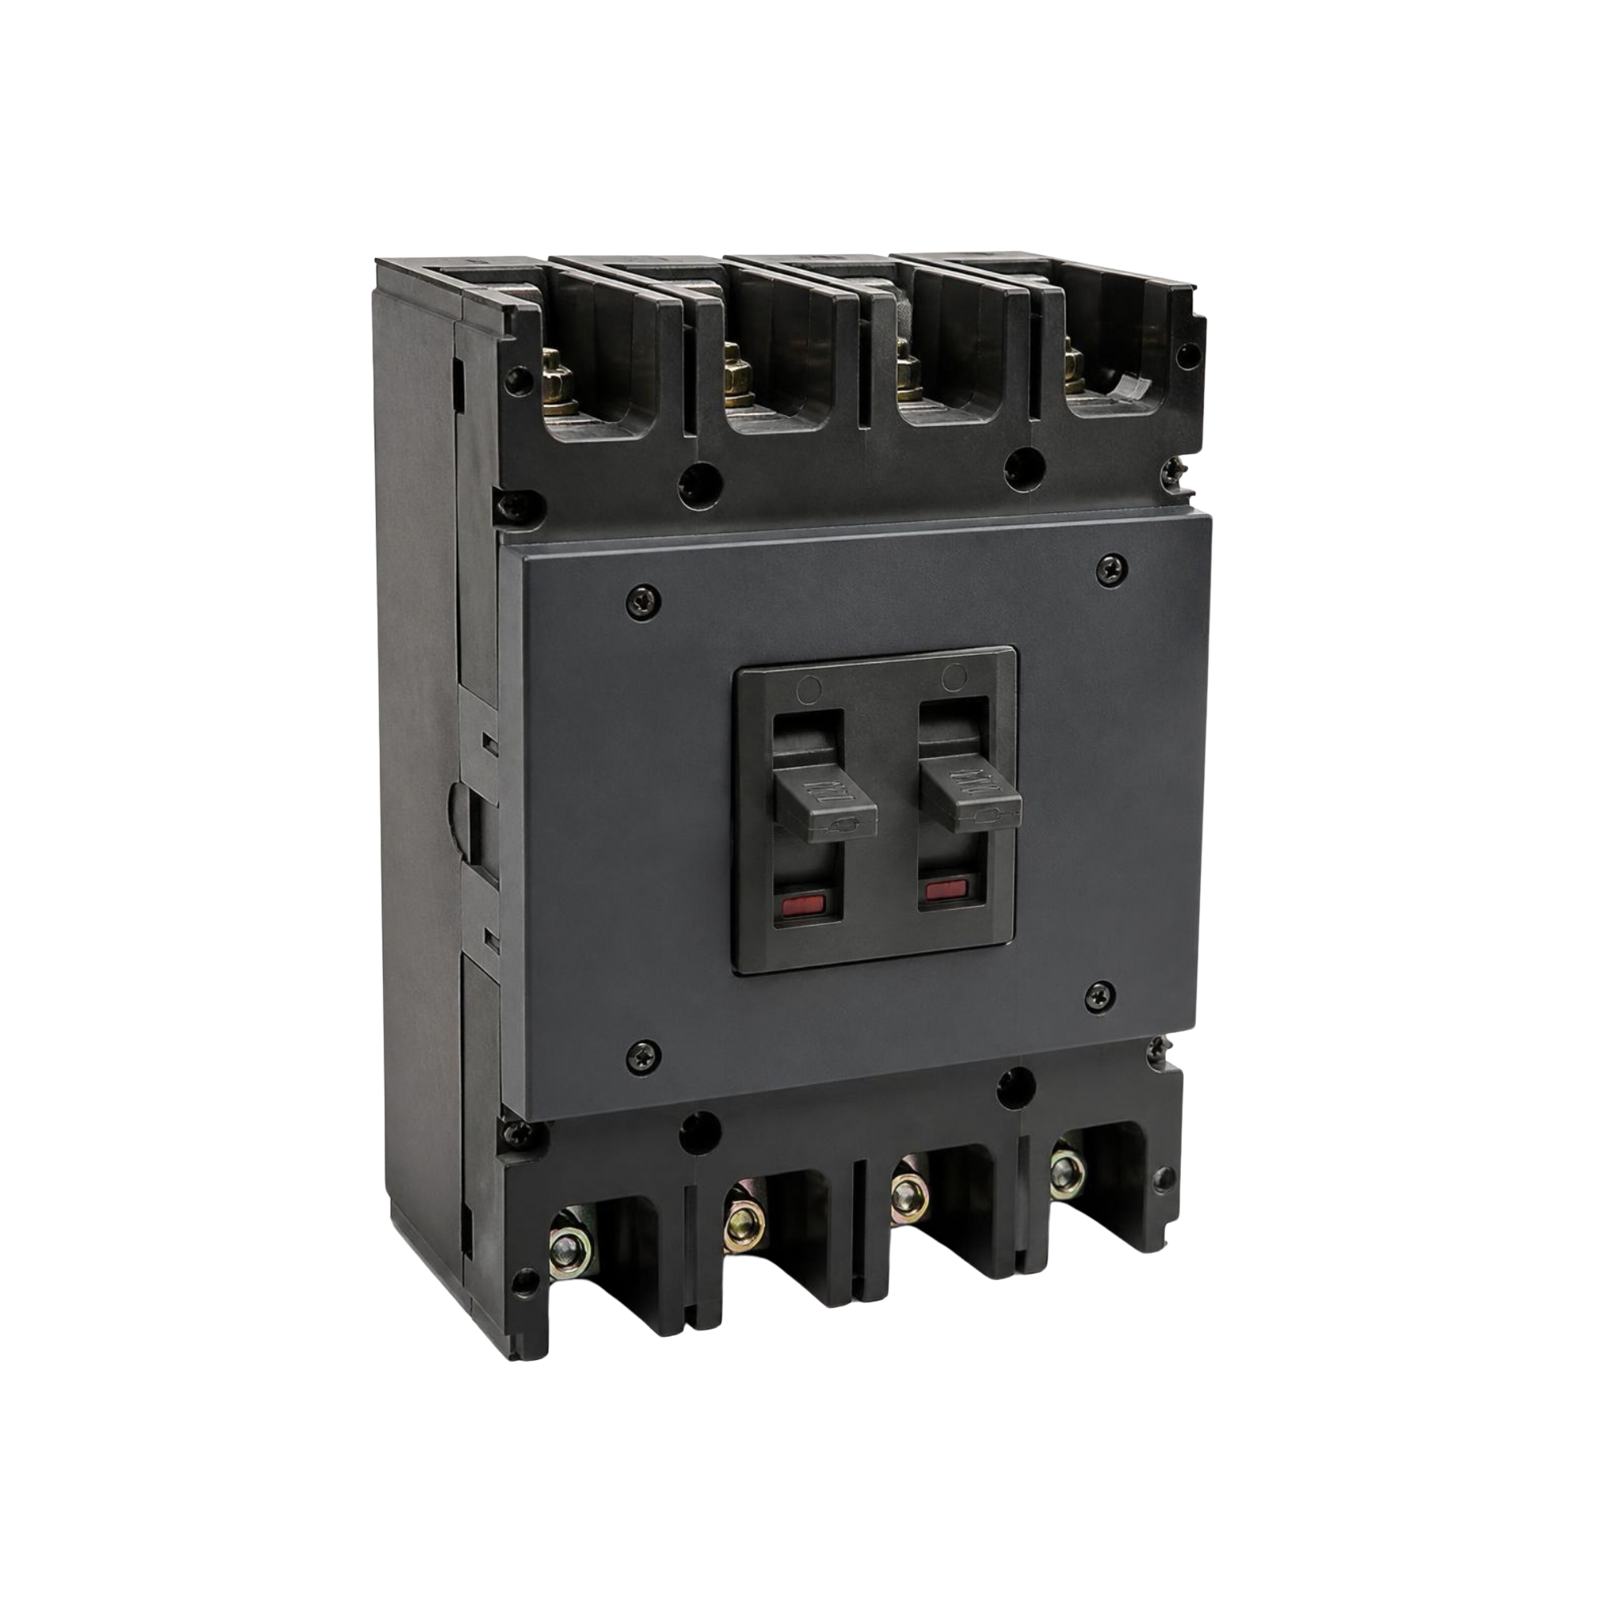
CLIENT PORTAL
Engineering Specifications & Dynamic Variant Selector
Engineering-Grade Product Detail Pages
Comprehensive Spec Sheets: Dedicated parameter tables for electrical engineers (Voltage, Amperage, Wire Gauge, Phase, Certifications).
Dynamic Variant Switching: Switch between package types, coil voltages, pole counts, and sizes without full page reloads.
Tiered Wholesale Pricing: Transparent unit wholesale rates with dynamic volume calculations for large-scale engineering contractors.
Stock Availability Verification: Checks specific SKU variant warehouse counts to ensure fulfillment readiness.
Related Product Carousel: Recommends matching components (e.g. matching circuit breaker enclosures, lugs, or contactor auxiliary relays).
Fuji Magnetic Contactor
Industrial Control
32A 220V heavy-duty motor starter switch.
Schneider Breaker
Circuit Protection
63A thermal-magnetic overload protection.

Slide 8
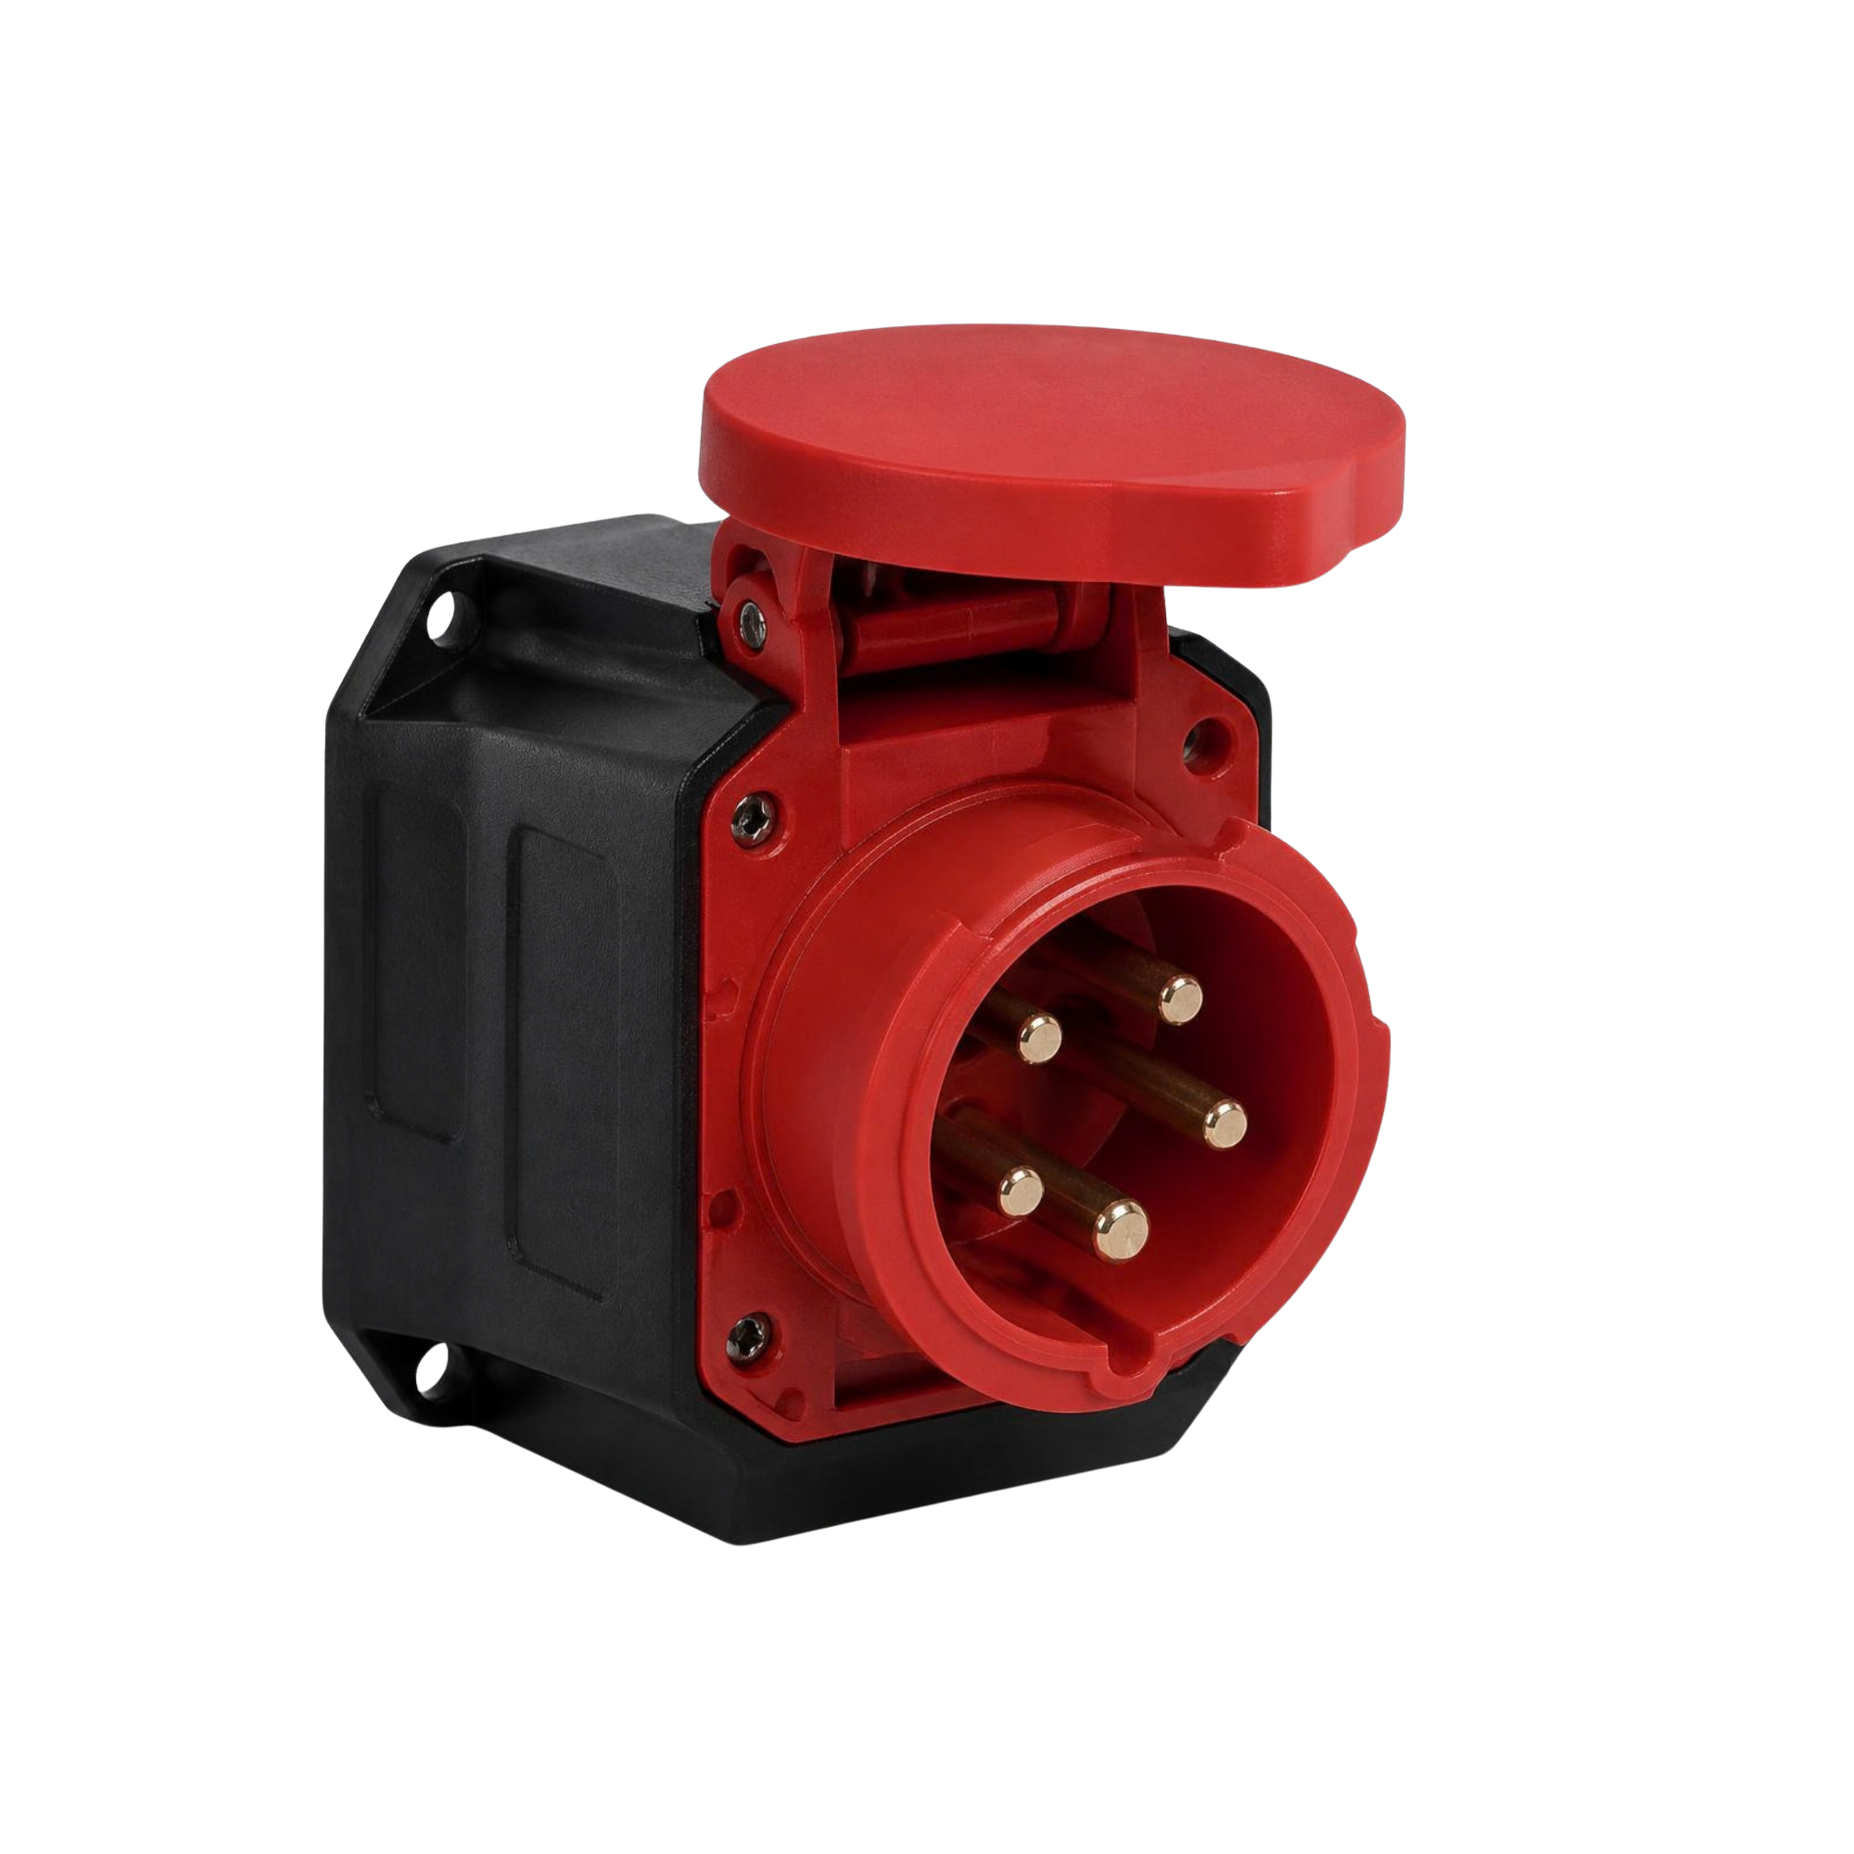
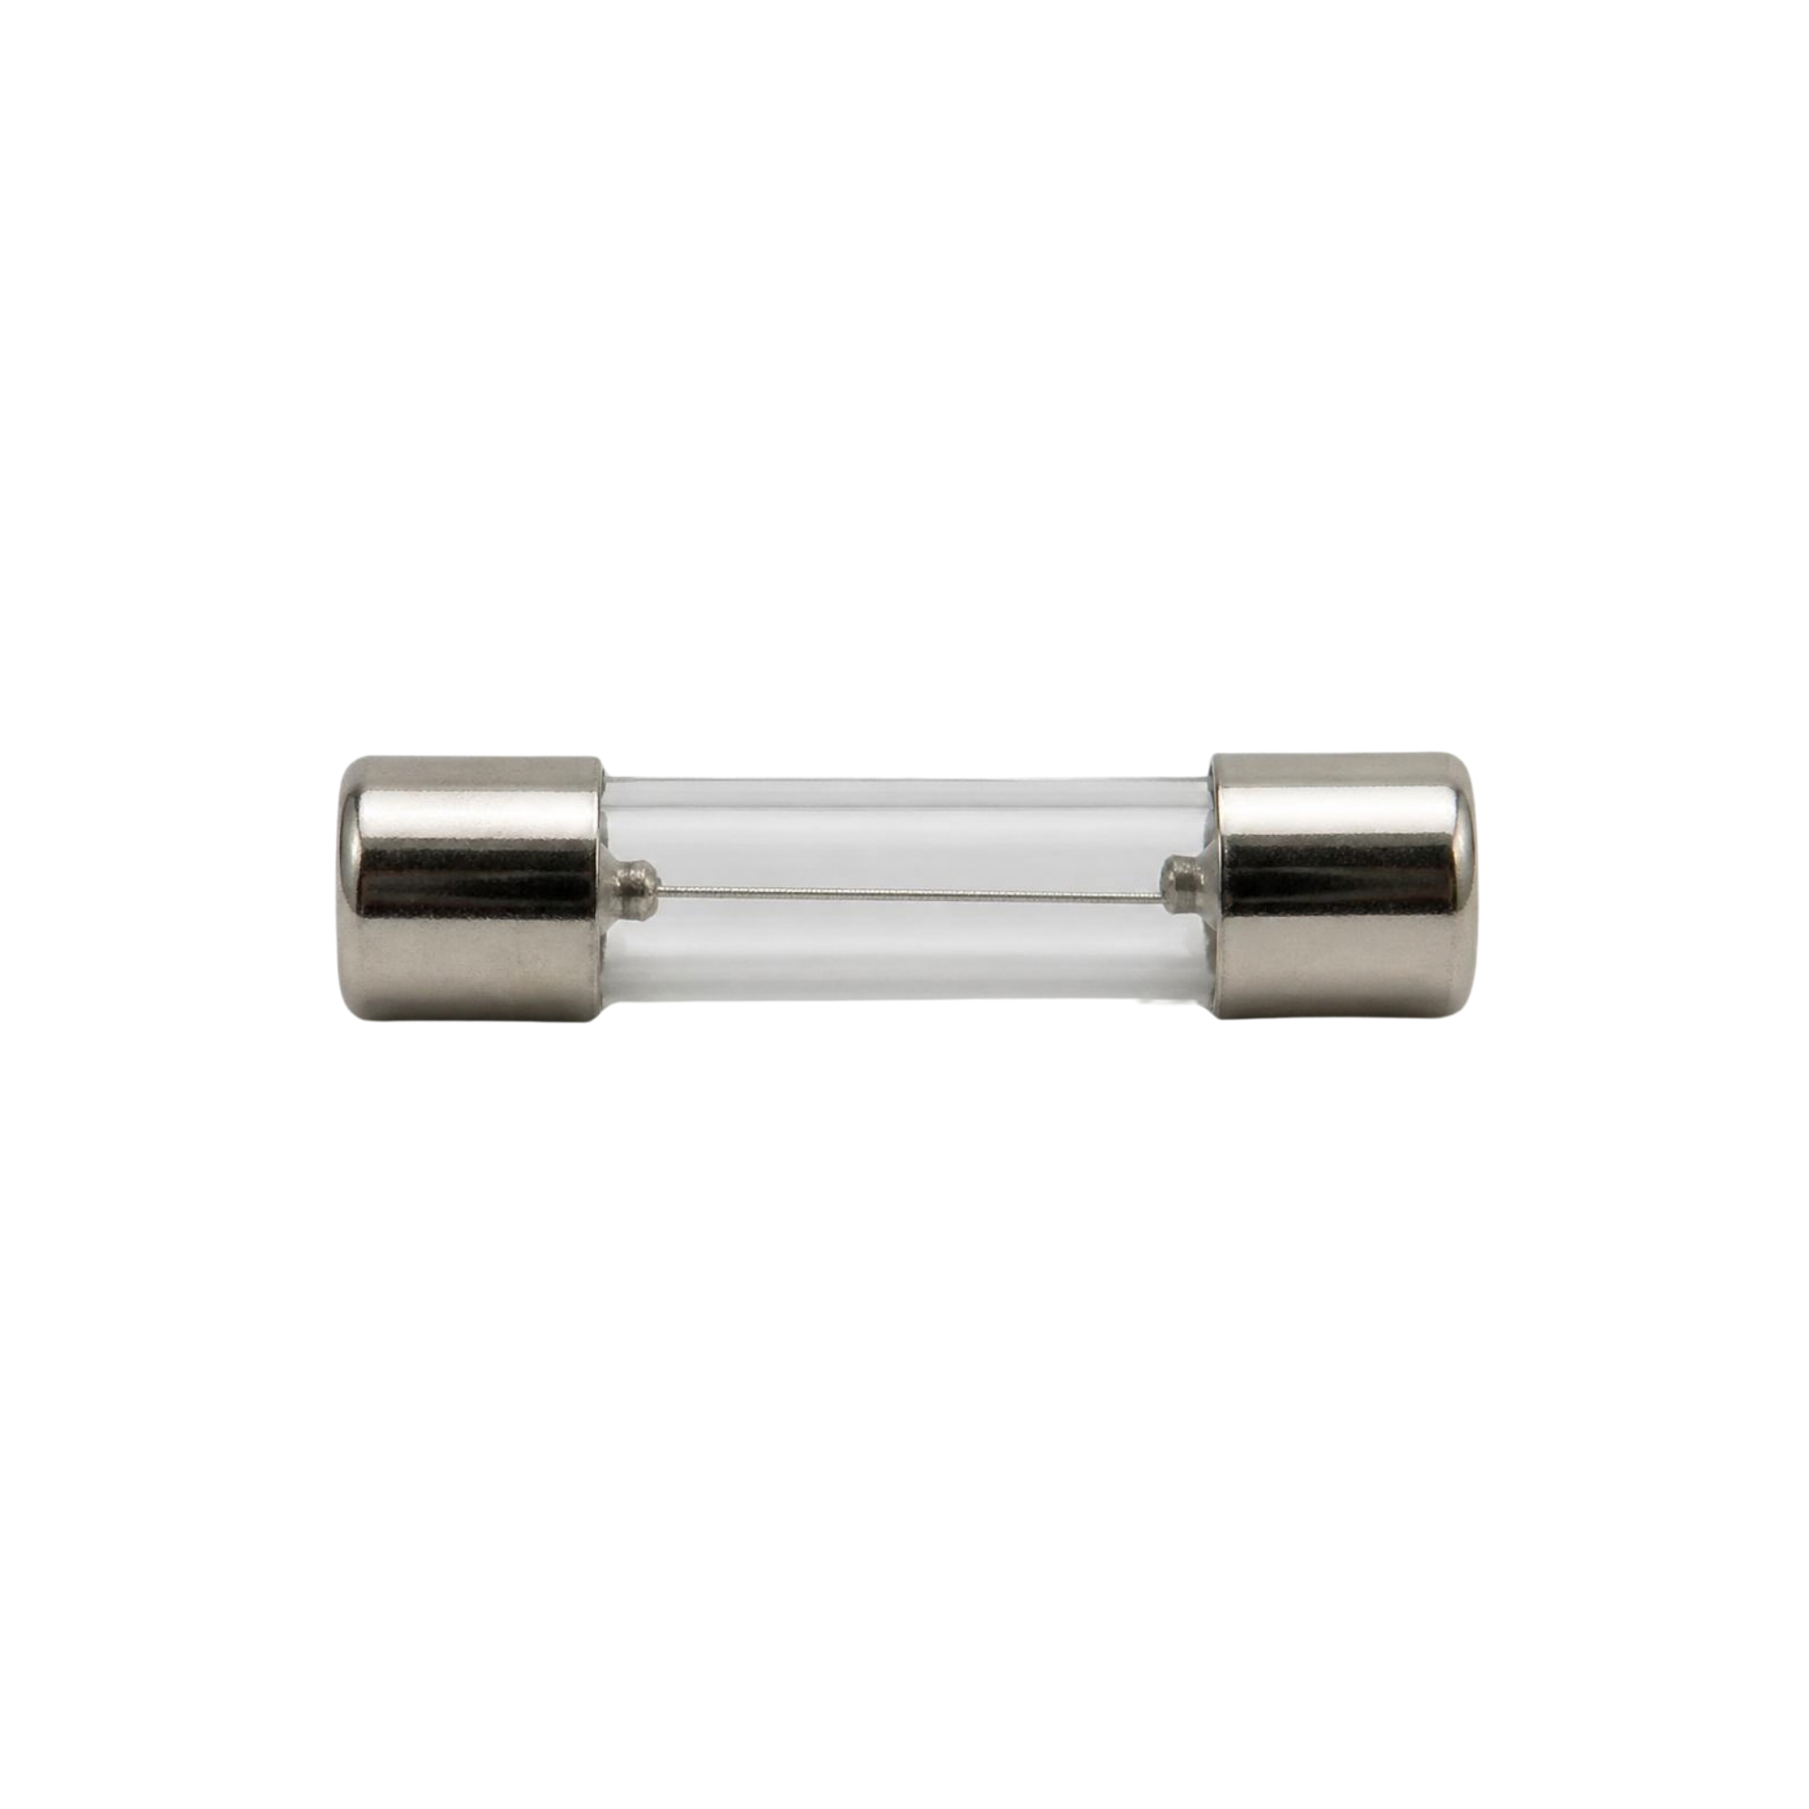
CLIENT PORTAL
Interactive RFQ Cart & Wholesale Quote Submission
B2B Request-For-Quote (RFQ) Model
B2B Quoting vs Consumer Checkout: Replaces rigid retail checkout with an RFQ cart designed for commercial negotiation and volume pricing.
Interactive Line Item Quantity Controls: Immediate subtotal recalculation, VAT estimation, and quantity validation against warehouse availability.
Custom Project Notes: Contractors can attach site delivery requirements, project reference codes, and billing instructions.
Inactive SKU Shield: Strict API guards ensure unlisted or discontinued products cannot be injected into the quotation cart.
Automatic Pipeline Routing: Submitting the cart automatically converts it from 'Draft' to 'Pending' in the Sales Department workbench.
PCE Industrial Socket
Heavy-Duty Connector
3-Pin 32A weatherproof socket assembly.
Bussman Glass Fuse
High-Voltage Protection
Fast-acting 10A 250V overcurrent fuse.

Slide 9
CLIENT PORTAL
Client Dashboard, Quote Statuses & Order Lifecycle
Customer Dashboard Experience
Authenticated User Hub (/dashboard): Clients access active quotes, invoices, and shipment tracking in one consolidated screen.
Quote Lifecycle Status Badges:
• Pending: Submitted, awaiting sales pricing review.
• Reviewed: Sales has appraised and added custom discounts.
• Approved: Officially finalized, unlocking invoice & payment.
• Rejected: Notification with inventory release.
Transparent Financial Overview: Shows total quoted values, VAT breakdowns, payment status, and due dates.
Order Historical Records: Permanent repository of past orders for repetitive corporate purchasing and procurement audits.
Direct Client Action Triggers
Instant Invoice PDF Download: One-click export of official stamped Jubis Marketing PDF invoices for procurement documentation.
Online Payment Gateway: Click 'Pay Now' to launch the secure PayMongo digital payment interface.
Net-30 Credit Terms Activation: High-volume wholesale orders unlock Net-30 credit terms at the touch of a button.
Live Carrier Tracking: Track logistics delivery progress in real-time with dispatched carrier updates.
RMA Warranty Returns: Easily submit defective component return requests directly against specific invoice lines.

Slide 10
CLIENT PORTAL
Dual Settlement Engine: PayMongo Gateway & Net-30 Terms
PayMongo Digital Payments
Omnichannel Payment Options: Direct support for GCash, Maya, QR Ph, and Mastercard/Visa credit and debit cards.
Centavo-Accurate Float Calculations: Eliminates binary floating-point rounding errors when submitting payment totals.
Automated Payment Link Dispatch: Sales quote approval automatically generates a custom PayMongo checkout link.
Replay-Resistant Webhook Architecture: Payment callbacks are protected by HMAC-SHA256 signature and timestamp verification.
Sandbox Payment Simulator: Built-in mock payment environment enabling real-time demonstration without live financial risk.
Enterprise Net-30 Credit Terms
Volume-Based Eligibility Guard: Available exclusively to large wholesale purchases exceeding 1,000 units.
30-Day Automated Terms: Sets official invoice status to 'on_terms' and schedules automated 30-day receivable maturity.
Immediate Order Release: Clears invoices for immediate warehouse picking and shipping prior to cash settlement.
Anti-Tamper Status Guard: Prevents already paid invoices from being improperly reverted into credit terms.
AR Ledger Synchronization: Instantly records outstanding receivables in the Finance Department reporting dashboard.

Slide 11

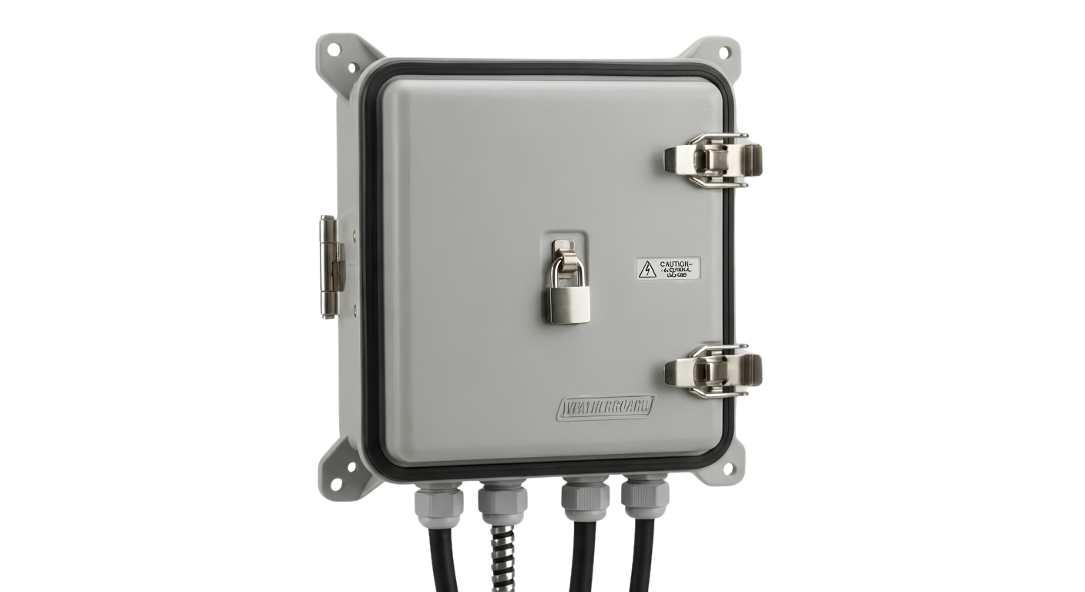
CLIENT PORTAL
Real-Time Logistics Tracking & Warranty RMA Processing
Logistics Visibility & Warranty Protection
Live Delivery Tracking Simulator (/api/mock/tracking/{id}): Full tracking page displaying dispatch time, assigned carrier, driver details, and current parcel location.
Lalamove Delivery Integration: Supports third-party courier APIs as well as in-house Jubis delivery fleet dispatch.
RMA Warranty Claims Workflow: Clients can initiate return merchandise requests directly against verified paid invoice lines.
Itemized Defect Categorization: Select from 'Defective Unit', 'Damaged in Transit', or 'Wrong Specification' with customer notes.
Atomic Database Rollback: Strict database transactions guarantee that partial line failures cleanly roll back parent RMA records without orphaned data.
Exhaust Ventilation
Ceiling & Wall Fan
Commercial ventilation fan with warranty protection.
Weatherproof Cover
Outdoor Electrical Box
Heavy-duty IP65 weatherproof protective cover.

Slide 12
ADMIN ERP COMMAND CENTER
Executive KPI Dashboard & Real-Time Financial Analytics
TOTAL REVENUE
PHP 2,450,800
Paid Invoice Settlements
OUTSTANDING AR
PHP 640,250
Unpaid & On-Terms Balance
PENDING QUOTES
14 Active RFQs
Awaiting Sales Review
LOW STOCK SKUs
8 Critical Items
Below Reorder Threshold
6-Month Revenue Analytics (Chart.js)
Dynamic Monthly Revenue Engine: Aggregates settled revenue across rolling 6-month cycles directly from the invoice ledger.
Cash Flow Visibility: Differentiates instant digital settlements from Net-30 receivables collection.
Interactive Chart.js Dashboard: Responsive chart component with hover tooltips and financial breakdown.
Real-Time Actionable Feeds
Recent Quotations Stream: Immediate visibility into arriving RFQs with client company name and total line items.
Recent Invoices Feed: Real-time settlement monitoring for accounting staff with instant payment status pills.
Urgent Reorder Alert Table: Prioritized list of inventory items with quantities < 20 units for instant PO generation.

Slide 13

ADMIN ERP INVENTORY
Inventory Control, Stock Movements & CSV Export
Warehouse Inventory Management Workbench
Master Product Catalog Table: Complete oversight of 900+ SKUs across all electrical categories with pagination and search.
Active State Toggle: Instantly enable or disable products from appearing in the client-facing catalog.
Immutable Stock Movement Ledger (stock_movements): Every single inventory delta logs:
• Exact quantity change (+ or -)
• Actor User ID and staff role
• Movement type ('purchase', 'adjustment', 'order')
• Reference tag (e.g. PO-12, QUOTE-REJECT-5).
Safe CSV Inventory Export: Sanitized one-click CSV export shielding against spreadsheet formula injection attacks (prefixes '=', '+', '-', '@').
Zero Phantom Stock Guarantee: Reverting or rejecting quotes automatically restores warehouse stock with atomic logging.
Granular SKU Control
Supports heavy industrial connectors, cables, transformers, and copper cable lugs with real-time warehouse count tracking and reorder limits.

Slide 14
ADMIN ERP PROCUREMENT
Supplier Directory & Purchase Order (PO) Engine
Supplier Directory Management
Centralized Vendor Profiles (/admin/suppliers): Comprehensive database of electrical manufacturers and component importers.
Supplier Compliance Metadata: Records official Tax Identification Number (TIN), corporate addresses, and primary sales contacts.
Direct Procurement Communications: Phone numbers and verified billing emails stored for automated replenishment requests.
Supplier Purchase Order History: Instant visibility into all past and active purchase orders linked to each vendor profile.
Purchase Order (PO) Lifecycle
Multi-Line PO Workbench: Create purchase orders with multiple product SKUs, supplier unit costs, and delivery date commitments.
Lifecycle State Machine: Transitions cleanly through Draft ➔ Ordered ➔ Partially Received ➔ Received.
Automatic Stock Replenishment: Transitioning PO to 'Received' automatically increments physical warehouse stock and logs movement.
Negative Stock Prevention: If a received PO is reverted back to ordered, the system checks whether inventory is sufficient to prevent negative stock.
Real-Time Cost of Goods Tracking: Calculates exact landed cost per unit for accurate margin calculation.

Slide 15
ADMIN ERP OPERATIONS
Sales Quotes, Financial Ledger & Shipment Dispatch
Sales & Quotes
Quote Review Queue: Inspect client RFQs with customer corporate details.
Wholesale Price Adjustments: Apply contractor discounts or custom shipping fees.
One-Click Approval: Automatically spawns official invoice, sets Net-30 date, and generates PayMongo link.
Stock Reservation Protection: Approving reserves stock; rejecting cleanly restores warehouse quantities.
Finance & Invoicing
Comprehensive Invoice Ledger: Filter by unpaid, partially paid, paid, and overdue.
Manual Payment Logging: Post bank wire or cash checks with date and reference.
Overpayment Defense Guard: Automatically rejects payment attempts exceeding the outstanding balance.
VAT & Tax Reporting (/admin/reports): Official breakdown of 12% output VAT, taxable sales, and exempt transactions.
Logistics & Shipments
Order Fulfillment Queue: Shows all paid or credit-approved invoices ready for dispatch.
Carrier Allocation: Assign shipping carriers (Lalamove, In-House Jubis Trucks, 3PL).
Tracking Number Generation: Attaches unique tracking IDs accessible by clients.
Automated Delivery Mails: Changing shipment status to 'delivered' triggers automated delivery confirmation emails to client.

Slide 16
ADMIN GOVERNANCE & QA
System Configuration, Security Controls & Release Gates
Enterprise System Administration
Company Profile Settings: Manage company legal name, official address, TIN, and contact details reflected on invoices.
Configurable VAT Engine: Dynamic VAT percentage configuration (default 12%) with decimal precision validation.
Strict Field Whitelisting: Rejects unknown secret fields (e.g. SMTP passwords) from ever being cached or exposed publicly.
Staff User Administration: Super Admins can add, edit roles, and assign departments across all employees.
Enterprise Security & Quality Gates
100% Passed Release Gates: Comprehensive PHPUnit test suite validating all P0 & P1 operational boundary cases.
Database Constraint Safeguards: Enforces strict unique constraints preventing duplicate invoices or shipments.
Replay-Resistant Webhook Verification: PayMongo webhooks validate HMAC signatures and reject stale requests (>1 hour).
Role-Based Route Isolation: Granular middleware prevents privilege escalation between departments.

Slide 17
PROJECT DEMONSTRATION
Live Cloud Handover & System Verification
Cloud Production Hosting
Production URL:
https://jubis-marketing-production-m2g1zm.laravel.cloud/
Infrastructure Provider: Laravel Cloud
Region: Asia Pacific (Singapore) Edge Network
Database Engine: MySQL 8.4 Enterprise Cluster
Features: SSL Automated Encryption, Edge CDN, Scale-to-Zero Compute & Database Architecture.
Zero Downtime: Multi-session support allows multiple concurrent users to test across departments simultaneously.
Live Demonstration Agenda
1. Client Flow: Browse catalog, filter by OMNI / Phelps Dodge, and submit an RFQ cart.
2. Sales Review: Log in as Sales / CEO, review RFQ lines, adjust pricing, and approve quote.
3. Financial Settlement: Inspect generated invoice, trigger PayMongo simulation or Net-30 credit terms.
4. Warehouse & Dispatch: Verify stock deduction and create a shipment with carrier tracking.
5. Client Tracking & RMA: View live shipment tracking page and submit a warranty RMA return request.

