Slide 1
Car registration system
Camacho, Fabay, Hilario

Slide 2
About
Car registration system is a necessity for the citizens who own private vehicles, for identification purposes, and for them to be allowed to travel the road legally.
The system registers the name of the owner, including the car brand/model, the weight of the car, and a plate no.(for newly registered vehicles the system provides temporary plates while waiting for the official one).
Notes:
brief

Slide 3
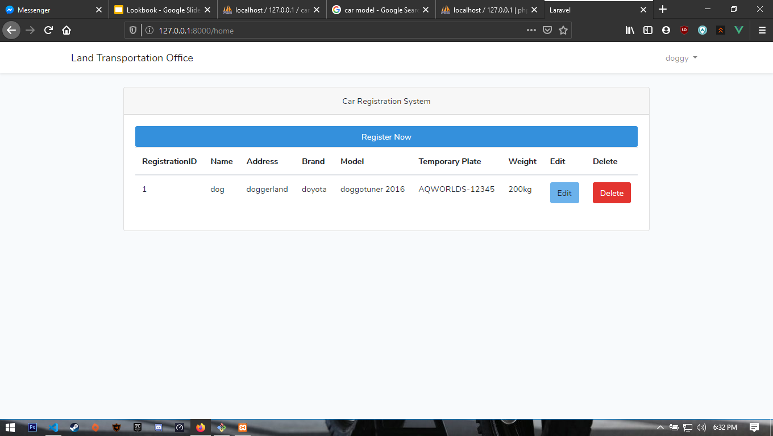
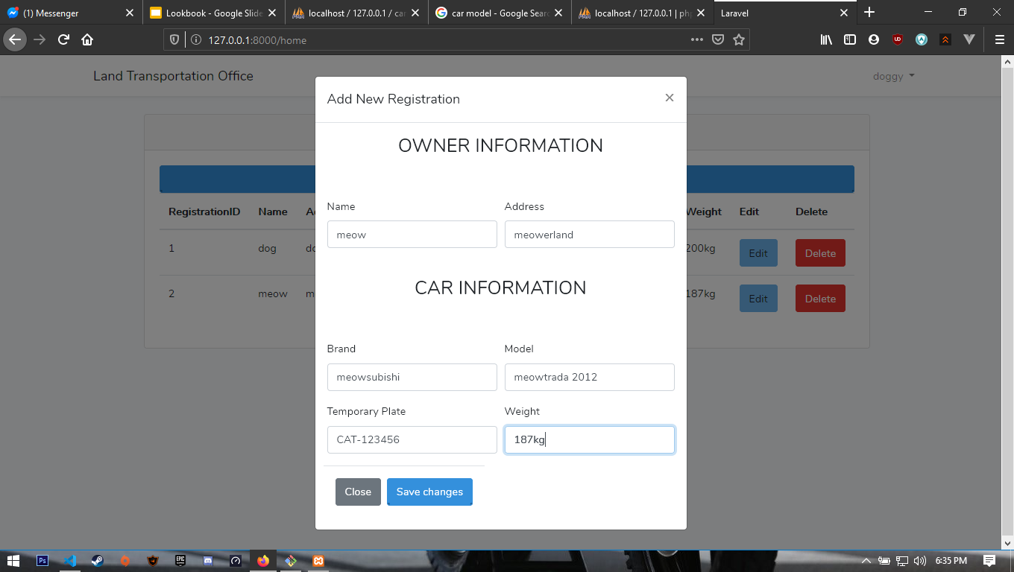
System Example

Slide 4

Stakeholders
LTO
-The people who manages the files.
-Encoder

Slide 5
Problem
Without Car Registration System, there will be a lot of problem on the road, trouble makers will arise specifically those people who do not follow the law.
Also:
-Process of Registration will be slower.
-Possibility of mistakes
-Loss of data

Slide 6
Objectives
Easy to navigate by any type of people.
Advanced protection of data.

